Slide 1
Putting Data Center Stage
PDE Data Summit
May 2016

Slide 2
Learning is not attained by chance, it must be sought for with ardor and attended to with diligence.
— Abigail Adams,
letter to John Quincy Adams

Slide 3
The Leader
Start small
Begin with core issues - Look at big picture, don’t go into too many details
Provide Positive Use Climate - Use data to support not recriminate
Provide learning opportunities for staff
Be the leader
Be patient

Slide 4
Where to Begin
What do you want to examine?
Are you collecting the data to provide this examination?
What is the process to provide the data for examination?
Who will examine the data?
Are they data literate?
When will the data be examined?
Will anything be done with the evidence?

Slide 5
What do you want to examine?
Based in research of Dr. Robert Balfanz of Johns Hopkins University
Attendance:
1. Course and Daily Attendance
Behavior:
2. State Offense
3. School Code of Conduct
Course Grades:
4. Math
5. English Language Arts

Slide 6
Are you collecting the data to provide this examination?
What information is currently collected via the various channels?
Inventory the data points collected (Data Quality)
The frequency
The fidelity
The validity

Slide 7
Critical Factors for Data Use
A practical framework for Building a Data Driven District or School. . . . . by David Ronka, Fobb Geier and Malgorzata Marciniak
Quality
Multiple measures
Organized
Accurate
Relevant
Disaggregating for analysis across multiple factors

Slide 8
Critical Factors for Data Use
Capacity
Organizational Factors
Data accessibility
Literacy
Culture
Commitment
Articulated vision
Accountability
Collaboration
Modeling
Improvements/ changes

Slide 9
What is the process to provide the data for examination
Look at the Student Information Systems in place in the district.
Use an Educator Dashboard – such as the PDE Educator Dashboard/Intervention Catalog
What effort will it take at the district to provide this information
How easy is it to read?

Slide 10
Who will examine the data?
Data Teams
Varied and many
Assembled to investigate specific data
Provide professional development for building analytic skills
Time to do the task

Slide 11
Who is on a data team
Administration
To be the model and leaders of data use
Whoever
is critical in the analysis process
has responsibility for creation of the data (programs, initiatives, solid understanding of programs in the district)
has responsibility in the response of the analysis results

Slide 12
Who Does What?
Data-driven decision-making, especially in the early stages, demands that district leaders point the way. Superintendents and school boards both must play important but distinct roles.
http://aasa.org/uploadedFiles/Policy_and_Advocacy/files/UsingDataToImproveSchools.pdf
Notes:
Using Data to Improve Schools: What Works
This report was produced in whole or part with funds from the
Office of Educational Research and Improvement, U.S. Department of Education, under award # R215 U99
0019. Its contents do not necessarily reflect the views or policies of the Department of
Education.
About AASA
The American Association of School Administrators, founded in 1865, is the professional
organization for over 14,000 educational leaders across the United States and in other
countries. AASA's mission is to support and develop effective school system leaders who
are dedicated to the highest quality public education for all children.

Slide 13
Who Does What?
The superintendent generally:
• Translates the board’s vision for the school district into measurable goals based on data.
• Works with district faculty, staff, parents and other community stakeholders to craft plans for meeting goals by certain dates.
• Collects data to show clear, steady progress.
• Celebrates successes, evaluates shortcomings and revises plans for improvement based on data, along with the board.
Using Data to Improve Schools: What Works

Slide 14
Who Does What?
The school board generally:
• Establishes a vision for the school district based on data showing what has been achieved so far and what progress is necessary.
• Spells out — for the superintendent and other employees and stakeholders— how district performance will be evaluated.
• Reviews relevant data to evaluate district progress toward identified goals.
• Revises goals and plans for improvement based on data.
Using Data to Improve Schools: What Works

Slide 15
Who Does What?
Broad participation in improvement efforts serves to:
• Promote a high level of support for those efforts.
• Generate sound solutions by expanding the discussion.
• Motivate participants and their associates.
• Increase the likelihood that the effort will lead to constructive action.
• Prepare participants for their role in implementing improvements.
• Increase ownership of and commitment to specific strategies.
• Empower important stakeholder groups.
• Foster lasting, rather than temporary, change.
Using Data to Improve Schools: What Works

Slide 16
Who Does What?
The Team leader
Sets meeting times
Sets agenda surrounding the 5 functions of analysis
Establishes group norms and protocols
Provides safe atmosphere for discussion
Deliberate action, hard work and determination to produce and effective team.

Slide 17
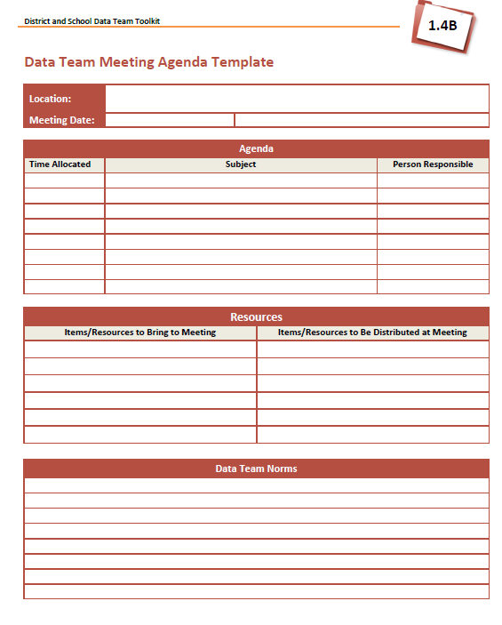
Team meeting Agenda Template

Slide 18
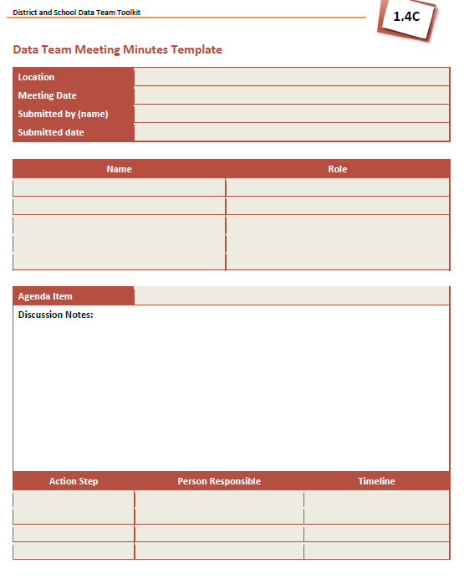
Team Meeting
Minutes Template

Slide 19
Are the teams data literate?
There are excellent resources available
Washington State Tool kit.
http://www.k12.wa.us/CEDARS/Data/pubdocs/FullToolkit.pdf
Using Data to Improve Schools: What’s Working
http://aasa.org/uploadedFiles/Policy_and_Advocacy/files/UsingDataToImproveSchools.pdf

Slide 20
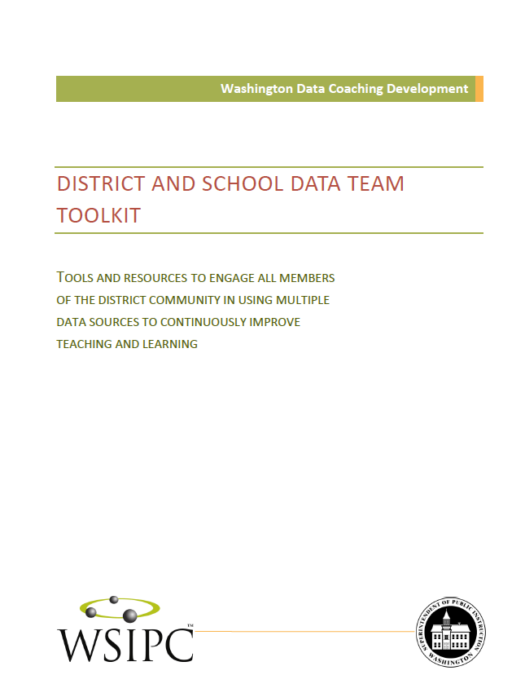
Washington State Toolkit.
http://www.k12.wa.us/CEDARS/Data/pubdocs/FullToolkit.pdf
Excellent document that provides complete professional development content on Data Literacy

Slide 21
Notes:
Evaluate Results extends the formative evaluation conducted during implementation to the summative evaluation of an action plan’s outcomes. Teams will use tools and guidance to conduct an evaluation that sums up the gains made through their actions and sets the stage to repeat the inquiry cycle. Evaluate Results also emphasizes the need to communicate with stakeholders about the project’s outcomes and provides resources to support that communication.

Slide 22
Identify Issues
The component includes resources and protocols to help teams clearly articulate questions and identify the data needed to answer them.

Slide 23
Understand Issues
moves to the next step in the inquiry process by helping both school and district teams begin to analyze data, generate clarifying questions to focus the inquiry, and identify data needed to dig deeper into the issue and learner-centered problems.

Slide 24
Victoria Bernhardt
Four layers of disaggregation:
First-Layer Disaggregations
How many students are there?
Male vs. female
Limited English Proficiency (LEP) vs. non-LEP
Ethnicities
Lunch codes
Second-Layer Disaggregations
How have the demographics changed over time?
Increases vs. decreases in categorical variables
Third-Layer Disaggregations
What percentage of students are gifted, and are they equally distributed among genders and
ethnicities?
Fourth-Layer Disaggregations
How has the enrollment of LEP students entering the building changed over the years?
Do students with higher attendance get better grades?
Using Data to Improve Schools: What’s Working
http://aasa.org/uploadedFiles/Policy_and_Advocacy/files/UsingDataToImproveSchools.pdf

Slide 25
Diagnose Causes
guides the process of root cause analysis using data from multiple sources to determine a hypothesized problem of practice that underlies the learner-centered problem.

Slide 26
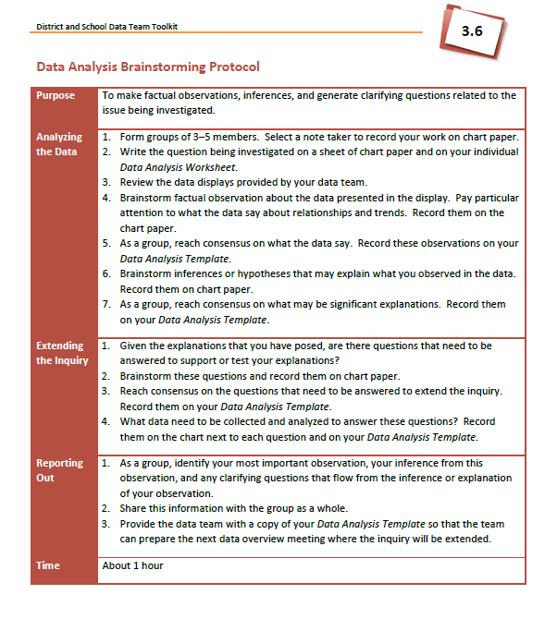
Root Cause Analysis

Slide 27
This is the critical point of data: It’s not necessarily the answers that are most important; it’s the discussion that occurs and the questions that are asked because of the data.
Karen Bates, superintendent,
Lake Washington (Wash.) School District

Slide 28
Plan and Take Action
provides a framework for putting new knowledge to work by developing a logic model and articulating clear measures that will guide and focus action.
Once desired outcomes have been clearly delineated, and strategies selected to achieve those outcomes, Plan and Take Action helps teams create a plan of action that will move the district/school toward the measurable results.
Additionally, Plan and Take Action provides guidance to help teams keep the plan alive through the use of implementation indicators and interim benchmarks to provide the basis for formative evaluation and to use data to guide mid-course corrections if necessary.

Slide 29
Evaluate Results
extends the formative evaluation conducted during implementation to the summative evaluation of an action plan’s outcomes.
Teams will use tools and guidance to conduct an evaluation that sums up the gains made through their actions and sets the stage to repeat the inquiry cycle.
Evaluate Results also emphasizes the need to communicate with stakeholders about the project’s outcomes and provides resources to support that communication.

Slide 30
When will the data be examined?
What are the expectations?
How frequent?
When in the school day?
Formal time?
Informal time?

Slide 31
Will anything be done with the evidence?
Plan and Take Action
Impact
A longer-range, high-level result of the initiative that is not always directly measurable, such as increased motivation to do well in school.
Goal
A high-level result of the initiative stated in general terms, such as improved student performance in mathematics.

Slide 32
Outcome
A longer-range measurable change in behavior, such as continually improving grade 10 mathematics test scores.
Target
A shorter-range measurable change, such as an annual increase as part of a multi-year initiative.
Objective
Very specifically stated measurable result of a strategy or action steps taken to implement that strategy, such as adjusting the master schedule to allow collaboration time for teachers.

Slide 33
Interventions
The intervention is the plan to mitigate the root cause of the identified problem.
Systemic
Social
Academic
Community
Personal

Slide 34
Resources
Every district has resources
Resource Catalog
Set goals based in the resources available.

Slide 35
Using data to make decisions is a cycle.
monitor
collect
review
revise
implement

Slide 36
Data Driven Decisions
Data-driven decision making requires a cultural shift in thinking that must be nurtured so all stakeholders are committed to this effort.

Slide 37
Continuous Improvement
Handout – (yellow)
http://eff.csuchico.edu/downloads/ACT_CIC.pdf

Slide 38
To access all training materials, visit http://www.pdesas.org/
Log in to SAS portal.
Under MySAS, select “Communities”.
If you have not joined the Educator Dashboard Early Warning System/Intervention Catalog community, search for the community by typing EWS in the search bar and request to join. Once you have joined the community, select from “My communities”.
Training materials can be found under “Content Repository” at the bottom of community’s page.
Click “Manage Content” to access “Putting Data Center Stage”

Slide 39
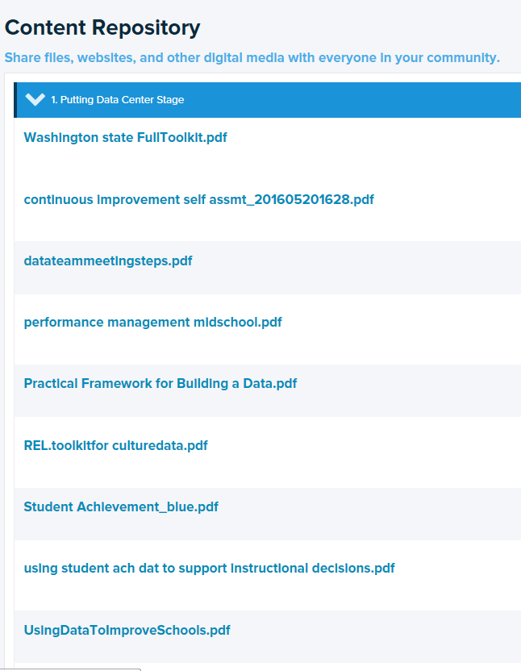
Resources

Slide 40
References
Data Teams 2006 Center for Performance Assessment
Geier, R., Smith, S. Washington State Data Coaching Development, District and school Data Team Toolkit, Washington Department of Education , (2012)
Gerzon, . and Guckenburg, S., Toolkit for a workshop on building a culture of data use, IES, REL, (2015)
Ronka, D., Geier, R, and Marciniak, M. , A practical Framework for building a data driven district or school, Public Focus Group, (2012)
Using Data to Improve Schools , Office of Educational Research and Improvement US Department of Education

Slide 41
Thank you.
For information concerning this presentation contact:
Sally Flaherty
saflaherty@pa.gov

