Slide 1
Course 4C Intervention Catalog Coordinator Navigation
Document #C4C.2
Notes:
Welcome to Course 4C Intervention Catalog Coordinator Navigation

Slide 2
Agenda
This course covers navigation of the PDE Educator Dashboard from the perspective of an Intervention Catalog (IC) Coordinator:
Review steps to access the application
Review the steps that enable an IC Coordinator to view, search and assign interventions
Review the steps that enable an IC Coordinator to add, edit, and delete interventions from the Intervention Catalog
Learn how to use notes, review and rate interventions and manage imports
Review how to assign Interventions to a Watch List
Learn how to manage the security of interventions
Notes:
This course covers navigation of the PDE Educator Dashboard from the perspective of an Intervention Catalog Coordinator:
Review steps to access the application
Review the steps that enable an IC Coordinator to view, search and assign interventions
Review the steps that enable an IC Coordinator to add, edit, and delete interventions from the Intervention Catalog
Learn how to use notes, review and rate interventions and manage imports
Review how to assign Interventions to a Watch List
Learn how to manage the security of interventions

Slide 3
Course Pre-Requisites
Participants must have:
An account to the Pennsylvania Department of Education Portal
An account to the Pennsylvania Educator Dashboard
An active account for the Standards Aligned Systems training platform (http:www.pdesas.org/)
Participants must have completed:
Course 1: Overview
Course 2: Early Warning System and at Risk Identification
Course 3: Family Educational Rights and Privacy Act for the LEA
Notes:
Prior to taking this course Participants must have:
An account to the Pennsylvania Department of Education Portal
An account to the Pennsylvania Educator Dashboard
An active account for the Standards Aligned Systems training platform (http:www.pdesas.org/)
Participants must have completed:
Course 1: Overview
Course 2: Early Warning System and at Risk Identification
Course 3: Family Educational Rights and Privacy Act for the LEA

Slide 4
Course Learning Objectives
Participants will be able to:
Login in as an Intervention Catalog Coordinator to the PDE Educator Dashboard
View, Search and Assign Interventions through the PDE Educator Dashboard
Add, edit and delete interventions from the Intervention Catalog
Manage notes, review and rate interventions and manage imports
Assign interventions to a Watch List
Manage intervention security functions
Notes:
At the end of this workshop participants will be able to:
Login in as an Intervention Catalog Coordinator to the PDE Educator Dashboard
View, Search and Assign Interventions through the PDE Educator Dashboard
Add, edit and delete interventions from the Intervention Catalog
Manage notes, review and rate interventions and manage imports
Assign interventions to a Watch List
Manage intervention security functions

Slide 5
Security/Roles
Security/Roles
The Educator Dashboard and Early Warning System have security restrictions to control the level of access for each school and district staff member.
The Intervention Catalog Coordinator role may be assigned to:
LEA Specialist
Staff member
District Administrator
School Administrator
Notes:
The Educator Dashboard and Early Warning System have security restrictions to control the level of access for each school and district staff member.
The Intervention Catalog Coordinator role may be assigned to:
LEA Specialist
Staff member
District Administrator
School Administrator

Slide 6
Educator Dashboard Login Review
Access the Pennsylvania Education portal - http://www.education.state.pa.us.
Login into the enterprise portal
Access myPDE
Login into the Educator dashboard
Notes:
Briefly review how to log into the dashboard:
To log in to the dashboard for your district, visit http://www.education.state.pa.us. Click Log In if you are already registered with the portal. If you are not registered, please click on “Register” to create a new account.
Enter your username and password.
Click My PDE on the Left Blue Pane to access the applications that you are authorized to view.
Click on Testing, if you have NOT moved your Dashboard data to Production.
OR Click on Dashboard under Insider PDE, if you have moved your Dashboard data to Production
Under Applications, select “Dashboard”. If this is your first time logging in, you will need to enter your PPID, Date of Birth, and the last four digits of your SSN.

Slide 7
Intervention Catalog Overview
Notes:
Intervention Catalog Overview – what is the purpose of the Intervention Catalog?

Slide 8
Intervention Catalog Overview
The Intervention Catalog may include a range of attendance, behavioral, academic, and/or social-emotional programs or agencies available in each district for use as a tool to assist at risk students. Under each category, the interventions for the catalog could include the following:
Attendance: Truancy elimination services, attendance monitoring
Behavior: Positive behavior supports, character education resources, anti-bullying, anger management
Academic: tutoring, afterschool programs, IEP, 504 services, career planning, differentiated instruction, study skill instruction
Social-emotional: Social workers, counseling, SAP teams, mental health, substance abuse education and services, mentors, ecumenical ministerial services
Notes:
Under each category, the interventions for the catalog could include the following:
Attendance: Truancy elimination services, attendance monitoring
Behavior: Positive behavior supports, character education resources, anti-bullying, anger management
Academic: tutoring, afterschool programs, IEP, 504 services, career planning, differentiated instruction, study skill instruction
Social-emotional: Social workers, counseling, SAP teams, mental health, substance abuse education and services, mentors, ecumenical ministerial services

Slide 9
Intervention Catalog Overview II
Additional state-mandated interventions should be included in the catalog such as the Student Assistance Program, truancy elimination programs supported by the county courts, mental health interventions, and drug and alcohol abuse services.
The Intervention Catalog is customized to meet the specific needs of the students in the district. Therefore each district will need to work with their community partners and district staff to determine all of the appropriate interventions to include in the Intervention Catalog.
Notes:
Additional state-mandated interventions should be included in the catalog such as the Student Assistance Program, truancy elimination programs supported by the county courts, mental health interventions, and drug and alcohol abuse services.
The Intervention Catalog is customized to meet the specific needs of the students in the district. Therefore each district will need to work with their community partners and district staff to determine all of the appropriate interventions to include in the Intervention Catalog.

Slide 10
Viewing and Searching Interventions
Notes:
Now we will examine how you View Interventions

Slide 11
Viewing Interventions I
The Intervention List shows interventions that are available to be assigned to students
Only the Intervention Catalog Coordinator and Dashboard Administrator have rights to add/delete/edit Interventions in the Intervention Catalog
Notes:
The Intervention List shows all interventions that are available to be assigned to students. It is important to note that only the Intervention Catalog Coordinator and Dashboard Administrator have rights to Add Interventions to the IC.
Each intervention listed includes; the Contact person assigned to the intervention,
The Population eligible for the intervention (Gen Ed, SpEd, 504, ELL, etc.),
Location (school- can be multiple or referral)
and the Intervention Level (1, 2, or 3).

Slide 12
Viewing Interventions: More Button
To see intervention details choose Details from the dropdown list that appears by clicking on the More button
Or see intervention details by clicking on the intervention name
Notes:
By clicking on the More Icon in the intervention , a dropdown list appears. We will choose Details.
You can also see intervention details by clicking on the intervention name

Slide 13
Viewing Interventions: Details
Contact
Levels
Gender
Area
Population
Duration
School
Location
Grade Level
Eligibility
Cost
Parent Permission
Description
Notes:
For each intervention, details include:
Intervention Name, Contact, Levels, Gender, Area, Population, Duration, School, Location, Grade Level, Eligibility, Cost, Parent Permission, Description
Interventions with the greatest detail can be assigned easily to the most appropriate audience.

Slide 14
Search for Interventions
Note the available search criteria
Notes:
This screen shows the layout of the search interventions page. Users can search for interventions using the following criteria:
Keyword
Eligibility Requirements
Cost
Parent Permission Required
School Availability
Location
Population
Improvement Area
Grade Level
Intervention Level
Gender-Specific

Slide 15
Intervention Search Parameters
Users can search for interventions using the following criteria:
Keyword, Eligibility Requirements , Cost, Parent Permission Required
School Availability , Location, Population , Improvement Area , Grade Level , Intervention Level, Gender-Specific
Notes:
Users can search for interventions using the following criteria:
Keyword
Eligibility Requirements
Cost
Parent Permission Required
School Availability
Location
Population
Improvement Area
Grade Level
Intervention Level
Gender-Specific

Slide 16
Search Results
After a user enters search criteria and selects Search, the Search Results will populate below
Notes:
After a user enters search criteria and selects Search, the Search Results will populate below.

Slide 17
View Interventions: Student List I
To view the students that have been assigned an intervention:
Click on More to view the dropdown menu
Select Student List
Notes:
To view the students that have been assigned an intervention, click on More to view the dropdown menu. Select Student List.

Slide 18
View Interventions: Student List II
The Assigned Students list displays all students who have been assigned this intervention
To view an individual student, click on the student’s name
Notes:
The Assigned Students list displays all students who have been assigned this intervention. Students are listed alphabetically.
To view an individual student, click on the student’s name.

Slide 19
Guided Practice Activity #1
From the Intervention List, select an intervention and find the following: contact, levels, population, location and eligibility
List 7 search categories you can use to search for specific interventions
Describe the steps you would take to view a list of the students in your school assigned to a specific intervention.
From the Intervention Student Assigned List, how would you choose one student and view their information?
Notes:
Trainer Notes: Have participants log into the Dashboard then:
From the Intervention List, select an intervention and find the following: contact, levels, population, location and eligibility
List 7 search categories you can use to search for specific interventions
Describe the steps you would take to view a list of the students in your school assigned to a specific intervention.
From the Intervention Student Assigned List, how would you choose one student and view their information?

Slide 20
Assigning Interventions
Notes:
Let’s review the process of assigning interventions to students.

Slide 21
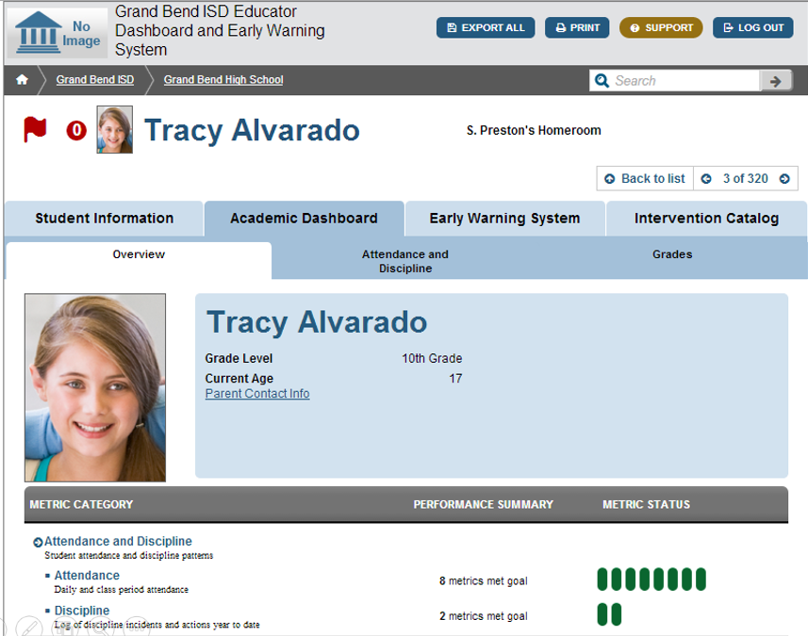
Identify Students who Need an Intervention
Student Tracy Alvarado has an Early Warning Flag and has 0 interventions assigned
Notes:
Student Tracy Alvarado has an Early Warning Flag and has 0 interventions assigned. While she has been flagged as at risk, no interventions have been assigned to her yet. This is a case that calls for action to be taken.

Slide 22
Assign an Intervention
Once you understand why the student is being flagged as at risk, navigate to the Intervention Catalog
Notes:
Once you have explored the information under Tracy’s profile and understand why the student is being flagged as at risk, navigate to the Intervention Catalog.

Slide 23
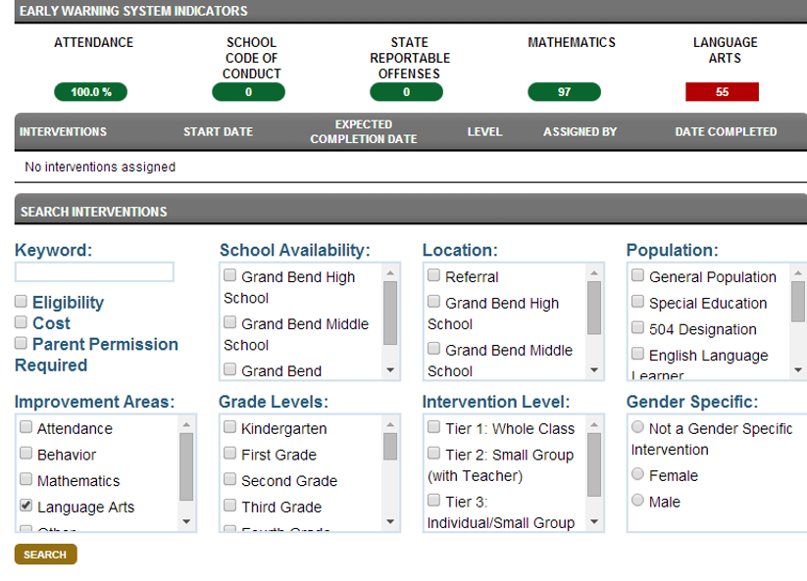
Searching Parameters for Interventions
Users can search for interventions by:
Keyword
School Availability
Population
Improvement Area
Grade Level
Intervention Level
Gender Specificity
Notes:
In order to narrow the list of interventions, users can search for interventions:
Keyword
School Availability
Population
Improvement Area
Grade Level
Intervention Level
Gender Specificity

Slide 24
Searching for an Appropriate Intervention
This student is flagged at risk for the Language Arts Indicator
Let’s select Language Arts under the Improvement Areas selection criteria
Notes:
This student is flagged at risk for the Language Arts Indicator. Let’s select Language Arts under the Improvement Areas selection criteria.

Slide 25
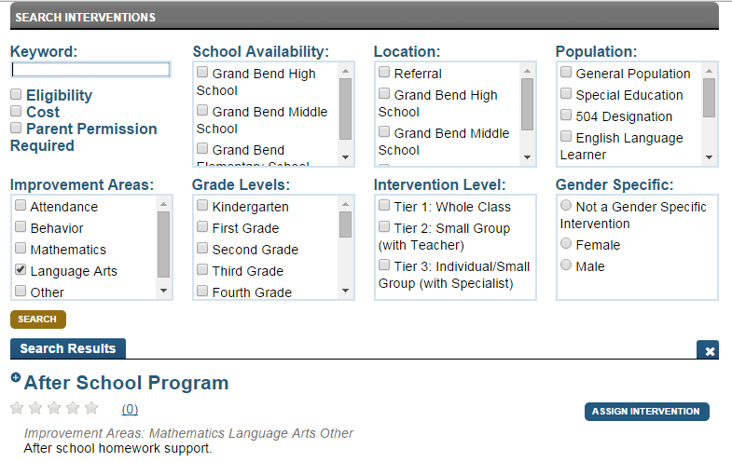
Selecting the Intervention
Select the desired Intervention from the Search Results
Click Assign Intervention
Notes:
Select the desired Intervention from the Search results. Click Assign Intervention.

Slide 26
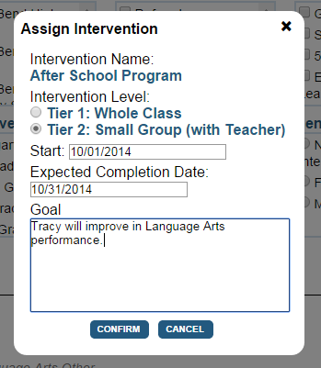
Setting Intervention Parameters
The Assign Intervention dialog box will pop up
Select the appropriate Tier for the Intervention Level
Select the Start and Expected Completion Date
Enter a goal
Click Confirm
Notes:
The Assign Intervention dialog box will pop up. Select the appropriate Tier for the Intervention Level. Select the Start and Expected Completion Date. Enter a goal. Click Confirm.

Slide 27
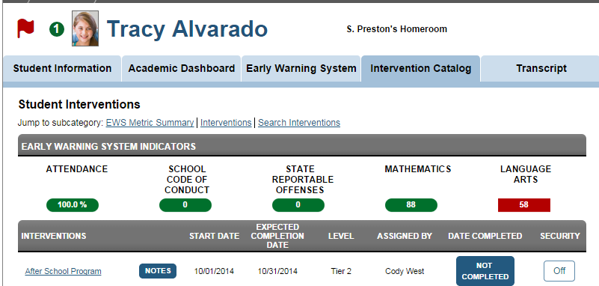
Confirming the Student’s Assigned Interventions
Note the green circle next to Tracy’s picture with 1 intervention assigned
This green circle reflects the total number of Interventions assigned to the student
Notes:
Note the green circle next to Tracy’s picture with 1 intervention assigned. This green circle reflects the total number of Interventions assigned to the student.

Slide 28
Reviewing the Student’s Assigned Interventions
The Intervention is now posted on the Student Interventions page
Start date, Expected Completion Date, Tiered Level, Assigned by Contact and Date Completed are also posted
Notes:
Note the green circle next to Tracy’s picture with 1 intervention assigned. This green circle reflects the total number od Interventions assigned to the student.

Slide 29
Guided Practice Activity #2
List the steps required to assign an intervention to a student.
What are the three fields that must be completed to assign an intervention?
Describe the two changes you see on the student’s Intervention Catalog Page when you have successfully assigned an intervention.
Notes:
Trainer Notes: Have participants log into the Dashboard then:
List the steps required to assign a student an intervention.
What are the two fields that must be completed to assign an intervention?
Describe the two changes you see on the student’s Intervention Catalog Page when you have successfully assigned an intervention.

Slide 30
Adding Interventions to the Catalog
Notes:
Let’s review Adding an Intervention to the Catalog. Only an intervention coordinator and dashboard administrator have the ability to add interventions to the intervention catalog.

Slide 31
Adding an Intervention to the Catalog
To add Interventions to the catalog:
Go to the Interventions tab in the Dashboard
Click Add Intervention
Notes:
To add Interventions to the catalog:
Go to the Interventions tab in the Dashboard
Click Add Intervention

Slide 32
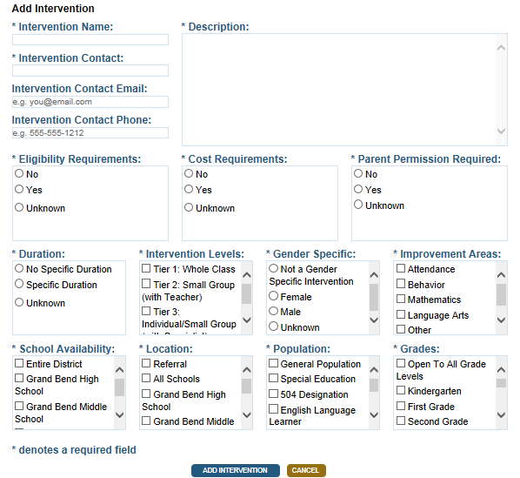
Intervention Details
When adding an intervention complete the required intervention details:
Intervention name, description, contact information, eligibility, cost, parent permission, duration, intervention level, school availability, location target population and grade level designation
Notes:
When adding an intervention complete the required intervention details: intervention name, description, contact information, eligibility, cost, parent permission, duration, intervention level, school availability, location target population and grade level designation.

Slide 33
Best Practices for Adding an Intervention
Interventions without the required fields cannot be saved to the catalog
Providing a relevant name and a detailed description will allow end users to select the correct intervention
Providing accurate details will also improve accuracy of selections
Notes:
As a note, interventions without the required fields cannot be saved to the catalog. Providing a relevant name and a detailed description will allow end users to select the correct intervention. Likewise, providing accurate details will also improve accuracy of selections.

Slide 34
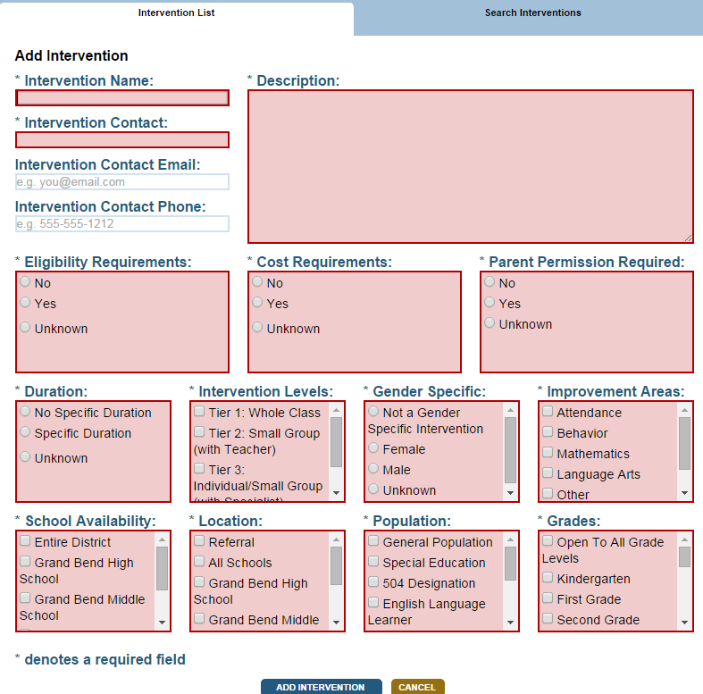
Required Fields
If a user clicks to save an intervention without providing all of the required fields, an error message appears at the top of the screen
The missing data fields will be highlighted in red
Notes:
If a user clicks to save an intervention without providing all of the required fields, an error message appears at the top of the screen. The missing data fields will be highlighted in red. The intervention cannot be saved without all the required fields.

Slide 35
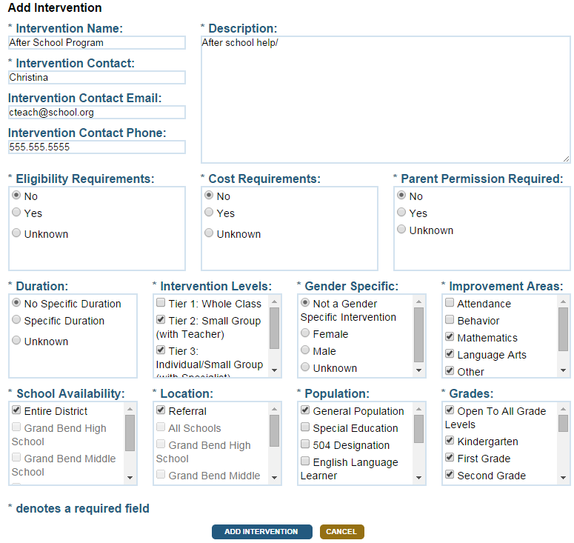
Adding an Intervention to the Catalog
Once all of the information has been completed, select Add Intervention at the bottom of the screen to save the intervention to the catalog
Notes:
Once all of the information has been completed, select Add Intervention at the bottom of the screen to save the intervention to the catalog.

Slide 36
Guided Practice Activity #3
What are the steps required to add interventions to the catalog?
What happens if a mandatory field is left blank?
Log into the Dashboard and create a sample intervention in the Intervention Catalog using the following naming convention: DELETE_your1stname_yourlastname. Once the Intervention is saved, used the Search feature to locate the intervention.
Notes:
Trainer Notes: Have participants log into the Dashboard
Distribute copies of Guided Practice Activity 3
What are the steps required to add interventions to the catalog?
What happens if a mandatory field is left empty

Slide 37
Editing An Intervention
Notes:
Now let’s examine Editing An Intervention

Slide 38
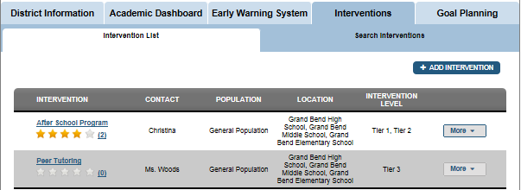
Choose the Intervention to Edit
Select the Interventions Dashboard and the Interventions List to display a list of the interventions in your catalog
Notes:
First we need to navigate to the Intervention tab, and then the Intervention List.

Slide 39
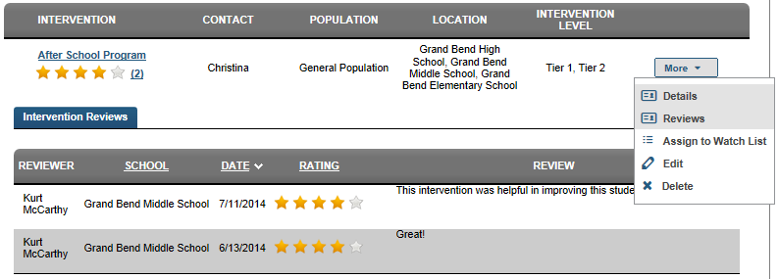
Editing an Intervention
Select the Intervention you wish to edit
Select the More button from the menu
Then select Edit
Notes:
Select the Intervention you wish to edit. Select the More button from the menu next to this intervention. Then select Edit.

Slide 40
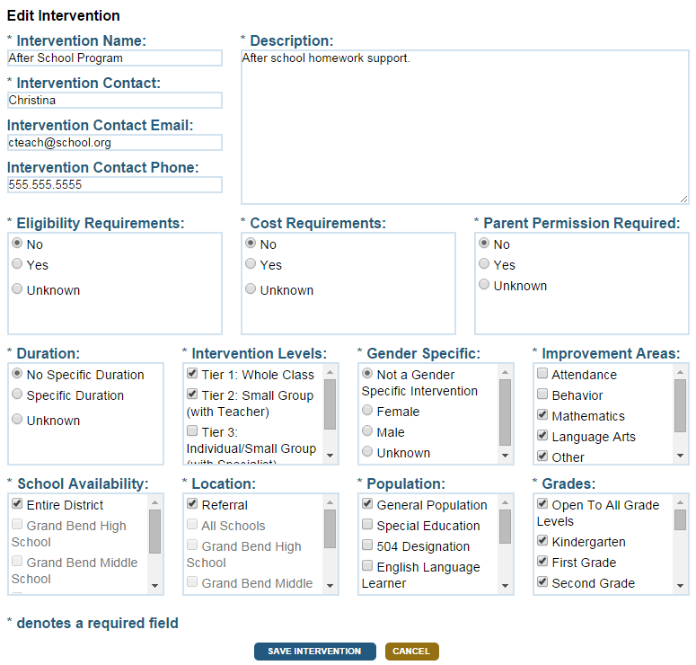
Saving Intervention Edits
The intervention is now in edit mode
Correct or update the necessary information
Click Save Intervention when you have completed your edits
Notes:
On this screen, the intervention is now in edit mode. Correct or update the necessary information, and then click Save Intervention when you have completed your edits.

Slide 41
Guided Practice Activity #4
What are the required steps for editing an intervention?
Log into the dashboard and edit the previously added intervention. Select edit from the menu options and change 1-2 parameters and save the edits.
Notes:
What are the required steps for editing an intervention?
Select Intervention to edit
Open the MORE Pull-down
Select Edit
The intervention is now in edit mode
Simply type the corrected intervention information in the appropriate field to edit the intervention
Click Save Intervention when you have completed your edits
Trainer Notes: Have participants log into the Dashboard then
From the Intervention List, select the intervention you added
DELETE_your1stname_yourlastname
Select Edit
Edit some of the fields (not intervention name)
Save your changes

Slide 42
Deleting an Intervention
Notes:
Now let’s talk about Deleting an Intervention.

Slide 43
Choose the Intervention to Delete
Select the Interventions Dashboard and the Interventions List to display a list of the interventions in your catalog
Notes:
We are returning to the Intervention List again. First we need to navigate to the Intervention tab, and then select the Intervention List.

Slide 44
Deleting an Intervention
Select the Intervention you wish to edit
Select the More button from the menu
Then select Delete
Notes:
Select the Intervention you wish to edit. Select the More button from the menu. Then select Delete.

Slide 45
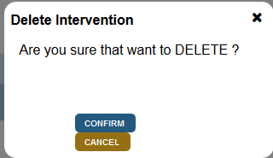
Deleting an Intervention: Confirm
The system will ask you to confirm the delete.
Note: The intervention will no longer be available to assign to students.
However, students who already have this intervention assigned will not lose the intervention in their list. They may still complete the intervention.
Notes:
The system will ask you to confirm the delete.
Note: The intervention will no longer be available to assign to students.
However, students who already have this intervention assigned will not lose the intervention in their list. They may still complete the intervention.

Slide 46
Guided Practice Activity #5
What are the required steps for deleting an intervention?
Log into the dashboard and locate the intervention that you previously added and edited. Delete the intervention.
Notes:
What are the required steps for deleting an intervention?
Select Intervention to delete
Open the MORE Pull-down
Select delete
The system will ask you to confirm the delete.
Note: The intervention will no longer be available to assign to students.
However, students who already have this intervention assigned will not lose the intervention in their list. They may still complete the intervention.
Trainer Notes: Have participants log into the Dashboard then:
From the Intervention List, select the intervention you added
DELETE_your1stname_yourlastname
Select Delete
Confirm the delete

Slide 47
Intervention Notes, Reviews, Ratings & Imports
Notes:
Next let’s look at the additional Intervention functions, including notes, reviews & ratings and imports.

Slide 48
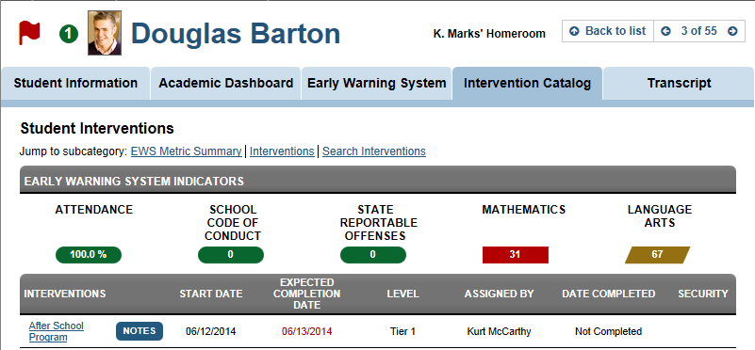
Intervention Notes
Teachers can add notes to students with interventions
Click the Intervention Catalog tab
Then click Notes
Notes:
Teachers can add notes to students with interventions
Click the Intervention Catalog tab.
Then click Notes next to the intervention name

Slide 49
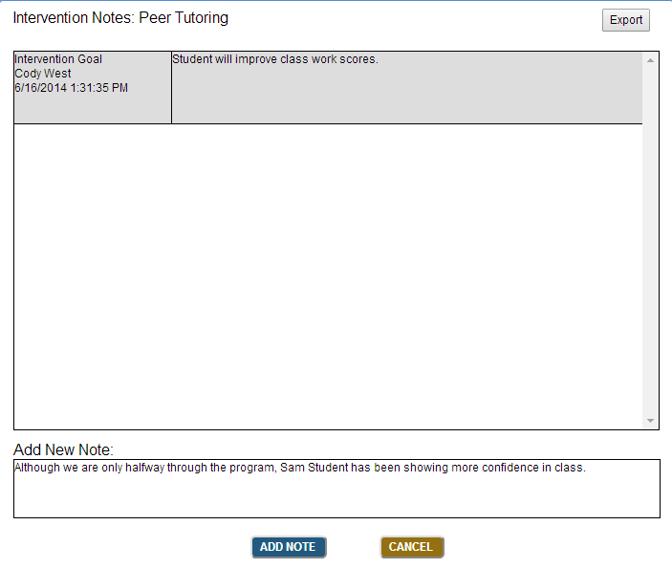
Adding Notes
Click in the Add New Note box
Use notes to assist with progress monitoring and to share implementation details
Click Add Note to save the note
Notes:
Teachers can add notes to students with interventions.
Click the Intervention Catalog tab
Then click Notes.
Use notes to assist with progress monitoring and to share implementation details

Slide 50
Exporting Notes
The Export Notes function allows users to export all the Intervention notes into an Excel spreadsheet
All the information about the Note is captured, including who entered the note, the time stamp and the details
Notes:
The Export Notes function allows users to export all the Intervention notes into an Excel sheet. All the information about the Note is captured, including who entered the note, the time stamp and the details.

Slide 51
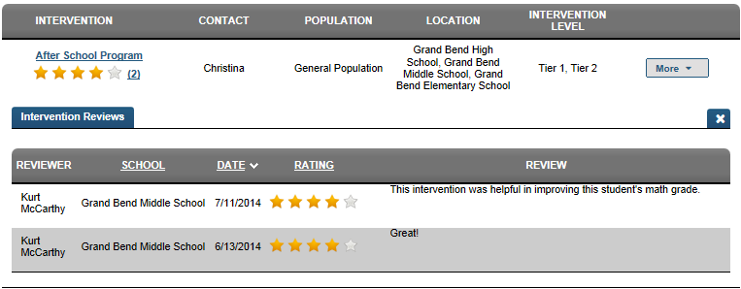
Ratings and Reviews
Ratings and reviews can be added to Interventions when Interventions are closed
We use ratings and reviews to share with colleagues how effective an Intervention was for a particular student
As a best practice, the more accurate and detailed reviews will be the most helpful
Notes:
Ratings and reviews can be added to Interventions when Interventions are closed. We use ratings and reviews to share with colleagues how effective an Intervention was for a particular student. As a best practice, the more accurate and detailed reviews will be the most helpful.

Slide 52
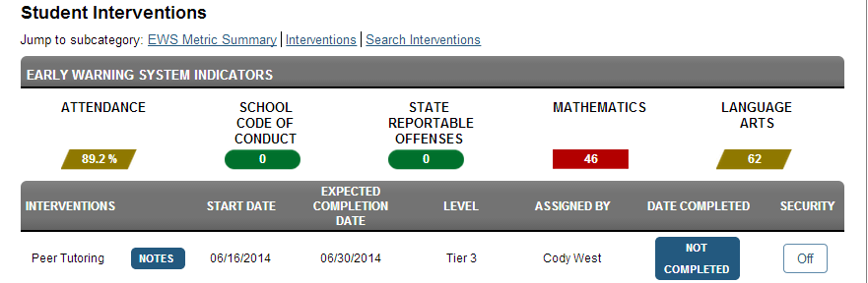
Marking an Intervention Complete
Close an Intervention for a student when the goal has been achieved or the resource is no longer available
Change the status of the Intervention by clicking Not Completed next to the target Intervention
Notes:
Close an Intervention for a student when the goal has been achieved or the resource is no longer available. Change the status of the Intervention by clicking Not Completed next to the target Intervention.

Slide 53
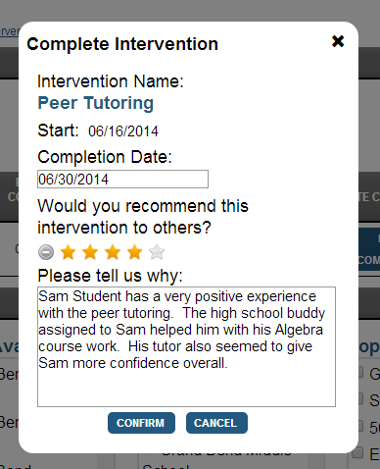
Creating a Rating & Review
Enter the Completion Date for the Intervention
Rate the Intervention using a 5-star scale
Provide a detailed reason for rating the Intervention
The more information provided here will make program evaluation more effective and accurate
Select Confirm when complete
Notes:
Enter the Completion Date for the Intervention.
Rate the Intervention using a 5-star scale.
Provide a detailed reason for rating the Intervention.
The more information provided here will make program evaluation more effective and accurate.
Select Confirm.

Slide 54
Accessing Intervention Reviews I
Once reviews have been added by individuals, staff members with access to the Intervention Catalog can access the peer reviews
The reviews help identify effective Interventions
Select More next to the target Intervention, and then click Reviews
Notes:
Once reviews have been added by individuals, staff members with access to the Intervention Catalog can access the peer reviews. The reviews help identify effective Interventions.
Select More next to the target Intervention, and then click Reviews.

Slide 55
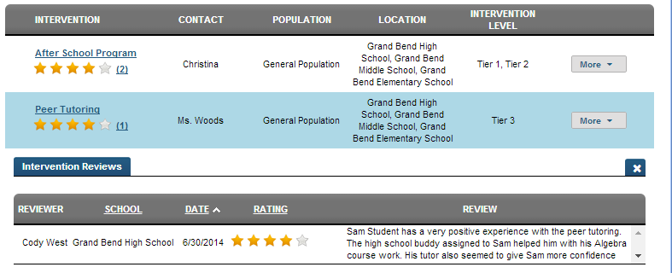
Accessing Intervention Reviews II
Next to each Intervention we can see how many reviews have been added
Once the reviews have been expanded we can review the details added by peers
Notes:
Next to each Intervention we can see how many reviews have been added. One the reviews have been expanded we can review the details added by peers.

Slide 56
Importing an Intervention
To help collaboration between districts, there is an Import Interventions function that allows users to bulk import selected interventions
Select the Import Interventions tab, under Interventions
Select a District from the drop down menu
Select the Interventions you wish to import
Demo District
Notes:
Interventions can be imported into the system.
Select the Import Interventions tab
Select a District from the drop down menu
Select the intervention you wish to import

Slide 57
Import Selected Interventions
Check all the interventions that will be included in the import
Select Import Selected Interventions at the bottom of the page
Notes:
Check all the interventions that will be included in the import. Select Import Selected Interventions at the bottom of the page.

Slide 58
Confirm Import and Edit Details
Next, confirm the import was successful
The contact, population, location, intervention level and availability will have the value “unknown”
Edit the intervention to meet your district specific requirements
Notes:
Next, confirm the import was successful
The contact, population, location, intervention level and availability will have the value “unknown”
Edit the intervention to meet your district specific requirements

Slide 59
Guided Practice #6
What kind of details should you include in a review of an intervention?
Do you feel that these reviews will help you select effective interventions?
Do you think your district will use the Import Interventions feature? Why or why not?
Notes:
Trainer Notes:
Prompt participants to respond the Guided Practice questions and then review responses as a group.

Slide 60
Assigning an Intervention to a Watch List
Notes:
Let’s take a look at add an Intervention to an entire Watch List and talk about why this may be useful.

Slide 61
Watch Lists and Interventions Overview
We use Watch Lists to track and monitor sub-groups of students based on the indicators and metrics within the Dashboard
These sub-groups of students have similar issues and therefore may benefit from participating in the same Interventions
The Assign an Intervention to a Watch List function allows us to assign an Intervention to all the students in the group at once
Notes:
We use Watch Lists to track and monitor sub-groups of students based on the indicators and metrics within the Dashboard. These sub-groups of students have similar issues and therefore may benefit from participating in the same Interventions. The Assign an Intervention to a Watch List function allows us to assign an Intervention to all the students in the group at once.

Slide 62
Accessing the Assign to a Watch List Function
Within the Intervention Catalog, to assign an Intervention to a Watch List:
Click the More button
Click Assign to Watch List
Notes:
Within the Intervention Catalog, to assign an Intervention to a Watch List:
Click the More button
Click Assign to Watch List

Slide 63
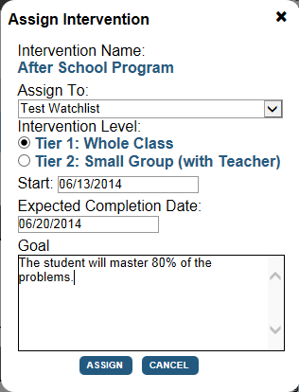
Watch Lists and Interventions
Select the desired watch list from the drop down box
Click the radio button next to the desired Intervention level
Select a Start Date and Completion Date from the calendar
Type the Goal (required)
Click Assign
Notes:
Select the desired watch list from the drop down box
Click the radio button next to the desired Intervention level
Select a Start Date and Completion Date from the calendar
Type the Goal (required)
Click Assign
Now any students who were on the watch list will now have this intervention assigned to them.

Slide 64
Intervention Security
Notes:
Intervention Security

Slide 65
Intervention Security Overview
Once an Intervention has been assigned to a student, the assignor can determine who can see the Intervention for this particular student
Some Interventions may be confidential in nature, and therefore not appropriate for all staff members to view
This access is managed through the Security feature with the student’s Intervention Catalog
Notes:
Once an Intervention has been assigned to a student, the assignor can determine who can see the Intervention for this particular student.
Some Interventions may be confidential in nature, and therefore not appropriate for all staff members to view.
This access is managed through the Security feature with the student’s Intervention Catalog.

Slide 66
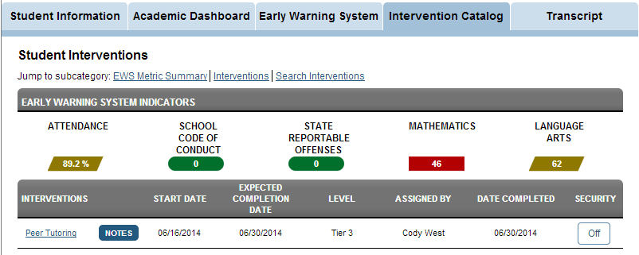
Enabling Intervention Security
Next to each Intervention assigned to a student there is a Security button
Click the button to change the status
Notes:
Security can be applied to interventions. The administrator viewing the student profile on the Intervention Catalog tab sees that the Security is currently ‘off’. Click Off to turn on the Security.

Slide 67
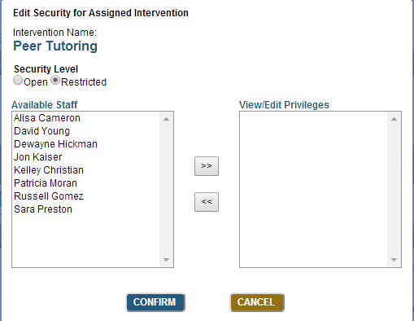
Intervention Security Settings
Click the radio button next to Restricted
Click the names of the staff members who will be able to view the Intervention for this student
Click Confirm
Notes:
To restrict access to a subset of staff members:
Click the radio button next to Restricted
Click the names of the staff members who will be able to view the Intervention for this student
Click Confirm

Slide 68
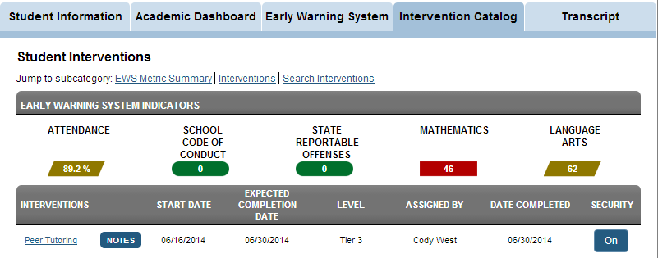
Confirming Security
Note the Security status is now On
The assignor can edit the security settings as necessary
Notes:
Note the Security status is now On.
The assignor can edit the security settings as necessary.

Slide 69
Guided Practice #7
When would it be appropriate to enable security on an intervention? Provide an example.
Notes:
Trainer Notes:
Prompt participants to respond the Guided Practice question and then review responses as a group.

Slide 70
Wrap Up, Assessment and Evaluation
Wrap Up
What are the steps you would take to search for an intervention in the IC?
Who can assign a student an intervention?
What role(s) have rights to add, delete and edit interventions?
What Intervention Catalog related procedures can the intervention coordinator perform that a district staff member can not?
Notes:
What are the steps you would take to search for an intervention in the IC?
Who can assign a student an intervention?
What roles have rights to add, delete and edit interventions?
What Intervention Catalog related procedures can the intervention coordinator perform that a district staff member can not?

Slide 71
Wrap Up, Assessment and Evaluation
Assessment
Take a moment and answer the questions on the brief assessment
Assessment
Notes:
Please take a moment and respond to the brief assessment questions. Your instructor will provide instructions on accessing the assessment.

Slide 72
Wrap Up, Assessment and Evaluation
Evaluation
Take a moment and answer the questions on the brief evaluation survey
Evaluation
Notes:
Please take a moment and complete the evaluation survey. Your instructor will provide instructions on accessing the survey.

Slide 73
For more information on Intervention Catalog Coordinator Navigation please visit PDE’s website at www.education.state.pa.us
The mission of the department is to academically prepare children and adults to succeed as productive citizens. The department seeks to ensure that the technical support, resources and opportunities are in place for all students, whether children or adults, to receive a high quality education.

