Slide 1
Course 4B Administrator Navigation
Document #C4B.2
Notes:
In this course we will be taking a look at how to navigate through the dashboards that are available to a school or district administrator

Slide 2
Agenda
This course will cover the navigation of the PDE Educator Dashboard and Early Warning System from the perspective of a district or building administrator:
Review steps that enable an administrator to access the application
Review navigation in the Pennsylvania Department of Education (PDE) Educator Dashboard and Early Warning System
Review the indicators and metrics available to Administrators in the PDE Educator Dashboard and Early Warning System
Notes:
This course will cover the navigation of the PDE Educator Dashboard and Early Warning System from the perspective of a district or building administrator:
Review steps that enable an administrator to access the application
Review navigation in the Pennsylvania Department of Education (PDE) Educator Dashboard and Early Warning System
Review the indicators and metrics available to Administrators in the PDE Educator Dashboard and Early Warning System – we will investigate both school level metrics that a school administrator can view and student level metrics

Slide 3
Course Pre-Requisites
Participants must have:
An account to the Pennsylvania Department of Education (PDE) Portal
An account to the Pennsylvania Educator Dashboard
An active account for the Standards Aligned Systems training platform (http:www.pdesas.org/)
Participants must have completed:
Course 3: Family Education Rights and Privacy Act (FERPA) for the LEA
Notes:
Participants must have:
An account to the PDE Portal
An account to the Pennsylvania Educator Dashboard
An active account for the Standards Aligned Systems training platform (http:www.pdesas.org/)
Participants must have completed:
Course 3: FERPA for the LEA

Slide 4
Course Learning Objectives
Participants will be able to:
Login in as a building administrator to the PDE Educator Dashboard
Successfully navigate through the PDE Educator Dashboard for Administrators: School and Student Information, Academic Information, Early Warning System, and Intervention Catalog
Describe the purpose of each of the PDE Educator Dashboards for administrators
List 2 examples of types of indicators available on each of the PDE Educator Dashboard for administrators
Notes:
At the end of this workshop participants will be able to:
Login in as a building administrator to the PDE Educator Dashboard
Successfully navigate through the PDE Educator Dashboards for Administrators: School and Student Information, Academic Information, Early Warning System, and Intervention Catalog
Describe the purpose of each of the PDE Educator Dashboards for administrators
List 2 examples of types of indicators available on each of the PDE Educator Dashboards for administrators

Slide 5
Security/Roles: Purpose
Security/Roles
The Educator Dashboard and Early Warning System have security restrictions to control the level of access for each school and district staff member.
Educators have access only to students with whom they have a direct instructional Interest
Teachers have access to data on his/her students only
Principals have access to data on students enrolled at his/her school only
Notes:
In order to protect students’ and staff’s privacy and security, The Educator Dashboard and EWS have security restrictions to control the level of access for each school and district staff member.

Slide 6
Dashboard Roles
Notes:
Dashboard security extends to the Intervention Catalog. Specifically, only certain staff members with specific roles are able to assign students to intervention or manage the intervention catalog

Slide 7
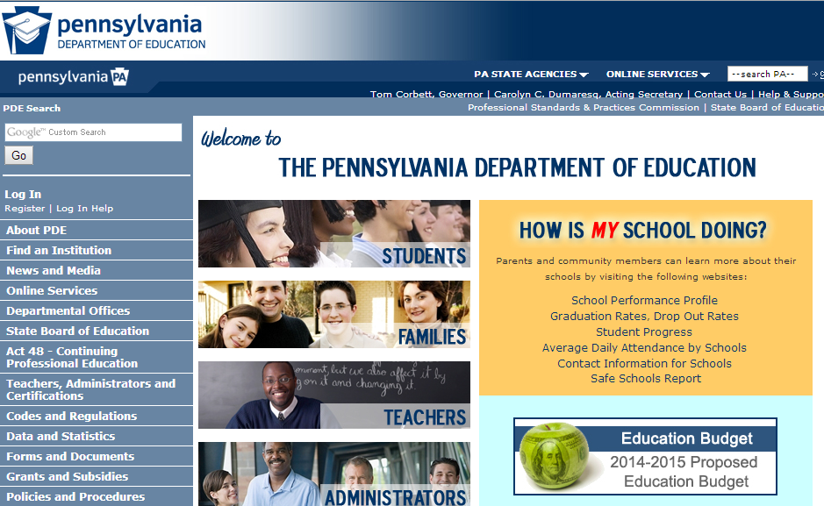
Accessing the Log In Screen
Visit: http://www.education.state.pa.us
Notes:
To log in to the dashboard for your district, visit http://www.education.state.pa.us. Click Log In if you are already registered with the portal. If you are not registered, please click on “Register” to create a new account.

Slide 8
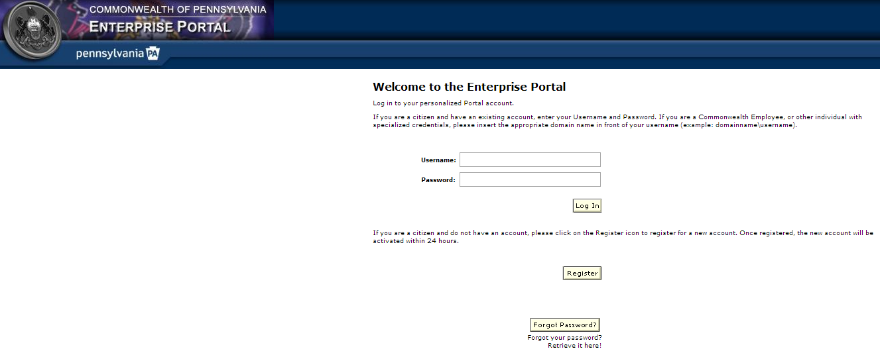
Logging in to the Enterprise Portal
Enter username and password
Notes:
Enter your username and password.

Slide 9
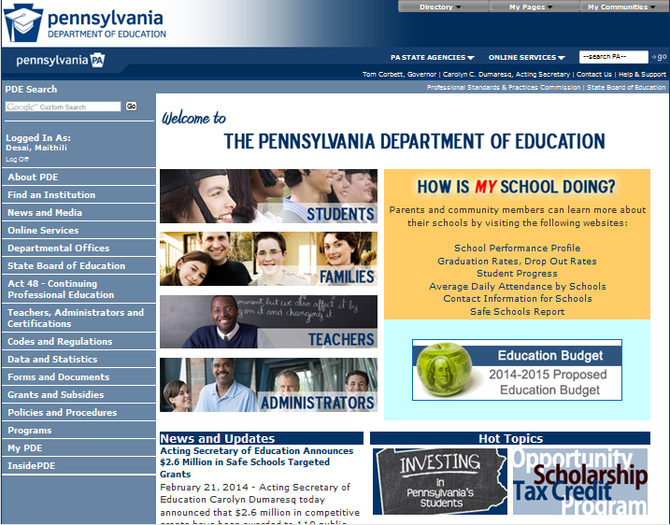
Accessing My PDE
Click on My PDE
Notes:
Click My PDE on the Left Blue Pane to access the applications that you are authorized to view.

Slide 10
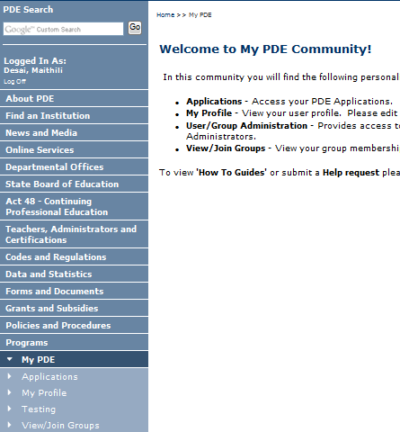
Accessing Test Environment
Click on Testing, if you have NOT moved your Dashboard data to Production
Notes:
Click on Testing, if you have NOT moved your Dashboard data to Production.

Slide 11
Accessing Production Environment
Click on Dashboard under Insider PDE, if you have moved your Dashboard data to Production
Notes:
Click on Dashboard under Insider PDE, if you have moved your Dashboard data to Production

Slide 12
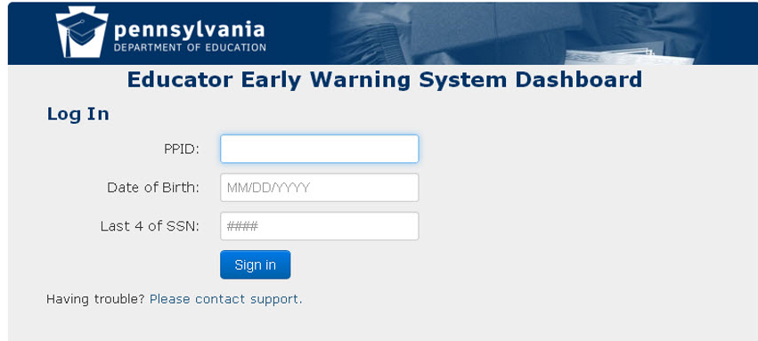
Logging Into the Educator Dashboard
Enter your PPID, DOB and the last four digits of your SSN
Notes:
Under Applications, select “Dashboard”. If this is your first time logging in, you will need to enter your PPID, Date of Birth, and the last four digits of your SSN.

Slide 13
Administrator Dashboard Layout
Notes:
We are going to navigate through the PA educator dashboard system as if we were a school administrator

Slide 14
Dashboard Layout: Header
A header is displayed at the top of each dashboard screen.
Across the top is displayed the name of the dashboard being displayed and links to Export All, Print, access the support page, or log out.
Notice the links back to the home page for this user, a link to the district level data and a link to the school level data (role driven)
Notes:
I am logged in here as a school principal at the high school level.
This is the header that is displayed at the top of every dashboard screen.
Across the top you see the district name
next to the dashboard title, are links to: Export All, Print, Support, log out
In the gray bar notice the link back to the home page for this user (the little schoolhouse), a link to the district level data (due to role driven security) and a link to the school level data (role driven)
On most of the subsequent slides we will not be showing the dashboard header but when you log into the system you will always see the header at the top of each dashboard.

Slide 15
Dashboard Layout: Legend
At the bottom of each dashboard screen is a legend
The different indicators used throughout the dashboards are defined in the legend
Notes:
Each dashboard has this same legend at the bottom.
On the subsequent slides we will not be showing the legend but it appears at the bottom of all dashboards.
Trainer note: Go though some examples of indicators and their definitions – red indicators generally show that something is amiss

Slide 16
School Level and Student Level Dashboards
School Administrators can view both school level aggregate data and individual student data for all students on the school’s roster
Many of the metric categories are the same between school level and student level dashboards
The difference is in the granularity of the data
Notes:
School administrators can view both school level aggregate data and individual student data for all students on the school’s roster
Many of the metric categories are the same between school level and student level dashboards
The difference is in the granularity of the data
For this training module we will be focusing on school level data but we will cover accessing individual student data briefly at the end of the session

Slide 17
School Information
Notes:
.
In this next section we will navigate to the school level information for a school administrator. We will investigate the kind of school level information that is available for a school administrator to view..

Slide 18
School Level Tabs
School information includes administration, accountability and demographics for this school
Other tabs available are the Academic Dashboard, containing academic related metrics for this school, the Early Warning System, and Interventions
Notes:
School information includes administration, accountability and demographics for this school
Other tabs available are the Academic Dashboard, containing academic related metrics for this school, the Early Warning System, and Interventions
We will look at the School Information tab first

Slide 19
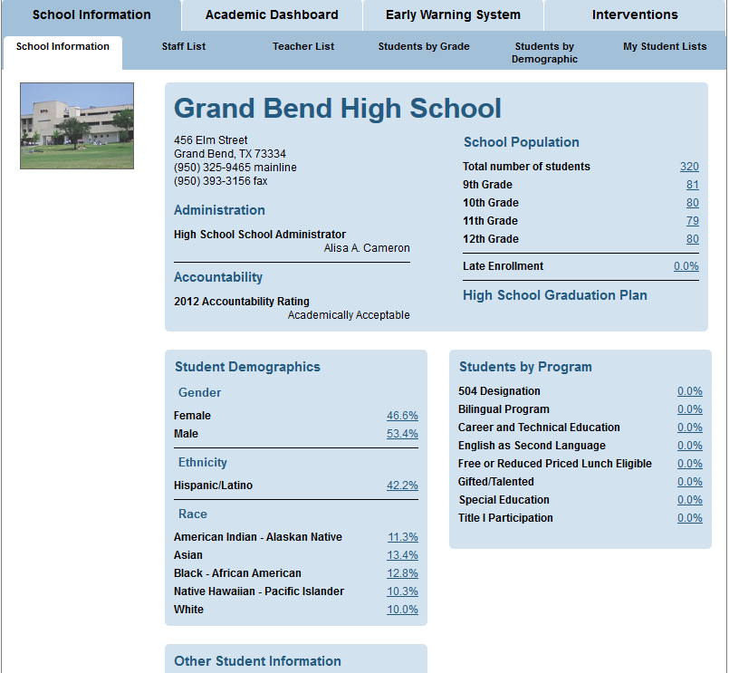
School Information: Homepage
Homepage for administrator includes:
Administration
Accountability
Population by grade
Demographics
Students by program
Other Student Information
Economically Disadvantaged, Homeless, Immigrant, LEP, Migrant, Over Age
Notes:
Click on the School information tab to see the overview information for this school
The School Information page is the landing page for administrator users. It shows the school’s address and contact information, School population by grade, as well as summative data for; Accountability, Student demographics percentages by gender, ethnicity and race.
Other Student Information includes percentages for; economically disadvantaged, homeless, immigrant, Limited English Proficiency, migrant and over age

Slide 20
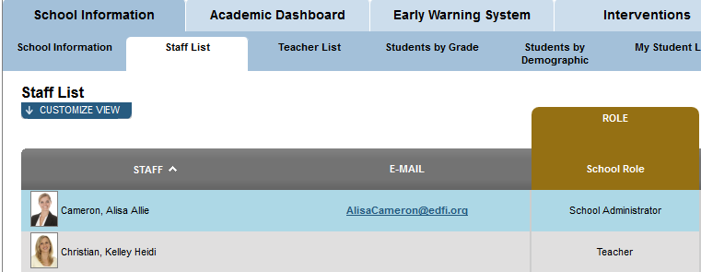
School Information: Staff List
All Staff:
Listed alphabetically by Last Name
E-Mail link
School Role
Notes:
The Staff List page displays all staff members alphabetically by name, e-mail, and School Role.

Slide 21
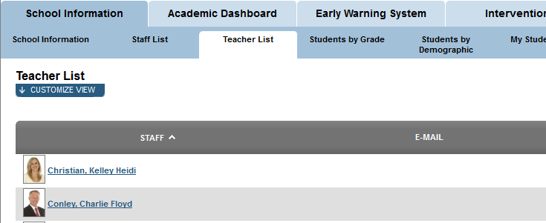
School Information: Teacher List
The Teacher List displays all teachers alphabetically with links to their emails
Notes:
The Teacher List page displays all teachers only, alphabetically by last name and e-mail.

Slide 22
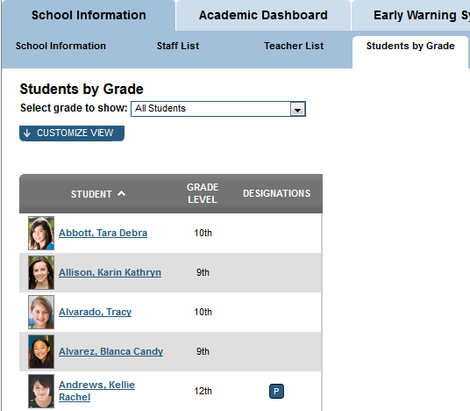
School Information: Students by Grade
Students by Grade Default view:
All Students listed alphabetically by last name
Sortable by
Grade Level
Designations
Attendance/Discipline
Grades
Notes:
Students by Grade List
Default view
All Students are listed alphabetically by last name
Sortable by
Grade Level
Designations
Attendance/Discipline
Grades

Slide 23
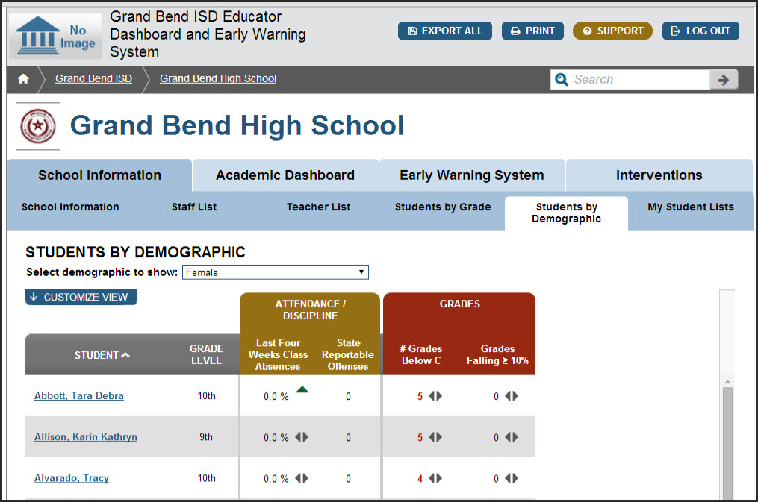
School Information: Students by Demographic
The Students by Demographic page allows users to select a demographic to view
Notes:
The Students by Demographic tab allows users to select a demographic to view from a dropdown.
The default view lists students alphabetically. For each student it shows the following; Grade Level, Attendance/Discipline (Last four weeks absences & State Reportable Offenses) and Grades (# Grades below C & Grades Falling ≥ 10%

Slide 24
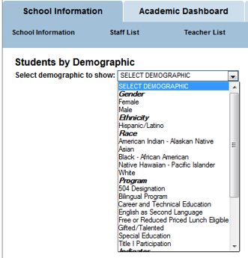
Students by Demographic Search Filters
Gender
Ethnicity
Race
Program
504, ESL, SpEd,Title I, etc.
Indicator
At Risk, Economically Disadvantaged, Homeless, LEP, Migrant, Late Enrollment
Notes:
Demographic Search Filters include, but are not limited to:
Gender
Ethnicity
Race
Program participation
504, ESL, SpEd,Title I, … etc.
Indicator
At Risk, Economically Disadvantaged, Homeless, LEP, Migrant, Late Enrollment, …etc.

Slide 25
Students by Demographic Lists
The default view shows various early warning metrics for the chosen demographic group
Notes:
The Students by Demographic Page allows users to select a demographic to view.
The default view lists students alphabetically. For each student it shows the following; Grade Level, Designations, metrics failing and metrics in the caution state, Attendance/Discipline and Grades Customize View lets the user create, add or delete students to/from a watch list. In addition users can choose which columns they see on their scree when they log in.

Slide 26
Student Lists: Customize View
Customize View lets the user:
See more data
Export data
Maximize the data grid
Create, add or delete students to/from a watch list
Notes:
Customize View button lets the user:
See more data
Export data
Maximize the data grid
Create, add or delete students to/from a watch list

Slide 27
Student Lists: Choose Columns for View
See More Data button allows users to choose which columns appear in the view
Choices include additional student indicators for Attendance, Behavior and Course Performance
Notes:
See More Data button allows users to choose which columns appear in the view
Choices include additional student indicators for Attendance, Behavior and Course Performance

Slide 28
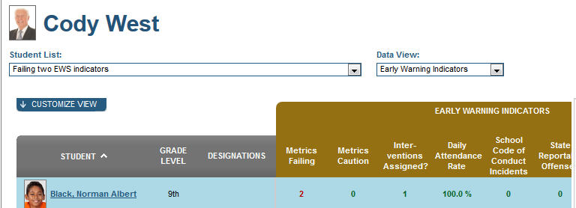
School Information: My Students List
By clicking on My Student Lists tab Administrators are able to:
Navigate to individual student profiles
Create their own customized lists to track student groups
Creation of Watch Lists is covered in Course 5A
Notes:
Administrators are able to: navigate to individual student profiles, create their own customized lists to track student groups, i.e., students with grades under/over a threshold. Creation of Watch Lists is covered in Course 5A.

Slide 29
Guided Practice Activity #1
Form groups of three or four. Each person should pick a particular grade and explore the following:
Explore 2 or 3 Demographic Groups.
How do the groups compare?
What are some ways you might use customized lists to help students?
What are some customized lists you would like to create for your personal use?
Be prepared to share your discussion points with the group
Notes:
Form groups of three or four. Each person should pick a particular grade and explore the following:
Explore 2 or 3 Demographic Groups.
How do the groups compare?
What are some ways you might use customized lists to help students?
What are some customized lists you would like to create for your personal use?
Be prepared to share your discussion points with the group

Slide 30
Academic Dashboard – School Overview
Notes:
Next, let’s look at the Academic Dashboard tab.

Slide 31
School Information: Academic Dashboard
School Level information available on the Academic Dashboard includes:
Prior year accountability rating
Summary metrics for attendance and discipline, state and local assessment results, grades and credits, advanced academic, college and career readiness and early warning system
Notes:
There are 7 sub-tabs under the academic dashboard tab.
The academic dashboard provides access to school level academic metrics such as: attendance and discipline metrics, grades and credits, state and local assessment results, PA specific advanced academic results and college and career readiness metrics.
The prior year’s accountability result is displayed

Slide 32
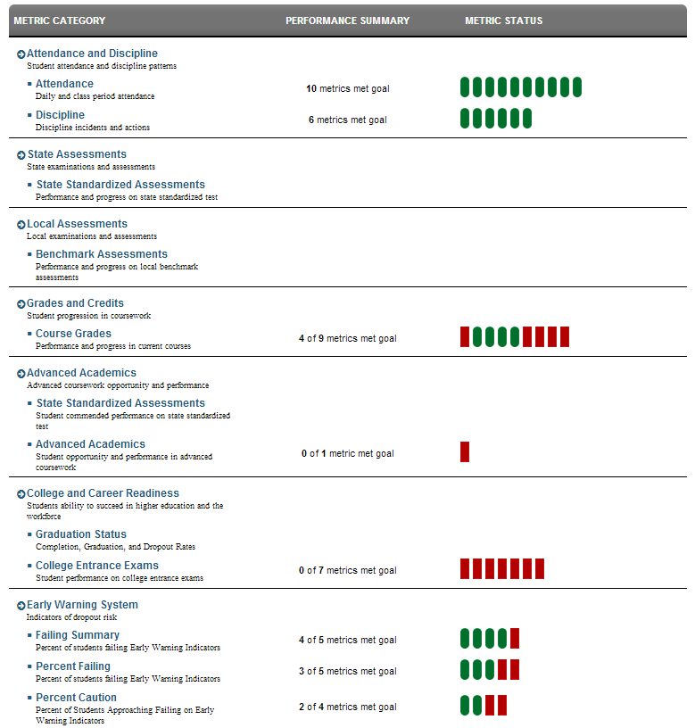
Academic Dashboard: Overview Tab
The Academic Overview page shows summative reports for each of the following areas:
Attendance and discipline
State and local assessments
Grade and credits
Advanced academics
College and career readiness
Early warning system
Notes:
The Academic Overview page shows summative reports for each of the following areas:
Attendance and discipline
State and local assessments
Grade and credits
Advanced academics
College and career readiness
Early warning system

Slide 33
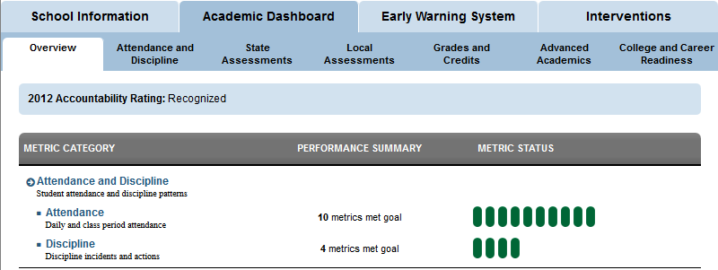
School Information: School Metrics
At the school level, the number of metrics that met the goals set for that category is indicated.
In the example shown, 10 metric goals were set for attendance and 10 attendance metrics met their goal
Notes:
This is a closer look at the attendance discipline section of the overview tab under the academic dashboard
For each section of this dashboard under the Overview tab the Metric category, performance summary and current metric status are displayed.
All of the other sections in the Overview tab of the Academic Dashboard follow the same format

Slide 34
Academic Dashboard – Attendance and Discipline
Notes:
Now let’s look at Attendance and Discipline tab of the Academic Dashboard.

Slide 35
Academic Dashboard: Metrics Displayed
For each tab on the academic dashboard the metrics displayed include: metric value, trend, school goal, difference from goal, student attainment, and a More button for details
Notes:
Except for the overview tab, the other tabs under the Academic Dashboard display the same categories of metric data.
For each tab on the academic dashboard (except the overview tab) the metrics displayed include the metric value, trend, school goal, difference from goal, student attainment and a More button for details

Slide 36
School Attendance and Discipline Metrics
School Attendance metrics
Average Daily Attendance
Daily Attendance Rate
Days Absent
Class Period Absence Rate
School Discipline metrics
All Discipline Incidents
School Code of Conduct Incidents
Notes:
Under the attendance/discipline tab of the Academic dashboard the following categories of attendance data are displayed -
School Attendance section of the metrics:
Average Daily Attendance
Daily Attendance Rate
Days Absent
Class Period Absence Rate
Under the attendance/discipline tab of the Academic dashboard the following categories of Discipline data are displayed
School Discipline metrics
All Discipline Incidents
School Code of Conduct Incidents
In each category the metrics displayed include the metric value, trend, school goal, difference from goal, student attainment and a More button for details

Slide 37
School Attendance: More Button
Clicking on the More icon displays choices of reports:
Grade level chart
Student list
Notes:
Clicking on the More icon displays choices of views, including Grade Level chart & Student List.

Slide 38
School Discipline
All incidents to date
Current Grading Period, Previous Grading Period, YTD, Prior Year
Code of Conduct incidents
Current Grading Period, Previous Grading Period, YTD, Prior Year
Notes:
School discipline information is Located Below Attendance on the Attendance/Discipline Page
On this slide only the “all discipline incidents” is shown but in the dashboard both all incidents and school of code of conduct incidents are displayed.
Metrics
All incidents to date
Current Grading Period, Previous Grading Period, YTD, Prior Year
Code of Conduct incidents
Current Grading Period, Previous Grading Period, YTD, Prior Year

Slide 39
Academic Dashboard – Assessments
Notes:
Lets look at the two assessment related tabs under the Academic Dashboard -

Slide 40
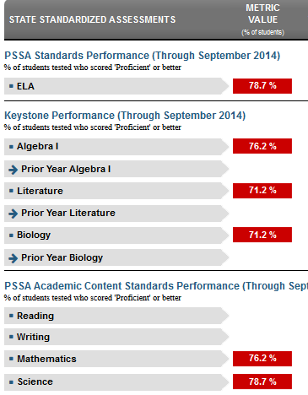
Academic Dashboard: State Assessments Tab
State Assessments show results for:
Performance on PSSA standards
Keystone performance
PSSA Academic Content Standards performance
Content Area results for each of these assessments
Notes:
State Assessments show results for:
Performance on PSSA standards
Keystone performance (for high school staff)
PSSA Academic Content Standards performance
Content Area results for each of these assessments

Slide 41
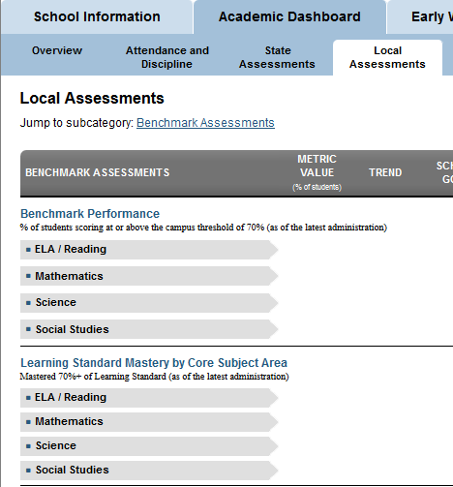
Academic Dashboard: Local Assessments Tab
Local assessments show results for:
Benchmark performance
Content area results
Learning Standard Mastery by Core Subject Area
Notes:
Local assessments show results for:
Benchmark performance
Content area results
Learning Standard Mastery by Core Subject Area

Slide 42
Academic Dashboard – Grades and Credits
Notes:
Now let’s look at the Course Grades and credits tab.

Slide 43
Academic Dashboard: Grades and Credits Tab I
Categories displayed are: Grades Below C Level, Repeat Courses, Failing Class Grades and Algebra 1
For each category, % of students in that category is displayed
Notes:
This screen shot only shows a portion of the Grades and Credits screen – the rest will be shown on the next slide
Categories displayed are: Grades Below C Level, Repeat Courses, Failing Class Grades and Algebra 1
For each category, % of students in that category is displayed – remember this is aggregated data

Slide 44
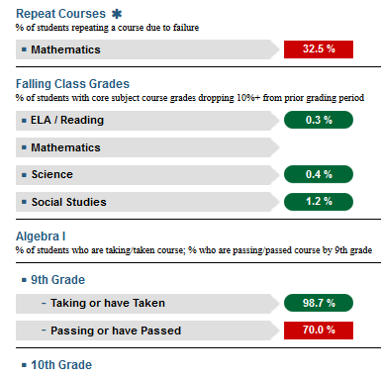
Academic Dashboard: Grades and Credits II
Repeat Courses shows % of students repeating a course due to a prior course failure
Falling Class Grades shows the % of students with core subject course grades dropping 10%+ from prior grading period.
Algebra I, by grade level shows the % of students taking/taken course, and % passing/passed the course
Notes:
Repeat Courses shows % of students repeating a course due to a prior course failure
Falling Class Grades shows the % of students with core subject course grades dropping 10%+ from prior grading period.
Algebra I, by grade level shows the % of students taking/taken course, and % passing/passed the course

Slide 45
Academic Dashboard – Advanced Academics
Notes:
we will look at the Advanced academics dashboard next

Slide 46
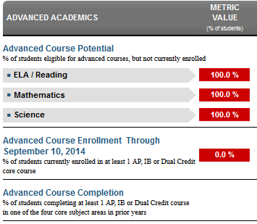
Academic Dashboard: Advanced Academics Tab
Advanced academics displays:
State standardized assessment results
% students with advanced course potential
Advanced course enrollment rate
Advanced course completion rate
Notes:
Advanced academics tab displays:
State standardized test results (not shown in this screenshot)
% students with advanced course potential
Advanced course enrollment rate
Advanced course completion rate

Slide 47
Academic Dashboard- College and Career Readiness
Notes:
The college and career readiness tab is the final sub-tab under the academic dashboard

Slide 48
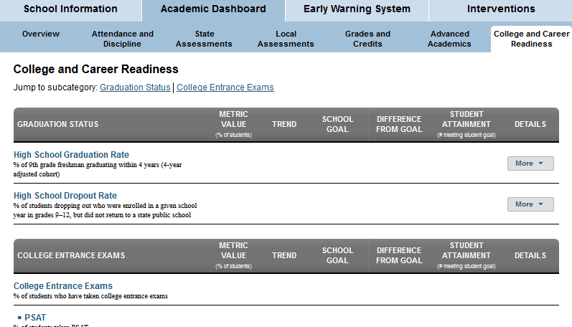
College and Career Readiness Tab: Overview
College and Career Readiness shows graduation status and an overview of college entrance exam results
College entrance exams displayed include: PSAT, SAT, ACT
Notes:
College and Career Readiness shows graduation status and an overview of college entrance exam results
Results from PSAT, SAT and ACT are displayed if available
For graduation status categories you can click on the More button to see a historical chart
Under the College Entrance exams categories the More button displays a historical chart and a student list for accessing individual student results
This brings us the end of the sub-tabs under the academic dashboard tab for the school level metrics

Slide 49
Guided Practice Activity #2
What are the areas reported on within the Academic Dashboard?
What are the Attendance Metrics?
What does the Failing Class Grades Metric measure? Give an example.
Choose one of your classes and dig deeper into one metric for attendance, discipline or grades. What did you discover that surprised you or made you want to learn more? Explain.
Notes:
What are the areas reported on within the Academic Dashboard?
What are the Attendance Metrics?
What does the Failing Class Grades Metric measure? Give an example.
Choose one of your classes and dig deeper into one metric for attendance, discipline or grades/credits. What did you discover that surprised you or made you want to learn more? Explain.

Slide 50
Early Warning System
Notes:
Next is The School Level Early Warning System tab

Slide 51
Early Warning System Tab
Early Warning System modules:
Failing Summary
Percent Failing
Percent Caution
Notes:
The Early Warning System (EWS) has three modules, Failing Summary, Percent Failing and Percent Caution.
First we will look at Percent Failing.

Slide 52
Early Warning System: Failing Summary
EWS Failing Summary shows the % of students failing 1 or more Early Warning Indicators
Notes:
Here is the Failing Summary section of the EWS tab
As with prior pages we have looked at, For each Metric the page shows; Metric Value, Trend (is the value increasing or decreasing over time), School Goal, Difference from Goal (+/-), Student Attainment (# meeting goal out of total student population). For each metric, users can drill down by using the More Icon
Trainer Notes: Review the early warning indicators. You could pose training questions such as "who can tell me the early warning indicators that are used in the dashboards? “ A prompt might be...."Remember the ABC's" What does that mean? (Attendance, Behavior, Current Course Grades)
What are the thresholds for:
Percent failing 1 or more indicators? (20.0%)
Percent failing 2 or more indicators (15.0%)

Slide 53
Early Warning System: Percent Failing
Attendance: % failing Daily Attendance Rate
Behavior: % failing – State Reportable Offenses and % failing School Code of Conduct Incidents
Current Course Grades: % failing Language arts and % failing mathematics
Notes:
There are 5 metrics for Percentage Failing:
Attendance (to date), % failing the Daily Attendance Rate
Behavior (to date), % failing – State Reportable Offenses and % failing the School Code of Conduct Incidents
Current Course Grades (through 6 weeks) % failing Language arts and % failing mathematics.
Which has the higher metric value, % failing language arts or % failing Mathematics?
Who can explain what the metric value for that course means? (School Goal, Difference from school goal, Student attainment)
Trainer Notes:
Ask “What are the thresholds for:”
Percent failing Daily attendance Rate? (100.%)
Percent failing Mathematics? (100%)

Slide 54
Early Warning System: Percent Caution
Attendance: (to date), % failing the Daily Attendance Rate
Behavior: % approaching failing School Code of Conduct Incidents
Current Course Grades: % approaching failing Language arts and % approaching failing mathematics
Notes:
There are 4 metrics for Percentage Caution:
Attendance (to date), % failing the Daily Attendance Rate
Behavior (to date), % failing – State Reportable Offenses and % failing the School Code of Conduct Incidents
Current Course Grades (through 6 weeks) % approaching failing Language arts and % failing mathematics.

Slide 55
Guided Practice Activity #3
Form groups of three.
Each person choose one of the following: Failing Summary, Percent Failing, Percent Caution.
Take 3 minutes to explore, then discuss how you would use the three areas together to address your school’s needs.
Be prepared to share your discussion points with the group.
Notes:
Form groups of three. Each person choose one of the following, Failing Summary, Percent Failing, Percent Caution.
Take a few minutes to explore, then discuss how you would use the three areas together to address your school’s needs.
Be prepared to share your discussion points with the group.

Slide 56
Intervention Catalog
Notes:
Let’s explore the Intervention Catalog for a school administrator.

Slide 57
Interventions Tab: Intervention List
The Intervention List shows interventions available to be assigned to students
Only the Intervention Catalog Coordinator and Dashboard Administrator have rights to add/delete/edit Interventions in the Intervention Catalog
Notes:
The Intervention List shows all interventions that are available to be assigned to students. It is important to note that only the Intervention Catalog Coordinator and Dashboard Administrator have rights to Add Interventions to the IC.
Each intervention listed includes; the Contact person assigned to the intervention,
The Population eligible for the intervention (Gen Ed, SpEd, 504, ELL, etc.),
Location (school- can be multiple or referral)
and the Intervention Level (1, 2, or 3).

Slide 58
Intervention List: More Button
More Button provides access to:
Intervention Details
Intervention reviews
Assign a watch list to this intervention
Students assigned to this intervention
Notes:
By clicking on the More button, a dropdown list appears
Intervention details and reviews can be accessed
Students assigned to this intervention can be viewed

Slide 59
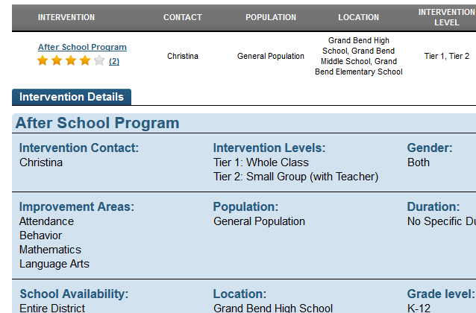
Viewing Intervention Details
Click on the intervention name to view Intervention Details
Notes:
For each intervention, details include:
Name, Contact, Levels, Gender, Area, Population, Duration, School, Location, Grade Level, Eligibility, Cost, Parent Permission, Description

Slide 60
Interventions Tab: Search Interventions
Note the available search criteria
Notes:
This screen shows the layout of the search interventions page. Users can search for interventions using the following criteria:
Keyword
Eligibility Requirements
Cost
Parent Permission Required
School Availability
Location
Population
Improvement Area
Grade Level
Intervention Level
Gender-Specific

Slide 61
Intervention Search Results
After a user enters search criteria and selects Search, the Search Results will populate below
Notes:
After a user enters search criteria and selects Search, the Search Results will populate below.

Slide 62
View Interventions: Student List I
To view the students that have been assigned an intervention:
Click on More to view the dropdown menu
Select Student List
Notes:
To view the students that have been assigned an intervention, click on More to view the dropdown menu. Select Student List.

Slide 63
View Interventions: Student List II
The Assigned Students list displays all students who have been assigned this intervention
To view an individual student, click on the student’s name
Notes:
The Assigned Students list displays all students who have been assigned this intervention. Students are listed alphabetically. To view an individual student, click on the student’s name. The student’s profile page will display.

Slide 64
Guided Practice Activity #4
From the Intervention List, select an intervention and find the following: contact, levels, population, location and eligibility
List 7 search categories you can use to search for specific interventions
Describe the steps you would take to view a list of the students in your school assigned to a specific intervention.
From the Intervention Student Assigned List, how would you choose one student and view their information?
Notes:
From the Intervention List, select an intervention and find the following: contact, levels, population, location and eligibility
List 7 search categories you can use to search for specific interventions
Describe the steps you would take to view a list of the students in your school assigned to a specific intervention.
From the Intervention Student Assigned List, how would you choose one student and view their information?

Slide 65
Accessing an Individual Student Profile
Notes:
We have completed our tour of the school level dashboards that are available to a school administrator. Remember the school level dashboards provide aggregated, summary data on the metrics that apply to the school as a whole.
In addition to having access to school level data, a School administrator also has access to data on each student on the school’s roster
In the next section we will investigate the data that can be accessed by a school administrator about an individual student.

Slide 66
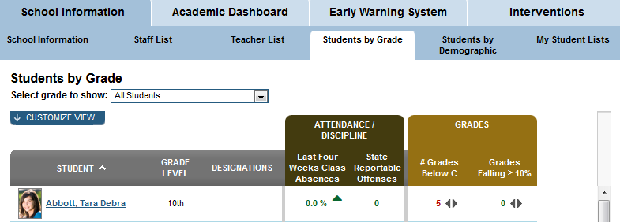
Navigate to an Individual Student Profile
Navigate to an individual student by clicking on a student name from one of the available student lists
Notes:
Navigate to an individual student by clicking on a student name from any of the following sub-tabs under the School Information tab: students by grade, student by demographic or my student lists

Slide 67
Individual Student Profile: Tabs Available
Clicking on a student name on the Staff Homepage displays individual student profile information about the chosen student
The Early Warning System tab is the default tab for Student Profile
Other tabs are: Student Information, Academic Dashboard, Intervention Catalog, Transcript
Notes:
Clicking on a student name on the Staff Homepage displays individual student profile information about the chosen student
The Early Warning System tab is the default tab for Student Profile
Other tabs are: Student Information, Academic Dashboard, Intervention Catalog, Transcript

Slide 68
Student Profile: Early Warning System
Notes:
now we will look at the data that is available on the early warning system tab of an individual Student Profile

Slide 69
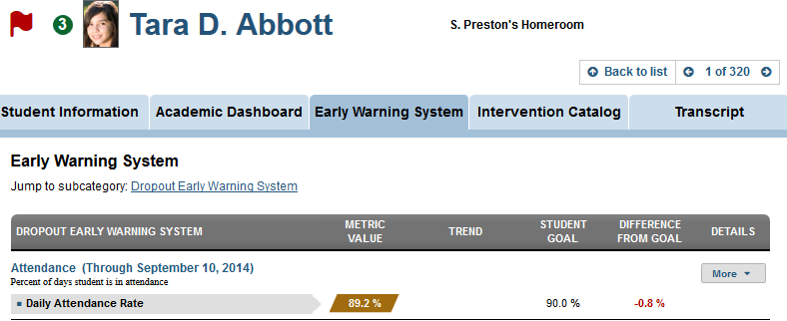
Student Early Warning System Flag and Metrics
Students identified as likely to dropout have a red flag
Number in green circle indicates interventions assigned
Metric value, trend, Student goal, Difference from goal, and Details are displayed
Notes:
Students identified as likely to dropout have a red flag next to their name.
The number in the green circle next to the student’s name indicates the number of interventions assigned to this student
The Dropout Early Warning System metrics for Attendance, Behavior, and Current Course Grades are displayed.
The current value for each metric is color coded Green, yellow, red with the current value followed by a trending indicator, the assigned student goal, this student’s current difference from goal value and a link to see more detail for each metric using the More button.

Slide 70
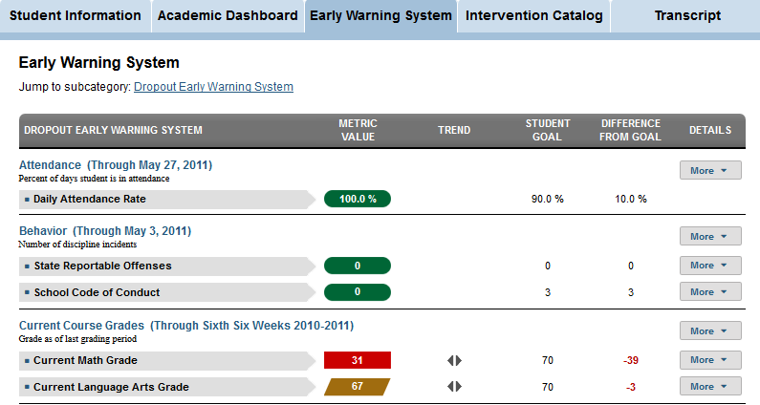
Student Profile: Early Warning System Tab
Information available under the EWS tab includes: Attendance, Behavior, Current course grades
To get further details about each metric click on the More button
Notes:
Information available under the EWS tab includes important EWS metrics: Attendance, Behavior, Current course grades
Note the More button to the far right for each metric allows you to drill into more detailed information about each metric for this student.

Slide 71
Student Profile: Student Information
Notes:
So we’ve looked at the early warning system tab of the student profile. In this next section we will look at the student information tab of the student profile

Slide 72
Student Profile: Student Information Overview
Interventions assigned to this student appear in the green circle next to the student picture
The red flag indicates this student is a dropout risk
Student’s homeroom teacher is indicated
Click on the Student Information tab to be shown student overview information
Notes:
first we will look at the Student Information overview
Again, Interventions assigned to this student appear in the green circle next to the student picture
And The red flag indicates this student is a dropout risk
Student’s homeroom teacher is indicated
Click on the Student Information tab to be shown student overview information

Slide 73
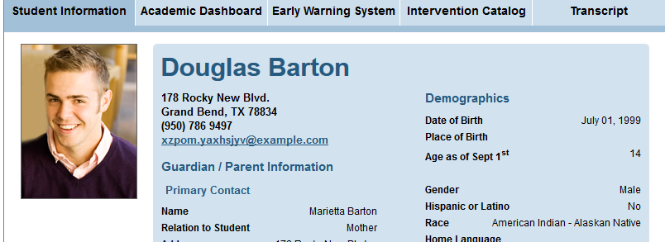
Student Profile: Student Information Tab
Address, parent contact and demographic information is displayed
Notes:
This is a partial screenshot of the student overview information.
Information displayed on this screen consists of address, parent contact info, and demographic info

Slide 74
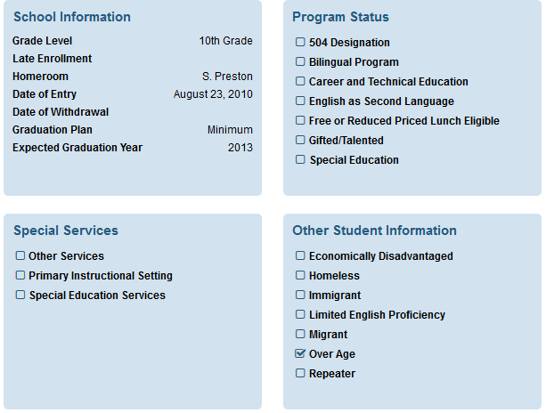
Student Profile: Additional Student Information
Additional student information displayed includes:
School information
Program status
Special services
Other student information
Notes:
The rest of the page looks like this - This is also part of the student information screen.
School information for the current school year, program participation, special services received and other relevant information is displayed on the Student Information dashboard.

Slide 75
Student Profile: Academic Dashboard
Notes:
We will investigate the Academic Dashboard tab now and look at the 7 different sub-tabs under the Academic dashboard tab

Slide 76
Academic Dashboard: Student Profile
The 7 tabs under Academic Dashboard include: Overview, Attendance and Discipline, State and Local Assessments, Grade and Credits, Advanced Academics, College and Career Readiness
Open the Overview tab under the Academic Dashboard tab
Notes:
The 7 tabs under Academic Dashboard include: Overview, Attendance and Discipline, State and Local Assessments, Grade and Credits, Advanced Academics, College and Career Readiness
We are going to look at each of these tabs individually
Open the Overview tab under the Academic Dashboard tab

Slide 77
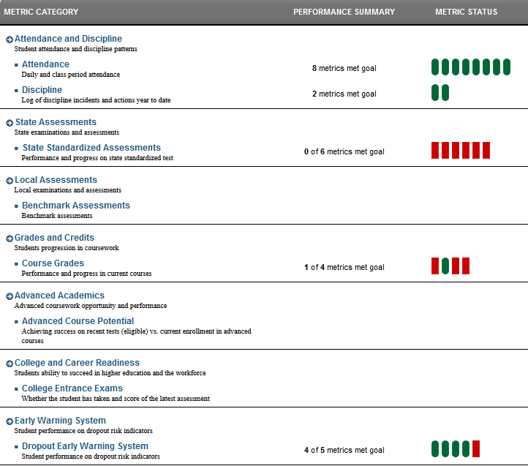
Academic Dashboard: Overview Tab
Overview tab for student displays high level metrics for this student in each of the categories
Performance Summary indicates metrics met against the goal for this student
Notes:
Clicking on The overview tab displays high level information about this student in each of the categories
Performance Summary indicates metrics met against the goal for this student
For example, this student had 8 goals set for attendance and attendance metrics indicates that all 8 goals were met
Now lets look at the Attendance and Discipline tab

Slide 78
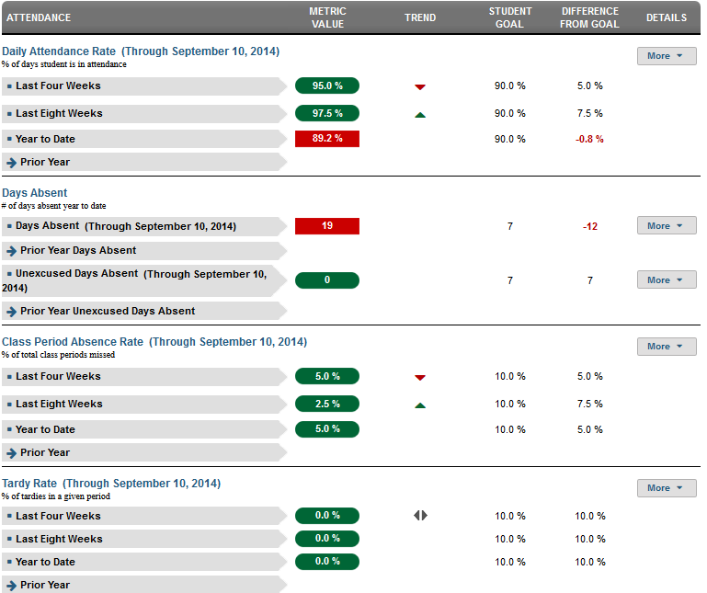
Academic Dashboard: Attendance and Discipline
Attendance metrics categories include: Daily attendance rate, Days absent, Class period absence rate, Tardy rate,
The More button provides additional detail in each of these categories
Notes:
Attendance metrics categories include: Daily attendance rate, Days absent, Class period absence rate, tardy rate,
Additional detail is provided in each of these categories
Where there is a “more” button you can click on it to get more information. We will look at the more button next.

Slide 79
Academic Dashboard: More Button
The More button is available for most metric categories on the Academic Dashboard
This button allows you to drill into more detailed information for the metric
Notes:
“More” button is available for most metric categories on the Academic Dashboard
Just like it did in the early warning system tab, this button allows you to drill into more detailed information for the metric

Slide 80
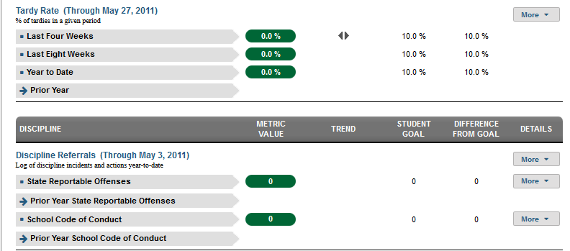
Academic Dashboard: Discipline
Discipline metrics are displayed under the same tab as the attendance metrics
Discipline referrals for state reportable offenses and school code of conduct offenses are displayed
Notes:
Discipline metrics are displayed under the same tab as the attendance metrics
Discipline is located at the bottom of the page
Discipline referrals for current year and prior year state reportable offenses and school code of conduct offenses are displayed
Note the More button is available to drill into more detail

Slide 81
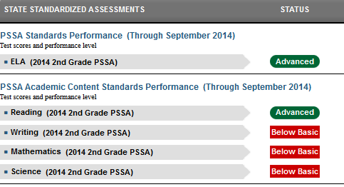
Academic Dashboard: State Assessments Tab
State Assessments tab shows results for:
Performance on PSSA standards
PSSA Academic Content Standards performance
Keystone performance results are shown if applicable
Notes:
State Assessments tab shows applicable results for:
Performance on PSSA core standards
Keystone performance (if applicable – not shown at the middle school level)
PSSA Academic Content Standards performance

Slide 82
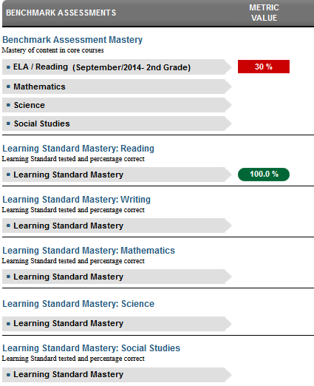
Academic Dashboard: Local Assessments Tab
Local assessments tab shows results for:
Benchmark Assessment Mastery
Learning Standard Mastery for Reading, Writing, Math, Science, Social Studies
Notes:
This is only a partial screen shot but Local assessments tab shows results for:
Benchmark Assessment Mastery
Learning Standard Mastery for Reading , Writing, Math, Science, Social Studies

Slide 83
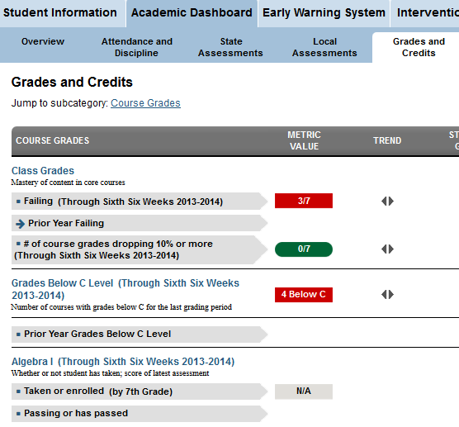
Academic Dashboard: Grades and Credits Tab
Three metrics for grades are displayed:
Class Grades
Grades below C level
Algebra 1
Notes:
Under the grades and credits tab Three metrics for grades for this student are displayed:
Class Grades
Grades below C level
Algebra 1

Slide 84
Student Grades: More button
To see more detail, click on the More button,
You see two options, Current Courses and Historical Chart
Notes:
Like on the attendance tab a user can see more detail by clicking on the More button,
you will see one or two options, Current Courses and Historical Chart,
we will look at Current Courses.

Slide 85
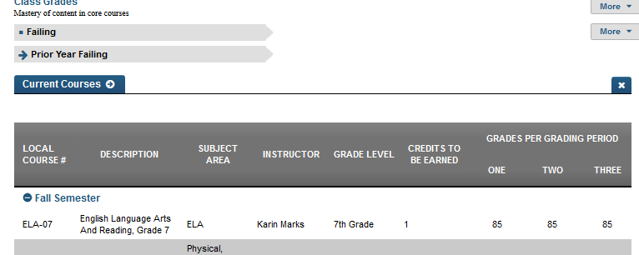
Student Grades: Current Courses
The page displays all the students current courses with Course#, Description, Subject, Instructor, Grade Level, Credits to be Earned, and Grades Per Grading Period
Notes:
From the Current Courses link under the More button the student’s Current courses can be accessed.
The page displays all the students current courses with:
Course#, Description, Subject
Instructor, Grade Level, Credits to be Earned, and Grades Per Grading Period (one, two, three)
As this student’s homeroom teacher, how would you use this information?

Slide 86
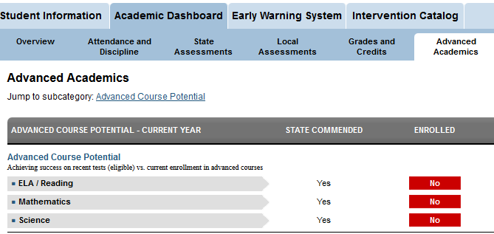
Academic Dashboard: Advanced Academics Tab
Advanced Academics tab displays advanced course potential for a student
Notes:
Advanced Academics tab displays advanced course potential for this student based on performance on various assessments.
In the sample page the student has reached the state commended level for advanced course potential but this student has not enrolled in any advanced courses.

Slide 87
College and Career Readiness Tab
College and Career Readiness tab displays information for this student on college entrance exams taken including, if available, results on:
PSAT
SAT
ACT
Notes:
For high school staff members CCR displays information on college entrance exams taken including, PSAT, SAT, ACT
This concludes our tour of the academic dashboard sub-tabs

Slide 88
Student Profile: Intervention Catalog
Notes:
We will investigate the intervention catalog as a staff member would see it while they are looking at an individual student profile

Slide 89
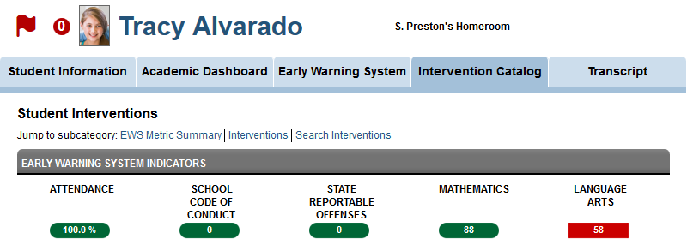
Assigning Interventions
This student has an Early Warning Flag and has 0 interventions assigned
Note the Early warning system indicators
Notes:
We are viewing the intervention catalog for this student. Student Tracy Alvarado has an Early Warning Flag and has 0 interventions assigned. While she has been flagged as at risk, no interventions have been assigned to her yet. This is a case that calls for action to be taken.

Slide 90
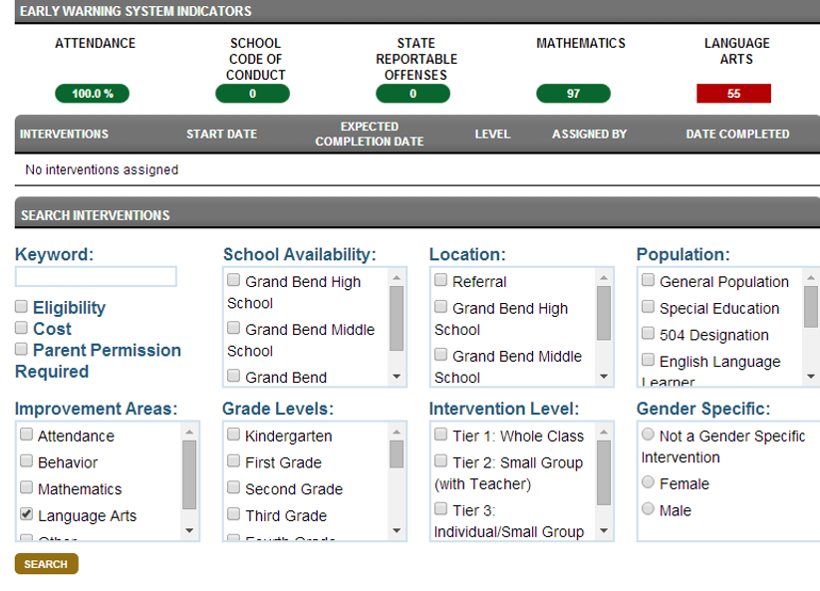
Search Parameters for Interventions
Users can search for appropriate interventions using the search parameters
Notes:
In order to narrow the list of interventions, users can search for interventions:
Keyword
School Availability
Population
Improvement Area
Grade Level
Intervention Level
Gender Specificity

Slide 91
Searching for an Appropriate Intervention
This student is flagged at risk for Language Arts
Select Language Arts under the Improvement Areas selection criteria
Click search to return results
Notes:
This student is flagged at risk for the Language Arts Indicator. Let’s select Language Arts under the Improvement Areas selection criteria.

Slide 92
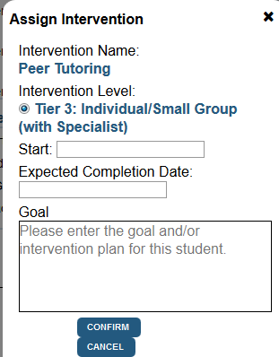
Selecting the Intervention
Select the desired Intervention from the Intervention Search Results
Click Assign Intervention
The Assign Intervention dialog box will pop up
Type the start date, expected completion date and goal in the space provided
Click Confirm
Notes:
Select the desired Intervention from the Intervention. Click Assign Intervention. The Assign Intervention dialog box will pop up. Type the start date, expected completion date and the goal for this intervention in the space provided. Click Confirm.

Slide 93
Confirming the Student’s Assigned Interventions
Note the green circle next to Tracy’s picture with 1 intervention assigned
This green circle reflects the total number of Interventions assigned to the student that have not yet been completed
Notes:
Note the green circle next to Tracy’s picture with 1 intervention assigned. This green circle reflects the total number of Interventions assigned to the student that have not yet been completed.

Slide 94
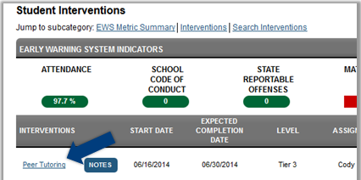
Reviewing the Student’s Assigned Interventions
The Intervention is now posted on the Student Interventions page
Start date, Expected Completion Date, Level, Assigned By and Date Completed are also posted
Notes:
The Intervention is now posted on the Student Intervention page
Start date, Expected Completion Date, Level, Assigned By and Date Completed are also posted
.

Slide 95
Guided Practice Activity Student Information #5
Select a student from your first class and List 3 things you learn about their Guardian/Parent.
Is this student participating in any programs or receiving Special Services?
Choose 2 of your students to examine. What patterns of attendance do you find?
Which of your students has the most absences year to date?
What is the value for the School Code of Conduct Goal for this student?
Explore the Academic Dashboard tabs of one of your students. List 5 things you learned about that student
Notes:
Select a student from your first class and List 3 things you learn about their Guardian/Parent.
Is this student participating in any programs or receiving Special Services?
Choose 2 of your students to examine. What patterns of attendance do you find?
Which of your students has the most absences year to date?
What is the value for the School Code of Conduct Goal for this student?
Explore the Academic Dashboard tabs of one of your students. List 5 things you learned about that student
Trainer’s note: When you demonstrate to any participants, you should always use the demo site with the anonymized data set. However, participants should log into their actual real production site whenever possible during training. The real data found in their production site is much more compelling to an educator than is an anonymized data set. As a note, you will need to monitor the participants closely as they will tend to get absorbed in the data they see. Keep participants on track by asking questions such as the following:
Did you identify the 1st and last student?
Did you find students with grades below C?
Did you find students who are trending down?
Did you find students who are trending up?

Slide 96
Student Profile: Student Transcript
Notes:
The last tab on the student profile dashboard is the student transcript tab

Slide 97
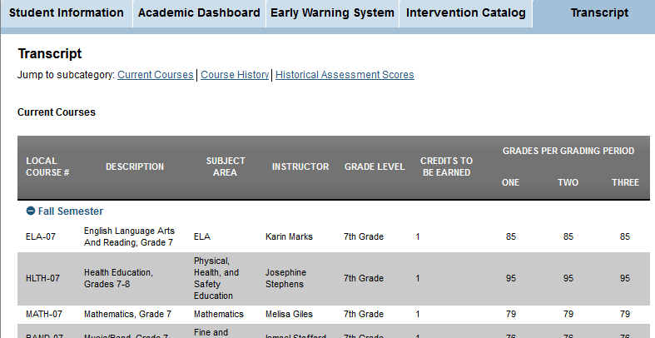
Student Transcript: View Transcript
Information about current courses is displayed
Course history and historical assessment scores are available from the “jump to” list
Notes:
Information about current courses is displayed
Information includes course number, course description, subject area, instructor, grade level, credits to be earned, and grades for each grading period
Course history and historical assessment scores are available from the “jump to” list

Slide 98
Wrap Up
Wrap Up
Describe the purpose of each tab on the PDE Educator Dashboard: School Information, Academic Dashboard, Early Warning System and Interventions
As a school administrator, what are some ways you might use the tabs under the Academic Dashboard to support your students and staff?
List 2 examples of types of indicators available on each tab of the PDE Educator Dashboard for administrators: School Information, Academic Dashboard, Early Warning System, and Interventions
Notes:
Wrap Up
Describe the purpose of each tab on the PDE Educator Dashboard: School Information, Academic Dashboard, Early Warning System and Interventions
As a school administrator, what are some ways you might use the tabs under the Academic Dashboard to support your students and staff?
List 2 examples of types of indicators available on each tab of the PDE Educator Dashboard for administrators: School Information, Academic Dashboard, Early Warning System, and Interventions

Slide 99
Assessment
Assessment
Take a moment and answer the questions on the brief assessment
Assessment
Notes:
Please take a moment and respond to the brief assessment questions. Your instructor will provide instructions on accessing the assessment.

Slide 100
Evaluation
Evaluation
Take a moment and answer the questions on the brief evaluation survey
Evaluation
Notes:
Please take a moment and complete the evaluation survey. Your instructor will provide instructions on accessing the survey.

Slide 101
For more information on Administrator Navigation of the Educator Dashboard please visit PDE’s website at www.education.state.pa.us
The mission of the department is to academically prepare children and adults to succeed as productive citizens. The department seeks to ensure that the technical support, resources and opportunities are in place for all students, whether children or adults, to receive a high quality education.
Notes:
Thank you for completing Course 4B Administrator Navigation.

