Slide 1
Course 4A: Staff Navigation
Document #C4A.2
Notes:
Welcome to Course 4A: Staff Navigation for the PDE Educator Dashboard and Early Warning System

Slide 2
Agenda
Review steps that enable staff to access the application
Review navigation in the Pennsylvania Department of Education (PDE) Educator Dashboard.
Review the indicators and metrics available to staff in the PDE Educator Dashboard
Notes:
Today we will explore Navigation of the dashboards from the perspective of a staff member including; Homepage, Academic Dashboard, Early Warning System, Intervention Catalog and Student Information

Slide 3
Course Pre-Requisites
Participants must have:
An account to the Pennsylvania Department of Education (PDE) Portal
An account to the Pennsylvania Educator Dashboard
An active account for the Standards Aligned Systems training platform (http:www.pdesas.org/)
Participants must have completed:
Course 1: PDE Educator Dashboard Overview
Course 2: Early Warning System and At Risk Identification
Course 3: Family Educational Rights and Privacy Act for the Local Education Agency (LEA)
Notes:
Prior to taking this course, participants must have: An account to the Pennsylvania Educator Dashboard a Standards Aligned Systems account, and completed courses one, two and three.

Slide 4
Course Learning Objectives
Participants will be able to:
Login in as a staff member to the PDE Educator Dashboard
Successfully navigate through the PDE Educator Dashboard for Staff: School and Student Information, Academic Information, Early Warning System, and Intervention Catalog
Describe the purpose of each of the tabs available on the PDE Educator Dashboard for Staff
List 2 examples of types of indicators available on each of the tabs of the PDE Educator Dashboard for Staff
Notes:
At the end of this workshop participants will be able to:
Login in as a staff member to the PDE Educator Dashboard
Successfully navigate through the PDE Educator Dashboard for Staff: School and Student Information, Academic Information, Early Warning System, and Intervention Catalog
Describe the purpose of each of the tabs available on the PDE Educator Dashboard for Staff
List 2 examples of types of indicators available on each of the tabs of the PDE Educator Dashboard for Staff

Slide 5
Security/Roles: Purpose
Security/Roles
The Educator Dashboard and Early Warning System (EWS) have security restrictions to control the level of access for each school and district staff member.
Educators have access only to students in whom they have a direct instructional interest
Teachers only have access to data on his/her students
Principals only have access to data on students enrolled at his/her school
Notes:
In order to protect student’s and staff’s privacy and security, The Educator Dashboard and EWS have security restrictions to control the level of access for each school and district staff member.

Slide 6
Dashboard Roles
Notes:
Dashboard security extends to the Intervention Catalog. Specifically, only certain staff members with specific roles are able to assign students to intervention or manage the intervention catalog

Slide 7
Accessing the Log In Screen
Visit: http://www.education.state.pa.us
Notes:
To log in to the dashboard for your district, visit http://www.education.state.pa.us. Click Log In if you are already registered with the portal. If you are not registered, please click on “Register” to create a new account.

Slide 8
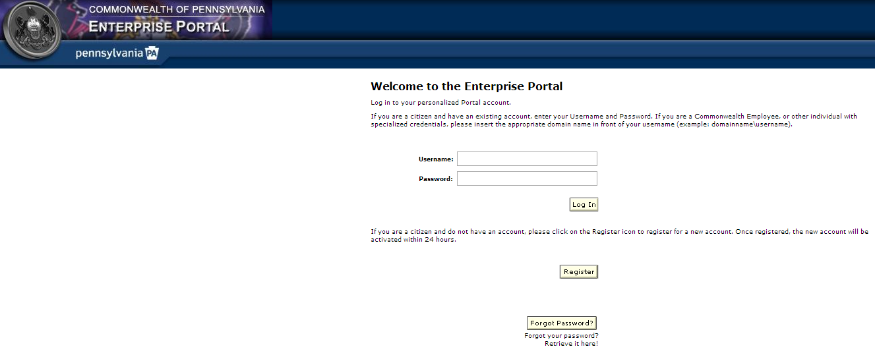
Logging in to the Enterprise Portal
Enter username and password
Notes:
Enter your username and password.

Slide 9
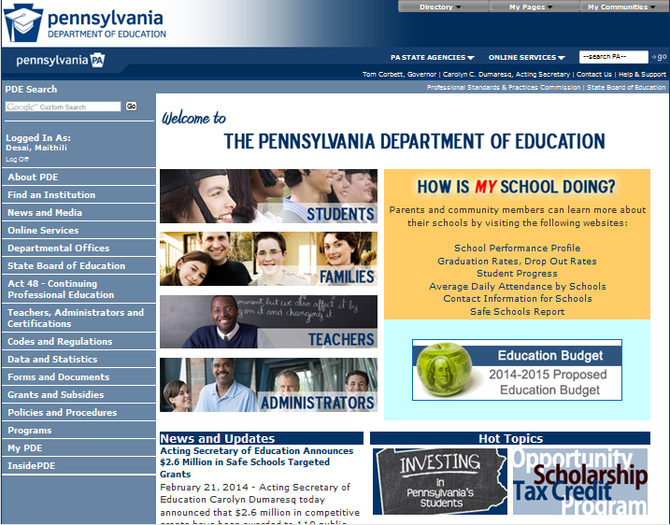
Accessing My PDE
Click on My PDE
Notes:
Click My PDE on the Left Blue Pane to access the applications that you are authorized to view.

Slide 10
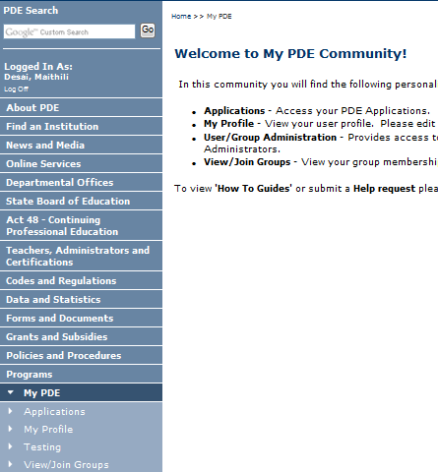
Accessing Test Environment
Click on Testing, if you have NOT moved your Dashboard data to Production
Notes:
Click on Testing, if you have NOT moved your Dashboard data to Production.

Slide 11
Accessing Production Environment
Click on Dashboard under Insider PDE, if you have moved your Dashboard data to Production
Notes:
Click on Dashboard under Insider PDE, if you have moved your Dashboard data to Production

Slide 12
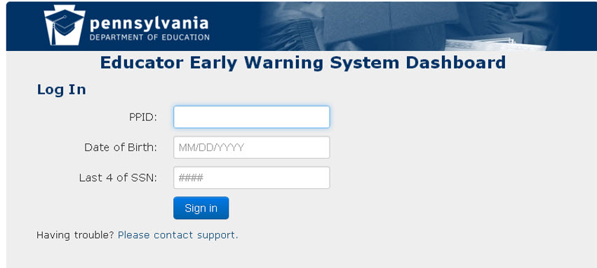
Logging Into the Educator Dashboard
Enter your PPID, DOB and the last four digits of your SSN
Notes:
Under Applications, select “Dashboard”. If this is your first time logging in, you will need to enter your PPID, Date of Birth, and the last four digits of your SSN.

Slide 13
Educator Dashboard Layout
Notes:
We are going to navigate through the PA educator dashboard system as if we were a staff member at a school.

Slide 14
Dashboard Layout: Header
A header is displayed at the top of each dashboard screen.
Across the top is displayed the name of the dashboard being displayed and links to Export All, Print, access the support page, or log out.
Notice the links back to the home page for this user, an inactive link to the district level data and a link to the school level summative data (role driven)
Notes:
This is the header that is displayed at the top of every dashboard screen.
Across the top you see the district name
Across the top, next to the dashboard title, are links to: Export All, Print, Support, log out
In the gray bar notice the link back to the home page for this user (the little schoolhouse), an inactive link to the district level data (due to role driven security) and a link to the school level summative data (role driven)
On most of the subsequent slides we will not be showing the dashboard header but when you log into the system you will always see the header at the top of each dashboard.

Slide 15
Dashboard Layout: Legend
At the bottom of each dashboard screen is a legend
The different indicators used throughout the dashboard are defined in the legend
Notes:
Each dashboard has this same legend at the bottom.
Go though some examples of indicators and their definitions – red indicators generally indicate something negative
On the subsequent slides we will not be showing the legend but it appears at the bottom of all dashboards.

Slide 16
School Level and Student Level Dashboards
Educators can view both school level aggregate data and individual student data for those students in whom they have an educational interest
Many of the metric categories are the same between school level and student level dashboards
The difference is in the granularity of the data
Notes:
Educators can view both school level aggregate data and individual student data for those student in whom they have an educational interest
Many of the metric categories are the same between school level and student level dashboards
The difference is in the granularity of the data
We will be looking at student level dashboard first

Slide 17
Staff Homepage
Notes:
First, let’s examine a staff member’s homepage and the individual student level data that a staff member can view.

Slide 18
Staff Homepage: Student List
Staff homepage consists of the Staff member’s Student List
Educator’s can access their students and choose the type of data view
Notes:
When a staff member successfully logs in, the screen shown here is displayed.
Under the teacher’s name locate the Student List; the default view is Subject/Grade/Section
From this screen the type of data view can be chosen from a drop down menu – we will show this in more detail on a later slide

Slide 19
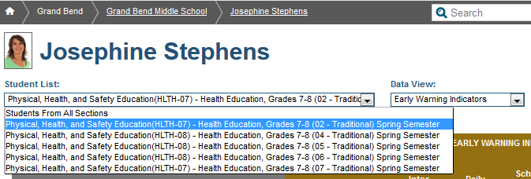
Staff Homepage: Student List Dropdown
Choose the class you want to view from the Student List Dropdown
Student List default view is Subject/Grade/Section
Notes:
Choose the class you want to view from the Student List Dropdown
Student List default view is Subject/Grade/Section

Slide 20
Staff Homepage: Student List Selection
The Student List Menu shows the course and sections for the staff member
The menu also shows the Watch Lists created by the staff member
Notes:
The Student List Menu shows the course and sections for the staff member. The menu also shows the Watch Lists created by the staff member. Watch list creation will be covered at a later time.

Slide 21
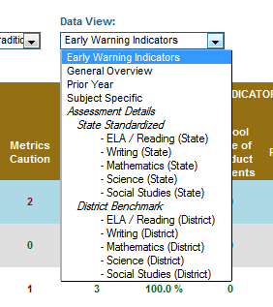
Staff Homepage: Data View Dropdown
Choose a Data view from the Dropdown
Default view is Early Warning Indicators
Selected list can be filtered by: Prior Year, Subject Specific, Assessment Details
Notes:
Choose a Data view from the Dropdown
The Default view is Early Warning Indicators
Possible choices include: Early Warning Indicators, General Overview, Prior Year, Subject Specific, Assessment Details

Slide 22
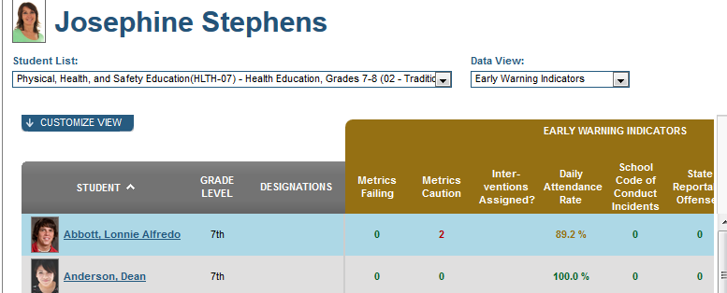
Staff Homepage: Student List Metrics
Students in the chosen class are listed with metrics from the chosen data view
Student lists are sorted by class/section#, alphabetical by student last name, grade level, attendance and discipline and grades
Notes:
Students in the chosen class are listed with information from the chosen data view (in this example the chosen data view is early warning indicators)
Student lists are sorted by class/section#, alphabetical by student last name, grade level, attendance and discipline and grades

Slide 23
Student List
Notes:
Now let’s look at the student list dashboard

Slide 24
Student List: Default View
Default view consists of Grade level, Designations, and Early Warning Indicators
Early Warning indicators displayed consist of: Metrics Failing, Metrics Caution, Interventions Assigned, Daily Attendance Rate, School Code of Conduct Incidents, State Reportable Offenses, Math Grade, Language Arts Grade
Customize View button allows you to customize the columns displayed
Notes:
The Default view consists of Grade level, Designations, and Early Warning Indicators
Early Warning indicators consists of: Metrics Failing, Metrics Caution, Interventions Assigned, Daily Attendance Rate, School Code of Conduct Incidents, State Reportable Offenses, Math Grade, Language Arts Grade
Customize View button allows you to customize the columns displayed

Slide 25
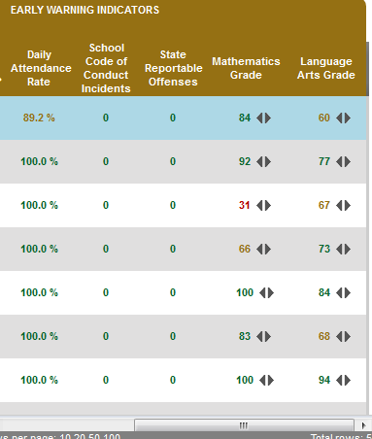
Student List: Viewing all Metrics
A scroll bar across the bottom of the dashboard allows you to view the rest of the metrics
Notes:
Frequently the amount of data available to be shown on the screen is more than there is space available for.
A scroll bar across the bottom of the dashboard allows you to view the rest of the metrics

Slide 26
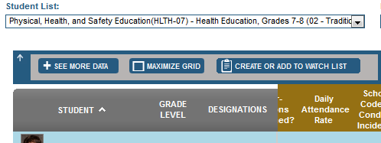
Student List: Customize View
Click on the Customize View button to:
see more data
maximize the grid
create or add students to a watch list
Notes:
Click on the Customize View button, located under the Student List dropdown, above the list of students to:
see more data
maximize the grid
create or add students to a watch list

Slide 27
Student List: Choose Columns for Default View
Click on the See More Data button to choose which columns should appear in the default view
Columns with a check will appear in the default view
Uncheck columns that you do not want to appear in the default view
Click on Save Columns to save default choices or Reset Columns to set columns back to system default
Notes:
You can configure which columns you want to appear in your default view
Click on the See More Data button to choose which columns should appear in your default view
Columns with a check will appear in the default view
Uncheck columns that you do not want to appear in the default view
Click on Save Columns to save default choices or Reset Columns to set columns back to system default

Slide 28
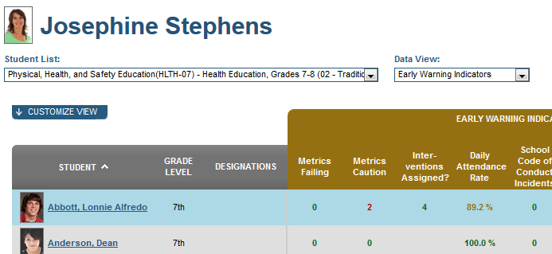
Student List: Access an Individual Student
Navigate to an individual student by clicking on a student name
Notes:
Click on an individual student name to view information about an individual student

Slide 29
Guided Practice Activity - Student List #1
Select one of the classes in your Student List then using the General Overview data view find the following:
# of students enrolled in this section
# of students with Last 4 Weeks Class Absences metric trending downward
# of students with ≥ 3 grades below a C
Using the Early Warning Indicators data view find two students that have an indicator in red
What categories are the red indicators for?
Are there any green indicators for these students?
What categories are they for?
Notes:
Select one of the classes in your Student List then using the General Overview data view find the following:
# of students enrolled in this section
# of students with Last 4 Weeks Class Absences metric trending downward
# of students with ≥ 3 grades below a C
Using the Early Warning Indicators data view find two students that have an indicator in red
What categories are the red indicators for?
Are there any green indicators for these students?
What categories are they for?
Trainer’s note: When you demonstrate to any participants, you should always use the demo site with the anonymized data set. However, participants should log into their actual real production site whenever possible during training. The real data found in their production site is much more compelling to an educator than is an anonymized data set. As a note, you will need to monitor the participants closely as they will tend to get absorbed in the data they see. Keep participants on track by asking questions such as the following:
Did you find students with grades below C?
Did you find students who are trending down?
Did you find students who are trending up?

Slide 30
Student Profile: Early Warning System
Notes:
we’ve have reviewed how to access class lists and navigate to an individual student profile so now we will look at the data that is available on the early warning system tab of an individual Student Profile

Slide 31
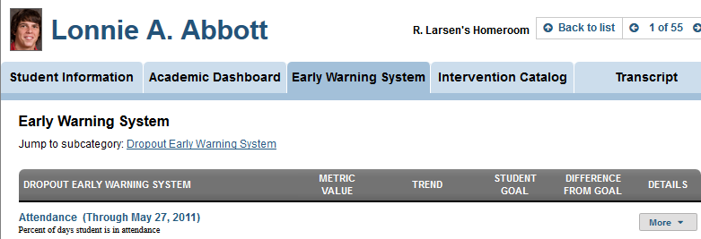
Student Profile: EWS Default Tab
Clicking on a student name on the Staff Homepage displays individual student profile information about the chosen student
The Early Warning System tab is the default tab for Student Profile
Other tabs are: Student Information, Academic Dashboard, Intervention Catalog, Transcript
Notes:
Clicking on a student name in the Student list displays EWS information about the chosen student
EWS tab is the default display for Student Profile
Other tabs are: Student Information, Academic Dashboard, Intervention Catalog, Transcript
We will look at the data that’s available on each of the student profile tabs
Lets start by looking at what’s available under the early warning system tab since this is the default tab for a staff member when they access individual student information

Slide 32
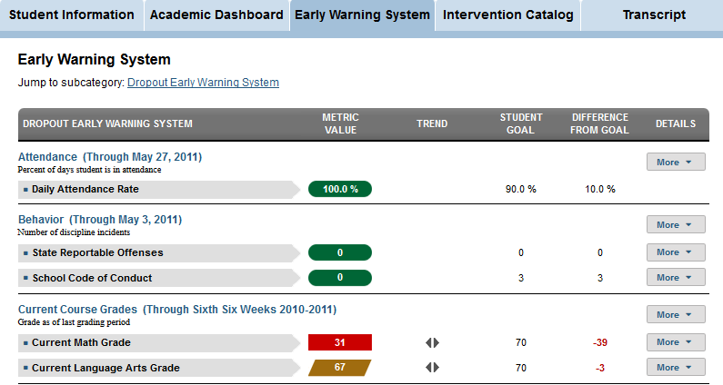
Student Profile: Early Warning System Tab
Information available under the EWS tab includes important EWS metrics: Attendance, Behavior, Current course grades
Notes:
Information available under the EWS tab includes important EWS metrics: Attendance, Behavior, Current course grades
Note the More button to the far right for each metric allows you to drill into more detailed information about each metric for this student. We will investigate the More button more fully in a later slide
Now, Lets look more closely at the EWS metrics for an individual student

Slide 33
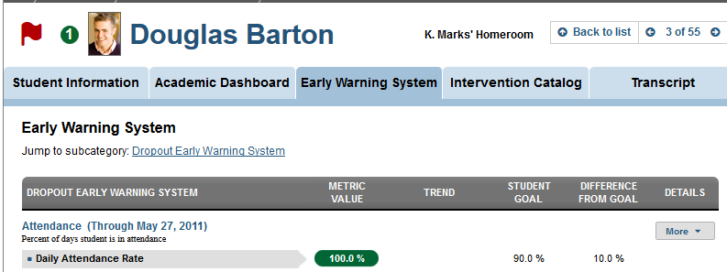
Student Early Warning System Flag and Metrics
Students identified as likely to dropout have a red flag
For the EWS metric category of attendance the daily attendance rate for this student is displayed
The value of the metric, trend, student goal and difference from goal are displayed
Notes:
Students identified as likely to dropout have a red flag next to their name.
The number in the green circle next to the student’s name indicates the number of interventions assigned to this student
The Dropout Early Warning System metrics for Attendance, Behavior, and Current Course Grades are displayed.
For Attendance the metric used for EWS is Daily Attendance Rate.
The current value for each metric is color coded Green, yellow, red with the current value followed by a trending indicator, the assigned student goal, this student’s current difference from goal value and a link to see more detail for each metric using the More button.

Slide 34
Student Early Warning System Metrics
Metrics for behavior and current course grades for this student are also displayed
To get further details about each metric click on the more button
Notes:
The other two categories of data used to identify early warning are behavior and current course grades. For Behavior there are two metrics displayed: State Reportable Offenses and School Code of Conduct incidents.
The third metric for EWS is Current Course Grades as of the last grading period for Math and ELA.
Again, The More button displayed additional data for each metric. Let’s investigate the More button on the EWS screen

Slide 35
Student Early Warning System: More Button
For the attendance metric the More button gives access to a historical rate chart and an attendance rate chart
The More button for the other Early Warning Metrics display relevant information for those metrics
Notes:
Here is an example of the More button for the student early warning system
For the attendance metric the More button gives access to a historical rate chart and an attendance rate chart
The More button for the other Early Warning Metrics displays relevant information for those metrics

Slide 36
Guided Practice Activity EWS Student #2
Do any of your students have a goal for which they are rated “Caution”?
What about a goal for which they are rated “Below Goal”?
What is the “Difference From Goal” value for one of your students? What does this value mean?
How would you find more information about a student’s current Math Grade?
Browse through your student lists and identify two students with red or yellow indicators. What do you learn about them by drilling down using “More”?
Notes:
Do any of your students have a goal for which they are rated “Caution”?
What about a goal for which they are rated “Below Goal”?
What is the “Difference From Goal” value for Current Math Grade?
How would you find more information about Jacob’s current Math Grade?
5. Browse through your student lists and identify students with red or yellow indicators. What do you learn about them by drilling down using “More”?
Trainer’s note: When you demonstrate to any participants, you should always use the demo site with the anonymized data set. However, participants should log into their actual real production site whenever possible during training. The real data found in their production site is much more compelling to an educator than is an anonymized data set. As a note, you will need to monitor the participants closely as they will tend to get absorbed in the data they see. Keep participants on track by asking questions such as the following:
Did you identify the 1st and last student?
Did you find students with grades below C?
Did you find students who are trending down?
Did you find students who are trending up?

Slide 37
Student Profile: Student Information
Notes:
So we’ve looked at the early warning system tab of the student profile. In this next section we will look at the student information tab of the student profile

Slide 38
Student Profile: Student Information Overview
Interventions assigned to this student appear in the green circle next to the student picture
The red flag indicates this student is a dropout risk
Student’s homeroom teacher is indicated
Click on the Student Information tab to be shown student overview information
Notes:
first we will look at the Student Information overview
Interventions assigned to this student appear in the green circle next to the student picture
The red flag indicates this student is a dropout risk
Student’s homeroom teacher is indicated
Click on the Student Information tab to be shown student overview information

Slide 39
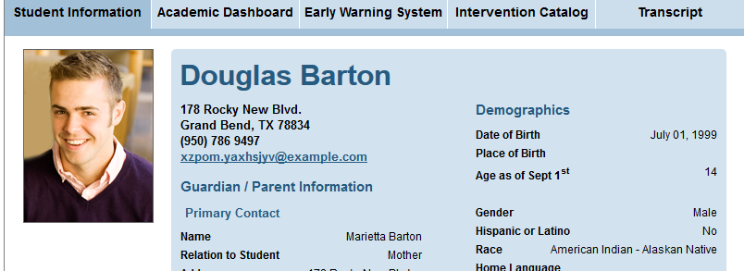
Student Profile: Student Information Tab
Address, parent contact and demographic information is displayed
Notes:
This is a partial screenshot of the student overview information.
Information displayed on this screen consists of address, parent contact info, and demographic info

Slide 40
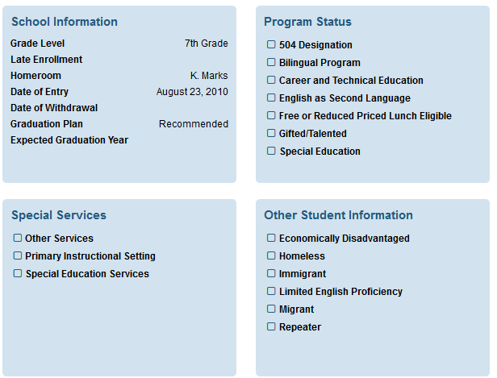
Student Profile: Additional Student Information
Additional student information displayed includes:
School information
Program status
Special services
Other student information
Notes:
The rest of the page looks like this - This is also part of the student information screen.
School information for the current school year, program participation, special services received and other relevant information is displayed on the Student Information dashboard.

Slide 41
Guided Practice Activity Student Information #3
Select a student from your first class and List 5 things you learn about their Guardian/Parent.
Is this student participating in any programs or receiving Special Services?
Find a student with . What does the indicate ?
Do you have students with interventions assigned?
If yes, what is the highest number of interventions?
Is the student with the highest number of interventions receiving any special services?
Notes:
Select a student from your first class and List 5 things you learn about their Guardian/Parent.
Is this student participating in any programs or receiving Special Services?
Find a student with flag . What does the flag indicate ?
Do you have students with interventions assigned?
If yes, what is the highest number of interventions?
Is the student with the highest number of interventions receiving any special services?
Trainer’s note: When you demonstrate to any participants, you should always use the demo site with the anonymized data set. However, participants should log into their actual real production site whenever possible during training. The real data found in their production site is much more compelling to an educator than is an anonymized data set. As a note, you will need to monitor the participants closely as they will tend to get absorbed in the data they see. Keep participants on track by asking questions such as the following:
Did you identify the 1st and last student?
Did you find students with grades below C?
Did you find students who are trending down?
Did you find students who are trending up?

Slide 42
Student Profile Academic Dashboard
Notes:
We will investigate the Academic Dashboard tab now and look at the 7 different sub-tabs under the Academic dashboard tab

Slide 43
Academic Dashboard: Student Profile
From the staff homepage navigate to an individual student
The 7 tabs under Academic Dashboard include: Overview, Attendance and Discipline, State and Local Assessments, Grade and Credits, Advanced Academics, College and Career Readiness
Open the Overview tab under the Academic Dashboard tab
Notes:
From the staff homepage navigate to an individual student
The 7 tabs under Academic Dashboard include: Overview, Attendance and Discipline, State and Local Assessments, Grade and Credits, Advanced Academics, College and Career Readiness
We are going to look at each of these tabs individually
Open the Overview tab under the Academic Dashboard tab

Slide 44
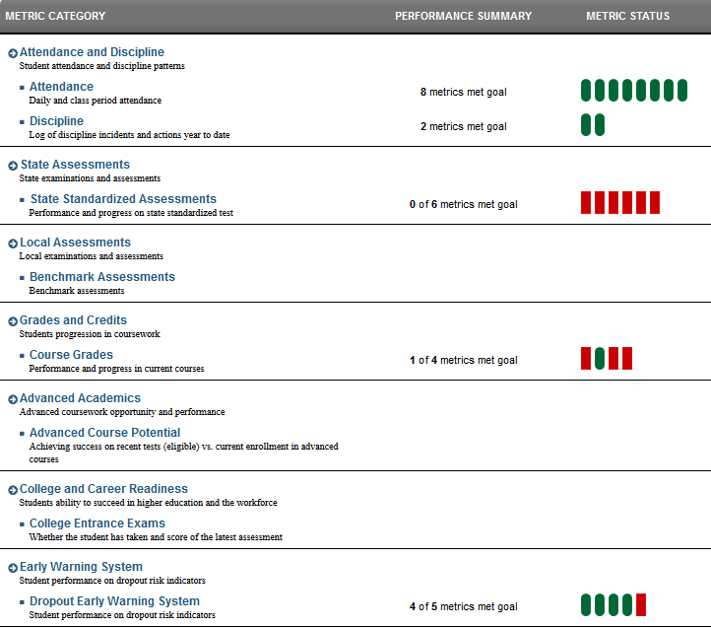
Academic Dashboard: Overview Tab
Overview tab for student displays high level metrics for this student in each of the categories
Performance Summary indicates metrics met against the goal for this student
Notes:
Clicking on The overview tab displays high level information about this student in each of the categories
Performance Summary indicates metrics met against the goal for this student
For example, this student had 8 goals set for attendance and attendance metrics indicates that all 8 goals were met
Now lets look at the Attendance and Discipline tab

Slide 45
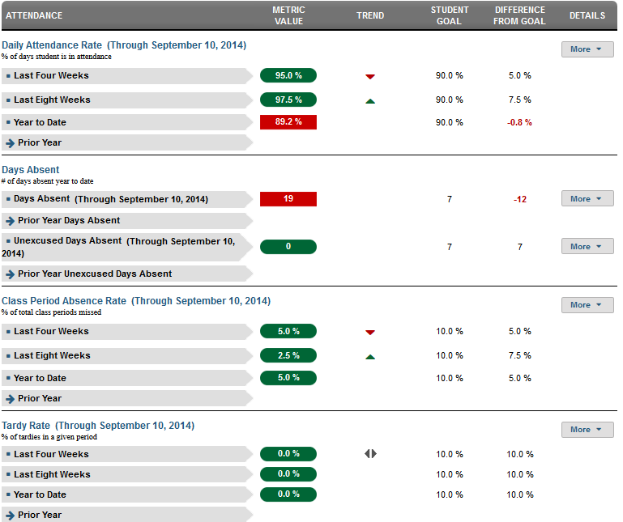
Academic Dashboard: Attendance and Discipline
Attendance metrics categories include: Daily attendance rate, Days absent, Class period absence rate, Tardy rate,
The More button provides additional detail in each of these categories
Notes:
Attendance metrics categories include: Daily attendance rate, Days absent, Class period absence rate, tardy rate,
Additional detail is provided in each of these categories
Where there is a “more” button you can click on it to get more information. We will look at the more button next.

Slide 46
Academic Dashboard: More Button
The More button is available for most metric categories on the Academic Dashboard
This button allows you to drill into more detailed information for the metric
Notes:
“More” button is available for most metric categories on the Academic Dashboard
Just like it did in the early warning system tab, this button allows you to drill into more detailed information for the metric

Slide 47
Guided Practice Activity Student Attendance #4
1) What are three attendance metrics available in the dashboards?
2) If a Metric Value indicator is red, what does that indicate?
3) Choose 2 of your students to examine. What patterns of attendance do you find?
4) Which of your students has the most absences year to date?
Notes:
1) What are the three attendance metrics?
2) If a Metric Value indicator is red, what does that indicate?
3) Choose 2 of your students to examine, what patterns of attendance do you find?
4) Which of your students has the most absences year to date?
Trainer’s note: When you demonstrate to any participants, you should always use the demo site with the anonymized data set. However, participants should log into their actual real production site whenever possible during training. The real data found in their production site is much more compelling to an educator than is an anonymized data set. As a note, you will need to monitor the participants closely as they will tend to get absorbed in the data they see. Keep participants on track by asking questions such as the following:
Did you identify the 1st and last student?
Did you find students with grades below C?
Did you find students who are trending down?
Did you find students who are trending up?

Slide 48
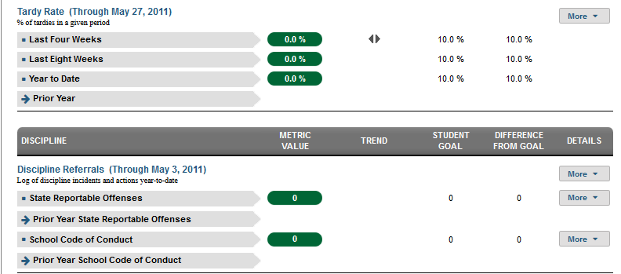
Academic Dashboard: Discipline
Discipline metrics are displayed under the same tab as the attendance metrics
Discipline referrals for state reportable offenses and school code of conduct offenses are displayed
Notes:
Discipline metrics are displayed under the same tab as the attendance metrics
Discipline is located at the bottom of the page
Discipline referrals for current year and prior year state reportable offenses and school code of conduct offenses are displayed
Note the More button is available to drill into more detail

Slide 49
Guided Practice Activity Student Discipline #5
Where on the Attendance and Discipline Page would you find Discipline Referrals?
What does the Metric Value for State Reportable Offenses indicate?
What is value for the School Code of Conduct Goal?
Use the More Button to explore one of your classes, what did you learn about that class?
Notes:
Group Discussion:
Where on the Attendance and Discipline Page would you find Discipline Referrals?
What does the Metric Value for State Reportable Offences indicate?
What is value for the School Code of Conduct Goal?
Use the More Button to explore one of your classes, what did you learn about that class?
Trainer’s note: When you demonstrate to any participants, you should always use the demo site with the anonymized data set. However, participants should log into their actual real production site whenever possible during training. The real data found in their production site is much more compelling to an educator than is an anonymized data set. As a note, you will need to monitor the participants closely as they will tend to get absorbed in the data they see. Keep participants on track by asking questions such as the following:
Did you identify the 1st and last student?
Did you find students with grades below C?
Did you find students who are trending down?
Did you find students who are trending up?

Slide 50
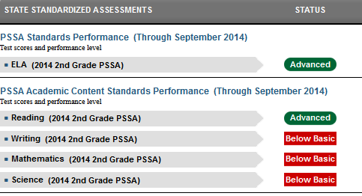
Academic Dashboard: State Assessments Tab
State Assessments tab shows results for:
Performance on PSSA standards
PSSA Academic Content Standards performance
Keystone performance results are shown if applicable
Notes:
State Assessments tab shows applicable results for:
Performance on PSSA core standards
Keystone performance (if applicable – not shown at the middle school level)
PSSA Academic Content Standards performance

Slide 51
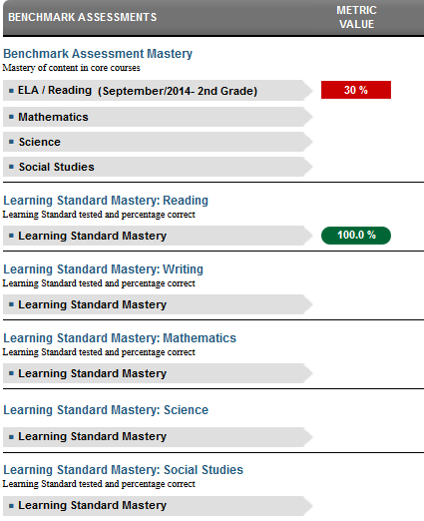
Academic Dashboard: Local Assessments Tab
Local assessments tab shows results for:
Benchmark Assessment Mastery
Learning Standard Mastery for Reading, Writing, Math, Science, Social Studies
Notes:
This is only a partial screen shot but Local assessments tab shows results for:
Benchmark Assessment Mastery
Learning Standard Mastery for Reading , Writing, Math, Science, Social Studies

Slide 52
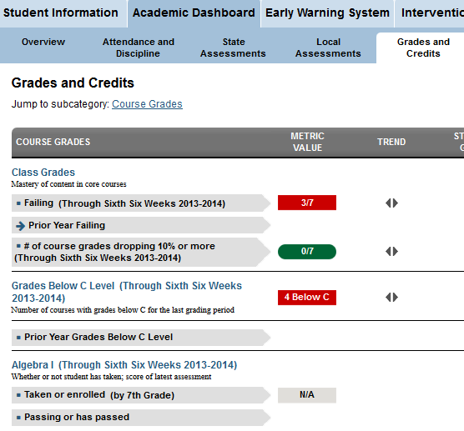
Academic Dashboard: Grades and Credits Tab
Three metrics for grades are displayed:
Class Grades
Grades below C level
Algebra 1
Notes:
Under the grades and credits tab Three metrics for grades are displayed:
Class Grades
Grades below C level
Algebra 1

Slide 53
Student Grades: More button
To see more detail, click on the More button,
You see two options, Current Courses and Historical Chart
Notes:
Like on the attendance tab a user can see more detail by clicking on the More button,
you will see one or two options, Current Courses and Historical Chart,
we will look at Current Courses.

Slide 54
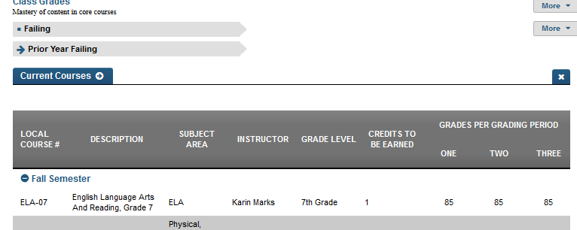
Student Grades: Current Courses
The page displays all the students current courses with Course#, Description, Subject, Instructor, Grade Level, Credits to be Earned, and Grades Per Grading Period
Notes:
The page displays all the students current courses with:
Course#, Description, Subject
Instructor, Grade Level, Credits to be Earned, and Grades Per Grading Period (one, two, three)
As this student’s homeroom teacher, how would you use this information?

Slide 55
Guided Practice Activity Student Grades #6
What are the three Grades Metrics?
How would you find which classes a student is failing?
Pick a student from one of your classes and drill into their Student Grades page. What did you learn that you did not already know?
Notes:
What are the three Grades Metrics?
How would you find which classes a student is failing?
Pick a student from one of your classes and drill into their Student Grades page. What did you learn that you did not already know?
Trainer’s note: When you demonstrate to any participants, you should always use the demo site with the anonymized data set. However, participants should log into their actual real production site whenever possible during training. The real data found in their production site is much more compelling to an educator than is an anonymized data set. As a note, you will need to monitor the participants closely as they will tend to get absorbed in the data they see. Keep participants on track by asking questions such as the following:
Did you identify the 1st and last student?
Did you find students with grades below C?
Did you find students who are trending down?
Did you find students who are trending up?

Slide 56
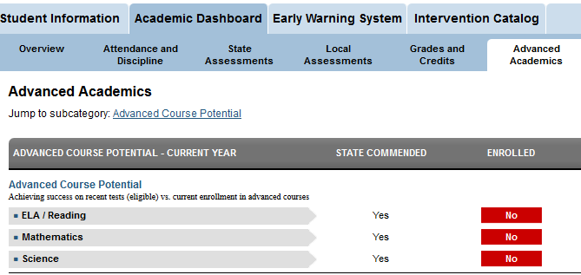
Academic Dashboard: Advanced Academics Tab
Advanced Academics tab displays advanced course potential for a student
Notes:
Advanced Academics tab displays advanced course potential for this student based on performance on various assessments.
In the sample page the student has reached the state commended level for advanced course potential but this student has not enrolled in any advanced courses.

Slide 57
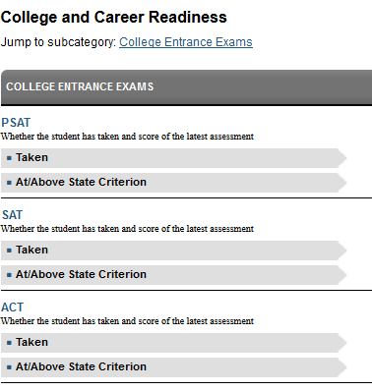
College and Career Readiness Tab
CCR tab displays information on college entrance exams taken including, if available, results on:
PSAT
SAT
ACT
Notes:
For high school staff members CCR displays information on college entrance exams taken including, PSAT, SAT, ACT
Staff members at middle school level may see results only of PSAT

Slide 58
Intervention Catalog
Notes:
We will investigate the intervention catalog as a staff member would see it while they are looking at an individual student profile

Slide 59
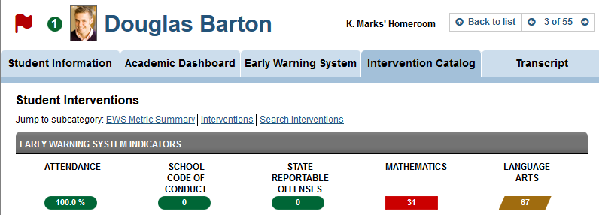
Student Interventions
Students with interventions assigned have a green circle with an indication of the number of interventions not yet completed
EWS indicators for attendance, discipline offenses and math and ELA grades are displayed with appropriate color coding
Notes:
Students who have Interventions assigned will have a green circle with a number displayed next to their picture.
Note that The green circle indicator at the top of the page indicates the number of NOT COMPLETED interventions.
The Early Warning System Indicators for Attendance, School Code of Conduct, State Reportable Offenses, Mathematics and Language Arts are displayed with the corresponding color coding.
Interventions assigned to this student are located below the EWS indicators(next slide).

Slide 60
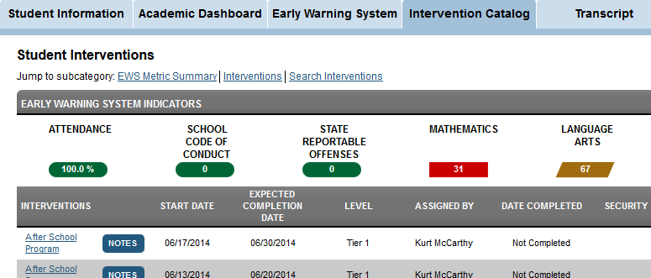
Student Interventions: View
Staff members can view interventions assigned to a student and search for interventions
Notes:
Staff members can view interventions assigned to a student and search for interventions

Slide 61
Student Interventions: Details
Each intervention assigned is listed with start date, expected completion date, level, assigned by, and date completed
Staff members can add Notes to the intervention record for a student
Notes:
Each intervention assigned to the student is listed with 1) Start Date, 2) Expected Completion Date,3) Level,4) Assigned by, 5) Date Completed
Staff member notes can be added by clicking on the Notes link in the intervention record

Slide 62
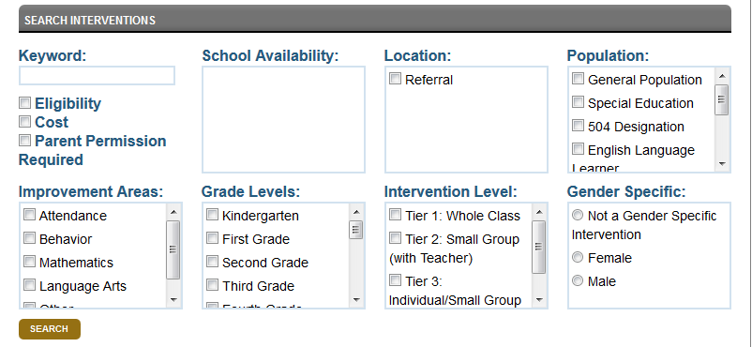
Student Interventions: Search
Search for interventions by keyword or by any of the other filters
Click on the Search link to complete the interventions search
Notes:
The search interventions capability is located below the list of interventions for a student.
To search for interventions, click on the Search Interventions link at the bottom of the interventions dashboard.
You can search for interventions by Keyword or by any of the other filters; School Availability, Grade Levels, Gender Specific, etc.
After the list of interventions is returned, based on your chosen filter, you can click on the intervention name to see more detail.

Slide 63
Guided Practice Activity Student Interventions #7
Turn to your neighbor and discuss the following:
What are two ways you know if a student has interventions assigned?
How can you find details about already assigned interventions for a student?
How would you view the interventions available to your school?
Notes:
Turn to your neighbor and discuss the following:
What are two ways you know if a student has interventions assigned?
How can you find details about already assigned interventions?
How would you view the interventions available to your school?
After the discussion, ask the following questions to the group.
Who can tell us two ways you know if a student has interventions assigned?
How can you find details about already assigned interventions?
Can someone explain how to view the interventions available to your school?
Trainer’s note: When you demonstrate to any participants, you should always use the demo site with the anonymized data set. However, participants should log into their actual real production site whenever possible during training. The real data found in their production site is much more compelling to an educator than is an anonymized data set. As a note, you will need to monitor the participants closely as they will tend to get absorbed in the data they see. Keep participants on track by asking questions such as the following:
Did you identify the 1st and last student?
Did you find students with grades below C?
Did you find students who are trending down?
Did you find students who are trending up?

Slide 64
Student Transcript
Notes:
Here is a look at the student transcript tab

Slide 65
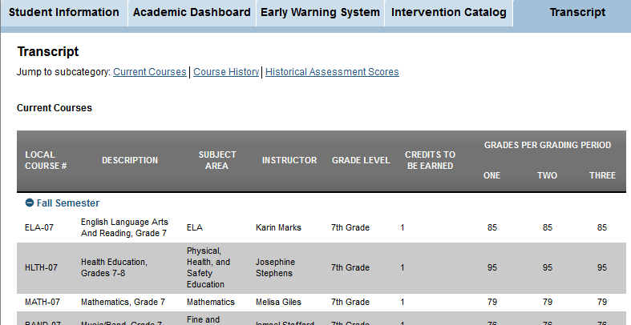
Student Transcript: View Transcript
Information about current courses is displayed
Course history and historical assessment scores are available from the “jump to” list
Notes:
Information about current courses is displayed
Information includes course number, course description, subject area, instructor, grade level, credits to be earned, and grades for each grading period
Course history and historical assessment scores are available from the “jump to” list

Slide 66
School Level Information
Notes:
That completes our tour of the student level educator dashboard.
In this next section we will navigate from a staff member’s home page to a school level information for that staff member. We will investigate the kind of school level information that is available for a staff member to view..

Slide 67
Navigate to Grand Bend Middle School
From the staff homepage navigate to Grand Bend Middle School by clicking on the active school link
Notes:
Now that we’ve looked at the layout of the educator homepage let’s navigate from the staff home page to the school level dashboards that are available to staff members
From the staff member’s home page, navigate to the dashboard showing school level data by clicking on the active link for the school where the staff member works.

Slide 68
School Information: Overview
School Information defaults to the School Information Overview
Under School Information, there are four additional tabs:
Staff List
Students by Grade
Students by Demographic
My Student Lists
Notes:
School Information defaults to the School Information Overview which we’ve already investigated.
Under School Information, there are four additional tabs:
Staff List
Students by Grade
Students by Demographic
My Student Lists

Slide 69
School Level Information
School level information includes school location and general demographic information
Staff lists, showing staff emails only, and students by grade and by demographic are available at the school level
Educators see only students they have access to in Students by Grade and by Demographic tabs
Notes:
The school information that is available for a staff member to see is general school information, such as school address and administration, as well as school demographic information.
The staff list that an educator can see only contains staff email addresses,
An educator can see lists of students by grade and demographic but only for those students that this educator has access to via his or her roster.
Access to the complete student list for this educator is also provided from this screen by clicking My Student Lists.

Slide 70
School Information
School Information includes:
School contact information
School population counts
Student demographics
Students by program
Other student information
Notes:
School Information includes overview and aggregated statistics for:
School contact information
School population counts
Student demographics
Students by program
Other student information

Slide 71
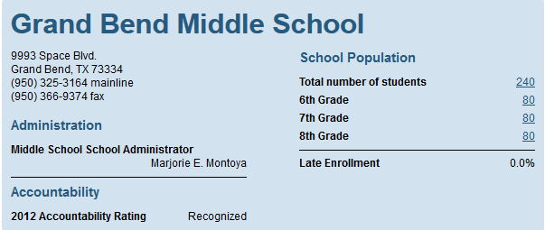
School Information: Contact & Population
The first section displays:
School contact information
School administrator
Prior year accountability rating
School population counts by grade level
Late enrollment %
Notes:
The first section displays:
School contact information
School administrator
Prior year accountability rating
School population counts by grade level
Late enrollment %

Slide 72
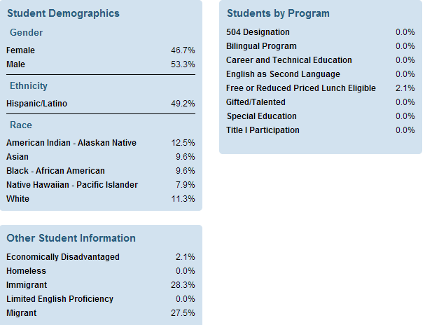
School Level Student Count
The overview also includes the student subgroups by % for:
Student demographics
Students by program
Other student information
Notes:
The overview also includes the student subgroups by % for:
Student demographics
Students by program
Other student information

Slide 73
Staff List
The Staff list shows all the staff members at the school, including:
Email address
School role
Notes:
The Staff list shows all the staff members at the school, including:
Email address
School role

Slide 74
Navigation Note: Customize View
Note that on the Staff List, Students by Grade and Students by Demographic tabs, there is a Customize View filter for each list
This allows users to adjust the indicator columns shown for each list
Notes:
Note that on the Staff List, Students by Grade and Students by Demographic tabs, there is a Customize View filter for each list.
This allows users to adjust the indicator columns shown for each list.

Slide 75
Student by Grade
Students by Grade allows Staff to filter the student list by the grades available at that campus
Staff will only see the student in their roster
Notes:
Students by Grade allows Staff to filter the student list by the grades available at that campus.
Staff will only see the student in their roster.

Slide 76
Students by Demographic
Students by Demographic provides Staff with a menu to filter the student list by certain indicators:
Gender
Race
Program
Example: 504, CTE, ESL, Spec Ed
Indicator
Example: At Risk, Homeless, LEP, Migrant
Notes:
Students by Demographic provides Staff with a menu to filter the student list by certain indicators:
Gender
Race
Program
Example: 504, CTE, ESL, Spec Ed
Indicator
Example: At Risk, Homeless, LEP, Migrant

Slide 77
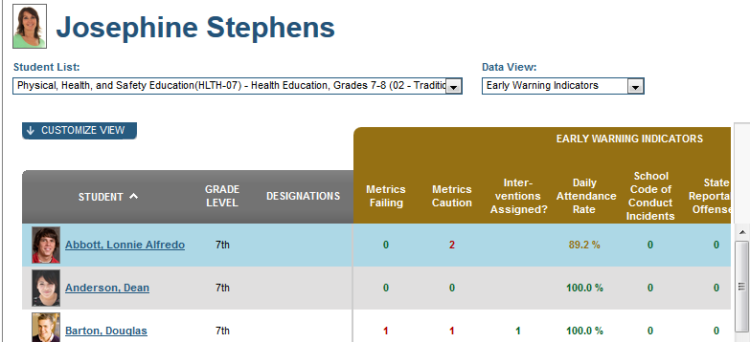
My Student Lists
My Student Lists navigates Staff back to the Staff homepage
Notes:
My Student Lists navigates Staff back to the Staff homepage.

Slide 78
School Level Information: Academic Dashboard
School Level information available on the Academic Dashboard includes:
Prior year accountability rating
Summary metrics for attendance and discipline, state and local assessment results, grades and credits, advanced academic metrics and college and career readiness
Notes:
The academic dashboard provides access to school level academic metrics such as: attendance and discipline metrics, grades and credits, state and local assessment results, PA specific advanced academic results and college and career readiness metrics.
The prior year’s accountability result is displayed

Slide 79
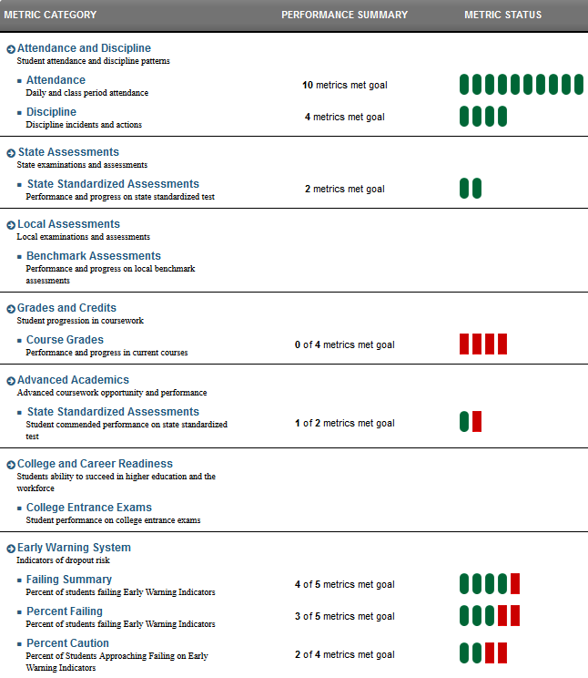
Academic Dashboard: Overview Tab
Seven sections with school level reports:
Attendance and discipline
State & local assessments
Grade and credits
Advanced academics
College and career readiness
Early warning system
Notes:
This is a screen shot of the Academic Dashboard Overview screen.
There are 7 sections altogether - attendance and discipline, state and local assessments, grade and credits, advanced academics, college and career readiness, and early warning system
The Staff School Information /Overview Page shows school level summative reports for each of these areas. At this time the state is not yet displaying data for all of these sections.
Now we will look at each section of the overview screen and explore the metrics captured at the school level.

Slide 80
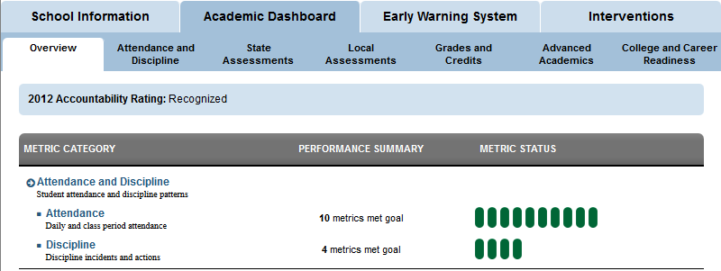
Performance Summary & Metric Status
The number of metrics that met the goals set for that category is indicated
In the example, 10 metric goals were set for
attendance and 10 goals were met
Note that red bars indicate unmet goals and green bars indicate met goals
Notes:
The number of metrics that met the goals set for that category is indicated
In the example, 10 metric goals were set for
attendance and 10 goals were met
Note that red bars indicate unmet goals and green bars indicate met goals

Slide 81
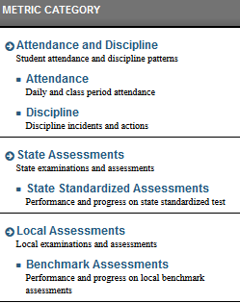
Calculation of Metrics on Overview Tab
Summary metrics for each section are aggregate counts of the student level metrics on each tab of the Academic Dashboard
Notes:
The summary metrics shown at the school level are aggregate counts of the student level metrics for each tab of the Academic Dashboard. There are summary metrics for each section of the Overview tab of the School Level Academic Dashboard. Only a sample is shown here.

Slide 82
Overview Tab: Attendance and Discipline Metrics
Attendance and discipline counts:
Daily and Class Attendance
Discipline incidents and actions
Notes:
Attendance and discipline counts:
Daily and Class Attendance
Discipline incidents and actions

Slide 83
Overview Tab: State & Local Assessment Metrics
State standardized assessments metrics aggregate data on performance and progress on state standardized tests
Local assessments metrics aggregate data on performance and progress on local benchmark assessments
Notes:
State standardized assessments metrics aggregate data on performance and progress on state standardized tests.
Local assessments metrics aggregate data on performance and progress on local benchmark assessments.

Slide 84
Overview Tab: Grades & Credits Metrics
Grades and credits metrics measure performance and progress in current courses
Notes:
Grades and credits metrics measure performance and progress in current courses.

Slide 85
Overview Tab: Advanced Academics Metrics
Advanced academics tracks school level advanced coursework opportunity and performance
Specifically student commended performance on state standardized tests
Notes:
Advanced academics tracks school level advanced coursework opportunity and performance. Specifically student commended performance on state standardized tests.

Slide 86
Overview Tab: College & Career Readiness Metrics
College and Career Readiness displays school level data regarding the students ability to succeed in higher education and the workforce
Specifically student performance on college entrance exams is displayed
Notes:
College and Career Readiness displays data regarding the students ability to succeed in higher education and the workforce
Specifically student performance on college entrance exams is displayed

Slide 87
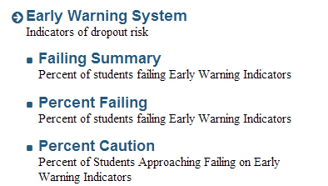
Overview Tab: Early Warning System Metrics
Early Warning System metrics track how the student body is performing against the Early Warning indicators
Failing Summary displays the count of students failing EWS indicators
Percent Failing shows the percent of students failing EWS indicators
Percent Caution shows the percent nearing failure
Notes:
Early Warning System metrics track how the student body is performing against the Early Warning indicators.
Failing Summary displays the count of students failing EWS indicators.
Percent Failing shows the percent of students failing EWS indicators.
Percent Caution shows the percent nearing failure.

Slide 88
Academic Dashboard: Other Tabs
The other tabs under Academic Dashboard display school level information in the specified domain:
Attendance & discipline
State Assessments
Local Assessments
Grades & Credits
Advanced Academics
College & Career Readiness
Notes:
We have looked at the Academic Dashboard Overview. Now we are going to explore the remainder of the tabs. Each tab displays school level information in each specified domain. Academic Dashboard tabs include:
Attendance & Discipline
State Assessments
Local Assessments
Grades and Credits
Advanced Academics
College and Career Readiness

Slide 89
School Level Tab Metrics
The columns for school level metrics are the same for each indicator on each tab
Metric Value shows the % of students in that indicator category
Trend shows if the metric is increasing or decreasing
School Goal shows the % goal set by the admin
Difference from Goal shows the delta between the Metric and the Goal
Student Attainment shows the count of students in that indicator category
Notes:
The columns are the same for each indicator on each tab.
Metric Value shows the % of students in that indicator category.
Trend shows if the metric is increasing or decreasing.
School Goal shows the % goal set by the admin.
Difference from Goal shows the delta between the Metric and the Goal.
Student Attainment shows the count of students in that indicator category.

Slide 90
Attendance & Discipline Tab: Attendance
Attendance Indicators include:
Average Daily Attendance
Daily Attendance Rate
Days Absent
Class Period Absence Rate
Each indicator may show the metrics for the:
Last four weeks
Last eight weeks
Year to date
Prior year
Notes:
Attendance Indicators include:
Average Daily Attendance
Daily Attendance Rate
Days Absent
Class Period Absence Rate
Each indicator may show the metrics for the:
Last four weeks
Last eight weeks
Year to date
Prior year

Slide 91
Attendance & Discipline Tab: Discipline
Discipline Indicators include:
All Discipline Incidents
School Code of Conduct Incidents
Each indicator shows the metrics for
Current grading period
Year to date
Prior year
Notes:
Discipline Indicators include:
All Discipline Incidents
School Code of Conduct Incidents
Each indicator shows the metrics for
Current grading period
Year to date
Prior year

Slide 92
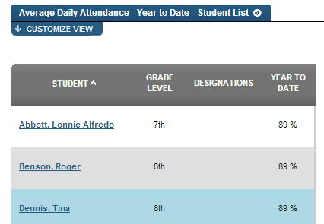
Navigation Note: More Menu
As a side note, each indicator has a More button
Under More, staff can access the Student List associated with that indicator group
Staff will only see the students in their roster
Notes:
As a side note, each indicator has a More button.
Under More, staff can access the Student List associated with that indicator group.
Staff will only see the students in their roster.

Slide 93
State Assessments Tab
State Standardized Assessments Indicators include:
PSSA Standards Performance
Keystone Performance
PSSA Academic Content Standards Performance
Notes:
State Standardized Assessments Indicators include:
PSSA Core Standards Performance
ELA
Math
Science
Keystone Performance
PSSA Academic Content Standards Performance
Reading
Writing
Math
Science

Slide 94
Local Assessments Tab
Benchmark Assessments Indicators include:
Benchmark Performance
Learning Standards Mastery by Core Subject Area
Both Indicators display the content area breakdown by:
ELA/Reading
Math
Science
Social Studies
Notes:
Benchmark Assessments Indicators include:
Benchmark Performance
Learning Standards Mastery by Core Subject Area
Both Indicators display the content area breakdown by:
ELA/Reading
Math
Science
Social Studies
As a note, the benchmark shows students scoring at or above the campus threshold of 70% and the mastery score for the Learning Standard Mastery is 70% or above.

Slide 95
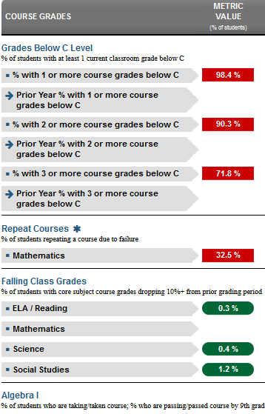
Grades & Credits Tab
Grades and Credits Indicators include:
Grades Below C
Current year
Prior year
Repeat Courses
Failing Class Grades
ELA/Reading
Math
Science
Social Studies
Algebra I
Taking or have taken
Passing or have passed
Notes:
Grades and Credits Indicators include:
Grades Below C
Current year
Prior year
Repeat Courses
Failing Class Grades
ELA/Reading
Math
Science
Social Studies
Algebra I
Taking or have taken
Passing or have passed

Slide 96
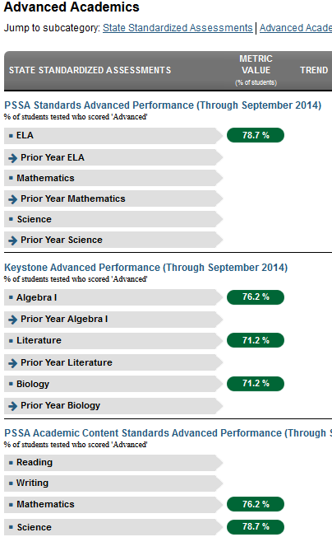
Advanced Academics Tab: State Assessments
Note: The data presented can vary depending on the school level
Advanced Academics tab includes two sections:
State Assessments
Advanced Academics
State Assessment indicators include the % of students who scored Advanced on:
PSSA Core Standards Advanced Performance
Keystone Performance
PSSA Academic Content Standards Advanced Performance
Notes:
NOTE: - data displayed can differ depending on the whether the staff member is at an elementary, middle or high school
For a high school teacher Advanced Academics tab includes two sections:
State Assessments
Advanced Academics
We are only looking at the state assessment portion of the page here.
State Assessment indicators include the % of students who scored Advanced on:
PSSA Core Standards Advanced Performance
ELA
Math
Science
Keystone Performance
PSSA Academic Content Standards Advanced Performance
Reading
Writing
Math
Science

Slide 97
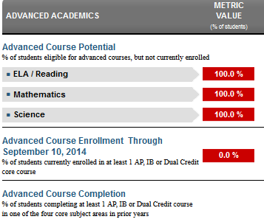
Advanced Academics Tab: Advanced Academics
Advanced Academics section of this tab includes % of students:
With Advanced course potential
Advanced course enrollment
Advanced course completion
Only high school staff members will see this section
Notes:
This section is only available to high school staff members
Here is the bottom section of the screen on the advanced academics tab
Advanced Academics section of this tab includes % of students:
With Advanced course potential
Advanced course enrollment
Advanced course completion

Slide 98
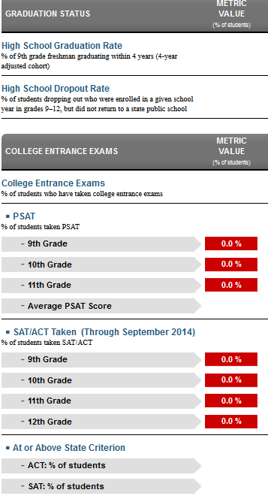
College & Career Readiness Tab
For high school staff, College and Career Readiness Indicators include:
Graduation Status
High School Graduation rate
High School Dropout rate
College Entrance Exams
PSAT
SAT/ACT
At or above state criterion
Notes:
For high school staff, College and Career Readiness Indicators include:
Graduation status
High school graduation rate
High school dropout rate
College Entrance Exams
% of students who have taken college entrance exams
PSAT
% of students who have taken PSAT
Average PSAT Score
SAT/ACT
% of Scores Meeting state criterion
NOTE: Staff members working at middle school or elementary school will see different data or might not see any data at all on this tab
This completes our tour of the School level academic dashboard tab -

Slide 99
School Level Early Warning System Overview
Staff can view school level Early Warning System metrics and indicators
We learned about the Early Warning System in Course 2, so we will only provide a high level review in this course
Notes:
Now lets review the final two tabs that a staff member can access.
Staff can view school level Early Warning System metrics and indicators.
We learned about the Early Warning System in Course 2, so we will only provide a high level review in this course.

Slide 100
School Level Early Warning System Indicators
School Level Early Warning Indicators include:
Failing Summary
Percent Failing
Percent Caution
Notes:
Here is an overview screenshot of the entire EWS page – we will investigate each section on the next few slides
School Level Early Warning Indicators include:
Failing Summary
Percent Failing
Percent Caution

Slide 101
EWS: Failing Summary
Metric Value: % of students in each category
Trend: Indicates if % is increasing/decreasing
School Goal: % set by administrator
Difference from Goal: % difference between school goal & current %
Student Attainment: student to group ratio indicating how many students achieved the school goal
Notes:
The first section summarizes the percent of students who fall into each range of triggering all 6 indicators, 5+ indicators, 4+indicators, 3+indicators, 2+ indicators or 1+ indicators. This allows an administrator to approximate what percentage of the student roster would fall into specific tiers of intervention. The metric value indicates the percent for each “bucket”. The trend column, if activated, would show which groups were experiencing upward or downward trends as far as overall percentages. The next two columns show the school goal (set by the administrator) and the percent difference from that goal. Student attainment shows the student to group ratio of how many students achieved the school goal.

Slide 102
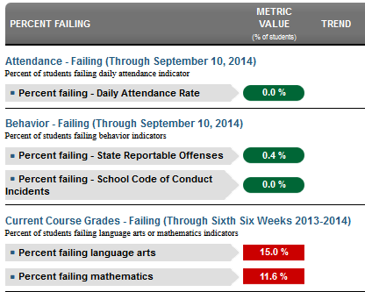
EWS: Percent Failing
Percent Failing:
Percent of students triggering each of the main Early Warning Indicators:
Attendance,
Behavior
Course Performance.
Notes:
The Percent Failing section is next. This highlights the same columns, but in this section we are looking at the percentages across overall Attendance, Behavior and Course Performance.
This section also shows the percent break down between the sub-indicators. For example, Behavior is broken down into the composite indicators of State Reportable Offenses and School Code of Conduct Incidents. Current Course grades is likewise broken down into content area.

Slide 103
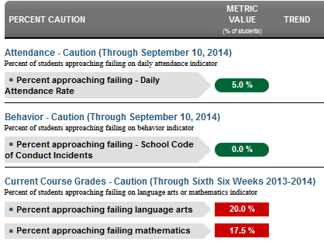
EWS: Percent Caution
Percent Caution:
Percent of students who have accrued absences, behavior incidents and/or poor course grades, but have not yet fallen into the “at-risk” category
Notes:
The Percent Caution section is next. This highlights the same columns, but in this section we are looking at the percent of students who have demonstrated issues with attendance, behavior and/or course performance, but have not yet fallen into the “at-risk’ category.

Slide 104
School Level Intervention Catalog Overview
Under the Interventions Tab, Staff members can view and search for the Interventions available at their school and/or district
Notes:
The final tab we will review is the interventions tab.
Under the Interventions Tab, Staff members can view and search for the Interventions available at their school and/or district.

Slide 105
Viewing Interventions
The Intervention List shows interventions available at that school and/or district
Only the Intervention Catalog Coordinator and Dashboard Administrator have rights to add/delete/edit Interventions in the Intervention Catalog
Notes:
The Intervention List shows all interventions that are available at that school and/or district. It is important to note that only the Intervention Catalog Coordinator and Dashboard Administrator have rights to Add Interventions to the IC.
Each intervention listed includes; the Contact person assigned to the intervention,
The Population eligible for the intervention (Gen Ed, SpEd, 504, ELL, etc.),
Location (school- can be multiple or referral)
and the Intervention Level (1, 2, or 3).

Slide 106
Viewing Interventions: More
Next to each Intervention is a More menu
The More menu links to:
Intervention Details
Intervention Reviews
Student Lists
Notes:
Next to each Intervention is a More menu
The More menu links to:
Intervention Details
Intervention Reviews
Student Lists

Slide 107
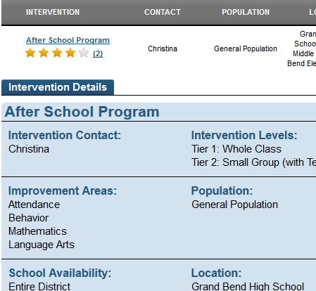
Viewing Intervention Details
Select Details from the More menu or click on the intervention name to view Intervention Details
Details include:
Contact, Tier, Gender, Area, Population, Duration, School, Location, Grade Level, Eligibility, Cost, Parent Permission & Description
Notes:
For each intervention, details include:
Name, Contact, Levels, Gender, Area, Population, Duration, School, Location, Grade Level, Eligibility, Cost, Parent Permission, Description

Slide 108
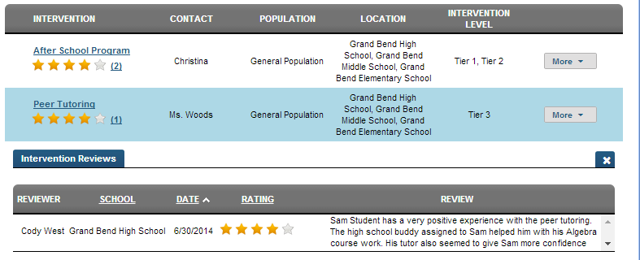
Intervention Reviews
Next to each Intervention we can see how many reviews have been added
Once the reviews have been expanded we can review the details added by peers
Notes:
Next to each Intervention we can see how many reviews have been added. Once the reviews have been expanded we can review the details added by peers.

Slide 109
View Intervention Student List
The Assigned Students list displays all students who have been assigned this intervention
To view an individual student, click on the student’s name
Notes:
The Assigned Students list displays all students who have been assigned this intervention. Students are listed alphabetically. To view an individual student, click on the student’s name.

Slide 110
Search for Interventions
Under Search, Staff can select search parameters to locate target interventions
Then click Search to generate results
Notes:
Under Search Staff selects search parameters to locate target interventions. Users can search for interventions using the following criteria:
Keyword
Eligibility Requirements
Cost
Parent Permission Required
School Availability
Location
Population
Improvement Area
Grade Level
Intervention Level
Gender-Specific

Slide 111
Search Results
Search results are returned according to the selected parameters
Notes:
Search results are returned according to the selected parameters.

Slide 112
Guided Practice Activity #8 – School Level Tabs
How is your school performing against the Academic Indicators? Are all of the metrics meet? How do you know?
Where would you find the break down of students enrolled in CTE programs in your school?
How would you generate a list of all your students with a 504 Plan?
Notes:
Trainer’s note:
Allow participants time to log in to the Dashboard and find the correct responses for this Guided Practice Activity. After participants have completed the activity, process the responses as a group.

Slide 113
Wrap Up, Assessment and Evaluation
Wrap Up
Describe the purpose of, and list 2 metrics that are available on, each of the following dashboards:
Staff Homepage
Student Information
School Information
Academic Dashboard
EWS
Intervention Catalog
Notes:
Wrap Up, pose the following questions to the group:
Describe in once sentence the general purpose of each of the following dashboards:
staff homepage,
student information,
school information,
academic dashboard,
EWS,
intervention catalog
Describe what information is available on each of the following dashboards by listing 2 metrics that are available on each of these dashboards:
Staff Homepage
Student Information
School Information
Academic Dashboard
EWS
Intervention Catalog

Slide 114
Wrap Up, Assessment and Evaluation
Assessment
Take a moment and answer the questions on the brief assessment
Assessment
Notes:
Please take a moment and respond to the brief assessment questions. Your instructor will provide instructions on accessing the assessment.

Slide 115
Wrap Up, Assessment and Evaluation
Evaluation
Take a moment and answer the questions on the brief evaluation survey
Evaluation
Notes:
Please take a moment and complete the evaluation survey. Your instructor will provide instructions on accessing the survey.

Slide 116
For more information on Staff Navigation for PDE Dashboard please visit PDE’s website at www.education.state.pa.us
The mission of the department is to academically prepare children and adults to succeed as productive citizens. The department seeks to ensure that the technical support, resources and opportunities are in place for all students, whether children or adults, to receive a high quality education.
Notes:
For more information on Staff Navigation for PDE Dashboards please visit PDE’s website at

