Slide 1
WELCOME
Bacher, Katherine kabacher@pa.gov
Rubican, Karen krubican@pa.gov
Bauman, David davbauman@pa.gov
Mauro, Kevin kmauro@pa.gov
www.education.state.pa.us
>
1

Slide 2
If I Could Tell PDE
Questions
Comments
Concerns
www.education.state.pa.us
>
2

Slide 3
Vertical Thinking Activity FOUR NUMBERS
Select four numbers from 1 to 9 at random.
Using these four numbers and any operations, make the values from 1 to 10.
www.education.state.pa.us
>
3

Slide 4
FOUR NUMBERS
DICUSSION:
Activity – What did it do for students?
Clarity – Is the problem clear?
Rewrite – Can it be clarified?
www.education.state.pa.us
>
4

Slide 5
STANDARDS ALIGNED SYSTEM
Can you log into SAS?
www.pdesas.org
PDESAS now requires multi-factor authentication. If you have not already updated your email address, please do so in your SAS Profile opens in new window to ensure access to your account. For assistance, contact the Help Desk at helpdesk@pdesas.org or 1-877-973-3727.
www.education.state.pa.us
>
5

Slide 6
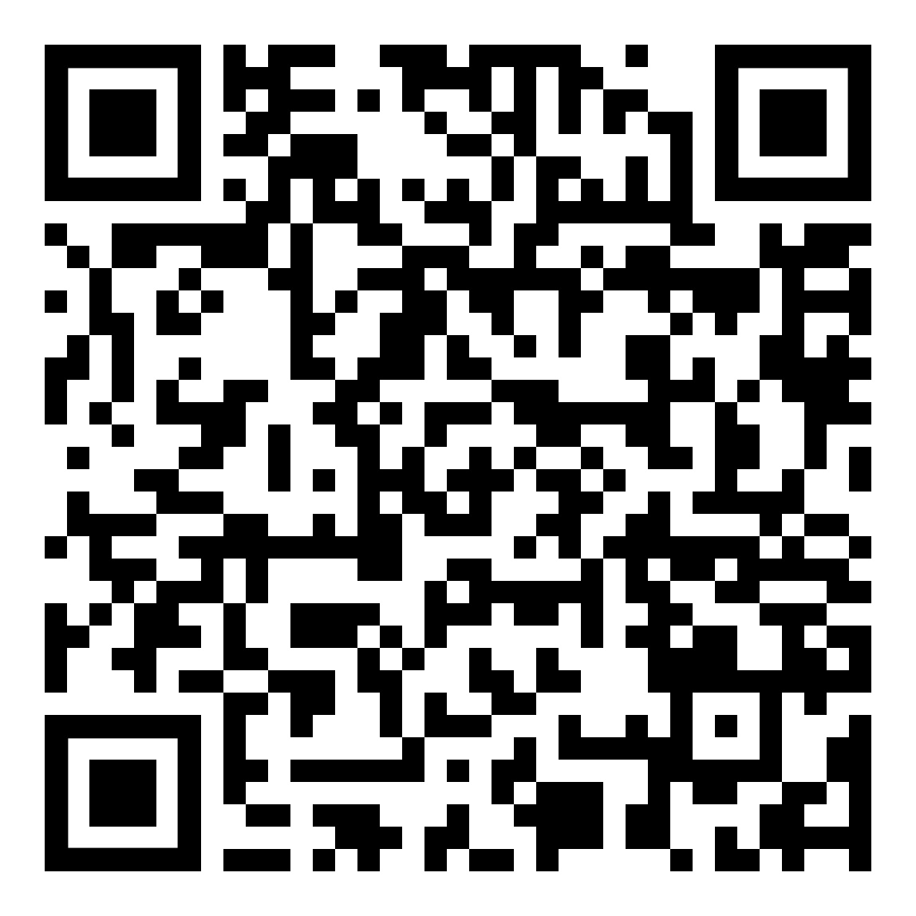
PSSA PRESSURE
https://pdesas.org/Assessment/CheckForUnderstanding/Respond/3284
www.education.state.pa.us
>
6

Slide 7
SAS
Lets spend some time in SAS
Help
Quick Links
SAS News
View Standards
Assessment Center
Materials and Resources
Instruction
PD Center
www.education.state.pa.us
>
7

Slide 8
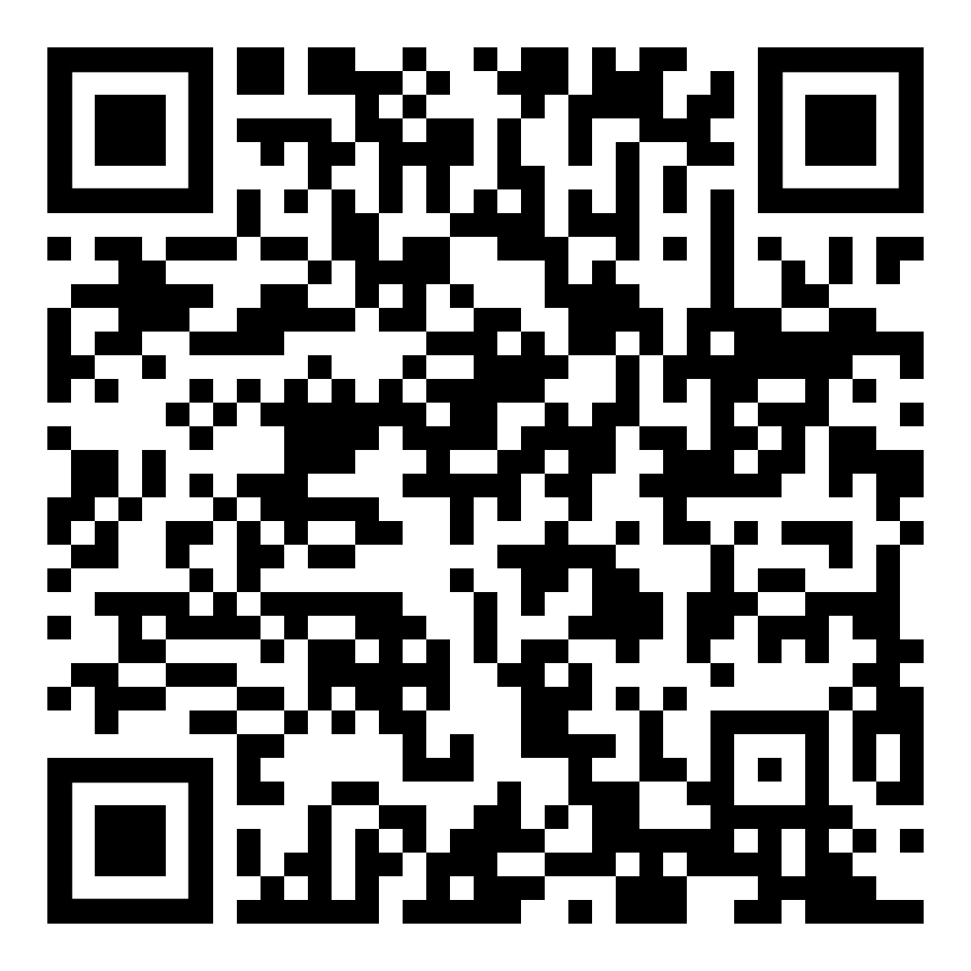
SAS
Educational Committees
https://web.cvent.com/survey/ffa3ba29-9d82-40d0-a85d-9b93c7f4748c/welcome
www.education.state.pa.us
>
8

Slide 9
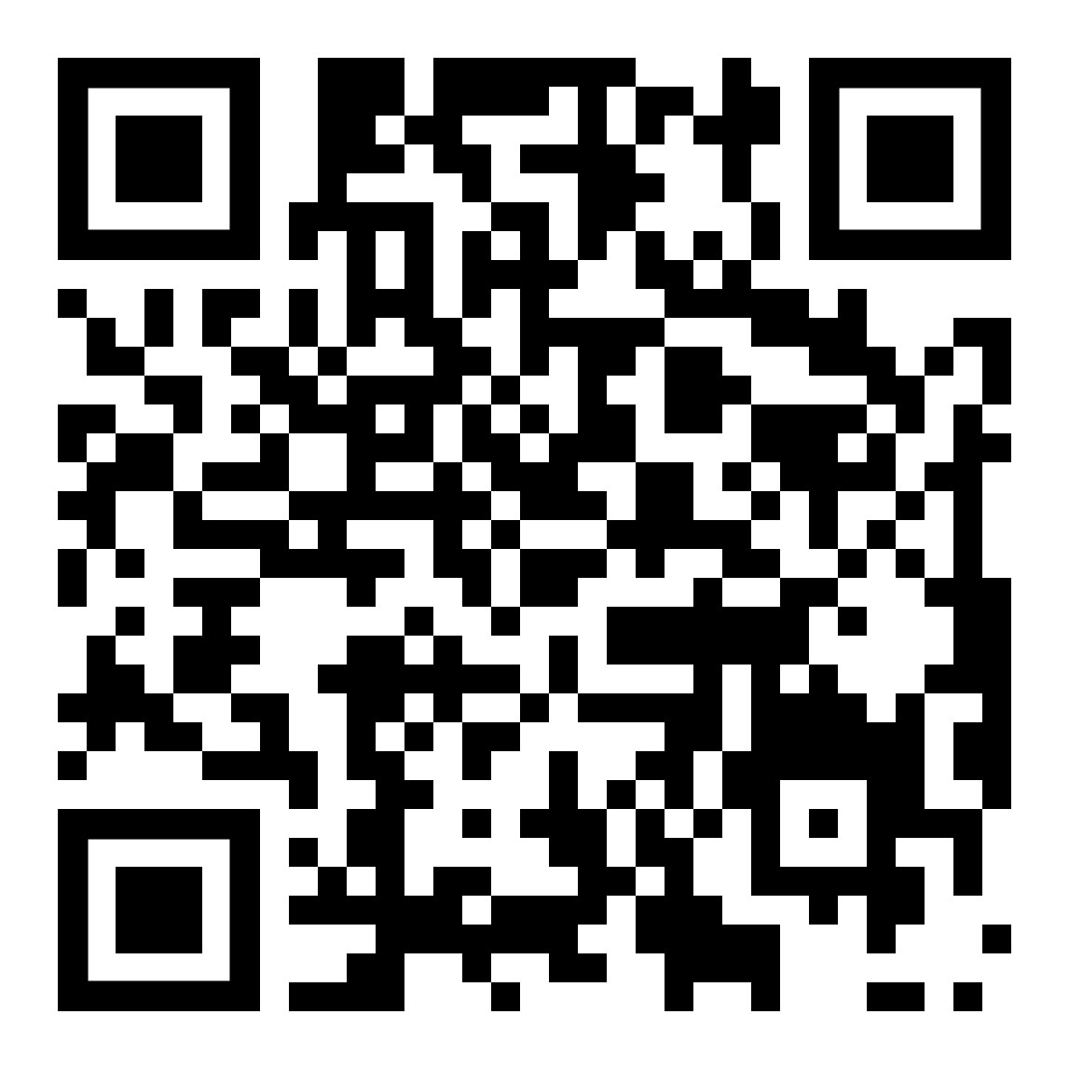
SAS
SAS Updates
https://pdesas.org//EduPortal/Home/viewupload/800675
www.education.state.pa.us
>
9

Slide 10
Writing Activity (TPS)
Let's do some Math
www.education.state.pa.us
>
10

Slide 11
Writing Activity (TPS)
Let's do some Math
What Instructional Strategy
Standards of Mathematical Practices
Depth of Knowledge
www.education.state.pa.us
>
11

Slide 12
Classroom Instruction Questions
Hand Out Activity (discussion)
What does the classroom routine look like day/week?
What Instructional Strategies to you use? Focus on Effective Instruction
www.education.state.pa.us
>
12

Slide 13
Assessment and Curriculum
Time Dependent Discussions
Curriculum
Assessment
www.education.state.pa.us
>
13

Slide 14
Thanks
Final Thoughts and Questions
Break
Next
www.education.state.pa.us
>
14

