Slide 1
Item Writing and Scoring
Kevin Mauro
Mathematics Curriculum Advisor
PDE
kmauro@pa.gov
www.education.state.pa.us
>
1

Slide 2
Can you find your grade level or course Assessment Anchors and Eligible Content?
www.pdesas.org
www.education.state.pa.us
>
2

Slide 3
Life of an Item
www.education.state.pa.us
>
3

Slide 4
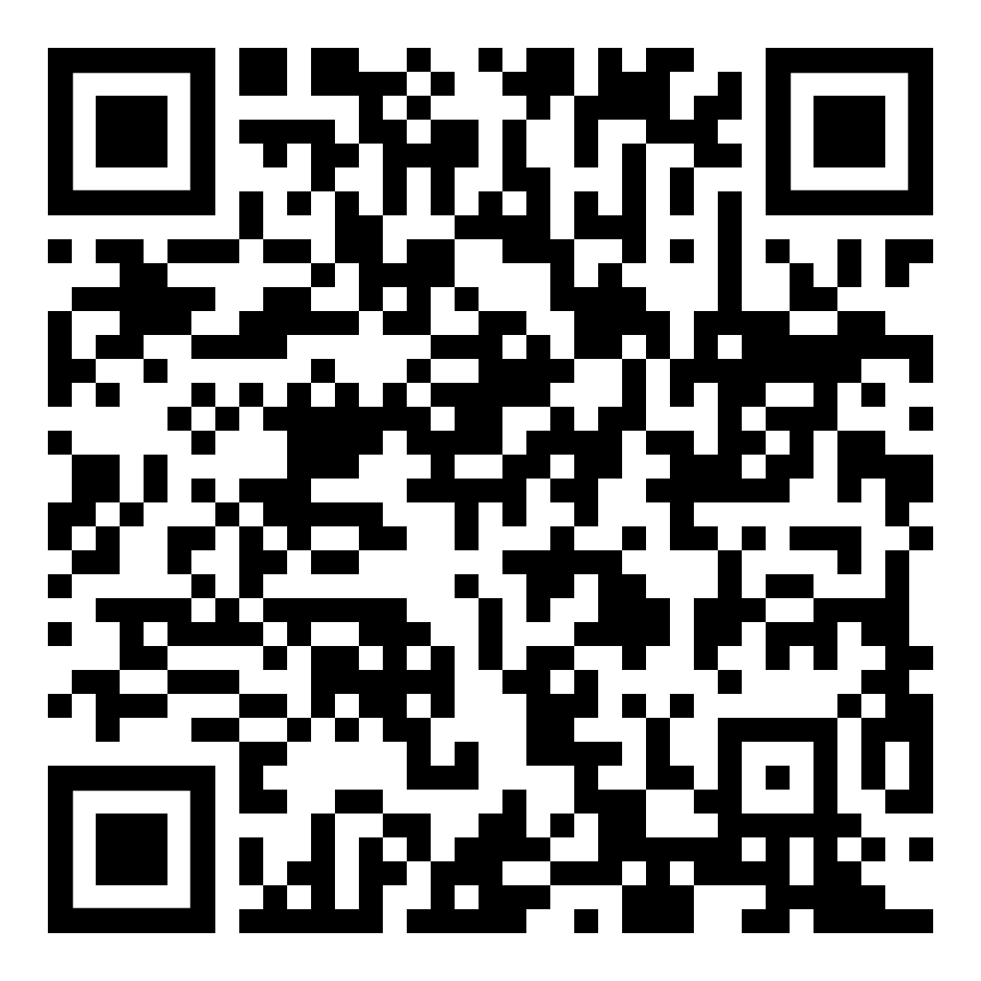
Any Questions before we begin?
Educational Committees
https://web.cvent.com/survey/ffa3ba29-9d82-40d0-a85d-9b93c7f4748c/welcome
www.education.state.pa.us
>
4

Slide 5
What makes a good opened math question?
Define Depth of Knowledge (DOK)
www.education.state.pa.us
>
5

Slide 6
Discuss the Item Writing Process and review rubric and practice scoring
www.education.state.pa.us
>
6

Slide 7
Practice problem activity
Standards of Mathematical Practices
www.education.state.pa.us
>
7

Slide 8
Writing open ended questions and the Standards of Mathematical Practices
Writing activity
www.education.state.pa.us
>
8

