Slide 1
Assessment Literacy
From
PDE Curriculum Division

Slide 2
What to expect in our delivery
I do – we do- you do
Learning Activities
DOK
Item type identification
Guided Build
Guided Score

Slide 3
Components
Design
Build
Score

Slide 4
Design

Slide 5
What Does It mean to “Design” an Assessment?
PM2
5
Notes:
Building a test, assessment or performance measure requires a design plan, much like building a house requires a design plan. The term “blueprint” is one of several terms used to describe the development of an test’s design.
a. Ask participants if their districts have developed any grade or content-based common assessments.
b. (If yes) Ask participants how these assessment were developed and maintained (administrator teams, teacher teams, items banks, etc.)
c. (If yes) Ask participants what their assessments look like: mid-terms and finals, paper and pencil or projects, multiple choice, short answer or other, etc.
d. (If yes) Ask participants how their assessments are used: student grade reporting, teacher evaluation/SLO, etc.

Slide 6
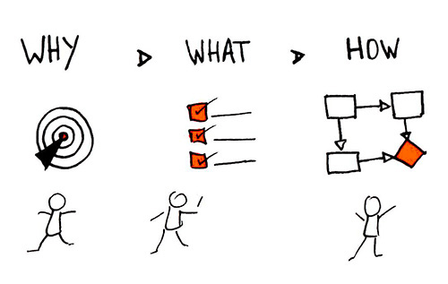
PURPOSE STATEMENT
Template #1.1: Creating an Assessment’s Purpose Statement
An assessment’s purpose statement outlines why the assessment was developed, what the assessment is measuring, and how the results (scores) can be used.
13
Notes:
An assessment’s purpose statement outlines why the assessment was developed, what the assessment is measuring, and how the results (scores) can be used.

Slide 7
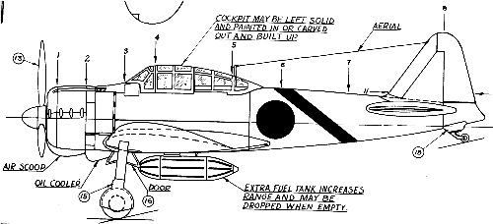
Blueprints support purpose
If the purpose is to build a cruise ship,
this may not be the best blueprint!
7
Notes:
Most test-design decisions are driven by information provided in documentation that pertains to the assessment’s purpose. The test-design blueprints provide information necessary to guide the item/task development process.

Slide 8
Assessment Title: ______________________________ Department: ______________________ Grade level: ____ Assessment Purpose:
Item/ Scoring Criteria | Item/Criteria Type |  |  |  |  |  |  |  | DOK
 | SR | Points | SCR | Points | ECR | Points | EP | Points | DoK 1 | DoK 2 | DoK 3 | DoK 4
totals

Slide 9
Build

Slide 10
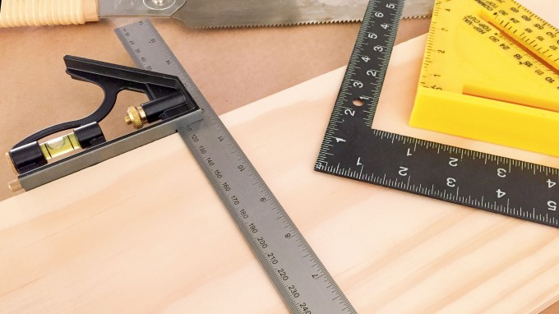
What is the role of assessment items and forms?
Building Phase
10
Notes:
Items, tasks and forms are part of the “Building” phase of assessment construction. Once a test or assessment has been designed,
items and tasks serve as the individual tools used to measure student achievement of content standards. Collectively, they are organized into operational forms. As with building a house, a variety of tools can and should be used to guarantee quality assessment construction. Module 2 will introduce eight item/task types. There are, however, additional item/task variations on the eight types presented.

Slide 11
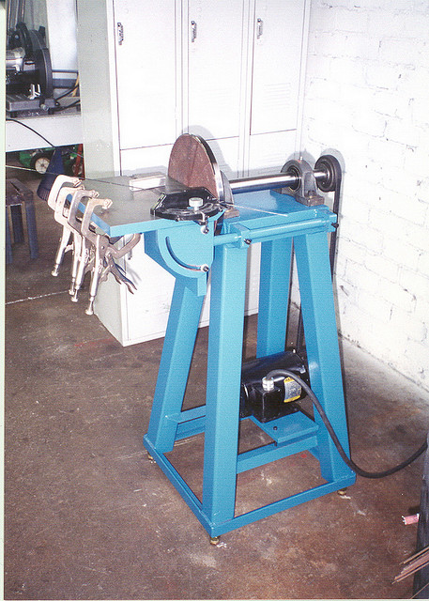
Module two: tools For Building assessment Items and Tasks
Template 2.1
Selected Response (SR)
Stand-Alone
Passage-Based
Evidence-Based
Short Constructed Response (SCR)
Stand-Alone
Passage-Based
Extended Constructed Response (ECR)
Stand-Alone
Text-Dependent Analysis
Performance Task (PT)
Multi-Day Task
Notes:
To build assessment items and tasks, test developers need some very specific tools and skills to insure that the items built are quality tools for measuring student achievement of content standards.
While there are some over-arching skills and concepts that apply to each of the eight assessment item/task types, there are also some very specific details that should be addressed for each individual type. Module 2 will present guidelines and procedural steps for each type, highlighting the similarities and differences among types.

Slide 12
SAMPLE
Who is buried in Grant’s Tomb?
John F. Kennedy’s Family
Dr. Seuss
Julia Grant
Grant Woods
General Ulysses S. Grant
Answers c and e are correct
Answers d and e are correct
Notes:
1. Use three answer options for grades K-2 and four or more options for grades 3-12.
4. Make sure distractors are plausible (realistic).
5. Present options in ascending/descending order when possible.
6. Avoid “All of the above.”, “None of the above.”, and “Both A and B are Correct.”

Slide 13
Improvement SAMPLE
The largest mausoleum in North America, built in 1897, is in New York City as a testament to a people’s gratitude for what person?
Frederick Douglas
Ulysses S. Grant
Harriet Tubman
William M. “Boss” Tweed

Slide 14
Score

Slide 15
Module 3.1.1
Scoring Keys
for use with
Selected Response (SR) Items
1. SR Stand-Alone Items
2. SR Passage Based Items
3. SR Evidence Based Items
8
Notes:
Scoring keys, rather than scoring rubrics, are used for selected-response items.
The guidelines in this section are meant to be used for assessing student responses to the three Selected Response item types introduced in Module 2.1:
.
1 Stand-alone items
2 Passage Based items, and
3 Evidence Based items.
Selected Response items require the test-taker to select the item’s answers from a bank of possible answers that have already been created. Since the test-taker is not creating his or her own answer, it is not necessary to create a rubric to assess the student’s answer, it is either “right” or “wrong.”

Slide 16
OBJECTIVES
Participants will be able to:
Develop scoring keys and rubrics for assessment items and tasks.
Create scoring guides for scoring keys and rubrics.
Engage in practices that eliminate errors in human scoring.
Notes:
The content for the first two objectives in this module shares a one-to-one relationship with the assessment item content found in module 2. Participants will be able to
Develop scoring keys and rubrics for assessment items and tasks, and
Create scoring guides for scoring keys and rubrics.
The final objective for this module puts rubrics at the forefront by
Engaging participants in practices that eliminate errors in human scoring.

Slide 17
Module 3.1.2
Scoring Rubrics
for use with
Short Constructed Response (SCR)
4. SCR Stand-Alone Items
5. SCR Passage Based Items
Extended Constructed Response (ECR)
6. ECR Stand-Alone Items
7. ECR TDA Items
Performance Task (PT) Items
8. Performance Task Items
14
Notes:
Short Constructed Response, Extended Constructed Response and Performance Task items require test-takers to create an answer rather than selecting it from a pre-supplied bank.
Scoring rubrics are created for these item types. Rubrics provide scorers with guidelines and criteria for scoring, as well as example student responses.

Slide 18
Definition
Scoring rubrics are…
tools used to measure and evaluate students’ achievement of a task
able to score items based on one or multiple dimensions (criteria)
There are two major types of scoring rubrics:
Holistic (single dimension)
Analytic (multiple dimensions)
15
Notes:
Scoring rubrics are tools used to measure and evaluate students’ achievement of a task. Rubrics are able to score items and tasks based on one or more dimensions. These dimensions are often called “criteria.”
There are two major types of scoring rubrics: holistic and analytic.
In holistic scoring, the scorer is combining multiple aspects or criteria with a particular classification scheme. This means that the performance is judged in its totality and assigned a point value based on a single dimension or criteria.
Conversely, analytic rubrics define key criteria either within or across multiple dimensions and assign point values. These point values are aggregated into the classification scheme, and aggregated points are assigned to determine “pass or fail” classifications.

Slide 19
Customized Design
The Assessment Literacy Series is designed to support the Administration and lead teachers in making changes in local assessments.
The professional development will be designed as PDE being the instructors, and local staff as the facilitators and support for implementation.

Slide 20
Administration Roles
Administration will be responsible for follow up scheduling of facilities, time and material distribution.
Facilitators time for accountability protocols (Professional Learning Communities, support for reviewing design, build and score in the classroom)
Set the standard for accountability and follow through

Slide 21
PDE Roles
Prepare and deliver the trainings to facilitators for half day sessions
Prepare and deliver trainings to staff and faculty for full day sessions
Support Administration in implementation

Slide 22
Thanks

