Slide 1
Enrichment…It is not just for gifted anymore.
Developing and Implementing Enrichment Tasks
Notes:
Cheryl and Tanya introduce themselves.

Slide 2
Enrichment
How do you define enrichment?
What do enrichment tasks look like?
How can enrichment be implemented successfully in a classroom?
Notes:
Tanya

Slide 3
Choose one of the following prompts to complete:
Enrichment is…
When you enrich in a classroom for all students you….
Enrichment looks like….
Participant choice…
msfalconesenrichmentclass.blogspot.com
Notes:
Tanya

Slide 4
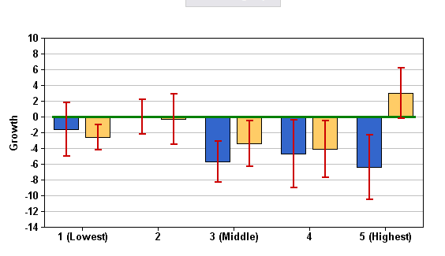
Look Similar/Familiar?
Notes:
Tanya

Slide 5
According to Chapter 4
4.1 – General Purpose
4.4 – Flexibility of LEA
4.11 – Challenge students to achieve at the highest level possible
Notes:
Tanya

Slide 6
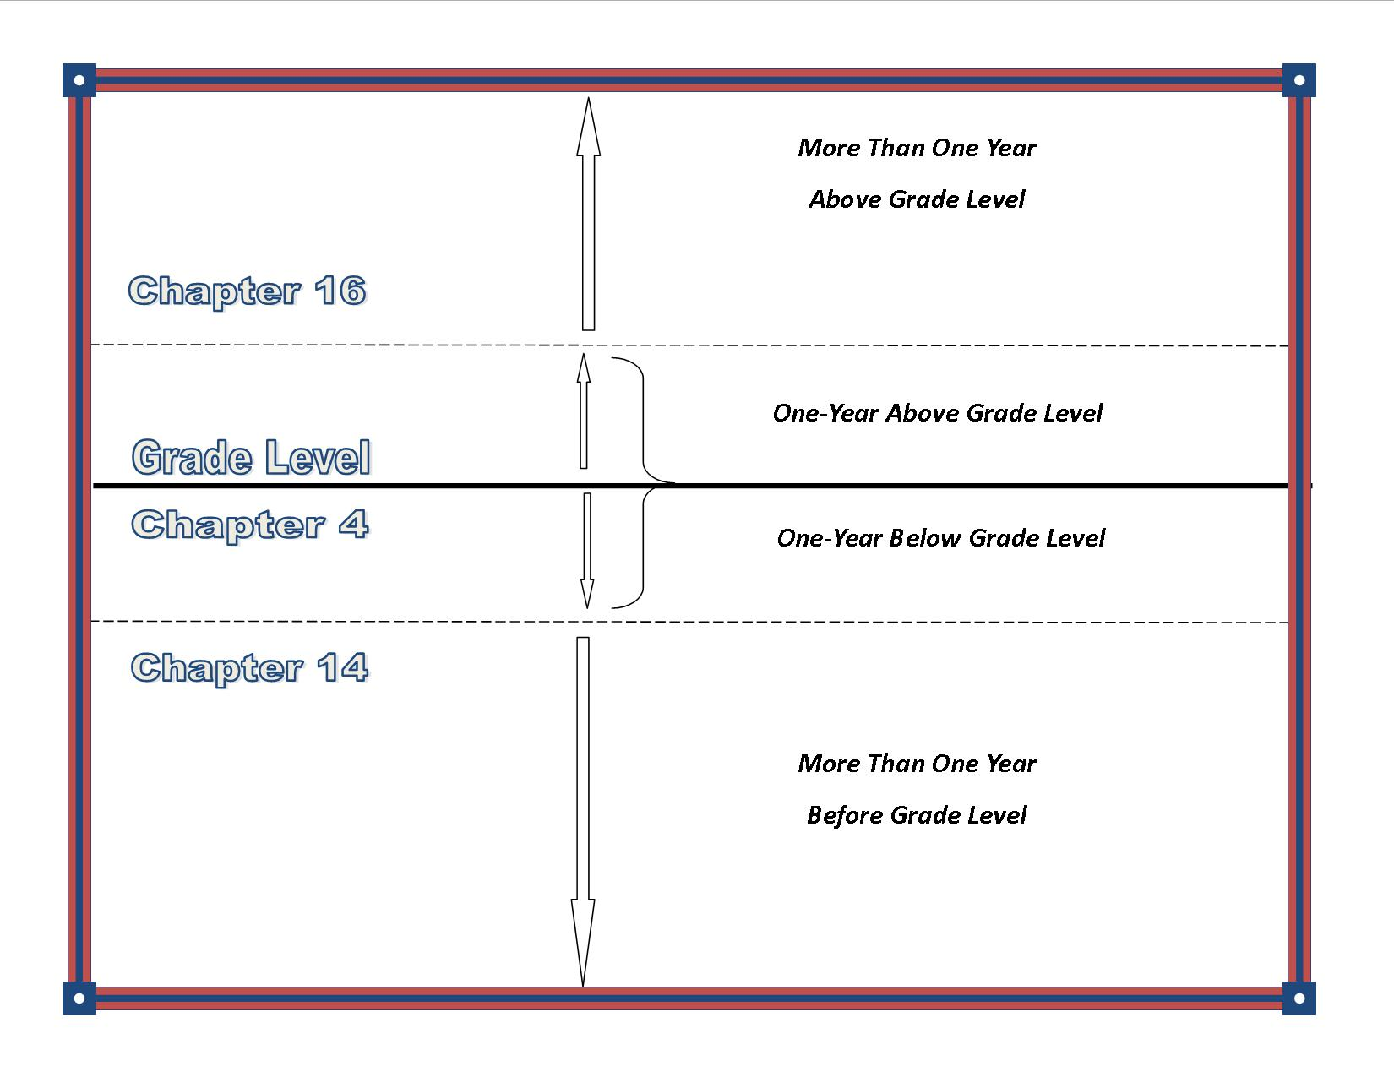
Enrichment
Notes:
Tanya

Slide 7
So….
Who should we be designing these enrichment tasks for?
Everyone!
Notes:
Tanya

Slide 8
Enrichment
How do you define enrichment?
What do enrichment tasks look like?
How can enrichment be implemented successfully in a classroom?
Notes:
Cheryl

Slide 9
What does enrichment look like in the classroom?
Marzano - Extended Learning
Focus on the 8 most common thinking skills: classifying/categorizing, inductive thinking, deductive thinking, compare/contrast, constructing support, error analysis, abstracting, and analyzing perspectives
John Hattie - Piagetian Programs
Focus on the thinking processes rather than the outcomes and do not impose the adult thinking process on to children.
Doug Reeves –Top Four
Writing/ Note taking
Recognizing Student Achievement
Engaging Classroom
Deep Questioning
Notes:
Cheryl

Slide 10
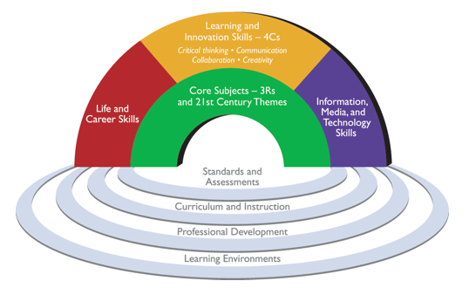
21st Century Student Outcomes and Support systems
Source: Partnership for 21st Century Skills. www.p21.org
Notes:
Cheryl

Slide 11
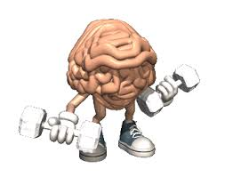
Webb’s Depth of Knowledge
LEVEL | DEFINITIONS
1 | Recall and Reproduction: Basic recall of information such as facts, definitions, terms, or performance of a simple process or procedure.
2 | Skills and Concepts: Engagement of some mental processing beyond recall or reproduction. Requires students to make some decisions as to how to approach the question or problem. Actions require more than one mental or cognitive process/step.
3 | Strategic Thinking: Requires deep understanding and reasoning as exhibited through planning, using evidence, and engaging in more demanding cognitive reasoning. Cognitive demands are complex and abstract.
4 | Extended Thinking: Process multiple conditions of real-world problems or tasks through analysis & synthesis of information. Requires high cognitive demand and is very complex.
changeyourchoices.wordpress.com
Notes:
Cheryl

Slide 12
By any other name….
Webb’s
Depth of
Knowledge – L3 and L4
Enduring
Understanding
Enrichment
Extended
Learning
Real World/
Authentic
21st Century Skills
Rigor/Relevance
Notes:
Cheryl

Slide 13
Enrichment
How do you define enrichment?
What do enrichment tasks look like?
How can enrichment be implemented successfully in a classroom?
Notes:
Tanya

Slide 14
Addressing the Standards
Use pre-assessment to plan for differentiation
Consider enrichment/acceleration as appropriate to the student’s needs and guided by the standards
Use formative assessment to adjust pace of instruction
Use flexible grouping to address readiness differences
Match students to materials and resources based on readiness
Engage students in progressively more complex learning
Commit to each student’s continual learning progress
Heacox and Cash, 2014
Notes:
Tanya

Slide 15
Comparing Math Examples
8th Grade Assessment
Scientific Notation Unit
“Traditional” vs “Common Core”

Slide 16
What types of learners do we have?
www.aspirehigheryouthprogram.com
Below Level
On Level
Above Level
Notes:
Tanya

Slide 17
Steps to Creating Tiered Task
Analyze the DOK level of the current enrichment task
Determine what standards coincide with this task
Essential Knowledge/Power Standard
Important knowledge/Nice to Know
Adjust the enrichment task to reflect DOK Level 2 or above
Use the Continuum of Complexity, to develop tiers for the task
Entry Level
Advanced Level
Most Challenging Level
Notes:
Tanya

Slide 18
Steps to Creating Tiered Task
Analyze the DOK level of the current enrichment task
Determine what standards coincide with this task
Essential Knowledge/Power Standard
Important knowledge/Nice to Know
Adjust the enrichment task to reflect DOK Level 2 or above
Use the Continuum of Complexity, to develop tiers for the task
Entry Level
Advanced Level
Most Challenging Level
Notes:
Cheryl

Slide 19
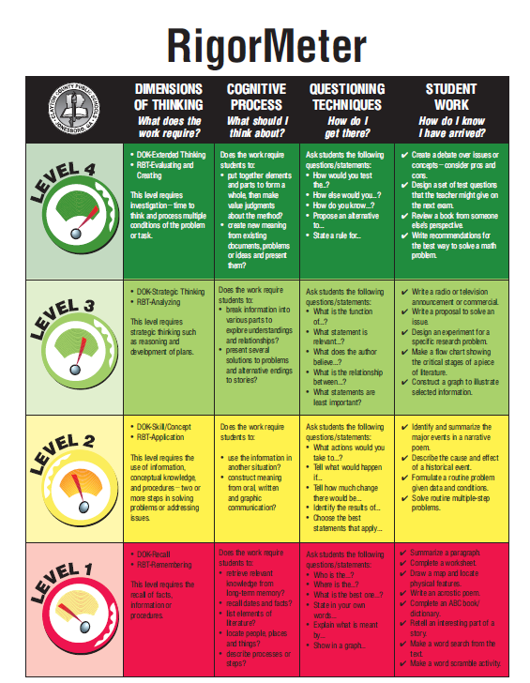
STEP 1
Notes:
Cheryl

Slide 20
Notes:
Cheryl

Slide 21
Making Connections
STEP 1
Notes:
Cheryl

Slide 22
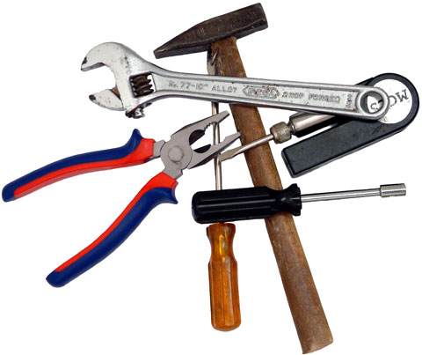
Give it a try…
Work with a neighbor to analyze the task you were given.
Which tool worked best for you?
https://gamesined.wikispaces.com
Notes:
Cheryl

Slide 23
Third Grade Math Task:
Explain how multiplication and division are connected. What is the reoccurring theme seen in both? Create a visual representation to display and explain this reoccurring theme.
DOK Level- ???
Notes:
Cheryl

Slide 24
Steps to Creating Tiered Task
Analyze the DOK level of the current enrichment task
Determine what standards coincide with this task
Essential Knowledge/Power Standard
Important knowledge/Nice to Know
Adjust the enrichment task to reflect DOK Level 2 or above
Use the Continuum of Complexity, to develop tiers for the task
Entry Level
Advanced Level
Most Challenging Level
Notes:
Cheryl

Slide 25
Math:
Explain how multiplication and division are connected. What is the reoccurring theme seen in both? Create a visual representation to display and explain this reoccurring theme.
STEP 2
CC.2.2.3.A.2: Understand properties of multiplication and the relationship between multiplication and division.
M03.B-O.1.2.1
M03.B-O.1.2.2
Essential v. Important
Notes:
Cheryl
M03.B-O.1.1.1
M03.B-O.1.1.2
M03.B-O.1.2.1
M03.B-O.1.2.2

Slide 26
Steps to Creating Tiered Task
Analyze the DOK level of the current enrichment task
Determine what standards coincide with this task
Essential Knowledge/Power Standard
Important knowledge/Nice to Know
Adjust the enrichment task to reflect DOK Level 2 or above
Use the Continuum of Complexity, to develop tiers for the task
Entry Level
Advanced Level
Most Challenging Level
Notes:
Cheryl

Slide 27
Math:
Explain how multiplication and division are connected. What is the reoccurring theme seen in both? Create a visual representation to display and explain this reoccurring theme.
STEP 3
Do we need to adjust the DOK? If so, how might you do it?
Notes:
Cheryl

Slide 28
Steps to Creating Tiered Task
Analyze the DOK level of the current enrichment task
Determine what standards coincide with this task
Essential Knowledge/Power Standard
Important knowledge/Nice to Know
Adjust the enrichment task to reflect DOK Level 2 or above
Use the Continuum of Complexity, to develop tiers for the task
Entry Level
Advanced Level
Most Challenging Level
Notes:
Tanya

Slide 29
What types of learners do we have?
www.aspirehigheryouthprogram.com
Below Level
On Level
Above Level
Notes:
Tanya

Slide 30
Math:
Explain how multiplication and division are connected. What is the reoccurring theme seen in both? Create a visual representation to display and explain this reoccurring theme.
Entry Level (Level at which they are mastering the essential knowledge) | Advanced Level | Most Challenging Level
Explain how multiplication and division are connected. What is the reoccurring theme seen in both? Create a visual representation to display and explain this reoccurring theme. | Describe how the four operations are connected to each other? Create a multi-step word problem and solve it, showing which connection(s) you used and explain why it was the most efficient option. | Describe an occupation that would apply multiplication and division in their field. Create a real life scenario describing how they would make use of that connection.
Notes:
Tanya

Slide 31
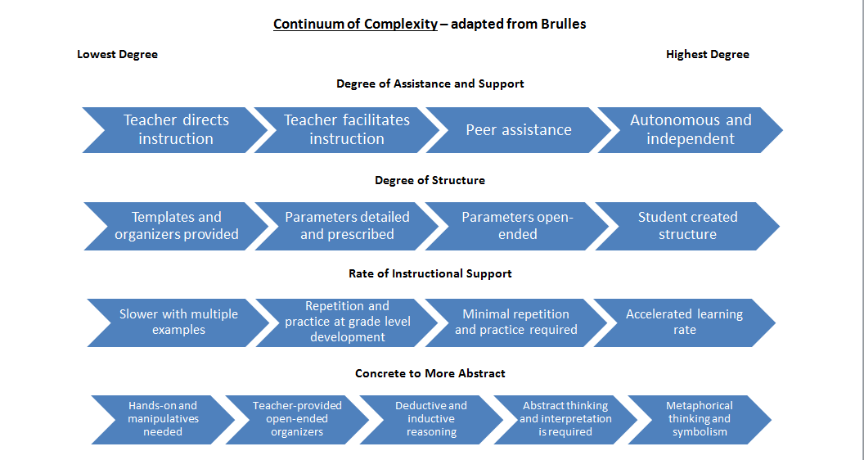
Notes:
Tanya

Slide 32
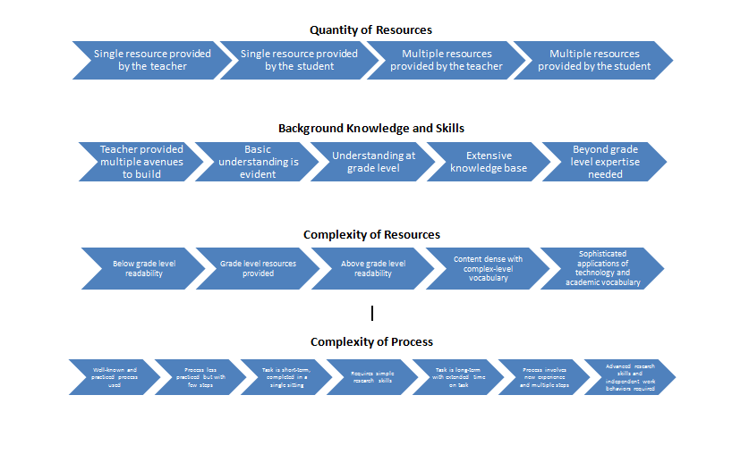
Notes:
Tanya

Slide 33
Notes:
Tanya

Slide 34
Entry Level (Level at which they are mastering the essential knowledge) | Advanced Level | Most Challenging Level
Explain how multiplication and division are connected. What is the reoccurring theme seen in both? Create a visual representation to display and explain this reoccurring theme. Give Detailed Parameters for representation (poster) | Explain how multiplication and division are connected. What is the reoccurring theme seen in both? Create a visual representation to display and explain this reoccurring theme. Give Open-Ended Parameters for representation (poster) | Explain how multiplication and division are connected. What is the reoccurring theme seen in both? Create a visual representation to display and explain this reoccurring theme. Allow student created structure (not necessarily a poster)
Notes:
Tanya

Slide 35
Entry Level (Level at which they are mastering the essential knowledge) | Advanced Level | Most Challenging Level
Explain how multiplication and division are connected. What is the reoccurring theme seen in both? Create a visual representation to display and explain this reoccurring theme. Give Detailed Parameters for representation (poster) | Explain how multiplication and division are connected. What is the reoccurring theme seen in both? Create a visual representation to display and explain this reoccurring theme. Give Open-Ended Parameters for representation (poster) | Describe two occupations that would apply multiplication and division in their fields?. Create a real life scenario describing how they would be implemented in one of those occupations.
Notes:
Tanya

Slide 36
Your Turn
Analyze the DOK level of the current enrichment task
Determine what standards coincide with this task
Essential Knowledge/Power Standard
Important knowledge/Nice to Know
Adjust the enrichment task to reflect DOK Level 2 or above
Use the Continuum of Complexity, to develop tiers for the task
Entry Level
Advanced Level
Most Challenging Level

Slide 37
Revisit your definition, would you make any changes?
msfalconesenrichmentclass.blogspot.com
Notes:
Tanya

Slide 38
Questions or Concerns
istudyincanada.com
Tanya Morret
Capital Area Intermediate Unit
tmorret@caiu.org
Cheryl Everett
Chester County Intermediate Unit
cheryle@cciu.org
Notes:
Tanya

