Slide 1
Enrichment…It is not just for gifted anymore.
Developing and Implementing Enrichment Tasks

Slide 2
Enrichment
How do you define enrichment?
What do enrichment tasks look like?
How can enrichment be implemented successfully in a classroom?

Slide 3
Look Similar/Familiar?

Slide 4
According to Chapter 4
4.1 – General Purpose
4.4 – Flexibility of LEA
4.11 – Challenge students to achieve at the highest level possible

Slide 5
According to Chapter 16
Options for Educational Placement (Service, not a Location)
Acceleration
Enrichment
Combination of both
Gifted Guidelines state that enrichment is:
“In-depth learning experiences that provide interaction with new ideas, skills and topics that enhance the curriculum. These experiences are based upon individual student strengths, interests and needs.”

Slide 6
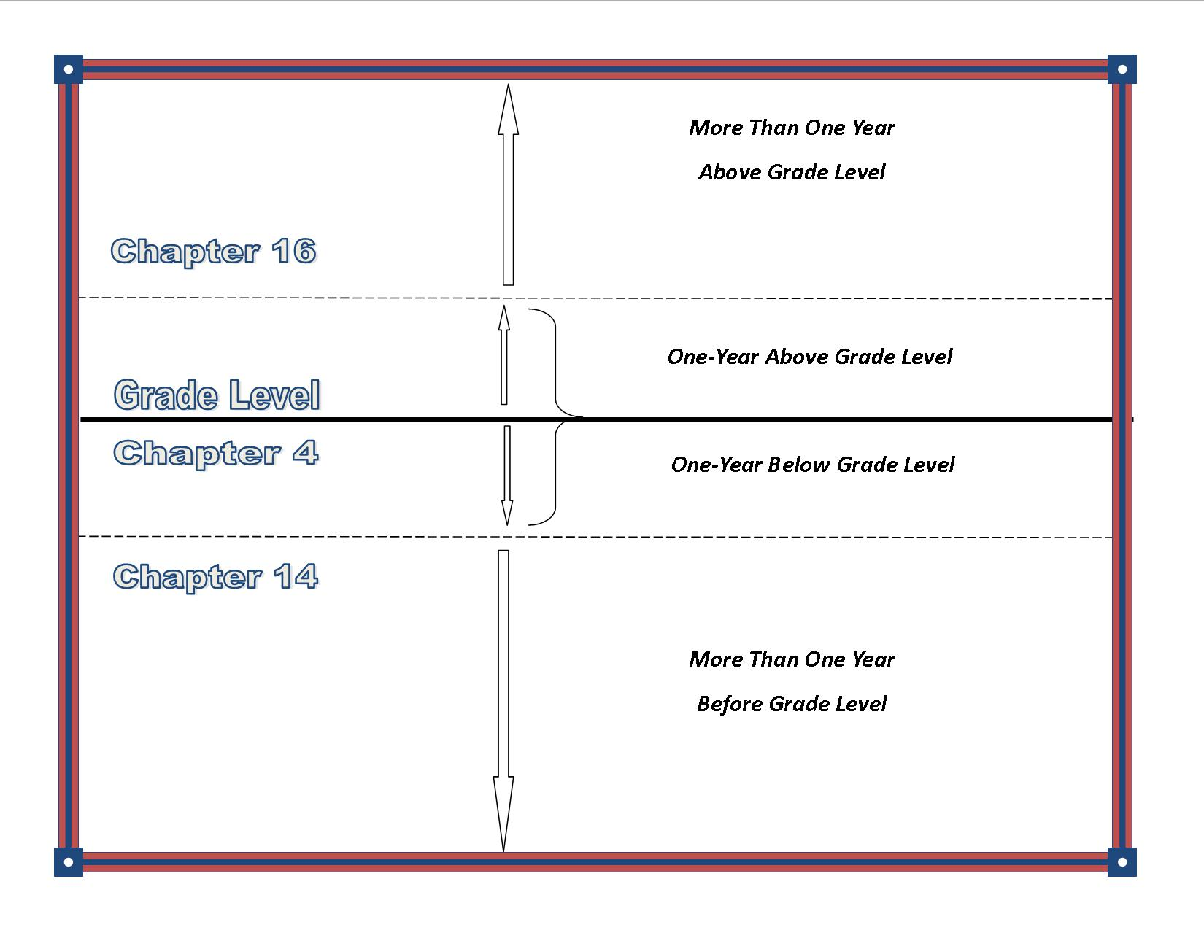

Slide 7
Enrichment

Slide 8
What does enrichment look like in the classroom?
Marzano - Extended Learning
Focus on the 8 most common thinking skills: classifying/categorizing, inductive thinking, deductive thinking, compare/contrast, constructing support, error analysis, abstracting, and analyzing perspectives
John Hattie - Piagetian Programs
Focus on the thinking processes rather than the outcomes and do not impose the adult thinking process on to children.
Doug Reeves –Top Four
Writing/ Note taking
Recognizing Student Achievement
Engaging Classroom
Deep Questioning

Slide 9
Chose one of the following prompts to complete and be prepared to share out in a Whip Around/Pass.
Enrichment is…
When you enrich in a classroom for all students you….
Enrichment looks like….
Participant choice…
msfalconesenrichmentclass.blogspot.com

Slide 10
Enrichment
How do you define enrichment?
What do enrichment tasks look like?
How can enrichment be implemented successfully in a classroom?

Slide 11
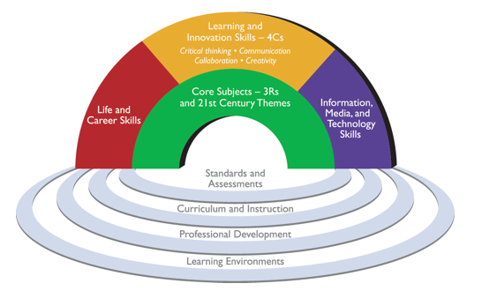
21st Century Student Outcomes and Support systems
Source: Partnership for 21st Century Skills. www.p21.org

Slide 12
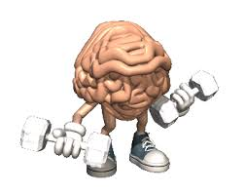
Webb’s Depth of Knowledge
LEVEL | DEFINITIONS
1 | Recall and Reproduction: Basic recall of information such as facts, definitions, terms, or performance of a simple process or procedure.
2 | Skills and Concepts: Engagement of some mental processing beyond recall or reproduction. Requires students to make some decisions as to how to approach the question or problem. Actions require more than one mental or cognitive process/step.
3 | Strategic Thinking: Requires deep understanding and reasoning as exhibited through planning, using evidence, and engaging in more demanding cognitive reasoning. Cognitive demands are complex and abstract.
4 | Extended Thinking: Process multiple conditions of real-world problems or tasks through analysis & synthesis of information. Requires high cognitive demand and is very complex.
changeyourchoices.wordpress.com

Slide 13
By any other name….
Webb’s
Depth of
Knowledge – L3 and L4
Enduring
Understanding
Enrichment
Extended
Learning
Real World/
Authentic
21st Century Skills
Rigor/Relevance

Slide 14
Enrichment
How do you define enrichment?
What do enrichment tasks look like?
How can enrichment be implemented successfully in a classroom?

Slide 15
Addressing the Standards
Use pre-assessment to plan for differentiation
Consider enrichment/acceleration as appropriate to the student’s needs and guided by the standards
Use formative assessment to adjust pace of instruction
Use flexible grouping to address readiness differences
Match students to materials and resources based on readiness
Engage students in progressively more complex learning
Commit to each student’s continual learning progress
Heacox and Cash, 2014

Slide 16
What types of learners do we have?
www.aspirehigheryouthprogram.com
Below Level
On Level
Above Level

Slide 17
Steps to Creating Tiered Task
Analyze the DOK level of the current enrichment task
Determine what standards coincide with this task
Essential Knowledge/Power Standard
Important knowledge/Nice to Know
Adjust the enrichment task to reflect DOK Level 2 or above
Use the Continuum of Complexity, to develop tiers for the task
Entry Level
Advanced Level
Most Challenging Level

Slide 18
Steps to Creating Tiered Task
Analyze the DOK level of the current enrichment task
Determine what standards coincide with this task
Essential Knowledge/Power Standard
Important knowledge/Nice to Know
Adjust the enrichment task to reflect DOK Level 2 or above
Use the Continuum of Complexity, to develop tiers for the task
Entry Level
Advanced Level
Most Challenging Level

Slide 19
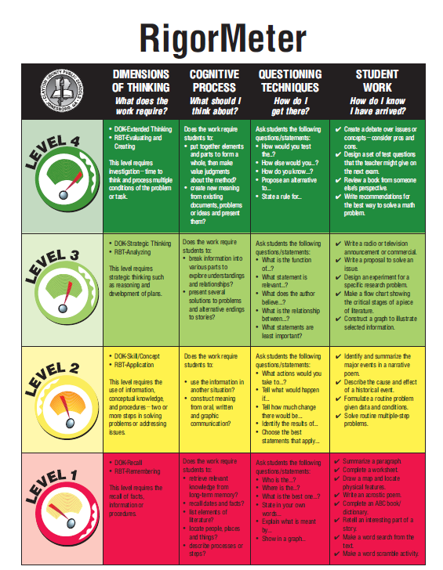
STEP 1

Slide 20
Making Connections
STEP 1

Slide 21
Third Grade Math Task:
Explain how multiplication and division are connected. What is the reoccurring theme seen in both? Create a visual representation to display and explain this reoccurring theme.
DOK Level- ???

Slide 22
Steps to creating tiered task
Analyze the DOK level of the current enrichment task
Determine what standards coincide with this task
Essential Knowledge/Power Standard
Important knowledge/Nice to Know
Adjust the enrichment task to reflect DOK Level 2 or above
Use the Continuum of Complexity, to develop tiers for the task
Entry Level
Advanced Level
Most Challenging Level

Slide 23
Math:
Explain how multiplication and division are connected. What is the reoccurring theme seen in both? Create a visual representation to display and explain this reoccurring theme.
STEP 2
CC.2.2.3.A.2: Understand properties of multiplication and the relationship between multiplication and division.
Essential v. Important
Notes:
M03.B-O.1.1.1
M03.B-O.1.1.2
M03.B-O.1.2.1
M03.B-O.1.2.2

Slide 24
Steps to creating tiered task
Analyze the DOK level of the current enrichment task
Determine what standards coincide with this task
Essential Knowledge/Power Standard
Important knowledge/Nice to Know
Adjust the enrichment task to reflect DOK Level 2 or above
Use the Continuum of Complexity, to develop tiers for the task
Entry Level
Advanced Level
Most Challenging Level

Slide 25
Math:
Explain how multiplication and division are connected. What is the reoccurring theme seen in both? Create a visual representation to display and explain this reoccurring theme.
STEP 3
Do we need to adjust the DOK? If so, how might you do it?

Slide 26
Steps to creating tiered task
Analyze the DOK level of the current enrichment task teachers Identify the standards that are connected to the task
Determine what standards coincide with this task
Essential Knowledge/Power Standard
Important knowledge/Nice to Know
Adjust the enrichment task to reflect DOK Level 2 or above
Use the Continuum of Complexity, to develop tiers for the task
Entry Level
Advanced Level
Most Challenging Level

Slide 27
Math:
Explain how multiplication and division are connected. What is the reoccurring theme seen in both? Create a visual representation to display and explain this reoccurring theme.
Entry Level (Level at which they are mastering the essential knowledge) | Advanced Level | Most Challenging Level
Explain how multiplication and division are connected. What is the reoccurring theme seen in both? Create a visual representation to display and explain this reoccurring theme. | Describe how the four operations are connected to each other? Create a multi-step word problem and solve it, showing which connection(s) you used and explain why it was the most efficient option. | Describe an occupation that would apply multiplication and division in their field. Create a real life scenario describing how they would make use of that connection.

Slide 28
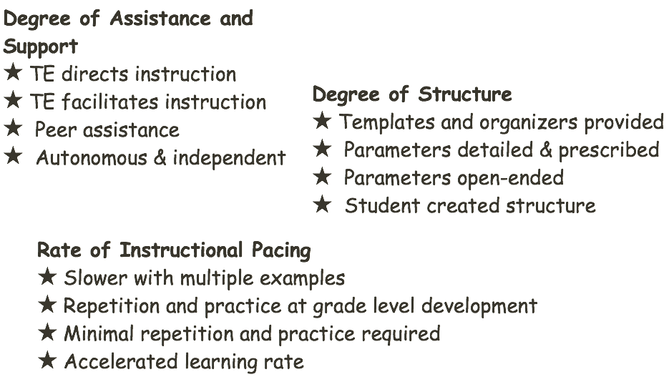
Add the Continuum of Complexity
STEP 4

Slide 29
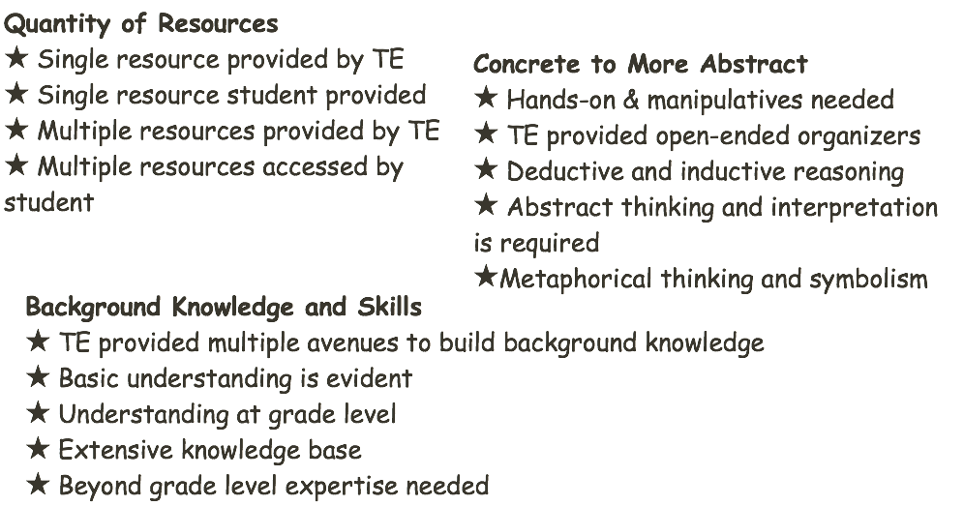
Continuum of Complexity
STEP 4

Slide 30
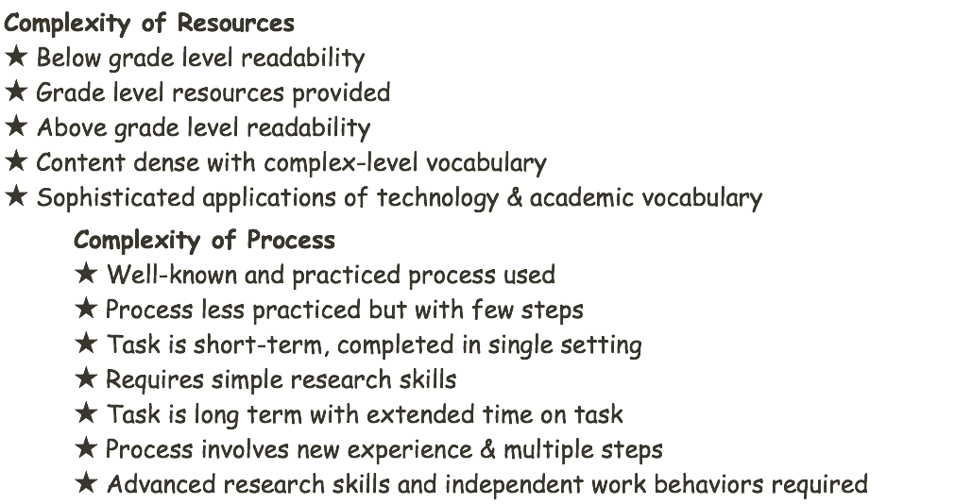
Continuum of Complexity
STEP 4

Slide 31
Continuum of Complexity
STEP 4

Slide 32
Entry Level (Level at which they are mastering the essential knowledge) | Advanced Level | Most Challenging Level
Explain how multiplication and division are connected. What is the reoccurring theme seen in both? Create a visual representation to display and explain this reoccurring theme. Give Detailed Parameters for representation (poster) | Explain how multiplication and division are connected. What is the reoccurring theme seen in both? Create a visual representation to display and explain this reoccurring theme. Give Open-Ended Parameters for representation (poster) | Explain how multiplication and division are connected. What is the reoccurring theme seen in both? Create a visual representation to display and explain this reoccurring theme. Allow student created structure (not necessarily a poster)

Slide 33
Entry Level (Level at which they are mastering the essential knowledge) | Advanced Level | Most Challenging Level
Explain how multiplication and division are connected. What is the reoccurring theme seen in both? Create a visual representation to display and explain this reoccurring theme. Give Detailed Parameters for representation (poster) | Explain how multiplication and division are connected. What is the reoccurring theme seen in both? Create a visual representation to display and explain this reoccurring theme. Give Open-Ended Parameters for representation (poster) | Describe two occupations that would apply multiplication and division in their fields?. Create a real life scenario describing how they would be implemented in one of those occupations.

Slide 34
Pre-assessing: Tier it
By the Lesson
By the Week
By The Unit/Chapter
With Acquired or New Knowledge

Slide 35
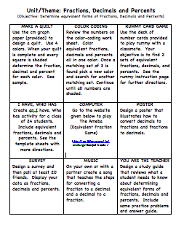
Extension Menu or Choice Board
Notes:
Not sure we need this slide.

Slide 36
Your Turn
Analyze the DOK level of the current enrichment task
Determine what standards coincide with this task
Essential Knowledge/Power Standard
Important knowledge/Nice to Know
Adjust the enrichment task to reflect DOK Level 2 or above
Use the Continuum of Complexity, to develop tiers for the task
Entry Level
Advanced Level
Most Challenging Level
Notes:
Ask participants to use the task they picked up as they walked into the session.- ES, MS, HS example.

Slide 37
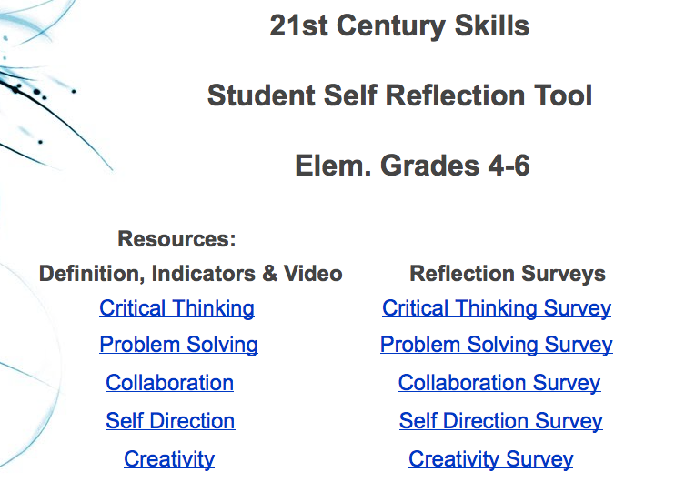
Self Reflection How do you learn?

Slide 39
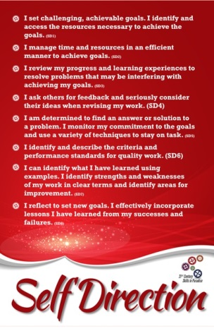
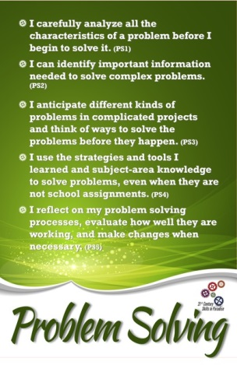
Self Reflection Tools

Slide 40
Questions or Concerns
istudyincanada.com
Tanya Morret
Capital Area Intermediate Unit
tmorret@caiu.org
Cheryl Everett
Chester County Intermediate Unit
cheryle@cciu.org

