Slide 1
Course 1 Pennsylvania Department of Education Educator Dashboard Overview
Document #C1.2
Notes:
In this course we will be taking a high level look at PDE’s Educator Dashboard project.

Slide 2
Agenda
Discuss the benefits of Local Education Agency (LEA) participation in the PDE Educator Dashboard Project
Review the high-level project implementation plan
Review the training and support available for LEAs
Discuss LEA roles and responsibilities
Review frequently asked questions (FAQs)
Notes:
In this course we specifically are going to:
Discuss the benefits of Local Education Agency (LEA) participation in the PDE Educator Dashboard Project
Review the high level project implementation plan
Review the training and support available for LEAs
Discuss LEA roles and responsibilities
Review frequently asked questions (FAQs)

Slide 3
Course Pre-Requisites
This is an introductory course. There are no pre-requisites.
Notes:
This is an introductory course. There are not pre-requisites.

Slide 4
Course Learning Objectives
Participants will be able to:
Identify the benefits of LEA participation in the project
Summarize the implementation plan
Articulate the training and support that will be available to Dashboard participants
Identify the roles and responsibilities for the LEA, Intermediate Unit (IU) and PDE resources
Articulate the responses to FAQs
Notes:
By the end of this course, participants will be able to:
Identify the benefits of LEA participation in the project
Summarize the implementation plan
Articulate the training and support that will be available to Dashboard participants
Identify the roles and responsibilities for the LEA, Intermediate Unit (IU) and PDE resources
Articulate the responses to FAQs

Slide 5
Benefits of Participation
Notes:
Next let’s talk about the benefits of participation.

Slide 6
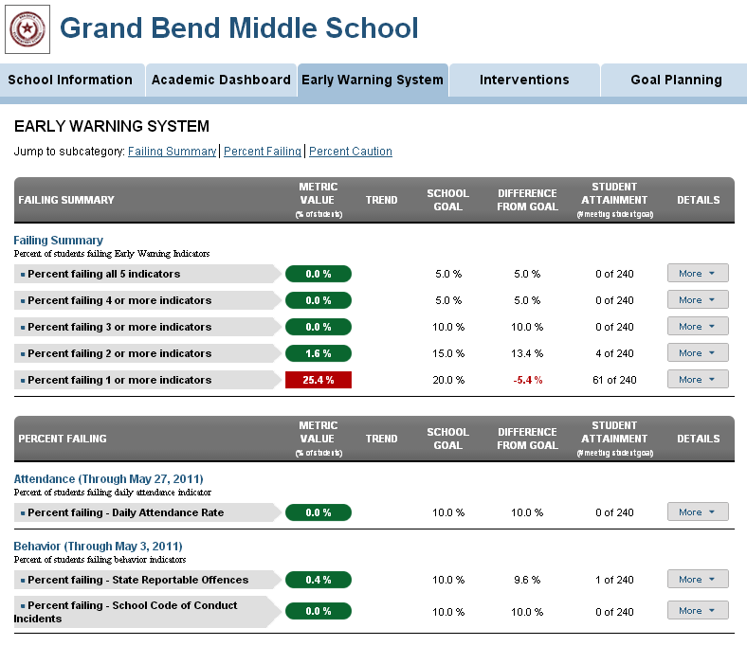
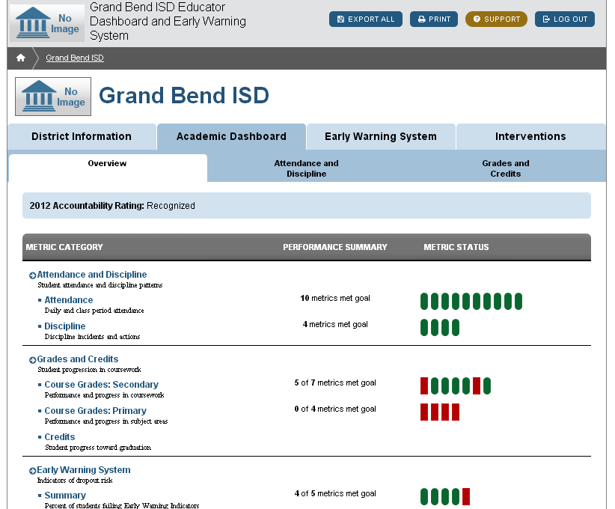
Educator Dashboard Introduction
The Educator Dashboard is a free, voluntary tool available to all commonwealth local education agencies
Notes:
The Educator Dashboard is a free, voluntary tool available to all commonwealth local education agencies.

Slide 7
Educator Dashboard Overview
Building on existing Pennsylvania Information Management Systems (PIMS) functionality, the Educator Dashboard provides a specific lens through which the districts are able to:
Identify students at risk of dropping out
Build a library of district-specific interventions
Increase community partnerships and support schools
Set goals for student achievement
Improve student success rates
Notes:
Building on existing Pennsylvania Information Management Systems (PIMS) functionality, the Educator Dashboard provides a specific lens through which the districts are able to:
Identify students at risk of dropping out
Build a library of district specific interventions
Increase community partnerships and support schools
Set goals for student achievement
Improve student success rates

Slide 8
Field-tested Model
The Educator Dashboard is based on the Ed-Fi Dashboard model
The Ed-Fi Alliance is a partnership of education agencies across the country
Alliance members collaborate to share insights and lessons learned
http://www.ed-fi.org/
Notes:
The Educator Dashboard are based on the Ed-Fi Dashboard model. The Ed-Fi Alliance, owned by the Michael and Susan Dell Foundation is a partnership of education agencies across the country. The Alliance allows education agencies to build from the success of others.

Slide 9
Research-based Practices
PDE engaged Dr. Robert Balfanz to guide the development of the Educator Dashboard
Dr. Robert Balfanz of Johns Hopkins University’s Everyone Graduates Center is a leader of research on drop out prevention
Balfanz focuses on data-based factors that identify students at risk for dropping out
http://www.every1graduates.org/
Notes:
PDE engaged Dr. Robert Balfanz to guide the development of the Educator Dashboard. Dr. Robert Balfanz of Johns Hopkins University’s Everyone Graduates Center is a leader of research on drop out prevention. Balfanz focuses on data-based factors that identify students at risk for dropping out.

Slide 10
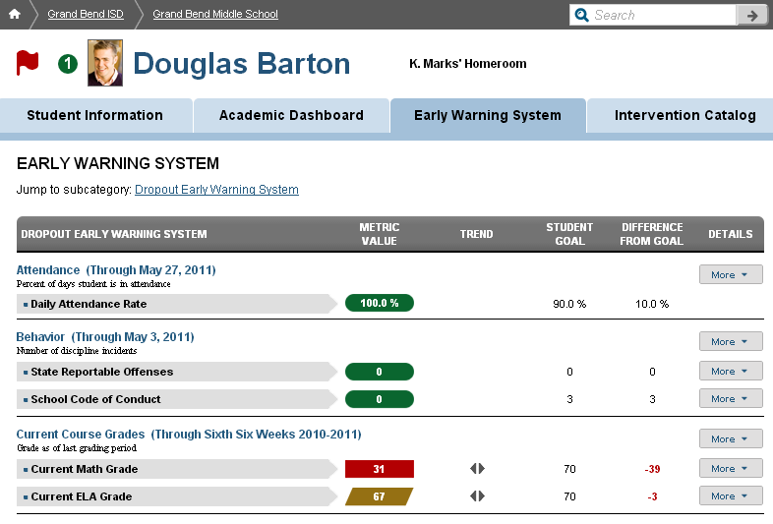
High Level Overview of the Early Warning System
The PDE Educator Dashboard based the development of the Early Warning metrics on the research provided by Balfanz and lessons learned by earlier implementations
The Early Warning screen focuses on the ABC’s of Early Warning Indicators
Attendance
Behavior
Course Performance
Notes:
The PDE Educator Dashboard based the development of the Early Warning metrics on the research provided by Balfanz and lessons learned by earlier implementations. The Early Warning screen focuses on the ABC’s of Early Warning Indicators, which include attendance, behavior and course performance. In Course 3 we will dig deeper into this research.

Slide 11
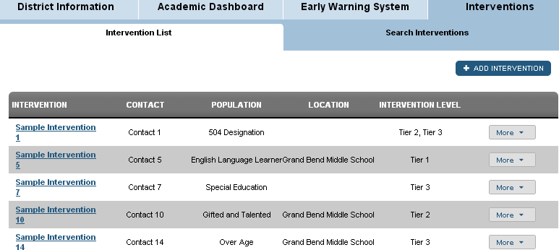
PDE Takes the Next Steps
PDE’s Educator Dashboard integrates a new component to address the Next Steps after a student is identified as at risk
PDE’s Educator Dashboard has an Intervention Catalog that is customized by each LEA so it’s representative of local resources
PDE’s Intervention Catalog is the first state-wide implementation of its kind
Notes:
PDE’s Educator Dashboard integrates a new component to address the Next Steps after an at-risk student is identified. PDE’s Educator Dashboard has an Intervention Catalog that is partially populated by PDE and customized by each LEA so it’s representative of local resources. PDE’s Intervention Catalog is the first state-wide implementation of its kind. We will learn more about the Intervention Catalog in Course 4 and Course 5C.

Slide 12
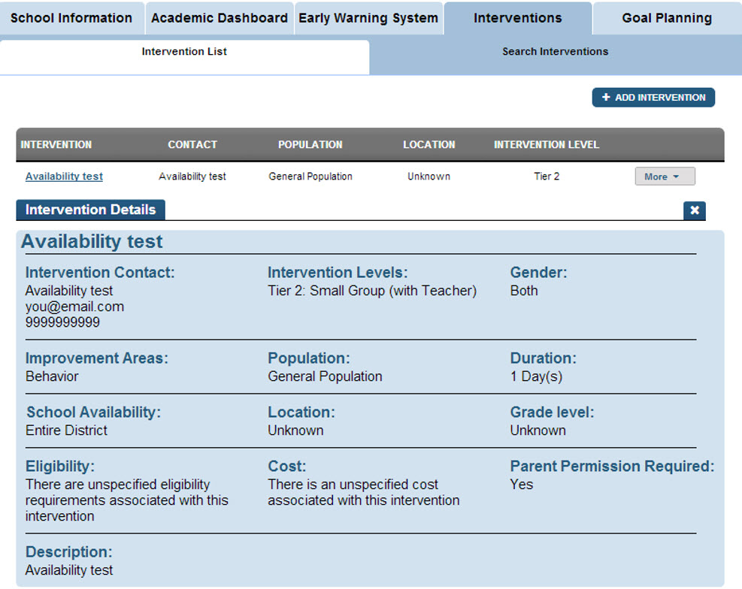
Intervention Catalog
Schools assign students with local interventions specific to his or her need
Staff members can track progress and rate the interventions
Interventions are categorized by area of need and specialization
Notes:
Students are assigned local interventions specific to his or her need
Staff members can track progress and rate the interventions
Interventions are categorized by area of need and specialization

Slide 13
Benefit to Teachers and Administrators
The PDE Educator Dashboard puts relevant, real-time data in the hands of educators working with students in the schools and districts
Time-saving information will be presented in a single, user-friendly platform to assist educators in making data-based decisions
Student success will increase as educators have access to the information in the Dashboard
Notes:
The PDE Educator Dashboard puts relevant, real-time data in the hands of educators working on the front lines of the schools and districts. Data will be returned to the source with the powerful value-add of the Dashboard to render the data into information. Students will ultimately reap the benefits of more-informed educators who base programmatic and instructional decisions on data.

Slide 14
Project Overview & Implementation
Notes:
Now that we know a little bit about the genesis of the project, let’s take a look at how we are going to make this work.

Slide 15
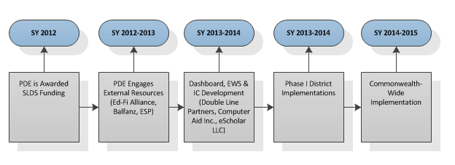
PDE Educator Dashboard Project Timeline
Notes:
Let’s walk through the high level implementation timeline. PDE was awarded SLDS funding for the PDE Educator Dashboard project. In the 2012-2013 school year PDE engaged external resources, including the Ed-Fi Alliance, Dr. Robert Balfanz of the Everyone Graduates Center, ESP Solutions and Double Line Partners. In the following school year, 2013-2014 development of the Dashboard, inclusive of the Early Warning System and Intervention Catalog began. PDE also began implementation with the Phase I districts. During the 2014-2015 school year the PDE Educator Dashboard will be available to LEAs across the Commonwealth.

Slide 16
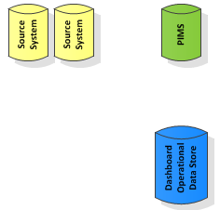
End User Process Map
Web Services
Notes:
Let’s walk through a high level of the End User Process Map. Data is extracted from source systems (SIS,HR, Assessments) using either web services or the manual data upload process. The data is sent to PIMS as an end result of this process. As a note, once the web services is set up, there is not a need to do the manual data submissions. The routines will run automatically. Once in PIMS, the Dashboard data is logically separated from the PIMS data.
On a nightly basis, the Operational Dashboard Data Store extracts the target data from PIMS and populates the Dashboard. This operational data store populate the Dashboard with information.

Slide 17
Security Statement
Data submitted by local education agencies (LEAs) to the EWS through PIMS is not at any time owned by PDE. This data can be deleted from the PIMS data warehouse by the respective LEA without prior notice using a delete utility provided by PDE.
The confidentiality of the EWS data as well as all other data in PIMS is of the utmost importance to PDE. Therefore, PDE will not release or disclose personally identifiable student level data regarding students in the public schools of Pennsylvania unless required by law.
Notes:
Data submitted by local education agencies (LEAs) to the EWS through PIMS is not at any time owned by PDE. This data can be deleted from the PIMS data warehouse by the respective LEA without prior notice using a delete utility provided by PDE.
The confidentiality of the EWS data as well as all other data in PIMS is of the utmost importance to PDE. Therefore, PDE will not release or disclose personally identifiable student level data regarding students in the public schools of Pennsylvania unless required by law.

Slide 18
Security Statement Cont’d
All EWS data is considered confidential and the Dashboard security is FERPA compliant. The data submitted to the Dashboard is owned and continues to be owned and managed by the local education agency that submitted the data.
PDE, in collaboration with each LEA, is responsible for managing appropriate access to and use of student information.
Chief School Administrators are responsible for authorizing access to student information at the LEA level.
The Educator Dashboard EWS & Intervention Catalog (IC) passed the commonwealth CA2 security check and has been certified as a secure site.
Notes:
All EWS data is considered confidential and the Dashboard security is FERPA compliant. The data submitted to the Dashboard is owned and continues to be owned and managed by the local education agency that submitted the data.
PDE, in collaboration with each LEA, is responsible for managing appropriate access to and use of student information.
Chief School Administrators are responsible for authorizing access to student information at the LEA level.
The Educator Dashboard EWS & Intervention Catalog (IC) passed the commonwealth CA2 security check and has been certified as a secure site.

Slide 19
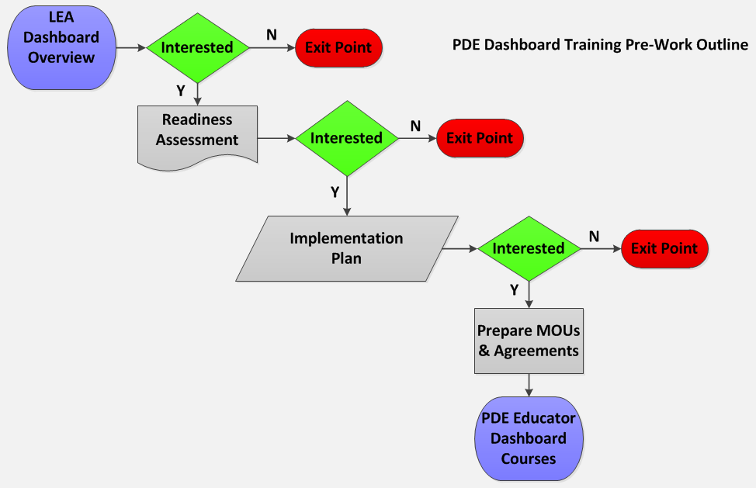
Professional Development Pre-Work
Notes:
Before the LEA decides to participate in the PDE Educator Dashboard implementation., PDE will provide an introductory course as well as a series of evaluations to ensure that the LEA understands the level of effort that will be necessary to support the Dashboards and the scale of resources that will be required.
The LEA will first partake in Course 1, which is an overview of the Dashboard implementation. At that point, if leadership is interested in learning more, PDE has created a Readiness Assessment. This tool provides the LEA with a checklist that itemizes necessary resources.
If the LEA is still interested at that point, PDE has provided an Implementation Plan. This tool helps the LEA strategize the roll out and define roles and responsibilities.
Upon completion of the Implementation Plan, if the LEA is ready to move forward the LEA leadership will need to develop MOUs and agreements to be used with PDE, supporting vendors or community agencies. Then staff will have access to the professional development and training courses provided by PDE.

Slide 20
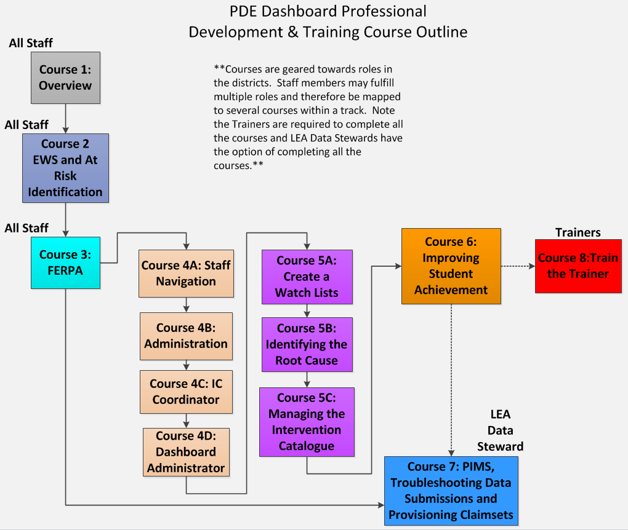
Professional Development and Training
Notes:
The PDE team wants to ensure that the Educator Dashboard are being successfully leveraged at the LEA. To that end PDE has developed a series of role-based courses that will provide districts resources with the knowledge, skills and abilities to succeed.
The first three courses provide all users with the foundational knowledge to move

Slide 21
Course Descriptions I
Course | Description
Course 1: Overview | This course will provide participants with an overview of the Educator Dashboard and EWS project. Participants will understand basics of the research behind the Dashboard, a high level implementation plan and a brief history of the project.
Course 2: EWS and At Risk Identification | This course will provide instruction on navigation of the EWS tab within the Dashboard, understanding the EWS metrics and using the information to identify At Risk students. Participants will likewise be exposed to a deeper review of the Early Warning research. This course will be based on current EWS research provided to PDE by Balfanz.
Course 3: FERPA | This course will provide participants with a knowledge of the FERPA regulations that protect the security and confidentiality of student data and will furthermore provide guidelines for practical application in day to day experiences. This course will rely on information provide by FPCO and PTAC.
Notes:
Trainer Notes: Read through the course descriptions with the participants.

Slide 22
Course Descriptions II
Course | Description
Course 4A: Staff Navigation | This course instructs on navigation of the Dashboard from the perspective of a Staff member (teacher, counselor, aide, etc.)
Course 4B: Administration Navigation | This course instructs on navigation of the Dashboard from the perspective of a building or campus administrator. As a note, this course will also include the Goal Setting component.
Course 4C: IC Coordinator | This course instructs on navigation of the Dashboard from the perspective of an IC Coordinator.
Course 4D: Dashboard Administrator | This course covers the administrative functions of the Dashboard, including system disable, photo management, and setting metrics.
Notes:
Trainer Notes: Read through the course descriptions with the participants.

Slide 23
Course Descriptions III
Course | Description
Course 5A: Create and Manage a Watch List | This course instructs participants on creating Watch Lists within the Dashboard and also provides use case scenarios for creating and using Watch Lists.
Course 5B: Identify Root Cause | This course covers the investigative process that leads staff members to discovering the root cause of an At Risk Identification. Participants will be provided with tools to guide the process. This course will rely on research by Middle School Matters and other current resources.
Course 5C: Managing the Intervention Catalog | While this course will cover the logistics of adding Interventions to the IC through the Dashboard, the course will also relay lessons learned from the ESP study on leveraging community resources and developing relationships. The course instructs on facilitating the aggregation of Intervention resources both within the schools and out in the communities and tagging them appropriately in the IC.
Notes:
Trainer Notes: Read through the course descriptions with the participants.

Slide 24
Course Descriptions IV
Course | Description
Course 6: Improving Student Achievement | This course will cover how the functionality of the state and local assessment tabs within the Dashboard. The course will also instruct participants on how to leverage the data, compare to other student indicators and then provide targeted assistance for that student.
Course 7: PIMS, Troubleshooting Data Issues and Provisioning Roles and Claim Sets | This course is geared specifically the to the PIMS Data Steward within each district. This course will cover the basis of uploading files to PIMS, understanding error and warning files generated by the data loading process and resolving issues with data submissions. This course will also provide instructions on provisioning roles, managing claim sets and creating cohorts within PIMS.
Notes:
Trainer Notes: Read through the course descriptions with the participants.

Slide 25
Train the Trainer Model
PDE
IU
LEA
Notes:
The implementation plan will build on the existing infrastructure to roll out support and training to the LEAs. PDE used a train the trainer model to share the courses with Intermediate Units (IUs) across the state. These IU trainers will be fully prepared to turn key training to staff at the LEAs.

Slide 26
Support for the Dashboard
PDE is prepared to provide support for the Dashboard:
If you are having issues with uploading files to PIMS, PIMS Help Desk representative, reached by phone at 1-800-661-2423 or online, accessed through the PDE home page at http://www.education.state.pa.us
Accessing help from the PDE Home Page:
From the blue PDE Search bar on the left, select “Programs”
Select “Programs O – R”
Select “PIMS”
Select “PIMS Help”
From the body of the text, select “Help Request Form.”
Notes:
PDE is prepared to provide support for the Dashboard:
PIMS Help Desk representative, reached by phone at 1-800-661-2423 or online, accessed through the PDE home page at http://www.education.state.pa.us
Accessing help from the PDE Home Page:
from the blue PDE Search bar on the left, select “Programs”
select “Programs O – R”
select “PIMS”
select “PIMS Help”
from the body of the text, select “Help Request Form.”

Slide 27
Support for the Dashboard
For questions regarding Dashboard EWS and intervention catalog, please send an email to: RA-EDEWSINFO.pa.gov

Slide 28
Roles & Responsibilities
Notes:
Now let’s take a look at the roles and responsibilities at the LEAs and the Ius.

Slide 29
LEA Roles & Responsibilities
LEA Role | Responsibilities
LEA Data Steward | PIMS data submissions Dashboard data submissions Managing PASecureID Troubleshooting errors in the data loading process Providing Level 1 support for system and data issues Manage user roles
Dashboard Administrator | Manage Dashboard admin functions QA data in the Dashboard Provide assistance to LEA users
Notes:
Trainer Notes: Read through the roles & responsibilities.

Slide 30
LEA Roles & Responsibilities
LEA Role | Responsibilities
LEA and Building Administrators | Oversee the Dashboard implementation Allow for professional development time for teachers and staff Lead FERPA compliance
Intervention Coordinator | Populate the Intervention Catalog for the LEA Manage the LEA Intervention Catalog Collaborate with staff and administrators to keep the Intervention Catalog current
School Board | Approve participation in the Dashboard implementation Approve resources for the implementation Provide the legal means to develop community partnerships
Notes:
Trainer Notes: Read through the roles & responsibilities.

Slide 31
Intermediate Unit Roles & Responsibilities
IU Roles | Responsibilities
IU Trainers | Turn key training to the LEAs Provide assistance to the LEA Dashboard Administrators
Notes:
Trainer Notes: Read through the roles & responsibilities.

Slide 32
PDE Roles & Responsibilities
PDE Role | Responsibilities
PDE Trainers | Turn key training to the Intermediate Units
PDE Onboarding Team | Assist the LEAs with validating data Collaborate with LEA SIS vendors to understand the LEA User Manual and to create file extracts
Notes:
Trainer Notes: Read through the roles & responsibilities.

Slide 33
PDE Educator Dashboard FAQs
Notes:
Next, let’s take a look at the FAQs we have collected.

Slide 34
PIMS and the Educator Dashboard FAQ
What does PIMS have to do with the Educator Dashboard and EWS?
The data displayed on the Dashboard is voluntarily submitted by participating LEAs through PIMS. PIMS provides a familiar data submission process for LEAs to follow and provides for high-quality Dashboard data by applying robust validations to the data during the submission process.
Notes:
What does PIMS have to do with the Educator Dashboard and EWS?
The data displayed on the Dashboard is voluntarily submitted by participating LEAs through PIMS. PIMS provides a familiar data submission process for LEAs to follow and provides for high-quality Dashboard data by applying robust validations to the data during the submission process.

Slide 35
PDE and Dashboard Data Access FAQ
How will PDE use the data submitted to PIMS for the Educator Dashboard?
Data submitted for use in the Dashboard will not be viewed, used, or reported by PDE in any way. The only use for this data is to power the Dashboard for the participating LEAs.
Notes:
How will PDE use the data submitted to PIMS for the Educator Dashboard?
Data submitted for use in the Dashboard will not be viewed, used, or reported by PDE in any way. The only use for this data is to power the Dashboard for the participating LEAs.

Slide 36
PIMS Data and Dashboard Data FAQ
Will the data submitted for the Educator Dashboard be “mixed” with the “accountability” data in PIMS?
PDE defines Accountability Data or Accountability Submissions as the data submitted and subsequently certified by LEAs that is used for federal and state reporting purposes.
The Dashboard data is voluntarily submitted by LEAs to PIMS and is considered uncertified. This data is intended to be a reflection of the participating LEA source system and may contain data items and values that do not exist or are unavailable in the PIMS accountability submissions.
PDE must maintain the integrity of the certified accountability data within PIMS. For this reason the Dashboard data is logically separated within PIMS.
Notes:
Will the data submitted for the Educator Dashboard be “mixed” with the “accountability” data in PIMS?
PDE defines Accountability Data or Accountability Submissions as the data submitted and subsequently certified by LEAs that is used for federal and state reporting purposes.
The Dashboard data is voluntarily submitted by LEAs to PIMS and is considered uncertified. This data is intended to be a reflection of the participating LEA source system and may contain data items and values that do not exist or are unavailable in the PIMS accountability submissions.
PDE must maintain the integrity of the certified accountability data within PIMS. For this reason the Dashboard data is logically separated within PIMS.

Slide 37
What Data Will be Used in the Dashboard FAQ?
Domain | Template | Frequency
Course & Grades | Course | Beginning of Year
Course & Grades | Course Instructor | As-Needed
Course & Grades | Student Class Grade Detail | Frequently
Course & Grades | Student Course Enrollment | Frequently
Discipline | Incident Offender | Frequently
Discipline | Incident Offender Infraction | Frequently
Discipline | Incident | Frequently
Discipline | Person | Frequently
Location | Location Marking Period | Beginning of Year
Location | Location MP Calendar Date | Beginning of Year
Staff | Staff Assignment | As-Needed
Notes:
What Data Will be Used in the Dashboard?
Trainer Notes: Read through the table with the participants.

Slide 38
General FAQs I
Will the dashboard work with any student information system?
Yes, the Dashboard is source system agnostic
Will parents be allowed to log into the Dashboard?
Parents will not have access to the Dashboard.
Is the Dashboard data restricted by user?
Dashboard access is restricted by user’s Staff Assignment Code which designates their role in the school.
This assignment code is very familiar to LEAs, a Principal can see all students within a school but a teacher can only view the students they teach.
Notes:
Will the dashboard work with any student information system?
Yes, the Dashboard is source system agnostic
Will parents be allowed to log into the Dashboard?
Parents will not have access to the Dashboard.
Is the Dashboard data is restricted by user ?
Dashboard access is restricted by user’s Staff Assignment Code which designates their role in the school.
This assignment code is very familiar to LEAs, a Principal can see all students within a school but a teacher can only view the students they teach.

Slide 39
General FAQs II
Is there a cost involved?
There is no cost to the district. This is a free tool.
What does a district need to have in place for use?
If the LEA is able to prepare PIMS data submissions and can support the roles and responsibilities outlined in this presentation, then the LEA is ready for implementation.
What is the timeline for implementation?
The data team should plan for a six-week window to upload templates, perform User Acceptance Test and check for data accuracy prior to Staff trainings.
Notes:
Is there a cost involved?
There is no cost to the district. This is a free tool.
What does a district need to have in place for use?
If the LEA is able to prepare PIMS data submissions and can support the roles and responsibilities outlined in this presentation, then the LEA is ready for implementation.
What is the timeline for implementation?
The data team should plan for a 6 week window to upload templates, perform User Acceptance Test and check for data accuracy prior to Staff trainings.

Slide 40
General FAQs III
Who will assign interventions to students?
The interventions will be assigned by the Student Assistance Team or as determined by individual LEAs.
How much training will the staff need to fully implement?
Training materials for the use of EWS are on the PDE SAS website in self-contained modules for customized training for LEA. http://pdcenter.pdesas.org/
Notes:
Who will assign interventions to students?
The interventions will be assigned by the Student Assistance Team or as determined by individual LEA.
How much training will the staff need to fully implement?
Training materials for the use of EWS are on the PDE SAS website in self-contained modules for customized training for LEA. http://pdcenter.pdesas.org/

Slide 41
Wrap Up, Assessment and Evaluation
Notes:
Now let’s review and wrap up this course.

Slide 42
Wrap Up, Assessment and Evaluation
Wrap Up
Identify the benefits of LEA participation in the project.
What type of information will the Dashboard provide to educators?
Summarize the implementation plan in a few sentences.
What are the roles and responsibilities for the LEA, IU and PDE resources?
Notes:
Now let’s review what we have discussed.
Identify the benefits of LEA participation in the project.
What type of information will the Dashboard provide to educators?
Summarize the implementation plan in a few sentences.
What are the roles and responsibilities for the LEA, IU and PDE resources?

Slide 43
Wrap Up, Assessment and Evaluation
Assessment
Take a moment and answer the questions on the brief assessment
Assessment
Notes:
Please take a moment and respond to the brief assessment questions. Your instructor will provide instructions on accessing the assessment.

Slide 44
Wrap Up, Assessment and Evaluation
Evaluation
Take a moment and answer the questions on the brief evaluation survey
Evaluation
Notes:
Please take a moment and complete the evaluation survey. Your instructor will provide instructions on accessing the survey.

Slide 45
For more information on the Overview of the PDE Educator Dashboard, please visit PDE’s website at www.education.state.pa.us
The mission of the department is to academically prepare children and adults to succeed as productive citizens. The department seeks to ensure that the technical support, resources and opportunities are in place for all students, whether children or adults, to receive a high quality education.

