Slide 1
STEELS Hub Science, Technology & Engineering, Environmental Literacy & Sustainability A Sneak Preview
Notes:
I’d like to walk you through our design for a SAS site that incorporates integral elements of our newly adopted standards.

Slide 2
Hub Organization
Notes:
The initial thinking for the Hub is to make the site a “one stop shop” for all standards resources. When fully populated, each tab will provide useful resources for curriculum development as well as classroom instruction.

Slide 3
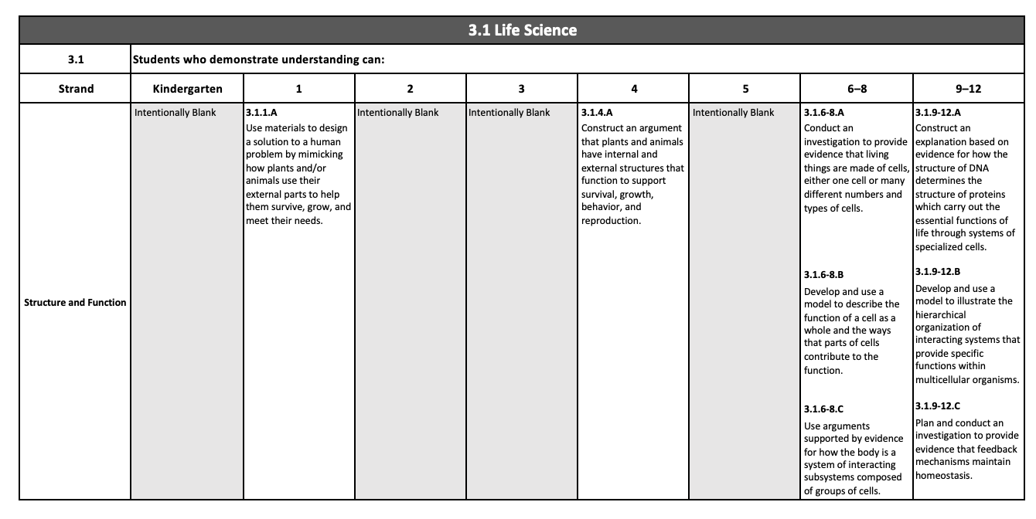
Standards Organization
Notes:
The standards document itself will include all STEELS standards – categorized by each of the content areas.

Slide 4
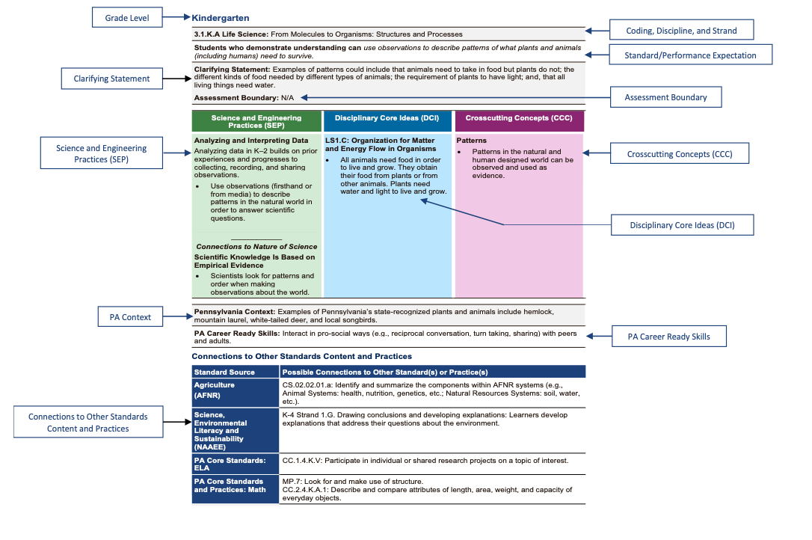
Standards Connection to Foundation Boxes
Notes:
For every standard, there is a related Foundation Box. Foundation Boxes support instruction by providing connections to ensure the standards are taught with fidelity.
When fully populated, users will be able to select a standard in the standards document and click on it to access the related Foundation Box.

Slide 5
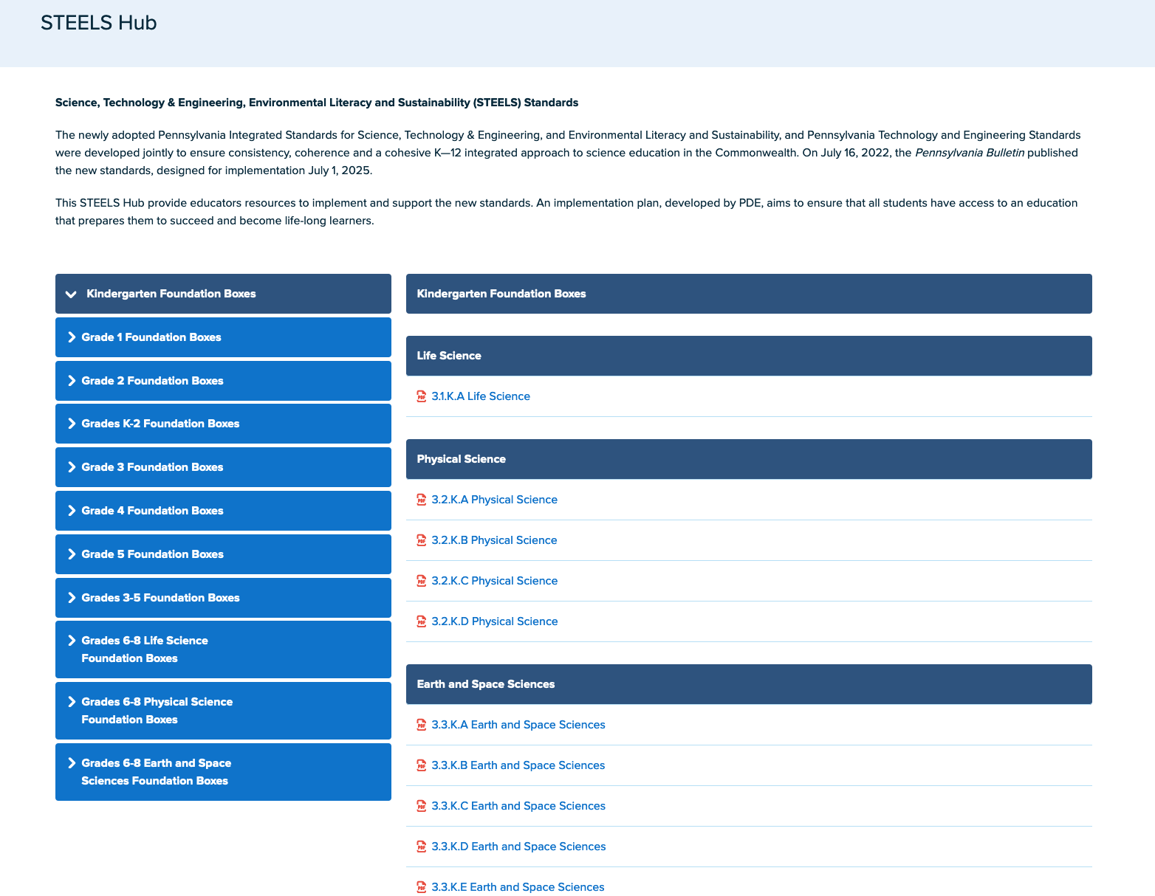
Foundation Boxes
Notes:
Users can also access Foundation Boxes by grade level. Thus, a Grade 1 teacher, for example, can access all Foundation Boxes relevant to Grade 1.

Slide 6
Professional Development
PDE content advisors will be scheduling a series of webinars to provide educators with a strong understanding of the integrated standards and how they impact teaching and learning.
All webinars will be recorded and posted in the STEELS Hub.

