Slide 1
How do I set up a station rotation model in my classroom?
What do I know?/What do I want to know?

Slide 2
Centers have been used in many traditional elementary schools for decades to differentiate, scaffold, and personalize for student needs in a low-tech way. With current programs and tech options, centers can evolve to even more strategic station rotations where students can take agency of their own learning and access content where they are in a personalized manner. In order to do this, three main aspects of your classroom need to be revisited and/or refined to best support implementation.

Slide 3
Culture: How can students take ownership of their own learning? How is it tied to space?
How can students have input into the classroom set-up and/or station options to better build buy-in and ownership?
How do your students learn best? Is that involved in your classroom design?
Are students currently given choices around where and how they learn?

Slide 4
Space: How can you reallocate/reinvent space and the way your students use it?
Space can mean many things: how you position your furniture, how you utilize hallways and doors, and even where you store materials and resources for students to access. In order to set up stations, you need to figure out how many stations you would like to set up, where they will be, what students will be doing, and where and how students will learn. Many classrooms start with three stations: a small group for directed instruction, an independent workstation, and a collaboration section. Each of these areas can utilize different materials, include tech or no tech, and give students time to learn in multiple ways.

Slide 5
Before you begin exploring or designing, take a moment to think about a few key questions:
What is your goal when creating stations in your classroom?
How do you envision the current classroom climate shifting as a result of creating stations?
What will students be doing at each station?
Reflecting on these answers will help you build a space that meets your students’ and your needs as opposed to just building a space that seems fun in theory!

Slide 6
When looking through these strategies, ask yourself:
Where do you want to position the small group (so you can see the rest of the class as well as engage with the small group)?
How many devices do you need? Where and how are they charged?
Do you want some choice spaces where students can work by themselves or in bigger groups?
How can you utilize your current furniture in new ways?

Slide 8
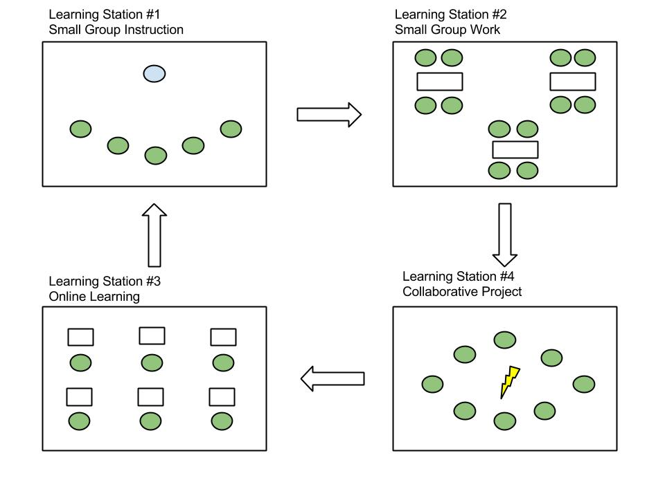

Slide 9
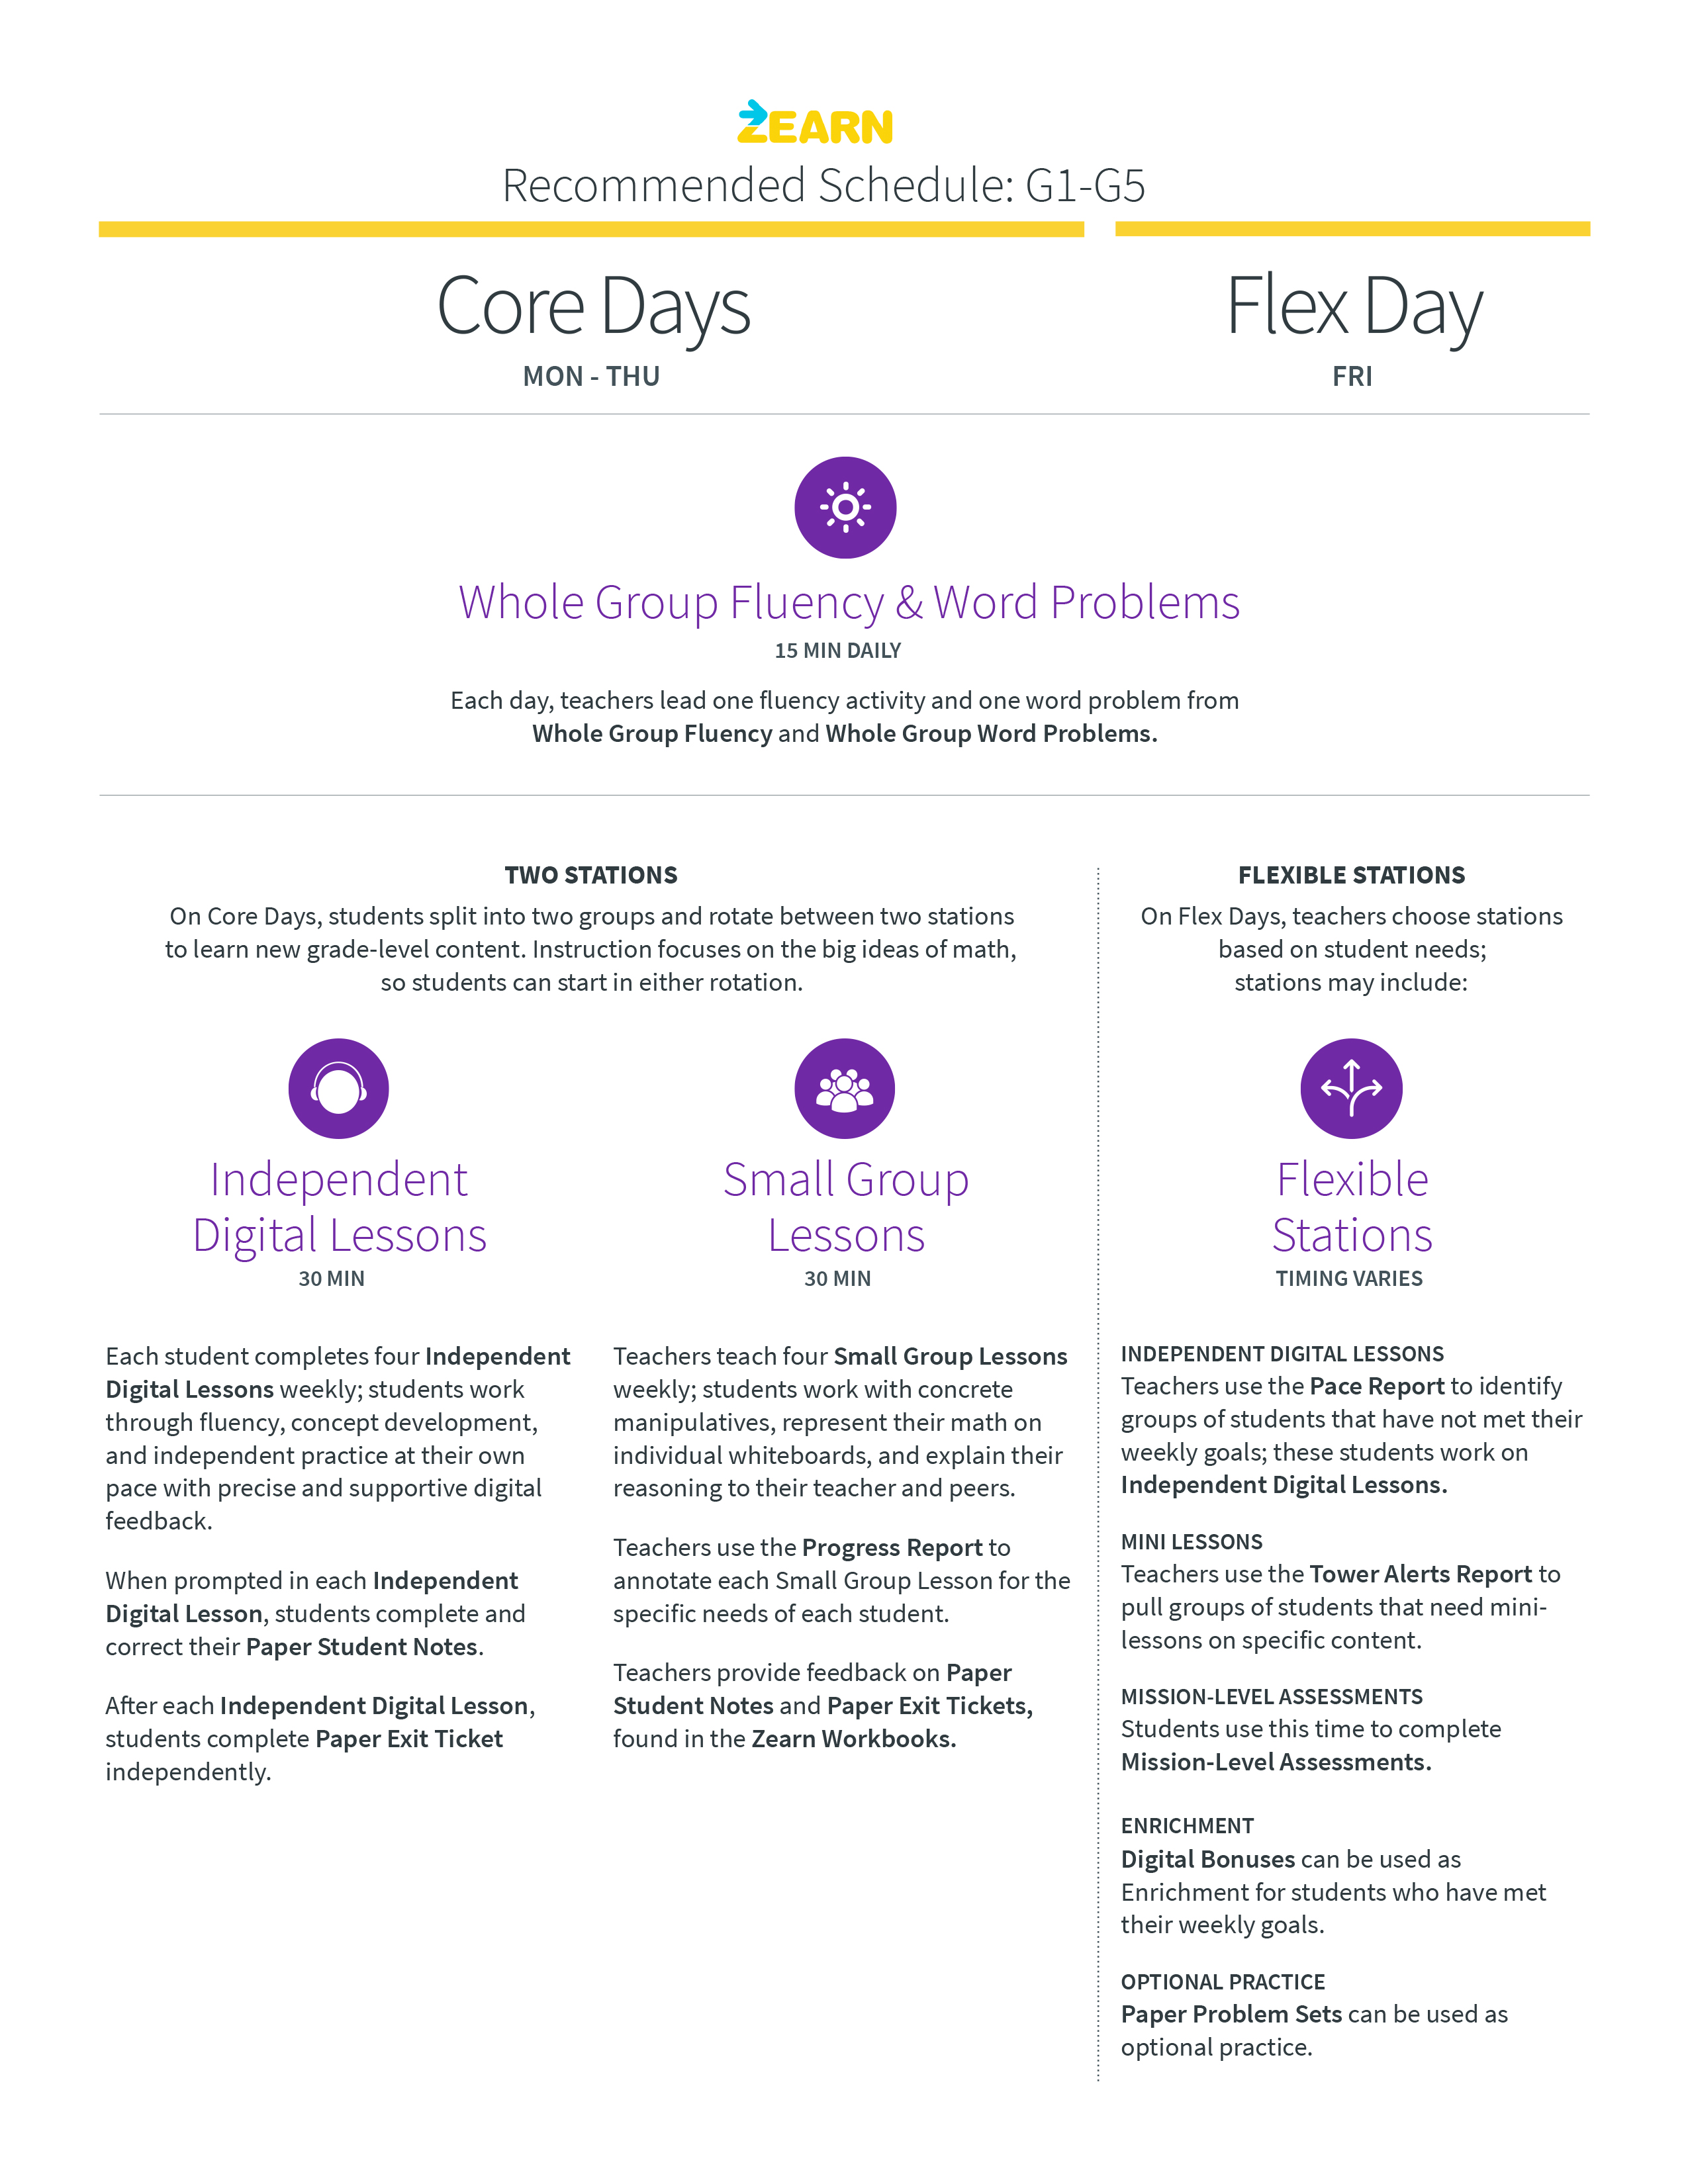

Slide 10
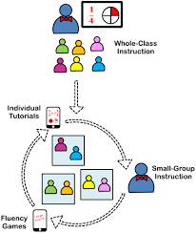

Slide 11
Routines: How will students move around the space? Use the space?
Once you have designed your space, you need to think about how students will move, enter, exit, and monitor themselves when they are in the various stations. Rolling out strong routines can help you use your time more efficiently and effectively, while also giving students clear expectations around behaviors and actions throughout the class time.

Slide 12
Routines:
When exploring these resources, remember routines shouldn’t be just copied and pasted since they should match your, your students’, and your classroom’s needs. You also don’t need to do every routine at once. It is important to roll out routines slowly so that students can master one at a time and see meaning in the why and how.

Slide 13
Practical Tips for Setting Up Learning Stations in Your Classroom
http://content.powermylearning.org/wp-content/uploads/9-Practical-Tips-for-Setting-Up-Blended-Learning-Stations-in-Your-Classroom.pdf
https://catlintucker.com/2018/09/10-tips-station-rotation-model/
https://www.edelements.com/hubfs/Resources%20without%20LPs/Station-Rotation-7.12.17.pdf

