Slide 1
Upping the Rigor of your Math Assessments
Data and Assessment Conference
February 8-9, 2018
Notes:
Set a goal of use!

Slide 2
Session Objectives
Build fluency in SBAC terminology
Protocol for assessment audit
Toolbox for upping rigor
Approaches to changing classroom practice to meet new assessments level of rigor

Slide 3
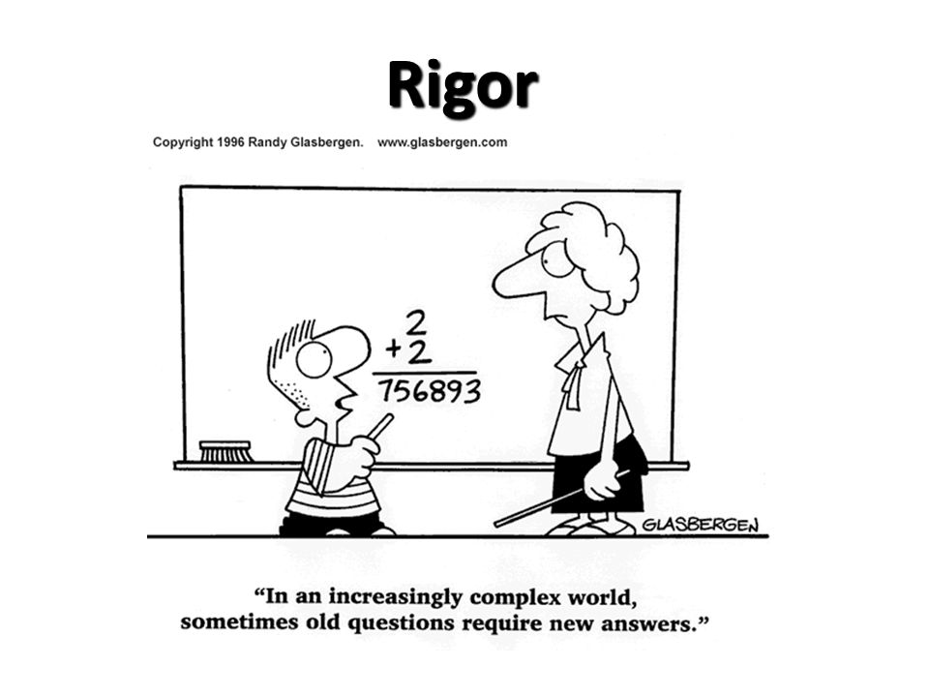

Slide 4
True or False
1. Lots of homework is a sign of rigor
2. Rigor means doing more
3. Rigor is not for everyone
4. Providing support means lessening rigor
5. Resources do not equal rigor

Slide 5
True or False
1. Lots of homework is a sign of rigor FALSE
2. Rigor means doing more FALSE
3. Rigor is not for everyone FALSE
4. Providing support means lessening rigor FALSE
5. Resources do not equal rigor TRUE

Slide 6
The Five Sources of Cognitive Complexity
1. Mathematical Content
2. Mathematical Practices
3. Stimulus Material
4. Response Mode
5. Processing Demand
Learner-Centered Design: A Cognitive View of Managing Complexity in Product, information and environmental design. .
By Wayne Reeves

Slide 7
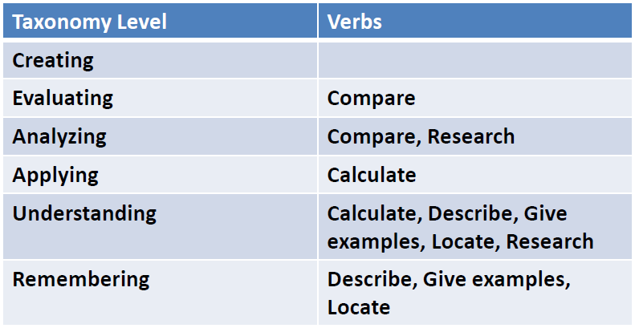
Bloom’s Taxonomy

Slide 8
Same Verb- Three different Levels of Knowledge
Describe 3 characteristics of a triangle.
Describe the difference between triangles and squares.
Describe a model where you may use triangles to determine the surface area.

Slide 9
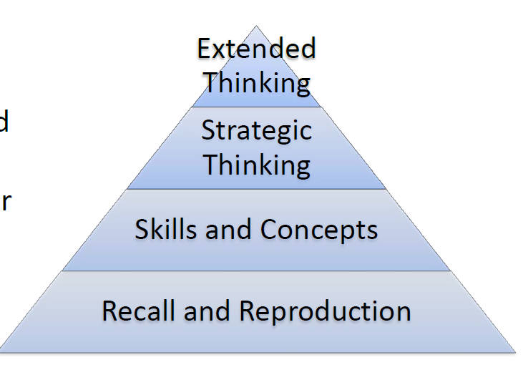
Webb’s Depth of Knowledge (DOK)

Slide 10
DOK Sort
Decide which DOK level each question meets.
Discuss why each question is at the indicated level.
Use Hess’ Cognitive Rigor Matrix and DOK wheel to help you.

Slide 11
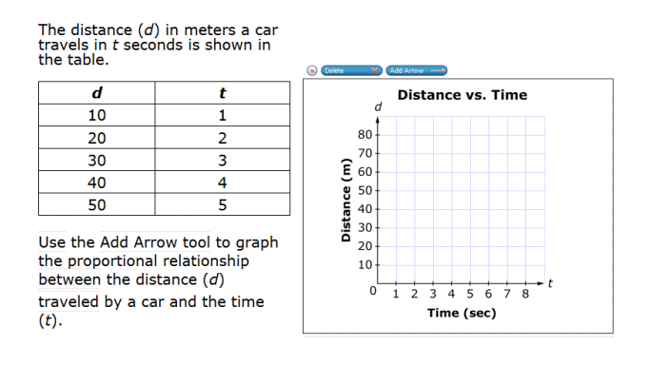
DOK Level 1
Grade 3
Grade 8
Notes:
SUBJECT: Math
GRADE: Grade 3
CLAIM: Concepts and Procedures
TARGET: B
ITEM TYPE: Matching Item
ITEM ID: 3579
DEPTH OF KNOWLEDGE: 1
COMMON CORE STATE STANDARD: Apply properties of operations as strategies to multiply and divide.2 Examples: If 6 × 4 = 24 is known, then 4 × 6 = 24 is also known. (Commutative property of multiplication.) 3 × 5 × 2 can be found by 3 × 5 = 15, then 15 × 2 = 30, or by 5 × 2 = 10, then 3 × 10 = 30. (Associative property of multiplication.) Knowing that 8 × 5 = 40 and 8 × 2 = 16, one can find 8 × 7 as 8 × (5 + 2) = (8 × 5) + (8 × 2) = 40 + 16 = 56. (Distributive property.)
TARGET DESCRIPTION: Understand properties of multiplication and the relationship between multiplication and division.

Slide 12
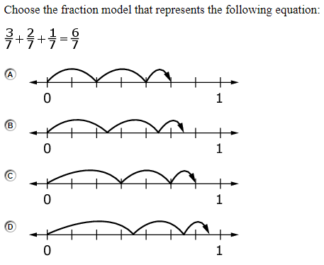
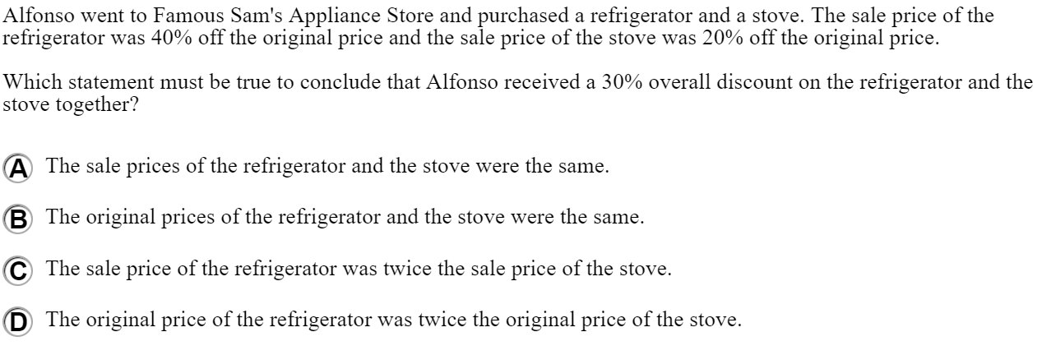
DOK Level 2
Grade 4
Grade 7
Notes:
SUBJECT: Math
GRADE: Grade 4
CLAIM: Concepts and Procedures
TARGET: G
ITEM TYPE: Multiple Choice
ITEM ID: 3619
DEPTH OF KNOWLEDGE: 2
COMMON CORE STATE STANDARD: Understand a fraction a/b with a > 1 as a sum of fractions 1/b.
TARGET DESCRIPTION: Build fractions from unit fractions by applying and extending previous understandings of operations on whole numbers.
SUBJECT: Math
GRADE: Grade 7
CLAIM: Communicating Reasoning
TARGET: C
ITEM TYPE: Multiple Choice
ITEM ID: 3635
DEPTH OF KNOWLEDGE: 2
COMMON CORE STATE STANDARD: Use proportional relationships to solve multistep ratio and percent problems. Examples: simple interest, tax, markups and markdowns, gratuities and commissions, fees, percent increase and decrease, percent error. Use ratio and rate reasoning to solve real-world and mathematical problems, e.g., by reasoning about tables of equivalent ratios, tape diagrams, double number line diagrams, or equations.
TARGET DESCRIPTION: State logical assumptions being used.

Slide 13
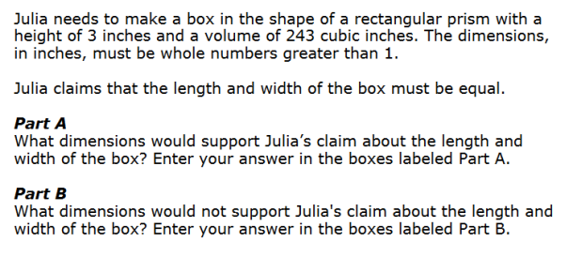
DOK Level 3
Grade 3
Grade 6
Notes:
SUBJECT: Math
GRADE: Grade 3
CLAIM: Modeling/Data Analysis
TARGET: A
ITEM TYPE: Grid Item
ITEM ID: 1578
DEPTH OF KNOWLEDGE: 3
COMMON CORE STATE STANDARD: Draw a scaled picture graph and a scaled bar graph to represent a data set with several categories. Solve one- and two-step “how many more” and “how many less” problems using information presented in scaled bar graphs. For example, draw a bar graph in which each square in the bar graph might represent 5 pets. Solve real world and mathematical problems involving perimeters of polygons, including finding the perimeter given the side lengths, finding an unknown side length, and exhibiting rectangles with the same perimeter and different areas or with the same area and different perimeters.
TARGET DESCRIPTION: Apply mathematics to solve problems arising in everyday life, society, and the workplace.

Slide 14
DOK Level 1
Basic recall of concepts, definition, facts and processes
Follow a simple formula
Perform a routine procedure
Simple skills and abilities

Slide 15
DOK Level 2
Mental processing beyond recall
Requires decisions as to how to approach the question or problem
Perform two or more steps with decision points along the way
Organize or display data, interpret or use simple graphs

Slide 16
DOK Level 3
Reason or develop a plan to approach a problem
Employ some decision-making and justification
Solve abstract, complex, or non-routine problems
Often allows more than one possible answer.

Slide 17
DOK Level 4
Requires high cognitive demand
Make connections, research, select or discuss approaches
Many ways a situation can be solved.
Some 3 Act Tasks: Robert Kaplinsky , Dan Meyer, Graham Fletcher
Design a survey and interpret results

Slide 18
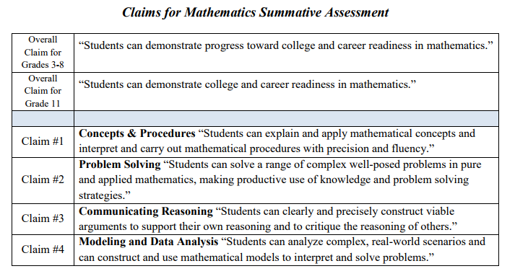
Claims
Concepts and Procedures
Problems Solving
Communicating Reasoning
Modeling and Data Analysis

Slide 19
Item Type
Multiple Choice with Single Answer
Multi Select
Short Text/Answer without justification or explanation (Equation/Numeric answer)
Short Test/Answer with justification or explanation
Matching Item- True/False, Yes/No
Table item
Hot Spots (click on particular area on screen – coloring in)
Drag and Drop
Graphing/ drawing object
Performance Task/constructed response

Slide 20
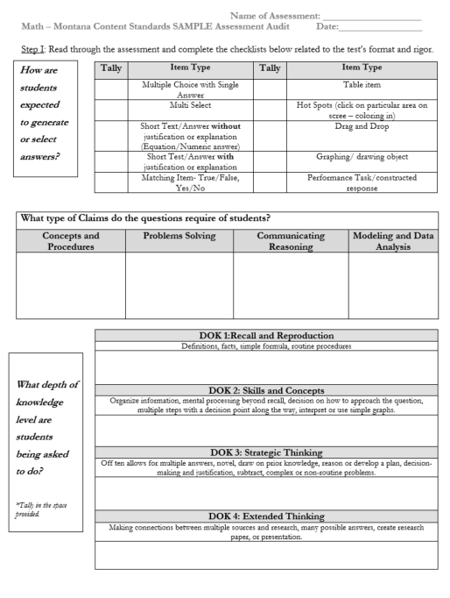
Assessment Audit
Individually
Groups
PLC
Grade level
Department level
Administration

Slide 21
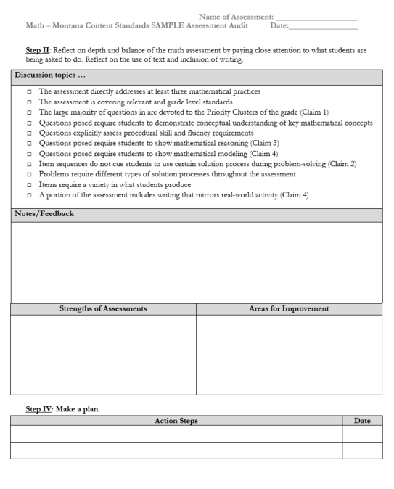
Assessment Reflection

Slide 22
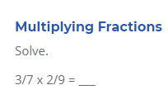
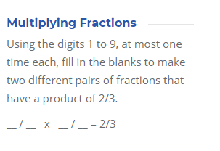
Upping the Rigor:Change DOK level
DOK1 DOK2
*https://robertkaplinsky.com/3steps/

Slide 23
Upping the Rigor:Change DOK level
DOK 1 DOK 3
*https://robertkaplinsky.com/3steps/

Slide 24
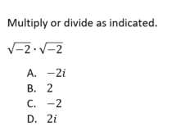
Upping the Rigor:Change Item Type
Multiple Choice:
Matching Item:

Slide 25
Upping the Rigor:Change the Claim
Concepts and Procedures
Communicating Reasoning

Slide 26
Practice: Choose one item
*DOK *Item Type *Claim

Slide 27
Examples of increased DOK

Slide 28
Resources to Upping the Rigor
SBAC Sample Questions
DOK question Stems: Robert Kaplinsky + General Question stems
DOK question cards
Mississippi DOK doc
Video explaining DOK (3 minute)
Rubrics usage

Slide 29
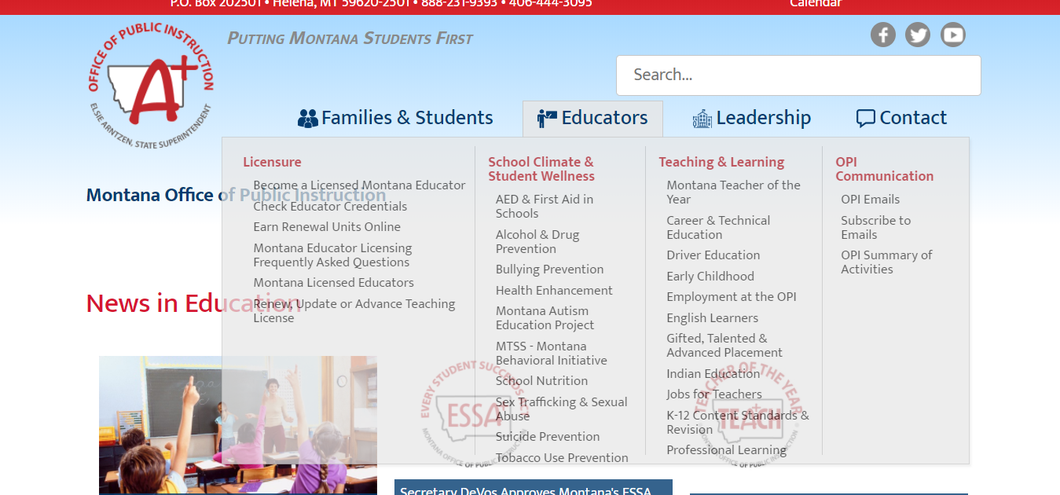
Standards

Slide 30
Now you have a rigorous assessment….

Slide 31
Change your practice… easier said than done
10% change to your practice every year*
Assessment Audit
Math Matters: Plains, Whitehall, Glendive, Brockton
STREAM courses online: Next session begins Feb 19
Teacher Learning Hub courses
Use Rich Tasks during the class
Let students ask the question
Add discourse into your math class
Try Problems of the Month
Engage in productive struggle
SBAC Interim Assessments (3-11)
Model thinking process explicitly
*Never Say Anything a Kid Can Not Say

Slide 32
Leave you with:
Set a Goal...
“For the system to work…its elements must be aligned. That is, if an assessment is to communicate and measure expected standards for student performance, it must be fully aligned with those standards. Similarly, if classroom teaching and learning activities are to help students attain the standards, they too must be aligned with the standards. Finally, it is only when assessment is aligned with both standards and classroom instruction that assessment results can provide sound information about both how well students are doing and how well schools and teachers within them are doing in helping students to attain the standards.” -Joan Herman and Noreen Webb, 2007

Slide 33
Link to handouts

