Slide 1
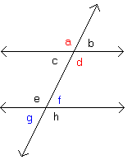
Bell Ringer

Slide 2
Section 3.2 Properties of Parallel Lines
LEQ: Given parallel or perpendicular lines, what properties about angle pairs can be proven?

Slide 3
How do you use a protractor to measure angles? Check it out
Measuring Angles Using a Protractor

Slide 4
Take 10-With a partner
Directions:
1. Using your rulers, make two parallel lines and label them m and n; m||n
2. Using your rulers, draw a transversal and label it t.
3. Label each of the angles 1-8.
4. Using your protractors, measure each of the angles.
5. Answer the questions at the bottom of this page using the types of angles (not the numbers you used in your diagram).

Slide 5
Section 3.2 Properties of Parallel Lines
LEQ: Given parallel or perpendicular lines, what properties about angle pairs can be proven?

Slide 6
Discussion
What angles are congruent?
What angles are supplementary?

Slide 7
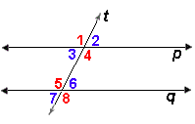
Postulate 10
If two parallel lines are cut by a transversal, then corresponding angles are __________.
congruent
$p∥q$
Name all the corresponding angles in the diagram:
$$∠1 \& ∠5; ∠2 \& ∠6;$$
$$∠3 \& ∠7; ∠4 \& ∠8$$
What can we conclude from Postulate 10 ?
$$m∠1 ≅m∠5; m∠2 ≅m∠6;$$
$$m∠3 ≅m∠7; m∠4 ≅m∠8$$

Slide 8
Theorem 3-2
If two parallel lines are cut by a transversal, then alternate interior angles are___________.
congruent
t
$k∥n$
Name all the alternate interior angles in the diagram:
k
1
2
n
4
3
$$∠1 \& ∠3; ∠2 \& ∠4$$
What can we conclude from Theorem 3-2?
$$m∠1 ≅m∠3;$$
$$m∠2 ≅m∠4$$

Slide 9
Proof of Theorem 3-2:
Given: k || n; transversal t cuts k and n.
Prove: $∠1≅∠2$
t
k
3
1
n
2
Statements | Reasons
1. $k∥n$
1. Given
2. $∠1≅∠3$
2. Vertical angles are congruent
$∠3≅∠2$
3.
3. If two parallel lines are cut by a transversal, then corr. angles are congruent.
$∠1≅∠2$
4. Transitive P.O.C
4.

Slide 10
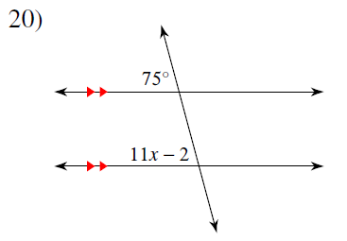
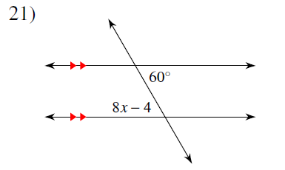
You Try!! Solve for x.
75=11x-2
77=11x
x=7
8x-4=60
8x=64
x=8

Slide 11
Theorem 3-3
If two parallel lines are cut by a transversal, then same-side interior angles are ______________.
supplementary
$k∥n$
Name the same- side interior angles:
t
k
1
2
$$∠1 and ∠4$$
n
4
3
$$∠2 and ∠3$$
What can we conclude from Theorem 3-3?
$$m∠1+m∠4=180°$$
$$m∠2+m∠3=180°$$

Slide 12
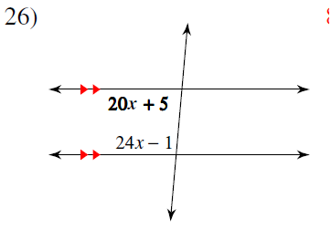
You Try! Solve for x.
20x+5+24x-1=180
44x+4=180
44x=176
x=4

Slide 13
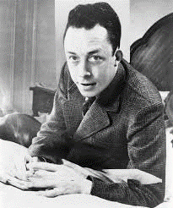
Celebrating “Camus” Day
“The only way to deal with an unfree world is to become so absolutely free that your very existence is an act of rebellion.” Albert Camus
“Real generosity towards the future lies in giving all to the present.” Albert Camus
“In the midst of winter, I found there was, within me, an invincible summer. And that makes me happy. For it says that no matter how hard the world pushes against me, within me, there’s something stronger – something better, pushing right back.” Albert Camus

Slide 14
Theorem 3-4
If a transversal is perpendicular to one of two parallel lines, then it is perpendicular to the other one also.
Transversal t cuts l and n and $l∥n$.
What is t perpendicular to according to the diagram?
t
l
1
$$t⊥l$$
n
2
What can we conclude from Theorem 3-4?
$$t is also ⊥to n$$

Slide 15
Homework
Kuta Worksheet
AND PG 81 #s 8, 11, 13, & 15
HONORS:
Kuta Worksheet
AND PG 81 #s 8, 11, 13-16

Slide 16
NO HW TONIGHT!

Slide 18
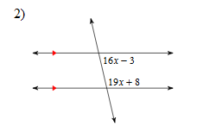
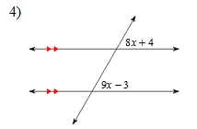
Bell Ringer
Solve for x.

Slide 19
Group Activity
I am going to give you each a number.
Take all of your belongings, and get with your group. Space yourselves out.
Listen for directions.
Everyone must turn in a separate sheet of paper at the end of class!!!

