Slide 1
Bell Ringer
Classify this polygon and find the total interior angle measure:
For this one,
Find the measure of ONE interior angle.

Slide 4
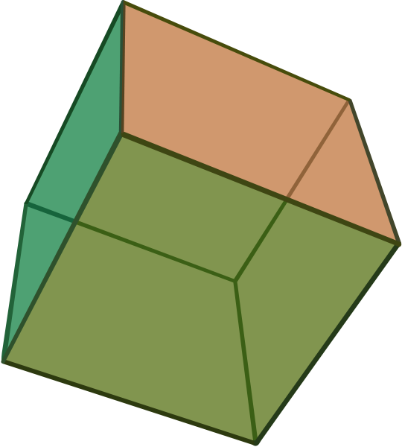
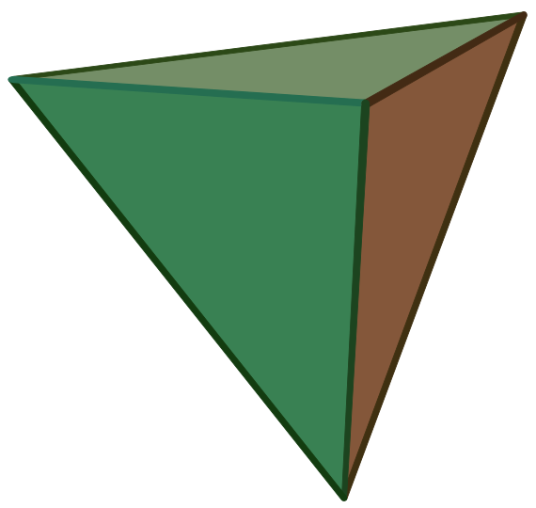
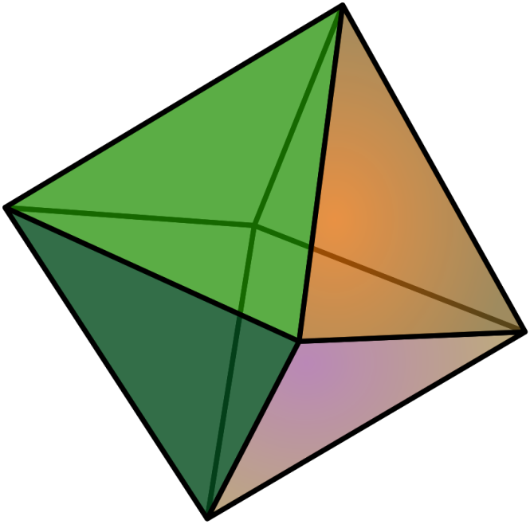

Slide 5
Section 3.6 Inductive Reasoning
LEQ:What is inductive reasoning and how does it help us predict a pattern in a sequence?

Slide 6
Open Your Books
Turn to page 106
Read up to and including the purple box on inductive reasoning

Slide 7
How is inductive reasoning used in mathematics?
Often in mathematics, you can reason inductively by observing a pattern.

Slide 8
Predict the Next Two Numbers
1) 1, 3, 9, 27,…
2) 8, 13, 23, 38, 58,…
3) 5, 6, 8, 11, 15,…
81, 243 (Multiply the previous number by 3)
83,113
(Add the next multiple of 5 to the previous #)
20, 26
(Add the next consecutive integer to the previous #)

Slide 9
Predict the Next Two Numbers or Letters
4) A, F, K, . . .
5) 5, 10, 20, 25, 35, 40, 50, . . .
6) 0, 9, 17, 24, . . .
P, U
Add 5 letters to previous letter
55, 65
Alternating Addition of 5 and 10
30, 35
Add next lower consecutive integer to the previous number

Slide 10
Predict the Next Two Numbers
7) 24, -12, 6, -3, …
3/2, -3/4 [ Alternatively: 1.5, -0.75 ]
Divide the previous # by -2

Slide 11
Predict the Next Two Numbers
8) 1, 4, 9, 16, 25,…
***9) 1, 1, 2, 3, 5, …
36, 49 Square the position number.
8, 13
Add the 2 #s before the next number

Slide 12
Fibonacci Sequence
The Fibonacci Sequence is the series of numbers:
0, 1, 1, 2, 3, 5, 8, 13, 21, 34, ...
The next number is found by adding up the two numbers before it.
*Let’s watch a video on the Fibonacci Sequence
(History of Mathematics #12) Stop at 2:15

Slide 13
Quiz Tomorrow
YOU WILL HAVE A QUIZ TOMORROW ON SECTIONS 3.4-3.6!!!!!!!!!!!!!!!!!!!!!!!!!!

Slide 14
Classroom Exercises
For the rest of class work on :
Page 107 Written Exercises #1-6
Study Guide for 3.3-3.6 Quiz
Both due tomorrow!!!!

Slide 15
The Bells Are Ringing
What are the next two terms in these sequences?
A. 2, 4, 12, 48,…
Your choice: 3, 2, 2.66, 1.5, 1.4, 1.33, 1.285714…
OR 3, 2, 5/3, 3/2, 7/5, 4/3, 9/7 …
OR 3, 2, 5/3, 6/4, 7/5, 8/6, 9/7…
Second term is 2 times the first. Third term is 3 times the second, etc. 2, 4, 12, 48, 240, 1440 2n!
$$\frac{n+2}{n} gives \frac{3}{1},\frac{4}{2},\frac{5}{3},\frac{6}{4},\frac{7}{5},\frac{8}{6},\frac{9}{7},\frac{10}{8},\frac{11}{9}$$

