Slide 1
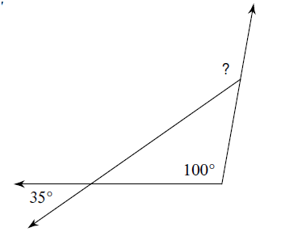
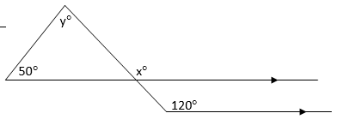
Bell Ringer-Find the measures of the missing angles (? and x and y)
1.
2.
108$°$
33$°$

Slide 2
Section 3-5 Angles of a Polygon
LEQ: How do I name polygons and how do I know if they are convex or concave?
Day 1

Slide 3
Polygons
The word polygon means “many angles”.
A polygon is formed by coplanar segments (sides) such that:
1. Each segment intersects exactly two other segments, one at each endpoint.
2. No two segments with a common endpoint are collinear.

Slide 4
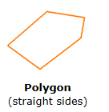
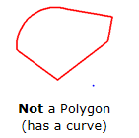
Polygon or Not?

Slide 5
Naming Polygons
To name a polygon, start at any vertex and list the vertices consecutively in a clockwise or counterclockwise direction.

Slide 6
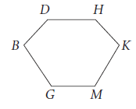
Name That Polygon!
DHKMGB
DBGMKH

Slide 7
Classifying Polygons
You can classify a polygon by the number of sides it has.

Slide 8
Number of Sides | Name
3
Triangle
4
Quadrilateral
5
Pentagon
6
Hexagon
7
Heptagon
8
Octagon
9
Nonagon

Slide 9
Number of Sides | Name
10
Decagon
n
n-gon

Slide 10
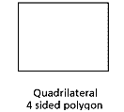
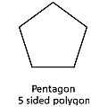
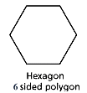
Diagrams
Heptagon
7 sided polygon

Slide 11
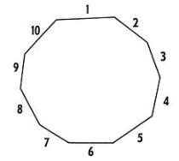
Nonagon
Decagon

Slide 12
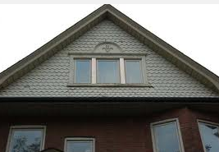
Where do we see polygons in real life?!

Slide 13
The names of polygons are formed with a prefix
Triangle, for example, has a the prefix tri, meaning three.
The prefixes of polygons appear in many common words.
How many wheels does a tricycle have?
How many events in the Pentathlon? Heptathlon?
Can you think of any common words that use a prefix of one of the polygons we just learned about?
Do you know what a HexahexaFlexagon is? Or, for that matter, a simple Hexaflexagon?

Slide 14
Convex vs. Concave Polygons
We must first know what a diagonal is in order to define convex and concave polygons.
A diagonal of a polygon is a segment that connects two non-consecutive vertices.

Slide 15
Diagonal Example
A
E
B
D
C

Slide 16
Convex Polygons
A convex polygon has no diagonal with points outside the polygon.
This is a convex pentagon.
All the diagonals are located INSIDE the polygon.

Slide 17
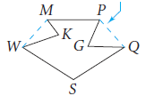
Concave Polygons
A concave polygon has at least one diagonal with points outside the polygon.
Your book refers to concave as “nonconvex”.
This is a concave heptagon.
Two diagonals are located OUTSIDE the polygon.

Slide 18
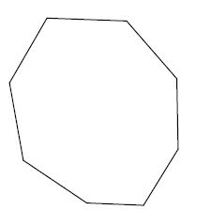
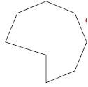
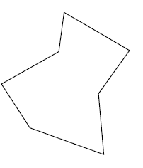
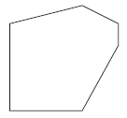
You Try! Classify each polygon by its sides. Identify each as convex or concave.
1. 2.
3. 4.

Slide 19
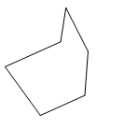
Summary
1. Classify the following polygon by its sides and then state whether it is concave or convex.
2.Name a type of polygon you use or have used in your shop class and how you used it.

Slide 20
Homework
Re-read the notes on this chapter so far.
Add examples of your own to the foldable.

Slide 22
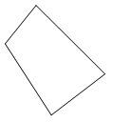
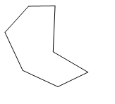
Bell Ringer:
State if each polygon is concave or convex and then classify each polygon by the number of sides it has:
1. 2.
-Heptagon (7 Sides)
-Concave
-Quadrilateral (4 Sides)
-Convex

Slide 23
Section 3-5 Angles of a Polygon
Day 2
LEQ: How do I find the sum of the interior and exterior angles of polygons?

Slide 24
Activity –The Sum of Polygon Angle Measures
You can use triangles and the Triangle Angle-Sum Theorem to find the sum of the measures of the angles of a polygon. Record your data in a table like the one below:

Slide 25
Activity Directions
1. Sketch convex polygons with 4, 5, 6, 7, and 8 sides in the first column of your table.
2. Divide each polygon into triangles by drawing all diagonals that are possible from ONE vertex.
3. Multiply the number of triangles by 180 to find the sum of the measures of the angles of each polygon.

Slide 26
Inductive Reasoning
Look for patterns in the table. Describe any that you find. (HINT: Look at # of triangles and # of sides columns)
Write a rule for the sum of the measures of the interior angles of an n-gon.

Slide 27
Polygon Angle Sum Theorem
The sum of the measures of the angles of a convex polygon with n sides is _________.
(n-2) 180

Slide 28
Example 1
Find the sum of the measures of the interior angles of a 15-gon.
(n-2) 180
(15-2) 180
(13) 180
=2340$°$

Slide 29
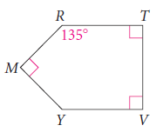
Example 2
Find the measure of angle Y in polygon TVYMR. Use the polygon Angle Sum Theorem.
134º
(n-2) 180
134+90+90+90+$∠Y=540$
(5-2) 180
404+ $∠Y=540$
(3) 180
$∠Y=540$-404
=540$°$
$∠Y$=136$°$

Slide 30
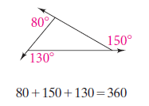
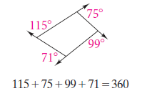
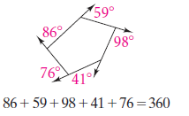
You can draw exterior angles at any vertex of a polygon. The figures below show that the sum of the measures of the exterior angles, one at each vertex, is 360.

Slide 31
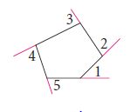
Polygon Exterior Angle-Sum Thm
The sum of the measures of the exterior angles of any convex polygon, one angle at each vertex, is 360.

Slide 32
Example ( Assume it is a regular hexagon)
Find the interior angle sum of the polygon.
$$\left(6−2\right)×180=4×180=720$$
Find the measure of ONE interior angle.
$720÷6=120$
Find the exterior angle sum.
$360°$
Find the measure of ONE exterior angle.
$360÷6=60$

Slide 33
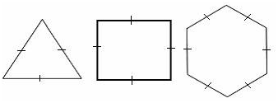
Regular Polygons
Polygons can be equiangular or equilateral.
Equiangular:
Equilateral:

Slide 34
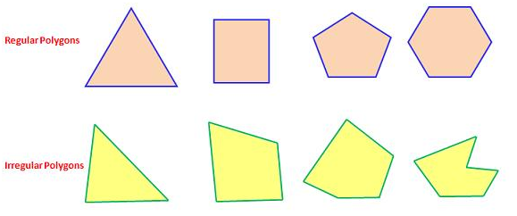
Regular Polygons
If a polygon is both equiangular and equilateral, it is called a regular polygon.

Slide 35
Summary
What is the formula we use to find the interior angles of a polygon?
What does the n stand for in this formula?

Slide 36
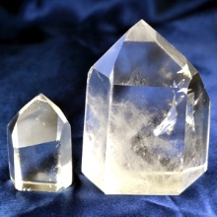
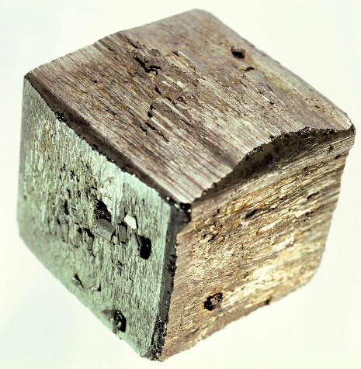
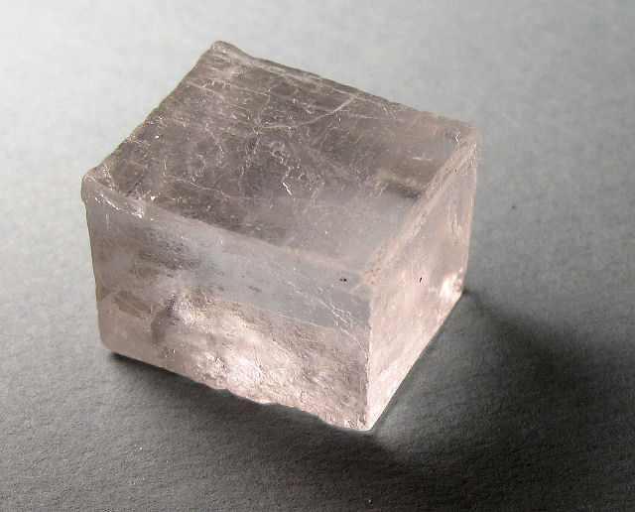
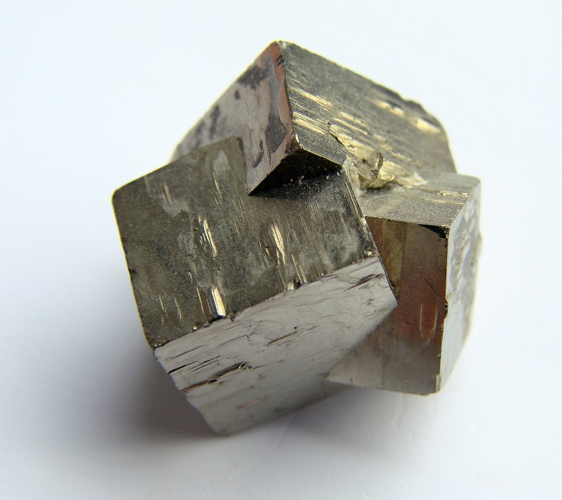
Homework
There are an infinite number of Regular Polygons, from 3-gons (triangles) to n-gons.
How many of them can be used
to make 3-Dimensional figures that use only one identical regular polygon shape
for every face? (Called a polyhedron)
Example: A cube is a polyhedron with all faces made of the same size square.
How many such polyhedrons are there?

Slide 37
