Slide 1
Bell Ringer
What are the different types of angles you can have?
What are the 3 classifications of triangles?

Slide 2
Geometry
3.4 Angles of a Triangle

Slide 3
Triangle
Vertex
B
A
C
Vertices

Slide 4
Triangles Classified by the # of Congruent Sides
Scalene Triangle
Isosceles Triangle
No sides congruent
Two Sides Congruent
Equilateral Triangle
All Sides Congruent

Slide 5
Triangles Classified by their Angles
Right Triangle
One Right Angle
Obtuse Triangle
One Obtuse <
x
Acute Triangle
3 Acute <‘s
x
x
Equiangular Triangle
All <‘s Congruent

Slide 6
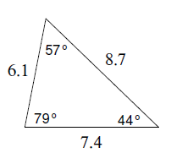
Example 1
Classify the following triangle by its sides and angles.
Sides? Scalene
Angles? Acute
Triangle?
**ACUTE SCALENE!!!**

Slide 7
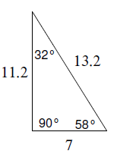
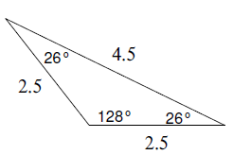
You Try!
Classify each triangle by its sides and angles.
Obtuse Isosceles Right Scalene

Slide 8
Theorem
The sum of the measures of the angles of a triangle is 180.
D
B
.
This is one of the best known theorems
in geometry and its proof is unique.
4
2
5
1
3
A
C
Given: Triangle ABC
Prove: m<1 + m<2 + M<3 = 180
The proof uses an auxiliary line. This is a line that is added
to the diagram to help in the proof.

Slide 9
Corollaries (Off-Shoots) of the Previous Theorem
1) If two angles of a triangle are congruent to two angles of
another triangle, then the third angles are congruent.
c
c
a
b
a
b
2) Each angle of an equilateral triangle has measure 60.
60
60
60
3) In a triangle, there can be at most one right angle or obtuse angle.
4) The acute angles of a right triangle are complementary.
a
<a and <b are complementary
c
b

Slide 10
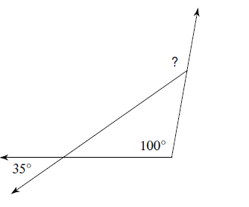
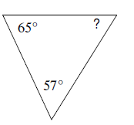
Example 2
? = 135

Slide 11
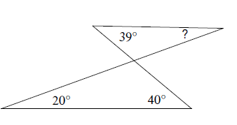
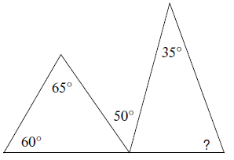
You Try!

Slide 12
Theorem
The measure of an exterior angle of a triangle equals the sum of the measures of the two remote interiors.
m<a = m<b + m<c
b
a
c
Example:
40 + 110 = 150
110
40
30
150

Slide 13
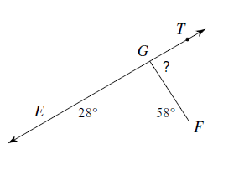
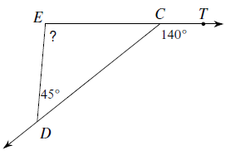
Example 3

Slide 14
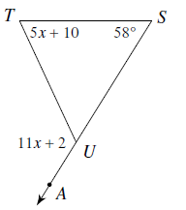
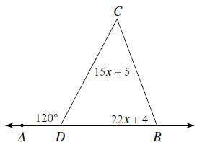
Example 4
Solve for x.
11x+2=5x+10+58 120=15x+5+22x+4
x=11 x=3

Slide 15
Homework
P. 97, #5 -16

