Slide 1
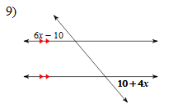
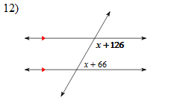
Bell Ringer
Find the measure of the angle indicated in bold.

Slide 3
Let’s Go Over Last Night’s HW
Kuta Worksheet
AND PG 81 #s 8, 11, 13, & 15
HONORS:
Kuta Worksheet
AND PG 81 #s 8, 11, 13-16

Slide 4
PG 81 #s 8, 11, 13-16
8) x = 10, y = 45 11) x = 14, y = 9
13) 1. Given 2 Def of Perpendicular lines
3 l || n 4 If 2 || lines are cut by a transversal then corresponding angles are congruent
5 m∠ 2 = 90 6 Def of perpendicular lines
14) x = 56 y = 100 z = 25
15) x = 70 y = 12 z = 38
16 x = 30 y = 8 z = 11

Slide 5
Section 3.3 Proving Lines Parallel
LEQ: How can we prove that lines are parallel?

Slide 6
The other day we saw that when two lines are ||, you can conclude that certain angles are congruent or supplementary.
In this section the situation is reversed.
From two angles being congruent or supplementary, you can conclude that certain lines forming the angles are ||.
We are going to be using the converses of the last section to do this.

Slide 7
From yesterday:
If two parallel lines are cut by a transversal, then corresponding angles are
CONGRUENT.
NEW: POSTULATE 11
If two lines are cut by a transversal and corresponding angles are congruent, then the lines are PARALLEL.
1
2
1
2
3
4
3
4
5
6
5
6
7
8
7
8
~
~
Ex:<1 = <5
If <1 = <5, then lines are ||

Slide 8
From yesterday:
If two parallel lines are cut by a transversal, then alternate interior angles are
CONGRUENT.
NEW: Theorem 3-5
If two lines are cut by a transversal and alternate interior angles are congruent, then the lines are PARALLEL.
1
2
1
2
3
4
3
4
5
6
5
6
7
8
7
8
~
~
<3 = <6
If <3 = <6, then lines are ||

Slide 9
Proof of Theorem 3-5
t
Given: Transversal t cuts lines k and n.
<1 = <2
Prove: k || n
Statements Reasons
3
k
2
1
n
1. < = <2
1. Given
2. <2 = <3
2. Vert. <s are congruent.
3. <1 = <3
3. Transitive Property
4. If two lines are cut by a transversal and corr. <s are congruent, then the lines are ||.
4. k || n

Slide 10
From yesterday:
If two parallel lines are cut by a transversal, then same-side interior angles are
SUPPLEMENTARY.
NEW: Theorem 3-6
If two lines are cut by a transversal and same-side interior angles are supplementary, then the lines are PARALLEL.
1
2
1
2
3
4
3
4
5
6
5
6
7
8
7
8
Ex: <4 is supp. to <6
If <4 is supp. to <6,
then lines are ||

Slide 11
From yesterday:
If a transversal is perpendicular to one of two || lines, then it is
Perpendicular to the other one also..
NEW: Theorem 3-7
In a plane two lines perpendicular to the same line are PARALLEL.
t
k
l
If k and l are both to t then the lines are||

Slide 12
3 More Quick Theorems
Theorem: Through a point outside a line, there is exactly one line parallel to the given line.
Theorem: Through a point outside a line, there is exactly one line perpendicular to the given line.
Theorem: Two lines parallel to a third line are parallel to each other.
.
.

Slide 13
Which segments are parallel ?…
Are WI and AN parallel?
W
H
A
T
No, because <WIL and <ANI
are not congruent
61 ≠ 62
22
23
61
62
Are HI and TN parallel?
L
I
N
E
Yes, because <WIL and <ANI
are congruent
61 + 23 = 84
62 + 22 = 84

Slide 14
In Summary (the key ideas)………

Slide 15
5 Ways to Prove 2 Lines Parallel
~
Show that a pair of Corr. <‘s are =
“ “ “ ” Alt. Int. <‘s are =
“ “ “ “ S-S Int. <‘s are supp
Show that 2 lines are to a 3rd line
“ “ “ “ to a 3rd line
~

Slide 16
CLASSWORK-Class Exercises
Pg 86 #1-11

Slide 17
Homework
PG 87 #1-17 ALL
HONORS: Pg 87 #1-19 ALL

Slide 18
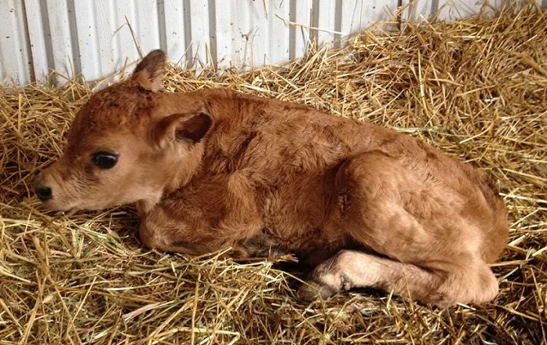

Slide 19
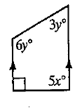
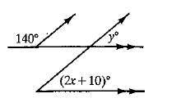
Bell Ringer
Find the values of x and y.

Slide 20
Game Plan
Today and Tomorrow : Work on review packet/study guide for your quiz.
Then: Quiz on 3.1-3.3

Slide 21
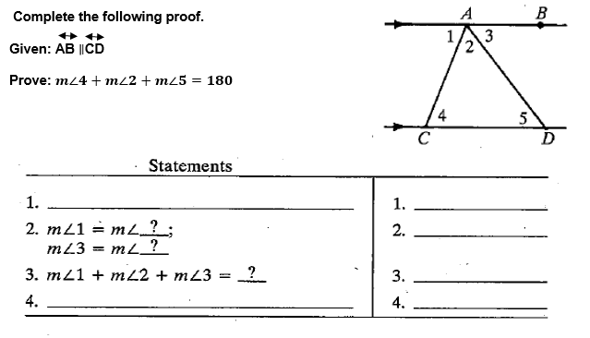
Bell Ringer-1

Slide 22
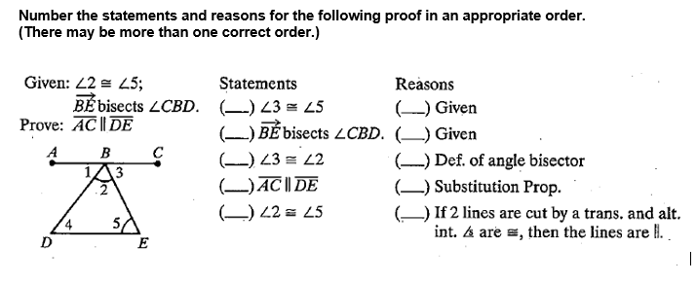
BR 2

Slide 23
Game Plan
Work on Packets today
QUIZ TOMORROW 3.1-3.3

