Slide 1
Bell Ringer
Identify each of the following.
1. points that lie in the same plane
2. two angles whose sum is 180°
3. the intersection of two distinct intersecting lines
4. The intersection of two planes
coplanar points
supplementary angles
point
A line

Slide 2
Chapter 3-Parallel Lines and Planes
LEQ: How do we classify pairs of angles formed by two lines and a transversal?
Day 1

Slide 3
Lines That Do NOT Intersect..
Two lines that do not intersect are either parallel or skew.

Slide 4
Parallel Lines
Definition-Coplanar lines that DO NOT intersect.
Symbol: ||
Segments and rays contained in || lines are also called ||.
Look around: Identify a pair of parallel lines in the classroom.
Parallel lines
l
A
B
n
C
D
l and n are parallel lines

Slide 5
Skew Lines
Definition-Non-coplanar lines.
They are neither parallel, nor intersecting.
CAREFUL: They MAY appear to be perpendicular. Why are they NOT perpendicular?
Skew lines
k
j
j and k are skew lines

Slide 6
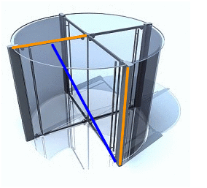
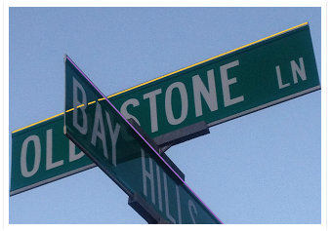
Skew Lines in Real Life

Slide 7
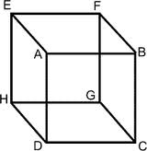
Terms
Parallel Planes (|| planes)-Planes that do not intersect.
Name a pair of parallel planes in the following diagram.
A line and a plane are parallel if they do not intersect.
Name a line and a plane that
are parallel.
X
Y

Slide 8
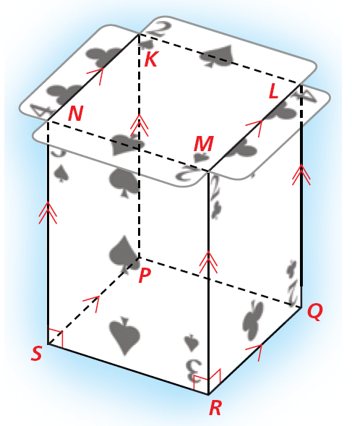
Example 1: Identifying Types of Lines and Planes
Identify each of the following.
A. a pair of parallel segments
LM ||QR
B. a pair of skew segments
KN and SR
C. a pair of perpendicular segments
NS ⊥ SP
D. a pair of parallel planes
plane NMRS || plane KLQP

Slide 9
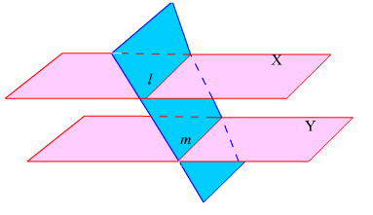
Theorem 3-1
If two parallel planes are cut by a third plane, then the lines of intersection are PARALLEL.
If Planes X and Y are cut by a plane, then line l || line m.

Slide 10
The following terms, which are needed for future theorems about parallel lines, apply only to COPLANAR lines.

Slide 11
Transversal
A transversal is a line that intersects two or more coplanar lines in different points.
In our diagram, line ____ is the transversal.
This transversal creates ____ angles.
Pairs of these angles have special names, depending on their positions.
1
2
3
4
n
5
t
6
7
8
m
8
t

Slide 12
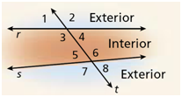
Interior vs. Exterior

Slide 13

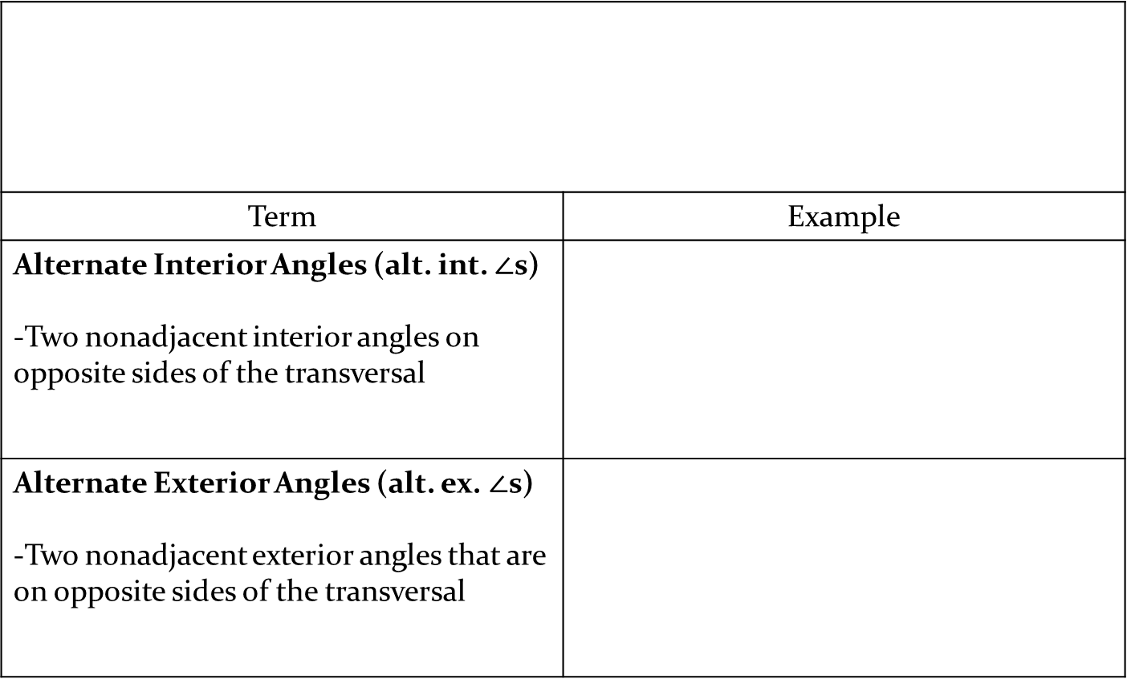

Angle Pairs Formed by a Transversal..
Term | Example
Alternate Interior Angles (alt. int. $∠$s) -Two nonadjacent interior angles on opposite sides of the transversal
Alternate Exterior Angles (alt. ex. $∠$s) -Two nonadjacent exterior angles that are on opposite sides of the transversal
$$∠3 \& ∠6$$
$$∠4 \& ∠5$$
$$∠1 \& ∠8$$
$$∠2 \& ∠7$$

Slide 14
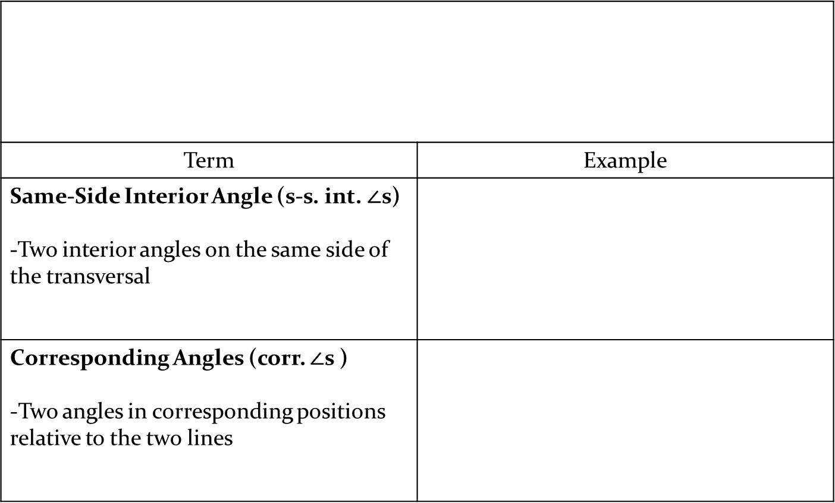


Angle Pairs Formed by a Transversal..
Term | Example
Same-Side Interior Angle (s-s. int. $∠$s) -Two interior angles on the same side of the transversal
Corresponding Angles (corr. $∠$s ) -Two angles in corresponding positions relative to the two lines
$$∠3 \& ∠5$$
$$∠4 \& ∠6$$
$$∠1 \& ∠5; ∠2 \& ∠6$$
$∠3 \& ∠7$; $∠4 \& ∠8$

Slide 15
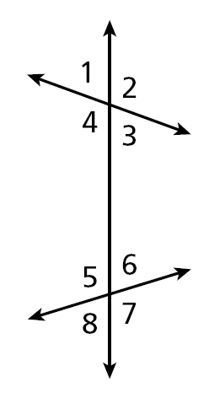
Example 2: Classifying Pairs of Angles
Give an example of each angle pair.
A. corresponding angles
∠1 and ∠5
B. alternate interior angles
∠3 and ∠5
C. alternate exterior angles
∠1 and ∠7
D. same-side interior angles
∠3 and ∠6

Slide 16
Helpful Hint
To determine which line is the transversal for a given angle pair, locate the line that connects the vertices.

Slide 17
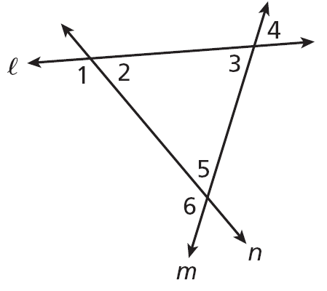
Example 3: Identifying Angle Pairs and Transversals
Identify the transversal and classify each angle pair.
A. ∠1 and ∠3
transversal l
corr. ∠s
B. ∠2 and ∠6
transversal n
alt. int ∠s
C. ∠4 and ∠6
transversal m
alt. ext ∠s

Slide 18
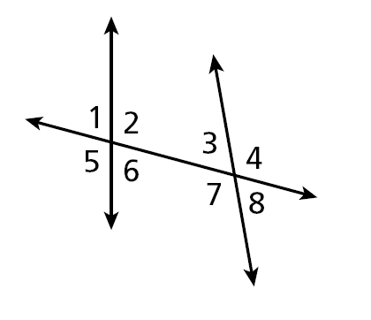
Summary
Give an example of each angle pair.
A. corresponding angles
B. alternate interior angles
C. alternate exterior angles
D. same-side interior angles

Slide 19
Homework
Pg 76-77 #1-17 & #23-28
Honors: pg 76-77 #1-17 & #23-39 omit #29

