Slide 1
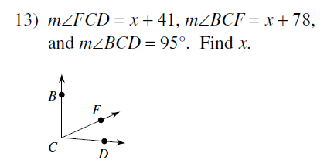
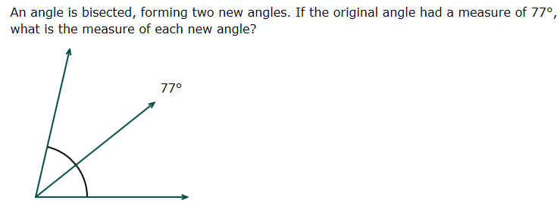
Bell Ringer-Get out HW!!!!

Slide 3
A Kwickie from Mr. K.
As quickly as you can,
Add the integers from 1 to 40.
Is there a quicker way than brute force arithmetic?

Slide 4
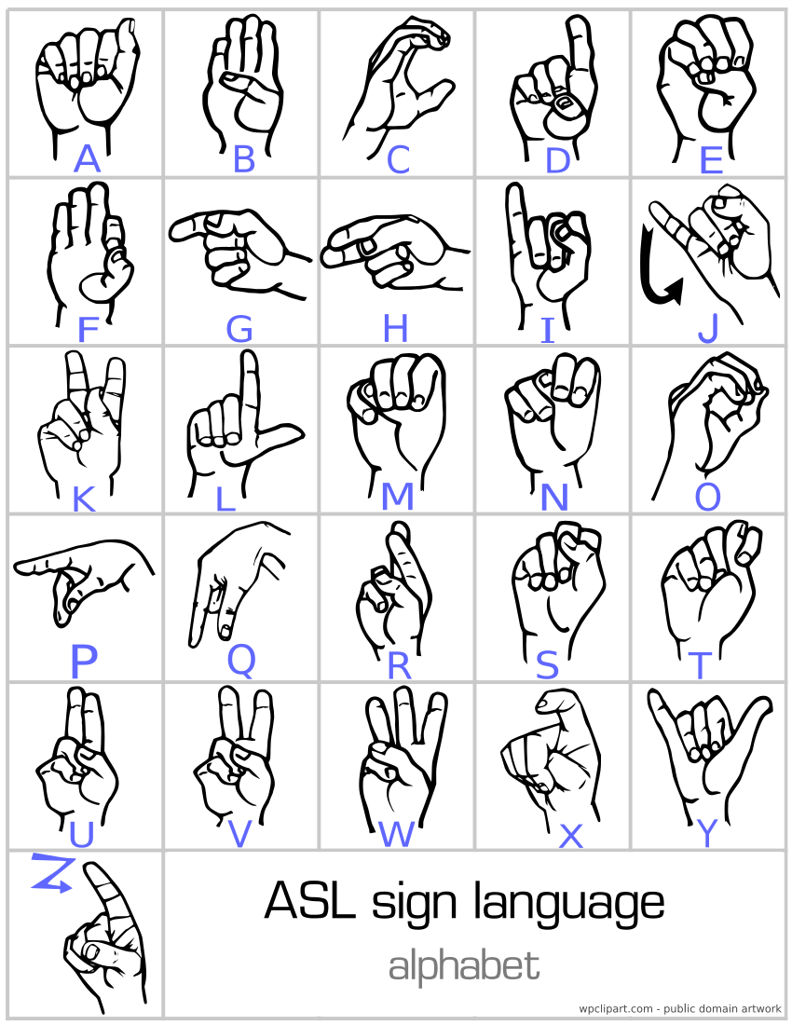

Slide 5
Geometry Section 1-5 LEQ: What is the relationship that postulates and theorems have with points, lines, and planes?

Slide 6
So far, we have accepted, without proof, the following four basic assumptions:
1. The Ruler Postulate
2. The Segment Addition Postulate
3. The Protractor Postulate
4. The Angle Addition Postulate
*These postulates deal with segments, lengths, angles, and measures.

Slide 7
Today
Today we are going to look at 5 postulates and 3 theorems dealing with the way points, lines, and planes are related.
Yes you must know the meaning.
No you do not have to memorize the numbers.

Slide 8
Terminology
Exists-there is at least one
“chairs exist in this room”
Unique-there is no more than one
“In this room, the computer is unique, the chairs are not”
One and only one-exactly one; shows existence and uniqueness
“In this room, there is one and only one SmartBoard”

Slide 9
What is a Postulate?
A postulate is a basic assumption accepted without proof.
They provide the starting point for the proof of a theorem.

Slide 10
Postulate 5 (3 Parts)
A line contains at least ___________ points.
A plane contains at least ________ points not all in one line.
Space contains at least _____ points not all in one plane.

Slide 11
Discussion
What is the minimum number of points needed to define a line?

Slide 12
Postulate 5 (part 1)
A line contains at least two points
Just a point…all alone, no line ☹
P
A
B
Two points are needed to make a line!

Slide 13
Postulate 5 (part 2)
A plane contains at least three points not all in one line (non-collinear).
A
B
C

Slide 14
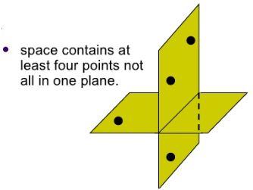
Postulate 5 (part 3)
Space contains at least four points not all in one plane.

Slide 15
Discussion
How many lines can be drawn that contain point A?
How many lines can be drawn that contain point A and point B?
Fill in the postulate:
Through any two points, there is only _____ line.
B
A

Slide 16
Postulate 6
Through any two points, there is only ONE line.
A
F

Slide 17
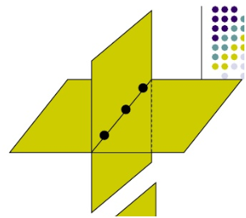
Postulate 7
Through any three points there is at least one plane, and through any three non-collinear points, there is exactly one plane
D
S
E

Slide 18
Discuss
Where does ST lie?
Finish the postulate:
If two points are in a plane, then the line that contains the points _________.
T
S
M

Slide 19
Postulate 8
If two points are in a plane, then the line that contains the points is in that plane.
B
A

Slide 20
Finish the postulate:
Two planes intersect in a ___________.

Slide 21
Postulate 9
Two planes intersect in a line.
m
P
K

Slide 22
Theorems
A theorem is a statement that can be proved using postulates, definitions, and previously used theorems.

Slide 23
Theorem 1-1
If two lines intersect, then they intersect in exactly ONE POINT !
A

Slide 24
Theorem 1-2
Through a line and a point not in the line, there is exactly one plane.
A
B
C

Slide 25
Theorem 1-3
If two lines intersect, then exactly one plane contains the lines.
B
A
C
D

Slide 26
True or False?
A postulate is a statement assumed to be true without proof.
The phrase “exactly one” has the same meaning as the phrase “one and only one”.
Three points determine exactly one plane.
Through any two points there is exactly one plane.
Through a line and a point not on the line there is one and only one plane.
TRUE
TRUE
FALSE
FALSE
TRUE

Slide 27
Homework (R)
Postulates and Theorems Relating Points, Lines, and Planes Worksheet ALL
For #1-6:
Write the postulate or theorem that justifies your answer.

Slide 28
Homework (H) If time allows, Start now.
Page 25 Written Exercises
#3-11 ALL, #17-18 (all parts)
How complete are your notes on this chapter?

