Slide 1
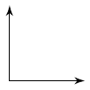
Bell Ringer
Classify each angle as acute, right, straight, or obtuse:

Slide 2
Geometry
1.4 Angles
What are angles and how are they classified and measured?
Day 1/2

Slide 4
The common endpoint is called the vertex of the angle.

Slide 7
Types of angles

Slide 8
Turn To Page 20
Take 5 Minutes
Classroom Exercises
#1-12
Omit #4

Slide 9
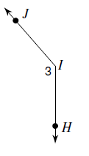
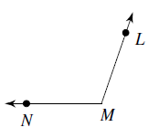
Naming Angles
Name the vertex and sides of the following angle.
Name the angle in 4 different ways.

Slide 10
Angle Addition Postulate
If Point B lies in the interior of AOC,
then m AOB + m BOC = m AOC

Slide 11
Angle Addition Postulate PART 2
If AOC is a straight angle and B is any point not on AC then
m AOB + m BOC = 180

Slide 12
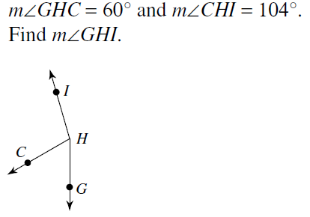
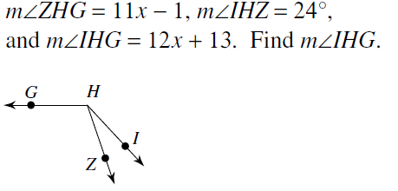
Class Examples

Slide 13
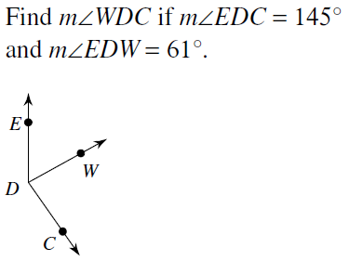
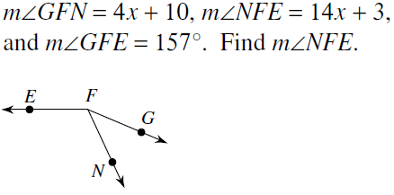
You Try!

Slide 14
Homework
Section 1.4 Angle Addition Postulate Practice Worksheet
#2-30 Evens
HONORS: ALL
**It’s okay to get negatives! Let’s look at #18.

Slide 16
Bell Ringer
Get your homework out from Friday so I can check it (Angle Add. Post. Worksheet)
Turn to Page 20
CLASSROOM EXERCISES
#1-12
Omit #4

Slide 17
Bell Ringer
Solve
2x + 7 = 31
8x – 1 = 23 – 4x
Simplify $\frac{\left(x^{5}y^{3}\right)}{x^{2}y}$
${\left(3y\right)}^{−3}$

Slide 18
Geometry
1.4 Angles
What are angles and how are they classified and measured?
Day 2/2

Slide 19
Measure of an angle
You can use a protractor to find a number associated with each side of an angle.
To find the measure in degrees of an angle, compute the absolute value of the difference of these numbers.

Slide 20
Using the protractor
*Be sure to line the vertex up on the 0

Slide 21
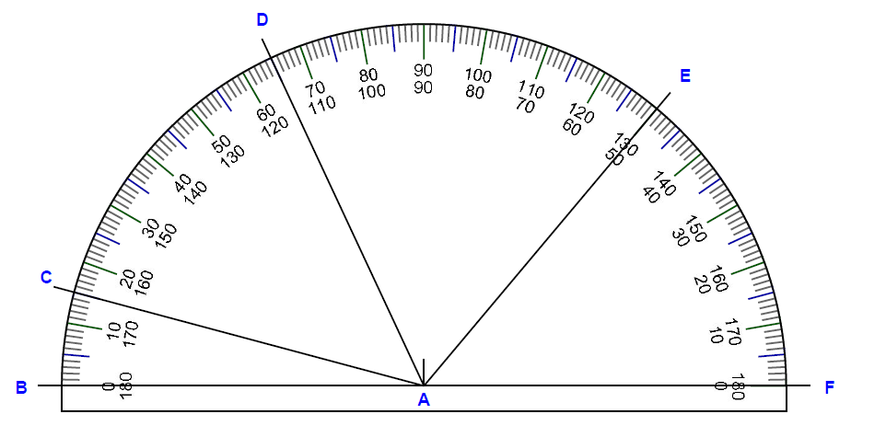
You Try!

Slide 22
Congruent Angles
Congruent angles have the same measure

Slide 23
Adjacent Angles
Adjacent angles have…
a common vertex
a common side
no common interior points.

Slide 24
Angle Bisector Definition
An angle bisector divides an angle into two angles of equal measure (congruent)

Slide 25
When you look at a figure, you can not assume congruent segments, congruent angles or right angles.
It must be explicitly stated.
Examples…

Slide 28
Check for understanding
Page 20
Classroom Exercises
#13-22

Slide 29
Homework Start in Class
Page 21-22 Written Exercises
#1-18 all
#26-34 all
HONORS:
#1-18 all
#26-35 all

