Slide 1
Bell Ringer
Use the appropriate symbols to name the following:
Point A, Line AB, Plane C, Plane XYZ
Find the absolute value of the following:
|-5| |7-(-3)| |-10-(-6)|

Slide 2
Go Over Homework
Page 7-9 #1-10 All & #13-28
OPEN YOUR BOOKS
PLEASE pay attention and check your work.
If you have questions, ASK!

Slide 3
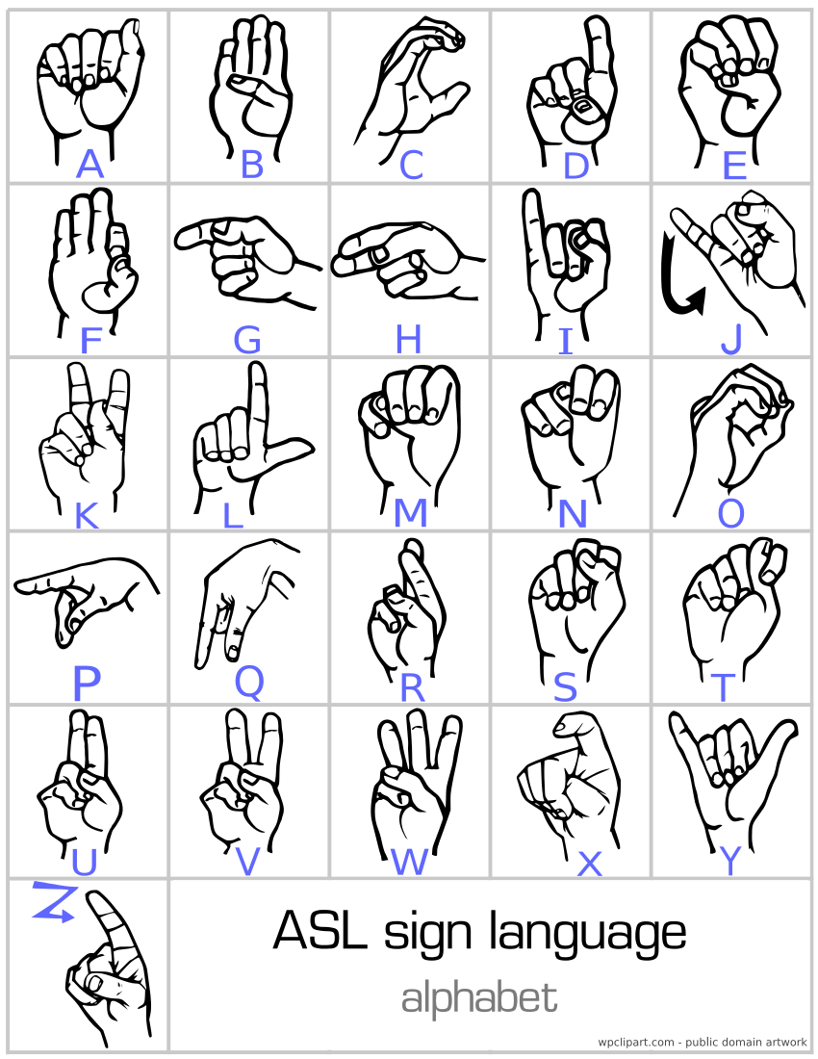

Slide 4
Geometry What is the difference between a line, a line segment, and a ray? Day 1
1.3
Segments, rays
and distance
Copyright, 1996 © Dale Carnegie & Associates, Inc.

Slide 5
Between (not on notes)
A B C
In the diagram, point B is BETWEEN points A and C.
Note that B must lie on AC

Slide 6
Segments
A C
Segment AC is made up of endpoints A and C and all points in between.
We denote this segment AC .

Slide 7
Rays
A C P
Ray AC (or Ray AP) is made up of segment AC and all other points P such that C is between A and P. The endpoint is always named first.
We denote this ray AC or AP

Slide 8
Opposite Rays-Let’s Demonstrate!
R S T
SR and ST are opposite rays if S lies between R and T.
(Note: in order to lie between S must be on the line RT)
The rays have the same endpoint.
Note: RS and SR are not opposite rays.

Slide 9
Opposite Rays-Hands on a Clock
Think of a time on a clock when the minute hand and hour hand would be OPPOSITE RAYS.

Slide 10
Length
On a number line every point is paired with a number and every number is paired with a point.
The length of a segment is the distance between its endpoints or the difference of the coordinates of the two endpoints.
Length is ALWAYS positive!

Slide 11
Find the length of: (not on notes)
a) MJ
b) JL
c) KM
J K L M
-4 -3 -2 -1 0 1 2 3 4

Slide 12
Line, Segment, Ray or Length? (not on notes)
1. PQ 2. PQ
3. PQ 4. PQ
Segment!
Ray!
Line!
Length!

Slide 14
Bell Ringer
Correctly label a segment using your initials
Correctly label a ray using your initials
Name a pair of opposite rays in the following diagram:

Slide 15
Weekly Agenda
Tuesday-1.1-1.3 Quiz
This slide has been covered to prevent panic attacks among more sensitive students.

Slide 16
Postulate 1: Ruler Postulate
The distance between any two points equals the absolute value of the difference of their coordinates.

Slide 17
Ruler Postulate Example
State the distance between the points.
1) 5 and 24
2) -3 and 8
3) -4 and -10
|5-24|=|-19|=19
|-3-8|=|-11|=11
|-4-(-10)|=|-4+10|=|6|=6

Slide 18
You Try!-1
State the distance between the points.
10 and 52
2) -6 and 15
3) -2 and -7
42
21
5

Slide 19
Postulate 2: Segment Addition Postulate
If B is between A and C, then
AB + BC = AC
A
B
C

Slide 20
Segment Addition Postulate Example
A
B
C
B is between A and C, with AB=x, BC=x+6, and AC=24. Find:
a. The value of x b. BC

Slide 21
You Try!
Practice the Segment Addition Postulate in the next two examples either by yourself or with a partner!

Slide 22
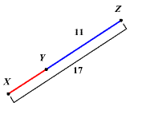
Find XY.
B is between A and C, with AC = 4x-5, BC = 6, and AB=2x-1.
FIND:
The value of x
b. AC
x=5
XY=6
AC=15

Slide 23
Ticket out the Door!-Use your initials!
1. Make a symbol to represent:
a. a segment
b. a ray
c. a line
d. a length
2. Write one COMPLETE sentence to describe the Ruler Postulate and write one COMPLETE sentence to describe the Segment Addition Postulate in your OWN WORDS.

Slide 24
Homework
Page 15 Written Exercises
#1-4 ALL and #19-22 ALL
AND
Segment Addition Postulate Worksheet
It’s okay to get negatives as your x-values (does not make segment negative, just the value of x-ex #4)
Answer questions being asked. Draw diagrams.

Slide 25
Homework (Honors)
Page 15 Written Exercises
#1-4 ALL and #19-22 ALL
AND
Segment Addition Postulate Worksheet
Page 14 Classroom Exercises
#1-9 all

Slide 27
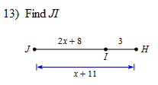
Bell Ringer
X Y Z
Use the diagram to name a pair of opposite rays and ALSO a pair of rays that are NOT opposite. Be sure to label answers correctly.
Find JI: Solve for x:

Slide 28
Homework
Let’s check homework
Segment Addition Postulate worksheet
Page 15 Written Ex #1-4 and #19-22
1. 15 2. 14 3. 4.5 4. 7.1
19. B 20. F 21. C, G 22. BA

Slide 29
Geometry What is the difference between a line, a line segment, and a ray? Day 3
1.3
Segments, rays
and distance
Copyright, 1996 © Dale Carnegie & Associates, Inc.

Slide 30
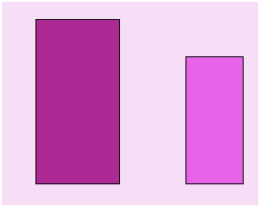
Congruent
Definition- Two objects that have the same size and shape.
Congruent
NOT Congruent

Slide 31
Do the figures appear to be congruent?

Slide 32
Do the figures appear to be congruent?

Slide 33
Do the figures appear to be congruent?

Slide 34
Congruent Segments
Definition- segments that have equal length. (Symbol ≅)
Congruent Segments
AB ≅ CD
Segments that are not congruent
AB ≅ CD
3
2
A
B
A
B
3
4
D
D
c
c

Slide 35
Midpoint of a Segment
Definition- the point that divides the segment into two congruent segments.
Midpoint of a Segment
AP = PB
AP ≅ PB
and P is the midpoint of AB
2
2
A
P
B

Slide 36
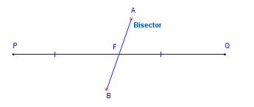
Bisector of a Segment
Definition- A line, segment, ray, or plane that intersects the segment at its midpoint.

Slide 37
M is the midpoint of BD
A
B
M
D
C
If MD = 4 and MB = 2x, find x.
Find BD.

Slide 38
A
B
M
D
C
If MA = x + 4 and AC = 16, What must x = so that M is the midpoint of AC?

Slide 39
Exit Discussion
What does congruent mean and what is its symbol?
What is a midpoint?
What is a bisector?

Slide 40
Homework
Page 15-16
#23-26 & #31-40
**QUIZ TOMORROW!***
**QUIZ NOTES!*

Slide 41
Homework (Honors)
Page 15-16
#23-26 & #31-40
#41-48 omit 46 & 47
**QUIZ TOMORROW!***

