Slide 1
Section 1-2
Lesson Essential Question:
What are the basic terms and their importance to Geometry?

Slide 2
Bell Ringer
In your own words define the following terms:
Point
Line
Plane
Point, Line, and Plane are often referred to as the three undefined terms of geometry.

Slide 3
Undefined Terms: Point
Points will be named using the capital letter that accompanies the point on a diagram.
Here we have point P and point R.
Doesn’t have any size, but is represented by a dot that does have some size.
All geometric figures consist of points.
P
R

Slide 4
Undefined Terms: Line
Lines will be named using two points. A line extends in two directions without ending.
k
This would be called Line PR or PR
It could also be named with a lower case letter.
Line k or k
P
R

Slide 5
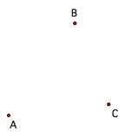
Space is the set of all points.
Collinear points are points all in one line.
Non- Collinear points are points NOT all in one line.

Slide 6
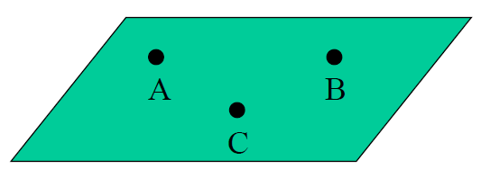
Undefined Terms: Plane
Planes can be named using a capital letter.
This would be called plane B
Planes can also be named using three non-collinear points in the plane.
This would be called plane ABC.
B

Slide 7
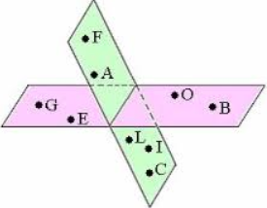
Coplanar points are points all in one plane.
Points A, B, C, and D are COPLANAR.
Non-Coplanar points are points NOT all in one plane.
Points O, A, and B are NON-COPLANAR.

Slide 8
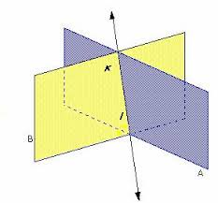
The intersection of two figures is the set of points that are in both figures. Dashes in the diagrams indicate parts hidden from view in figures in space.

Slide 9
Classify each statement as true or false.
X
1. XY intersects plane M at point O.
TRUE!
M
T
S
O
R
W
Y

Slide 10
Classify each statement as true or false.
X
2. Plane M intersects XY in more than one point.
M
FALSE!
T
S
O
R
W
Y

Slide 11
Classify each statement as true or false.
X
3. T, O, and R are collinear.
M
FALSE!
T
W
O
R
S
Y

Slide 12
Classify each statement as true or false.
X
4. R, O, S, and W are coplanar.
M
TRUE!
T
S
O
R
W
Y

Slide 13
Ticket Out the Door!!!!!
1.) What are the three undefined terms in geometry?
2.) Label a point G.
3.) Make a line and use your initials as its points. Then, name the line using the correct symbol.
4.) Make a plane and name it using one of the two ways we learned.

Slide 14
Homework (Regular)
Page 7-9 WRITTEN EXERCISES
#s 1-10 ALL & #s 13-28 ALL
**Please show as much work as possible to receive full credit on your homework!

Slide 15
Homework (Honors)
Page 7-9 WRITTEN EXERCISES
#s 1-10 ALL & #s 13-36 ALL
**Please show as much work as possible to receive full credit on your homework!

