Slide 1
Algebra I Review-Bell Ringer
Solve the following linear equation for x.
$$\frac{3}{4}x−4=8$$

Slide 2
Sect 1-1
Lesson Essential Question:
What are the basic terms and their importance to Geometry?
Mr. K’s Web Page: Make note of this
http://websites.pdesas.org/Index/ViewWebPage?websitePageId=425308
http://websites.pdesas.org/Indes/ViewWebPage?websitePageID=425308

Slide 3
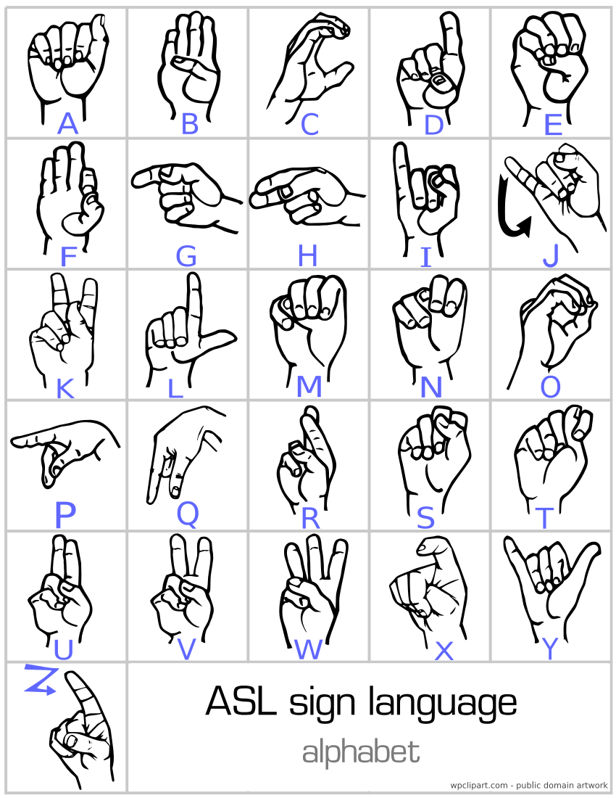

Slide 4
Sect 1-1 A Game and Some Geometry
1. What is the distance from C to E?
from D to E?
5 cm
5 cm

Slide 5
2. What is the distance from C to F?
from D to F?
5 cm
5 cm

Slide 6
Definition
E and F are said to be EQUIDISTANT from C and D because they are EQUALLY DISTANT from C and D.
Equidistant has the prefix ‘equi’, meaning equal, and a suffix of distant. Therefore, two locations that are equidistant from a third location are the same distance from the third location.

Slide 7
3. Find another point on the diagram that is equidistant from C and D. What is its distance?
Point G
7 cm

Slide 8
4. How many points exist that are equidistant from C and D? Describe the geometric figure the points would form.
Infinite # of points!
Line

Slide 9
You Try!
Try number 5 on your own!
When you are done, tell the person next to you what geometric figure the points would form.

Slide 10
Why should I care?
This game involves points and distances. When you approach the game systematically, you use lines and circles. Understanding the properties of geometric figures like these is an important part of geometry.

Slide 11
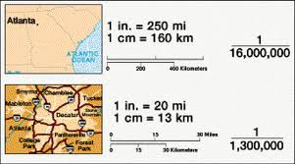
Real-World Connection
Geometric ideas can be used to represent physical objects (mapmaker).
On our diagram, what was our scale?
What if every 1 cm on our map actually represented 5 feet?

Slide 12
Summary-Ticket Out the Door
Solve the following linear equation for x.
$\frac{2}{3}x+5=11$
Homework: p. 4, # 5-10.

Slide 14
Section 1-2
Lesson Essential Question:
What are the basic terms and their importance to Geometry?

Slide 15
Bell Ringer
In your own words define the following terms:
Point
Line
Plane
Point, Line, and Plane are often referred to as the three undefined terms of geometry.

Slide 16
Undefined Terms: Point
Points will be named using the capital letter that accompanies the point on a diagram.
Here we have point P and point R.
Doesn’t have any size, but is represented by a dot that does have some size.
All geometric figures consist of points.
P
R

Slide 17
Undefined Terms: Line
Lines will be named using two points. A line extends in two directions without ending.
k
This would be called Line PR or PR
It could also be named with a lower case letter.
Line k or k
P
R

Slide 18
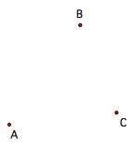
Space is the set of all points.
Collinear points are points all in one line.
Non- Collinear points are points NOT all in one line.

Slide 19
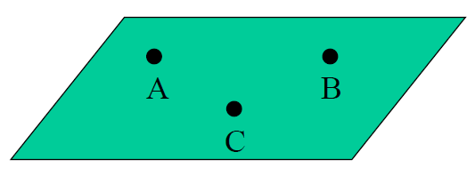
Undefined Terms: Plane
Planes can be named using a capital letter.
This would be called plane B
Planes can also be named using three non-collinear points in the plane.
This would be called plane ABC.
B

Slide 20
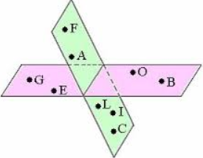
Coplanar points are points all in one plane.
Points A, B, C, and D are COPLANAR.
Non-Coplanar points are points NOT all in one plane.
Points O, A, and B are NON-COPLANAR.

Slide 21
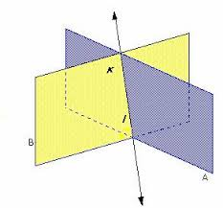
The intersection of two figures is the set of points that are in both figures. Dashes in the diagrams indicate parts hidden from view in figures in space.

Slide 22
Classify each statement as true or false.
X
1. XY intersects plane M at point O.
TRUE!
M
T
S
O
R
W
Y

Slide 23
Classify each statement as true or false.
X
2. Plane M intersects XY in more than one point.
M
FALSE!
T
S
O
R
W
Y

Slide 24
Classify each statement as true or false.
X
3. T, O, and R are collinear.
M
FALSE!
T
W
O
R
S
Y

Slide 25
Classify each statement as true or false.
X
4. R, O, S, and W are coplanar.
M
TRUE!
T
S
O
R
W
Y

Slide 26
Ticket Out the Door!!!!!
1.) What are the three undefined terms in geometry?
2.) Label a point G.
3.) Make a line and use your initials as its points. Then, name the line using the correct symbol.
4.) Make a plane and name it using one of the two ways we learned.

Slide 27
Homework (Regular)
Page 7-9 WRITTEN EXERCISES
#s 1-10 ALL & #s 13-28 ALL
**Please show as much work as possible to receive full credit on your homework!

Slide 28
Homework (Honors)
Page 7-9 WRITTEN EXERCISES
#s 1-10 ALL & #s 13-36 ALL
**Please show as much work as possible to receive full credit on your homework!

