Slide 2
DNA Mutations

Slide 3
10.16 Mutations can affect genes
A mutation is any change in the nucleotide sequence of DNA.
Mutations can involve
large chromosomal regions
just a single nucleotide pair
Notes:
Student Misconceptions and Concerns
• Beginning college students are often intensely focused on writing detailed notes. The risk is that they will miss the overall patterns and the broader significance of the topics discussed. Consider a gradual approach to the subjects of transcription and translation, beginning quite generally and testing comprehension, before venturing into the finer mechanics of each process.
• Mutations are often discussed as part of evolutionary mechanisms. In this sense, mutations may be considered a part of a creative process. The dual nature of mutations, potentially deadly yet potentially innovative, should be clarified.
Teaching Tips
• A simple way to demonstrate the effect of a reading frame shift is to have students compare the following three sentences. The first is a simple sentence. However, look what happens when a letter is added (2) or deleted (3). The reading frame is reformed into nonsense.
(1) The big red pig ate the red rag.
(2) The big res dpi gat eth ere dra g.
(3) The big rep iga tet her edr ag.
• The authors have noted elsewhere that “A random mutation is like a random shot in the dark. It is not likely to improve a genome any more than shooting a bullet through the hood of a car is likely to improve engine performance!”
Active Lecture Tips
• See the Media Review: “Learn.Genetics” Genetic Science Learning from the University of Utah on the Instructor Exchange. Visit the Instructor Exchange in the MasteringBiology instructor resource area for a description of this activity.
• See the Activity Demonstrating a Frame Shift Mutation on the Instructor Exchange. Visit the Instructor Exchange in the MasteringBiology instructor resource area for a description of this activity.

Slide 4
10.16 Mutations can affect genes
Nucleotide substitutions involve the replacement of one nucleotide and its base-pairing partner with another pair of nucleotides.
have no effect at all, producing a silent mutation
change the amino acid coding, producing a missense mutation, which produces a different amino acid
lead to a base substitution that produces an improved protein that enhances the success of the mutant organism and its descendants
change an amino acid into a stop codon, producing a nonsense mutation.
Notes:
Student Misconceptions and Concerns
• Beginning college students are often intensely focused on writing detailed notes. The risk is that they will miss the overall patterns and the broader significance of the topics discussed. Consider a gradual approach to the subjects of transcription and translation, beginning quite generally and testing comprehension, before venturing into the finer mechanics of each process.
• Mutations are often discussed as part of evolutionary mechanisms. In this sense, mutations may be considered a part of a creative process. The dual nature of mutations, potentially deadly yet potentially innovative, should be clarified.
Teaching Tips
• A simple way to demonstrate the effect of a reading frame shift is to have students compare the following three sentences. The first is a simple sentence. However, look what happens when a letter is added (2) or deleted (3). The reading frame is reformed into nonsense.
(1) The big red pig ate the red rag.
(2) The big res dpi gat eth ere dra g.
(3) The big rep iga tet her edr ag.
• The authors have noted elsewhere that “A random mutation is like a random shot in the dark. It is not likely to improve a genome any more than shooting a bullet through the hood of a car is likely to improve engine performance!”
Active Lecture Tips
• See the Media Review: “Learn.Genetics” Genetic Science Learning from the University of Utah on the Instructor Exchange. Visit the Instructor Exchange in the MasteringBiology instructor resource area for a description of this activity.
• See the Activity Demonstrating a Frame Shift Mutation on the Instructor Exchange. Visit the Instructor Exchange in the MasteringBiology instructor resource area for a description of this activity.

Slide 5
10.16 Mutations can affect genes
Nucleotide insertions or deletions of one or more nucleotides in a gene may
cause a frameshift mutation, which alters the reading frame (triplet grouping) of the genetic message
lead to significant changes in amino acid sequence
produce a nonfunctional polypeptide.
Notes:
Student Misconceptions and Concerns
• Beginning college students are often intensely focused on writing detailed notes. The risk is that they will miss the overall patterns and the broader significance of the topics discussed. Consider a gradual approach to the subjects of transcription and translation, beginning quite generally and testing comprehension, before venturing into the finer mechanics of each process.
• Mutations are often discussed as part of evolutionary mechanisms. In this sense, mutations may be considered a part of a creative process. The dual nature of mutations, potentially deadly yet potentially innovative, should be clarified.
Teaching Tips
• A simple way to demonstrate the effect of a reading frame shift is to have students compare the following three sentences. The first is a simple sentence. However, look what happens when a letter is added (2) or deleted (3). The reading frame is reformed into nonsense.
(1) The big red pig ate the red rag.
(2) The big res dpi gat eth ere dra g.
(3) The big rep iga tet her edr ag.
• The authors have noted elsewhere that “A random mutation is like a random shot in the dark. It is not likely to improve a genome any more than shooting a bullet through the hood of a car is likely to improve engine performance!”
Active Lecture Tips
• See the Media Review: “Learn.Genetics” Genetic Science Learning from the University of Utah on the Instructor Exchange. Visit the Instructor Exchange in the MasteringBiology instructor resource area for a description of this activity.
• See the Activity Demonstrating a Frame Shift Mutation on the Instructor Exchange. Visit the Instructor Exchange in the MasteringBiology instructor resource area for a description of this activity.

Slide 6
Example:
The big red pig ate the red rag.
The big res dpi gat eth ere dra g.
The big rep iga tet her edr ag.

Slide 7
10.16 Mutations can affect genes
Mutagenesis is the production of mutations.
Mutations can be caused
by spontaneous errors that occur during DNA replication or recombination
by mutagens, which include
high-energy radiation such as X-rays and ultraviolet light
chemicals.
Notes:
Student Misconceptions and Concerns
• Beginning college students are often intensely focused on writing detailed notes. The risk is that they will miss the overall patterns and the broader significance of the topics discussed. Consider a gradual approach to the subjects of transcription and translation, beginning quite generally and testing comprehension, before venturing into the finer mechanics of each process.
• Mutations are often discussed as part of evolutionary mechanisms. In this sense, mutations may be considered a part of a creative process. The dual nature of mutations, potentially deadly yet potentially innovative, should be clarified.
Teaching Tips
• A simple way to demonstrate the effect of a reading frame shift is to have students compare the following three sentences. The first is a simple sentence. However, look what happens when a letter is added (2) or deleted (3). The reading frame is reformed into nonsense.
(1) The big red pig ate the red rag.
(2) The big res dpi gat eth ere dra g.
(3) The big rep iga tet her edr ag.
• The authors have noted elsewhere that “A random mutation is like a random shot in the dark. It is not likely to improve a genome any more than shooting a bullet through the hood of a car is likely to improve engine performance!”
Active Lecture Tips
• See the Media Review: “Learn.Genetics” Genetic Science Learning from the University of Utah on the Instructor Exchange. Visit the Instructor Exchange in the MasteringBiology instructor resource area for a description of this activity.
• See the Activity Demonstrating a Frame Shift Mutation on the Instructor Exchange. Visit the Instructor Exchange in the MasteringBiology instructor resource area for a description of this activity.

Slide 8
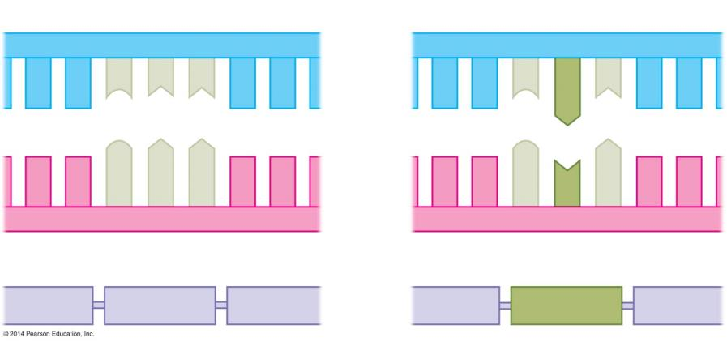
Figure 10.16a
Normal hemoglobin DNA
Mutant hemoglobin DNA
C T T
C A T
mRNA
mRNA
G A A
G U A
Normal hemoglobin
Sickle-cell hemoglobin
Glu
Val
Notes:
Figure 10.16a The molecular basis of sickle-cell disease

Slide 9
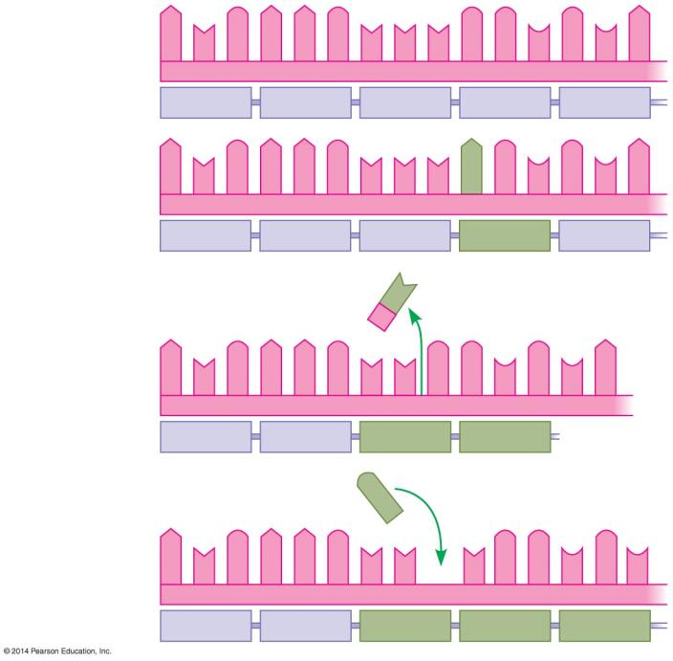
Figure 10.16b-0
Normal gene
A U G A A G U U U G G C G C A
mRNA Protein
Met
Lys
Phe
Gly
Ala
Nucleotide substitution
A U G A A G U U U A G C G C A
Met
Lys
Phe
Ser
Ala
U
Deleted
Nucleotide deletion
A U G A A G U U G G C G C A
Met
Lys
Leu
Ala
G
Inserted
Nucleotide insertion
A U G A A G U U U G G C G C
Met
Lys
Leu
Trp
Arg
Notes:
Figure 10.16b-0 Types of mutations and their effects

Slide 10
In Notebooks:
Compare the following mutated DNA strands to the original. Transcribe each in mRNA and translate mRNA into amino acids. Give the type of mutation for each.
Original DNA: G A C G C C T A C
Mutation A: G A C G C T C T A C
Mutation B: G A C G C A T A C
Mutation C: G A C C C T A C

