Slide 1
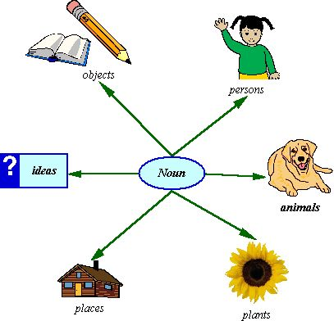
Chapter 2
Test Review

Slide 2
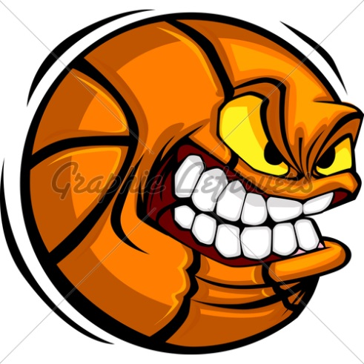
Identify the nouns in each sentence.
Happytown had no happiness in it last night.
Our school lost the important competition.
The people expected a huge win.
Taylor Bowman scored many points.
The other school showed greater talent.

Slide 3
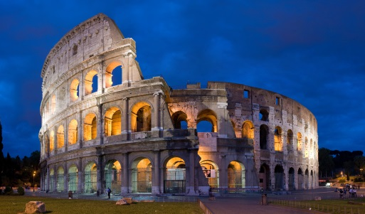
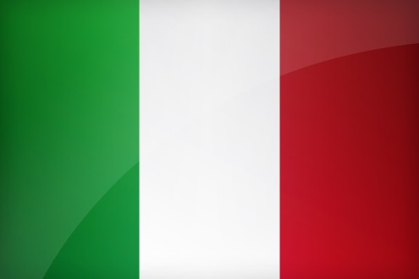
Pick out the common nouns and fix the proper nouns.
The country of italy is a beautiful place.
This place lies between the mediterranean sea and the adriatic sea.
The capital is rome, near the center of the country.
The pantheon is an amazing attraction.
An important holiday in june is called republic day.

Slide 4
Write the plural form of each noun.
tooth _________
wife _________
child _________
moose _________
mouse _________
hero _________
stereo _________
cuff _________
lady _________
mattress _________
pencil _________
eyelash _________
cookie _________
couch _________
monkey _________
booth _________

Slide 5
Rewrite each phrase.
Singular Possessive
Plural Possessive
The pencil belonging to Jacob
The seat on the bus
The hat of the man
The shoes of the children
The gloves of the players
The notes of the students

Slide 6
Noun Jobs
My class is excited for the trip.
Mr. Serfass is a science teacher.
The family lives in Lehighton.
The cutest animal on the farm is a pig.
My friend sent Jami a card.
I enjoyed the burger.
The class enjoyed watching the movie.
What happened to the animals?
The people in the store are shoppers.
My family played a game.
I would love to go to Florida over the summer.
The team played a great game.
We love to attend festivals during the summer.
The students wrote a speech.
The students made Mr. Ebbert a cake.
(S)- Subject
(PN)- Predicate Noun
(DO)- Direct Object
(IO)- Indirect Object
(OP)- Object of the
Preposition

