Slide 1
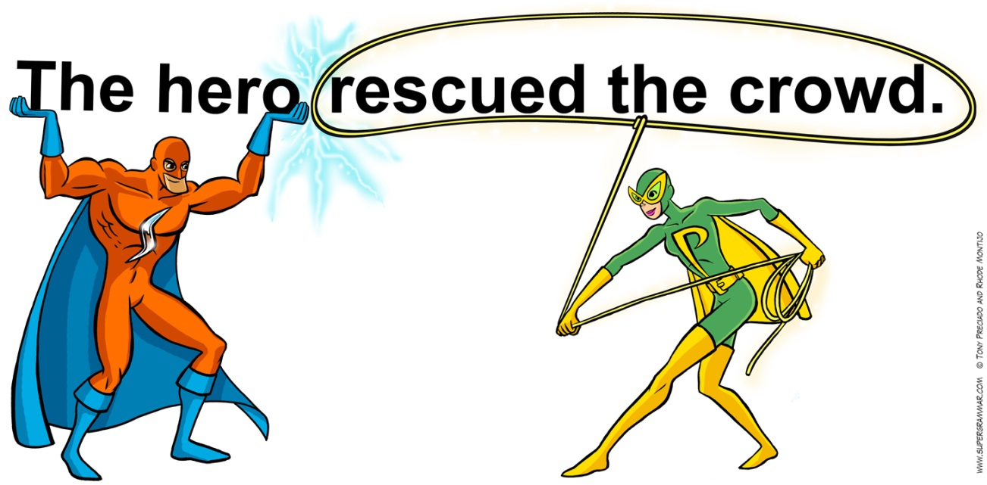
Chapter 1
Test Review

Slide 2
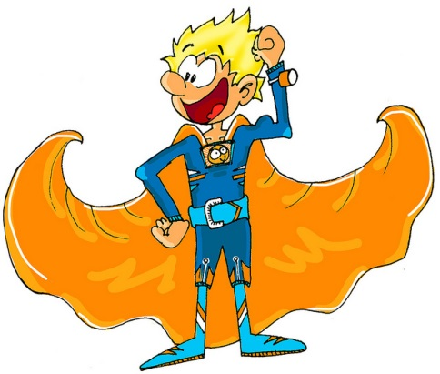
Underline the simple subject once and the simple predicate twice.
The superheroes were rescuing the people.
One villain's name is Mr. Evil.
The people were running and screaming from Mr. Evil.
Spaceworms and aliens like to chase the people around town.
Mr. Stretch and Flamegirl were on the scene.
The evil villian was quickly captured by the superheroes.

Slide 3
Label the sentences. D- Declarative Int- Interrogative E- Exclamatory Imp- Imperative
That’s really scary! _____
What will you be for Halloween? _____
Stop interrupting me; I’m trying to tell you about my costume. _____
People from all countries dress in costumes. _____
Please give me some candy. _____
Will you be going to the parade? _____
The Halloween party will begin at 7:00. _____

Slide 4
Find the complement in each sentence. Tell whether it is a PA or PN.
Football is a sport in the United States. _____
The quarterback became the best player on the team. _____
His strength is amazing. _____
That new football field is very clean. _____
The man is the coach for the team. _____
The team is very hardworking. _____
The Steelers are a good team in the
NFL. _____

Slide 5
Label the parts of the sentence. S- Subject DO- Direct Object V- Verb IO- Indirect Object
Our class is watching a movie.
The teacher gave the students some popcorn.
Lucy brought her friends some candy.
We sent other classes invitations to the movie.
The principal placed napkins on the table.
Anna and Ethan spilled soda on the floor.
The students made the principal a thank you card.

Slide 6
Fragments and Run-Ons
You must turn off the lights. When you are done in the room.
Make sure to study for your test tomorrow you want to get the best possible grade on your test.

