Slide 1
Biological Molecules
Nucleic Acids

Slide 2
#20. What are nucleic acids?

Slide 3
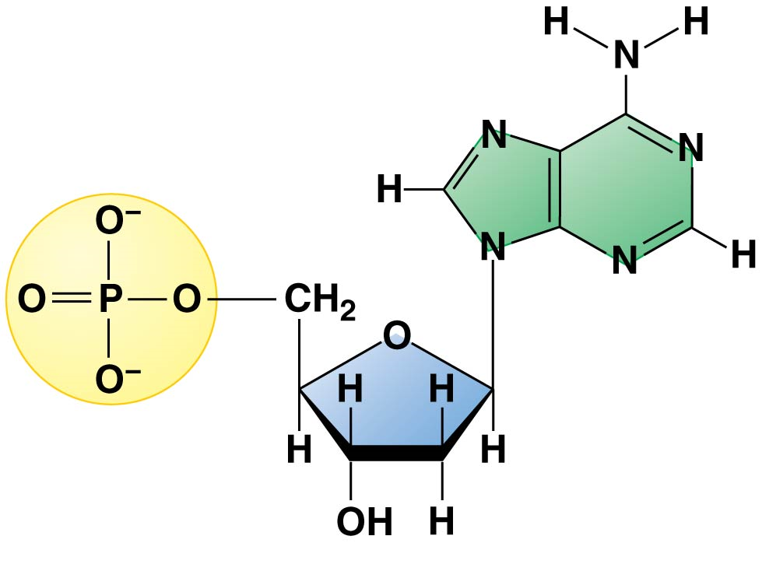
Nucleic Acids
a. Store and transmit hereditary info. Composed of a sugar, a phosphate group and a base (nucleotide).

Slide 4
DNA and RNA are the two types of nucleic acids
The amino acid sequence of a polypeptide is programmed by a discrete unit of inheritance known as a gene.
Genes consist of DNA (deoxyribonucleic acid), a type of nucleic acid.
DNA is inherited from an organism’s parents.
DNA provides directions for its own replication.
DNA programs a cell’s activities by directing the synthesis of proteins.
Notes:
4
Student Misconceptions and Concerns
• Module 3.15 is the first time the authors present the concept of transcription and translation, discussed extensively in later chapters. The basic conceptual flow of information from DNA to RNA to proteins is essential to these later discussions. A flow chart that also relates the location where these processes occur in a eukaryotic cell will help to cement this fundamental transmission of genetic information.
Teaching Tips
• The “NA” in the acronyms DNA and RNA stands for “nucleic acid.” Students often do not make this association without assistance.
Active Lecture Tips
• See the Activity Reviewing Macromolecules on the Instructor Exchange. Visit the Instructor Exchange in the MasteringBiology instructor resource area for a description of this activity.

Slide 5
Nucleic acids are polymers of nucleotides
DNA (deoxyribonucleic acid) and RNA (ribonucleic acid) are composed of monomers called nucleotides.
Nucleotides have three parts:
a five-carbon sugar called ribose in RNA and deoxyribose in DNA
a phosphate group
a nitrogenous base
Notes:
5
Teaching Tips
• When discussing the sequence of nucleotides in DNA and RNA, consider challenging your students with the following questions based upon prior analogies. If the 20 possible amino acids in a polypeptide represent “words” in a long polypeptide sentence, how many possible words are in the language of a DNA molecule? (Answer: Four nucleotides, GCAT, are possible). Are these the same “words” used in RNA? (Answer: No. Uracil substitutes for thymine.)
Active Lecture Tips
• See the Activity Reviewing Macromolecules on the Instructor Exchange. Visit the Instructor Exchange in the MasteringBiology instructor resource area for a description of this activity.

Slide 6
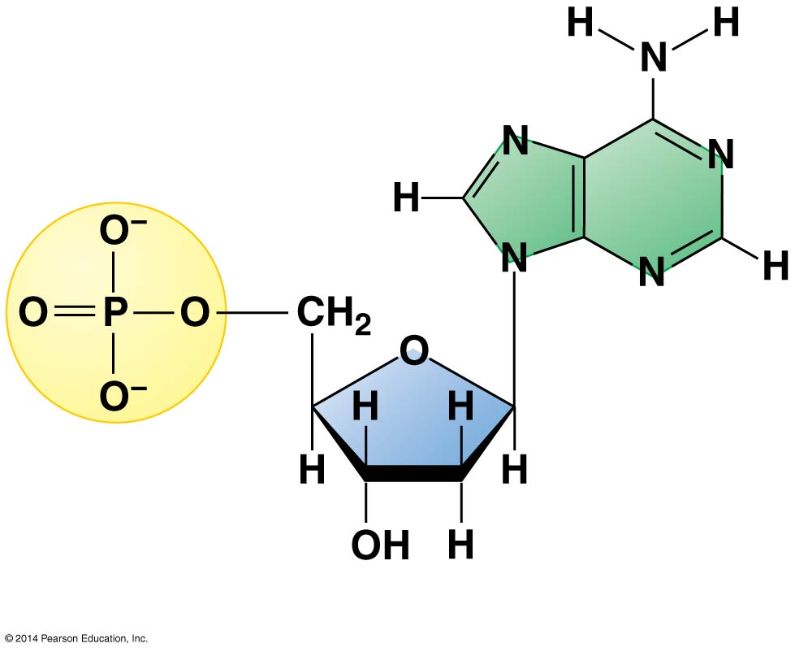
Figure 3.16a
Nitrogenous base (adenine)
Phosphate group
Sugar
Notes:
Figure 3.16a A nucleotide

Slide 7
Answer in Notebooks:
21. What are the 3 parts of a nucleotide?

Slide 8
DNA (deoxyribonucleic acid) → stores hereditary information
- Deoxyribose is the sugar
RNA (ribonucleic acid) → carries protein coding instructions from DNA to ribosomes
- Ribose is the sugar

Slide 9
Nucleic acids are polymers of nucleotides
RNA is usually a single polynucleotide strand
DNA is a double helix, in which two polynucleotide strands wrap around each other.
The two strands are associated because particular bases always hydrogen-bond to one another.
A pairs with T, and C pairs with G, producing base pairs.
Notes:
9
Teaching Tips
• When discussing the sequence of nucleotides in DNA and RNA, consider challenging your students with the following questions based upon prior analogies. If the 20 possible amino acids in a polypeptide represent “words” in a long polypeptide sentence, how many possible words are in the language of a DNA molecule? (Answer: Four nucleotides, GCAT, are possible). Are these the same “words” used in RNA? (Answer: No. Uracil substitutes for thymine.)
Active Lecture Tips
• See the Activity Reviewing Macromolecules on the Instructor Exchange. Visit the Instructor Exchange in the MasteringBiology instructor resource area for a description of this activity.

Slide 10
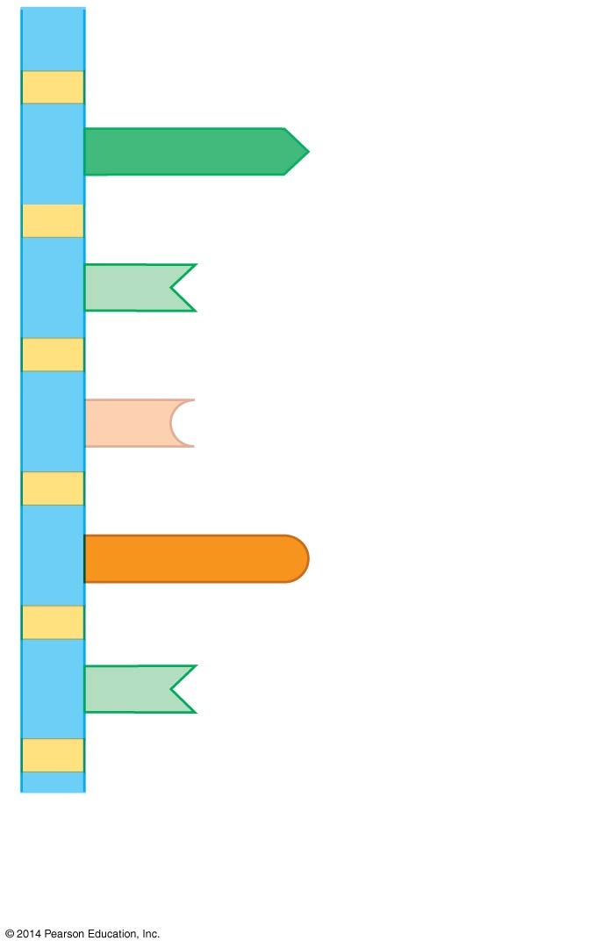
Figure 3.16b
A
Nucleotide
T
C
G
T
Sugar-phosphate backbone
Notes:
Figure 3.16b Part of a polynucleotide

Slide 11
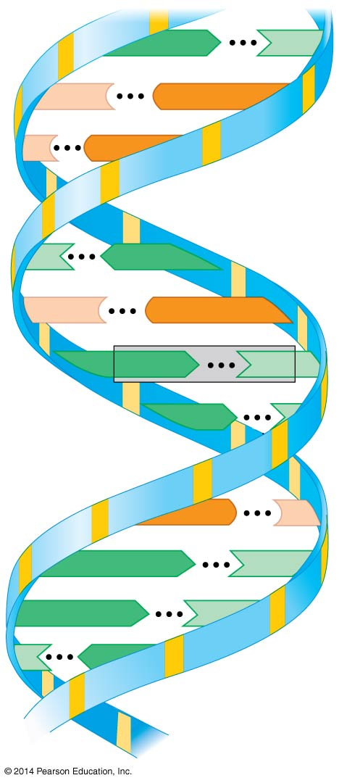
Figure 3.16c
C
G
C
G
T
A
C
G
A
T
Base pair
A
T
G
C
A
T
A
T
T
A
Notes:
Figure 3.16c DNA double helix

Slide 12
Answer in Notebooks:
22. What are some differences between DNA and RNA?

Slide 13
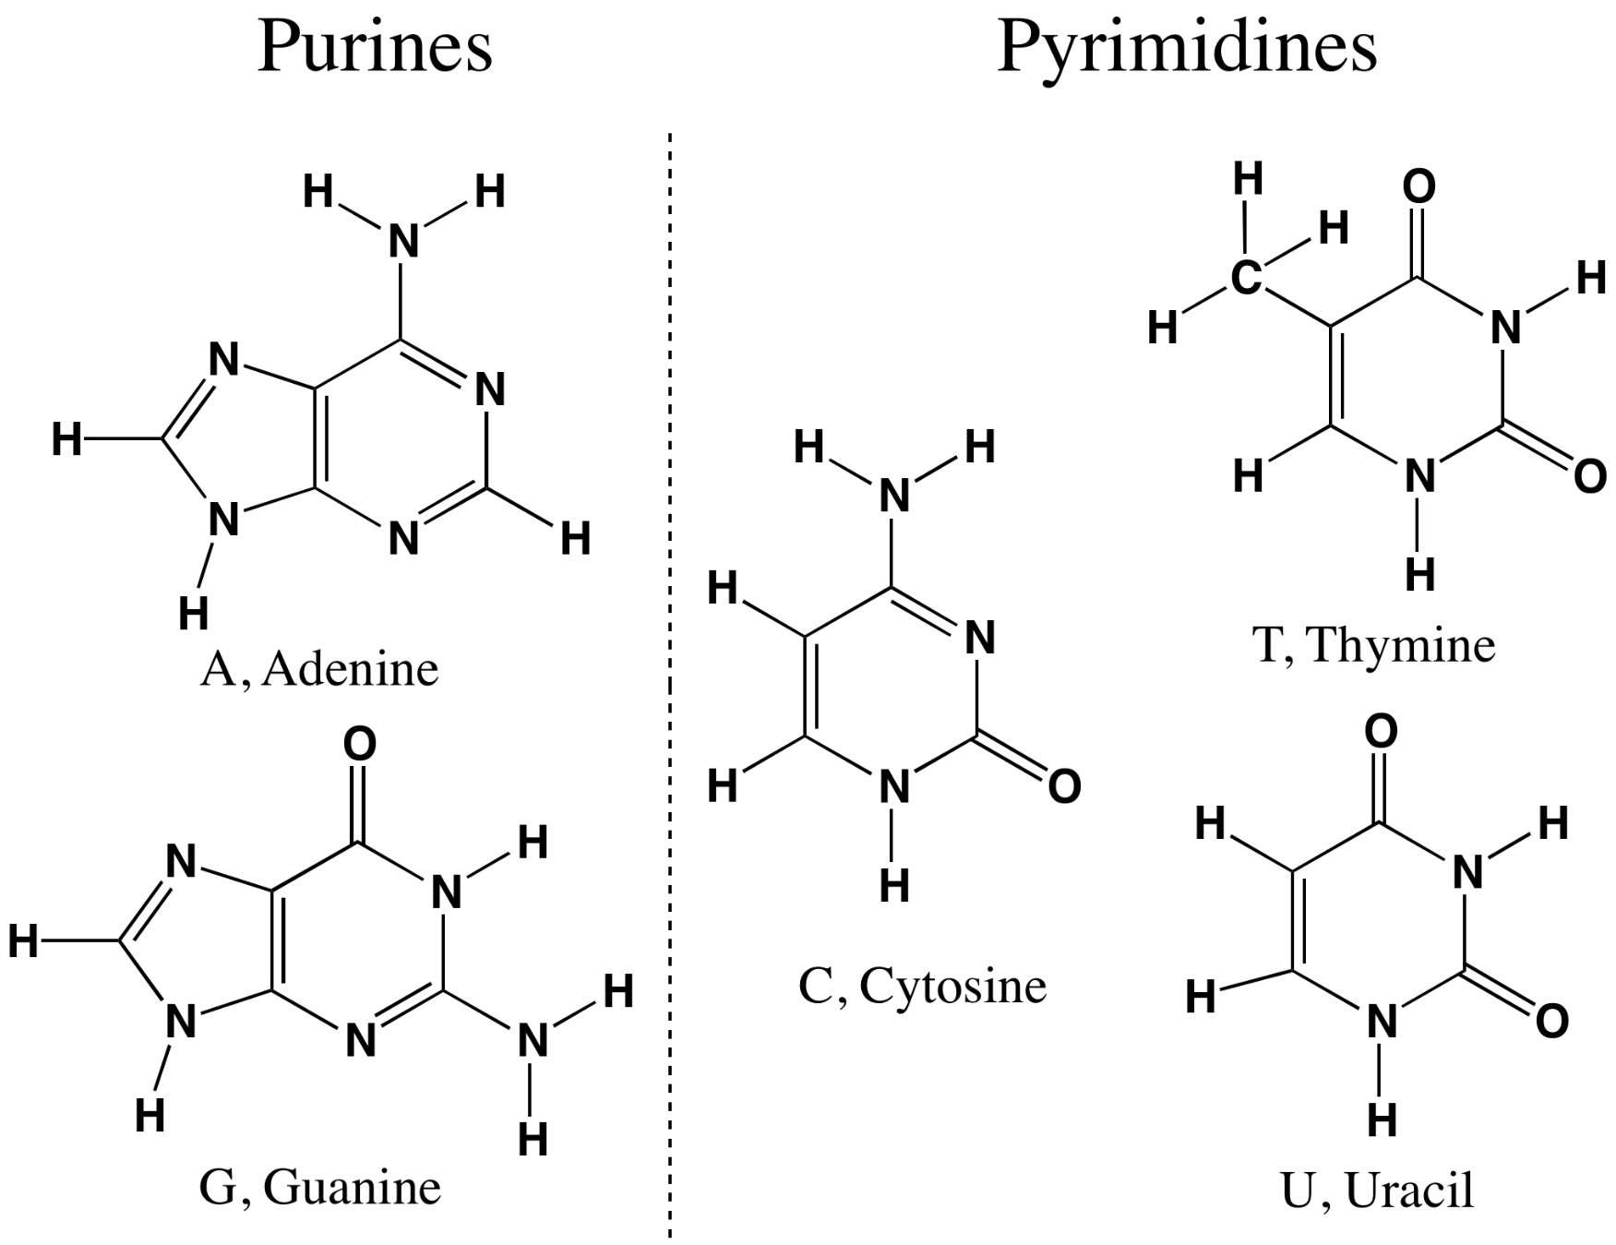

Slide 14
Review
Nucleic Acids

