Slide 1
Biologic Molecules
Proteins

Slide 2
3.12 Proteins have a wide range of functions and structures
Proteins
help build and repair cells
Enzymes (catalysts)
Proteins are composed of differing arrangements of a common set of just 20 amino acid monomers.
- all amino acids have an amino group and carboxyl group
* There are 8 essential amino acids, they cannot be synthesized by the body, must be obtained in diet
Notes:
2
Student Misconceptions and Concerns
• The functional significance of protein shape is an abstract molecular example of form and function relationships, which might be new to some students. The binding of an enzyme to its substrate is a type of molecular handshake, which permits specific interactions. To help students think about form and function relationships, share some concrete analogies in their lives—perhaps flathead and Phillips screwdrivers that match the proper type of screws or the fit of a hand into a glove.
Teaching Tips
• Most cooking results in changes in the texture and color of food. The brown color of a cooked steak is the product of the denaturation of proteins. Fixatives such as formalin also denature proteins and cause color changes. Students who have dissected vertebrates will realize that the brown color of the muscles makes it look as if the animal has been cooked.
Active Lecture Tips
• See the Activity Reviewing Macromolecules on the Instructor Exchange. Visit the Instructor Exchange in the MasteringBiology instructor resource area for a description of this activity.

Slide 3
Answer in Notebooks:
#15. What are the building blocks of proteins?
#16. What is the function of proteins?

Slide 4
3.13 Proteins are made from amino acids linked by peptide bonds
Amino acid monomers are linked together in a dehydration reaction
joining the carboxyl group of one amino acid to the amino group of the next amino acid
creating a peptide bond.
Additional amino acids can be added by the same process to create a chain of amino acids called a polypeptide.
Notes:
4
Teaching Tips
• Many analogies help students appreciate the diversity of proteins that can be made from just 20 amino acids. The authors note that our language uses combinations of 26 letters to form words. Proteins are much longer “words,” creating even more diversity. Another analogy is to trains. This builds upon the earlier analogy suggested when polymers were introduced. Imagine making different trains about 100 cars long, using any combination of 20 types of railroad cars. Mathematically, the number of possible trains is 20¹⁰⁰, a number beyond imagination.
• The difference between a polypeptide and a protein is analogous to the relationship between a long strand of yarn and a sweater knitted from yarn. Proteins are clearly more complex!
Active Lecture Tips
• See the Activity Reviewing Macromolecules on the Instructor Exchange. Visit the Instructor Exchange in the MasteringBiology instructor resource area for a description of this activity.

Slide 5
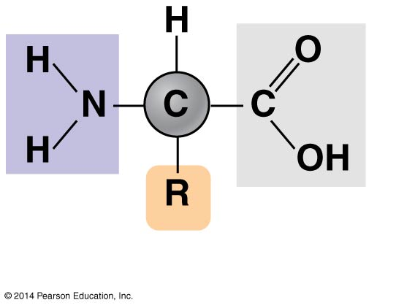
Figure 3.13a
Amino
group
Carboxyl
group
Notes:
Figure 3.13a General structure of an amino acid

Slide 6
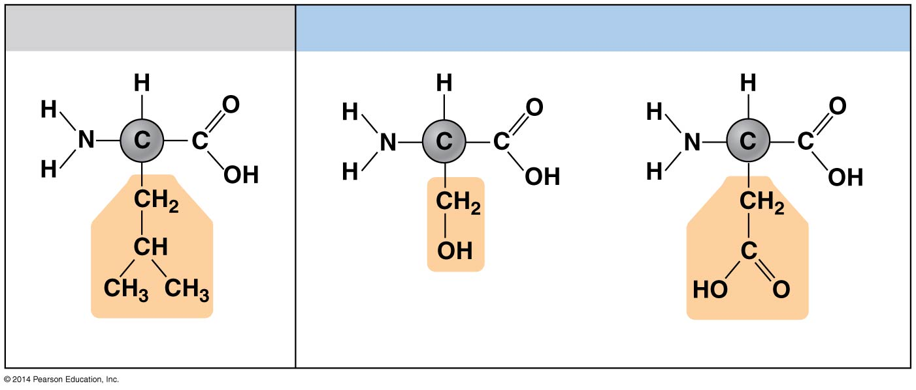
Figure 3.13b
Hydrophobic
Hydrophilic
Leucine (Leu)
Serine (Ser)
Aspartic acid (Asp)
Notes:
Figure 3.13b Examples of amino acids with hydrophobic and hydrophilic R groups

Slide 7
Figure 3.13c-2
Carboxyl group
Amino group
Peptide bond
Dehydration reaction
H₂O
Amino acid
Amino acid
Dipeptide
Notes:
Figure 3.13c-2 Peptide bond formation (step 2)

Slide 8
Answer in Notebooks:
#17. What is a peptide?
#18. Draw the basic structure of an amino acid.

Slide 9
Proteins are one or several polypeptide chains bonded together, folded and coiled into distinct 3-D shapes which determines the protein’s function.
- there are 4 levels of protein structure:
- if the shape is changed (denaturation), the protein will lose function

Slide 10
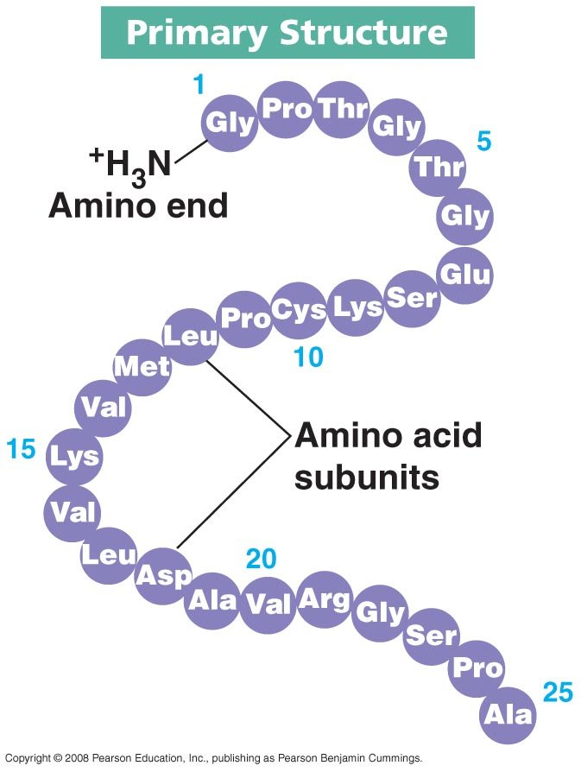
Primary structure - # and order of amino acids in polypeptide - determined by genetics, not random

Slide 11
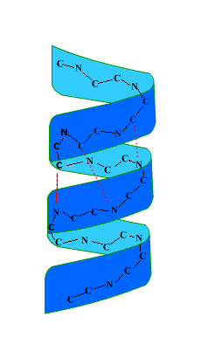
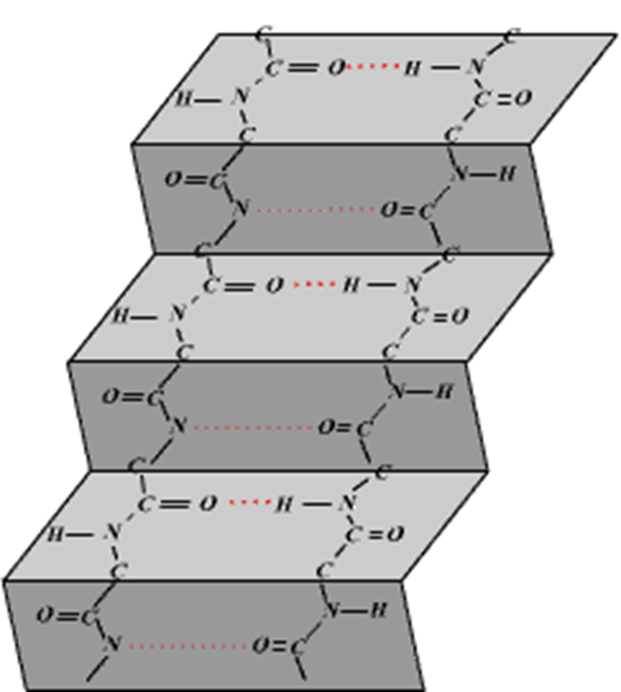
Secondary structure – coils and folds contributing to overall structure of protein - α helix
- β pleated sheet
Notes:
Bond every 4th H

Slide 12
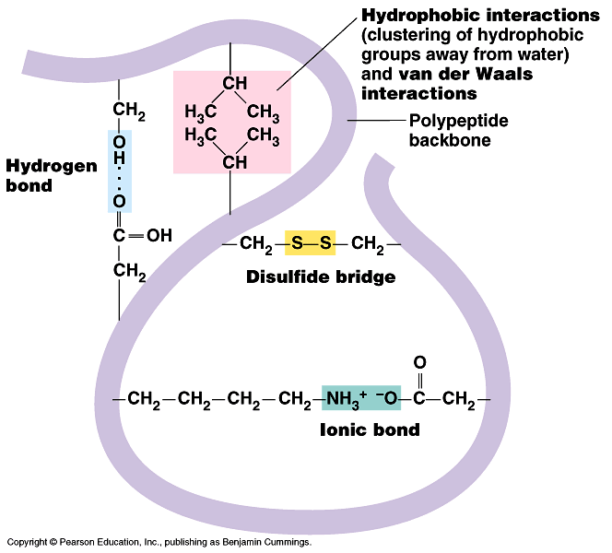
Tertiary structure – the 3-dimensional shape of the polypeptide - shape is determined by interactions of R groups of the amino acids

Slide 13
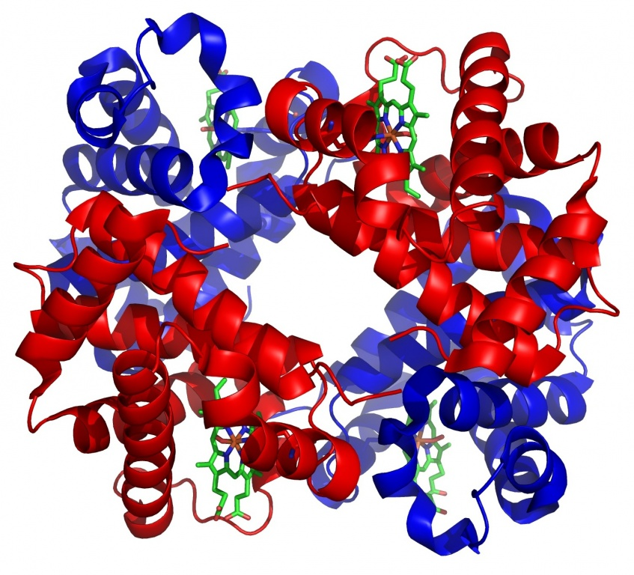
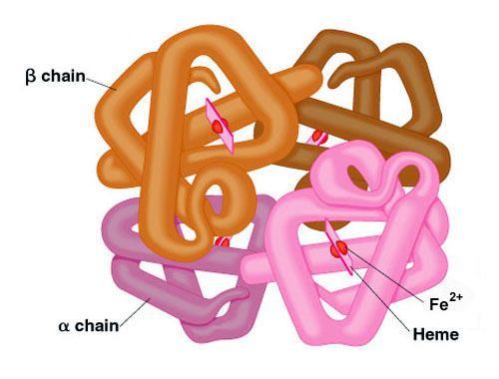
Quaternary structure – overall structure of aggregated polypeptides into 1 functional macromolecule

Slide 14
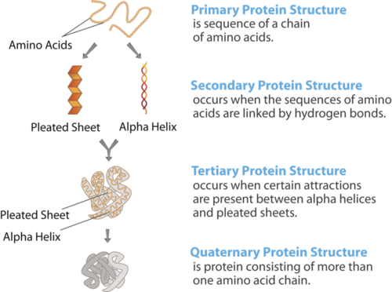

Slide 15
Figure 3.14-0
PRIMARY STRUCTURE
⁺H₃N Amino end
Peptide bonds connect amino acids.
Amino acids
Two types of SECONDARY STRUCTURES
Alpha helix
Secondary structures are maintained by hydrogen bonds between atoms of the backbone.
Beta pleated sheet
TERTIARY STRUCTURE
Tertiary structure is stabilized by interactions between R groups.
QUATERNARY STRUCTURE
Polypeptides are associated into a functional protein.
Notes:
Figure 3.14-0 A protein’s functional shape results from four levels of structure

Slide 16
Answer in Notebooks:
#19. Differentiate between Primary, Secondary, Tertiary, and Quaternary structures of proteins.

Slide 17
Protein Examples
Function | Example | Details | Shape
Structural | Collagen | Strengthens bones, tendon and skin. These tissues all produce tough collagen fibres in the spaces between their cells (extra cellular matrix) | Fibrous
Transport | Hemoglobin | An iron containing protein whose functions is to bind with oxygen in the lungs and transport it to all body tissues. | Globular
Movement | Myosin and actin | Myosin, with the help of another protein actin, causes the contraction of muscle fibers which results in movement in animals. | Fibrous
Defence | Immunoglobin | Function as antibodies to fight bacteria and viruses. An almost endless number of antibodies can be produced from the protein because part of the immunoglobulinin molecule can be varied. | globular

Slide 18
Many proteins are Enzymes which are biological catalysts.
They lower the activation energy for reactions yielding a faster rate.
- large globular proteins often w/prosthetic groups
- unchanged by reaction

Slide 19
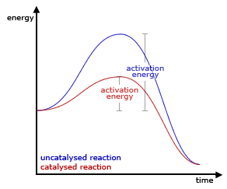

Slide 20
- substrate (reactant) specific
- active site – region of binding
- enzyme – substrate complex = temporary complex formed when enzyme binds to its substrate
lock & key vs. induced fit

Slide 21
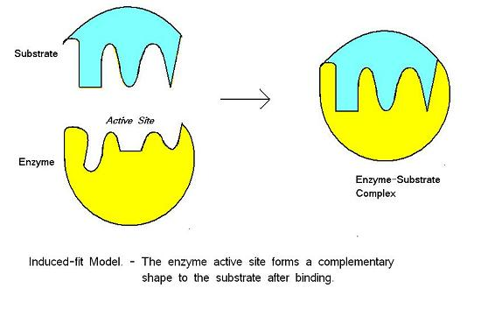
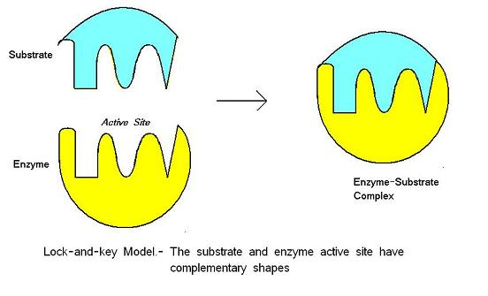

Slide 22
Temperature and pH effects
Proteins!

