Slide 1
Biologic Molecules
LIPIDS

Slide 2
Answer in Notebooks:
#11. What are calories?
Which do you think has more calories:
A pound of fat or a pound of sugar?

Slide 3
3.8 Fats are lipids that are mostly energy-storage molecules
Lipids differ from carbohydrates, proteins, and nucleic acids in that they are
not huge molecules
not built from monomers
Lipids vary a great deal in structure and function.
Notes:
3
Student Misconceptions and Concerns
• Students may struggle with the concept that a pound of fat contains more than twice the calories of a pound of sugar. It might seem that a pound of food would potentially add on a pound of weight. Other students may have never understood the concept of calories in the diet, simply following general guidelines of avoiding fatty foods. Furthermore, fiber and water have no caloric value but add to the weight of food. Consider class discussions that explore student misconceptions about calories, body weight, and healthy diets.
• Students might struggle to extrapolate the properties of lipids to their roles in an organism. Ducks float because their feathers repel water instead of attracting it. Hair on our heads remains flexible because of oils produced in our scalp. Examples such as these help connect the abstract properties of lipids to concrete examples in our world.
Teaching Tips
• The text in Module 3.8 notes the common observation that vinegar and oil do not mix. A simple demonstration can help make this point. In front of the class, mix together colored water and a yellow oil (corn or canola oil works well). Shake up the mixture and then watch as the two separate. (You may have a mixture already made ahead of time that remains separated; however, the dye may bleed between the oil and the water.) Placing the mixture on an overhead projector or other well-illuminated imaging device makes for a dramatic display of hydrophobic activity!
• The text notes that a gram of fat stores more than twice the energy of a gram of polysaccharide, such as starch. You might elaborate with a simple calculation to demonstrate how a person’s body weight would vary if the energy stored in body fat were stored in carbohydrates instead. If a 100-kg man carried 25% body fat, he would have 25 kg of fat in his body. Fat stores about 2.25 times more energy per gram than carbohydrate. What would be the weight of the man if he stored the energy in the fat in the form of carbohydrate? (2.25 × 25 = 56.25 kg of carbohydrate + 75 kg (nonfat body weight) = 131.25 kg, an increase of 31.25%.)
Active Lecture Tips
• See the Activity Reviewing Macromolecules on the Instructor Exchange. Visit the Instructor Exchange in the MasteringBiology instructor resource area for a description of this activity.
• See the Activity What Ingredients Make Up Your Snack Food on the Instructor Exchange. Visit the Instructor Exchange in the MasteringBiology instructor resource area for a description of this activity.
• See the Activity Drawing Hydrophobic and Hydrophilic Interactions on the Instructor Exchange. Visit the Instructor Exchange in the MasteringBiology instructor resource area for a description of this activity.

Slide 4
Lipids – not true polymers
a. Hydrophobic organic compounds composed of C, H and O. In lipids the ratio of H to O is much greater (<O).
b. In animals excess carbohydrates are converted to fats as a storage mechanism for energy (fat stores 2x more energy than carbohydrate)

Slide 5
c. Fats are built from two types of molecules – fatty acids and glycerol.
-- Fatty acids are long unbranched chains of C atoms with attached H and other groups.
All fatty acids have an attached carboxyl group (--COOH) which explains the “acid.”

Slide 6
3.8 Fats are lipids that are mostly energy-storage molecules
A fatty acid can link to glycerol by a dehydration reaction.
A fat contains 1 glycerol linked to 3 fatty acids.
Fats are often called triglycerides because of their structure.
Notes:
6
Student Misconceptions and Concerns
• Students may struggle with the concept that a pound of fat contains more than twice the calories of a pound of sugar. It might seem that a pound of food would potentially add on a pound of weight. Other students may have never understood the concept of calories in the diet, simply following general guidelines of avoiding fatty foods. Furthermore, fiber and water have no caloric value but add to the weight of food. Consider class discussions that explore student misconceptions about calories, body weight, and healthy diets.
• Students might struggle to extrapolate the properties of lipids to their roles in an organism. Ducks float because their feathers repel water instead of attracting it. Hair on our heads remains flexible because of oils produced in our scalp. Examples such as these help connect the abstract properties of lipids to concrete examples in our world.
Teaching Tips
• The text in Module 3.8 notes the common observation that vinegar and oil do not mix. A simple demonstration can help make this point. In front of the class, mix together colored water and a yellow oil (corn or canola oil works well). Shake up the mixture and then watch as the two separate. (You may have a mixture already made ahead of time that remains separated; however, the dye may bleed between the oil and the water.) Placing the mixture on an overhead projector or other well-illuminated imaging device makes for a dramatic display of hydrophobic activity!
• The text notes that a gram of fat stores more than twice the energy of a gram of polysaccharide, such as starch. You might elaborate with a simple calculation to demonstrate how a person’s body weight would vary if the energy stored in body fat were stored in carbohydrates instead. If a 100-kg man carried 25% body fat, he would have 25 kg of fat in his body. Fat stores about 2.25 times more energy per gram than carbohydrate. What would be the weight of the man if he stored the energy in the fat in the form of carbohydrate? (2.25 × 25 = 56.25 kg of carbohydrate + 75 kg (nonfat body weight) = 131.25 kg, an increase of 31.25%.)
Active Lecture Tips
• See the Activity Reviewing Macromolecules on the Instructor Exchange. Visit the Instructor Exchange in the MasteringBiology instructor resource area for a description of this activity.
• See the Activity What Ingredients Make Up Your Snack Food on the Instructor Exchange. Visit the Instructor Exchange in the MasteringBiology instructor resource area for a description of this activity.
• See the Activity Drawing Hydrophobic and Hydrophilic Interactions on the Instructor Exchange. Visit the Instructor Exchange in the MasteringBiology instructor resource area for a description of this activity.

Slide 7
Animation: Fats

Slide 8
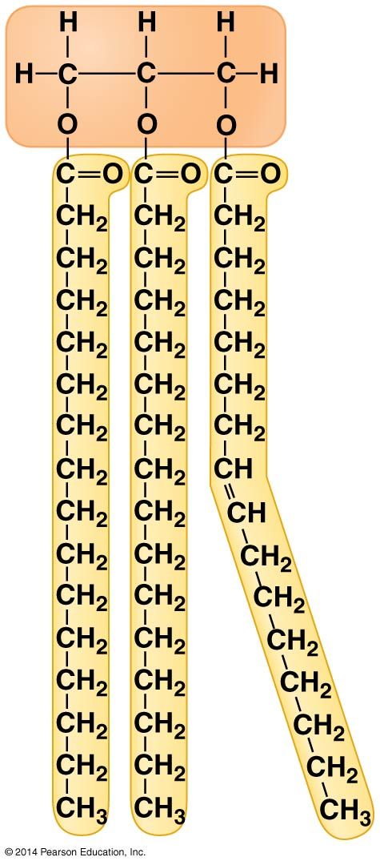
Figure 3.8b
Notes:
Figure 3.8b A fat molecule (triglyceride) consisting of three fatty acids linked to glycerol

Slide 9
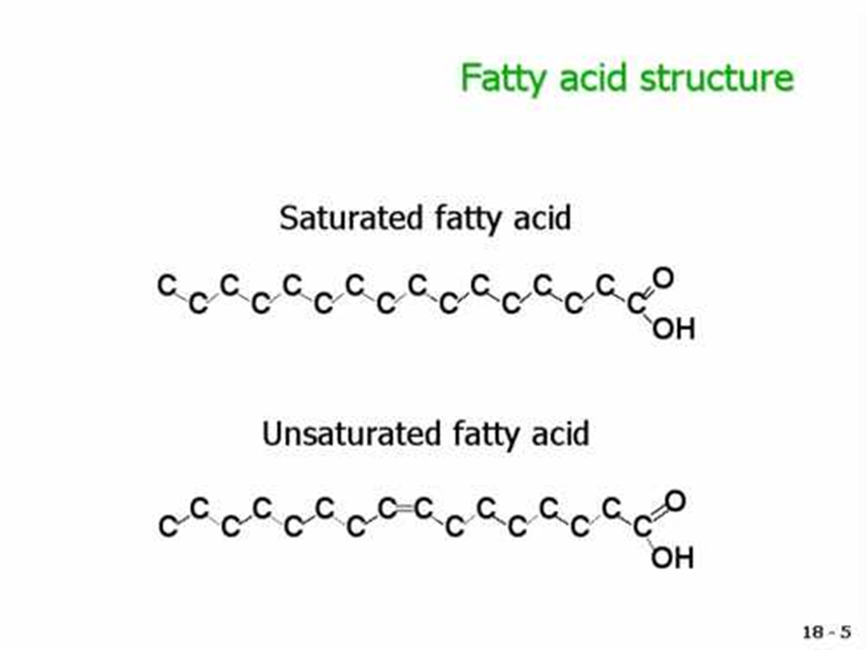
d. 2 types of fatty acids:
-- Saturated fatty acids
-- Unsaturated fatty acids
-- monounsaturated
-- polyunsaturated

Slide 10
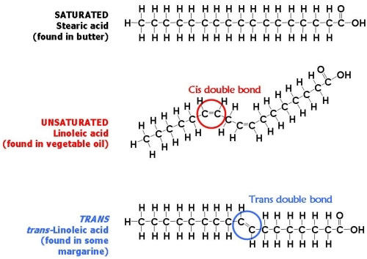
-- hydrogenated lipids – H₂ is added to convert an unsaturated fat to a saturated fat.
-- trans fats – the arrangement of the double bond allows for a straighter molecule

Slide 11
Answer in Notebooks:
#12. What are some differences between saturated, unsaturated, and trans fats?

Slide 12
3.10 Phospholipids and steroids are important lipids with a variety of functions
Phospholipids are the major component of all cell membranes.
Phospholipids are structurally similar to fats.
Fats contain 3 fatty acids attached to glycerol.
Phospholipids contain 2 fatty acids attached to glycerol.
Notes:
12
Student Misconceptions and Concerns
• Students might struggle to extrapolate the properties of lipids to their roles in an organism. Ducks float because their feathers repel water instead of attracting it. Hair on our heads remains flexible because of oils produced in our scalp. Examples such as these help connect the abstract properties of lipids to concrete examples in our world.
Teaching Tips
• Before explaining the properties of a polar molecule such as a phospholipid, have students predict the consequences of adding phospholipids to water. See if the class can generate the two most common configurations: (1) a lipid bilayer encircling water (water surrounding the bilayer and water contained internally) and (2) a micelle (polar heads in contact with water and hydrophobic tails clustered centrally).
Active Lecture Tips
• See the Activity Reviewing Macromolecules on the Instructor Exchange. Visit the Instructor Exchange in the MasteringBiology instructor resource area for a description of this activity.
• See the Activity Drawing Hydrophobic and Hydrophilic Interactions on the Instructor Exchange. Visit the Instructor Exchange in the MasteringBiology instructor resource area for a description of this activity.

Slide 13
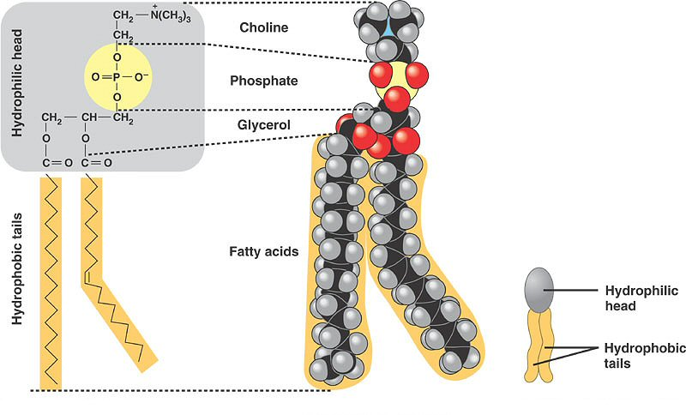
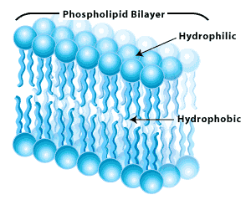
-- phospholipids = 2 fatty acid ‘tails’ (hydrophobic) attached to 1 phosphate glycerol ‘head’ (hydrophilic)
- self assemble into a bilayer when immersed in water
- cell barrier (membranes)

Slide 14
Answer in Notebook:
#13. Sketch a phospholipid bilayer – make sure to label the hydrophilic heads and hydrophobic tails.

Slide 15
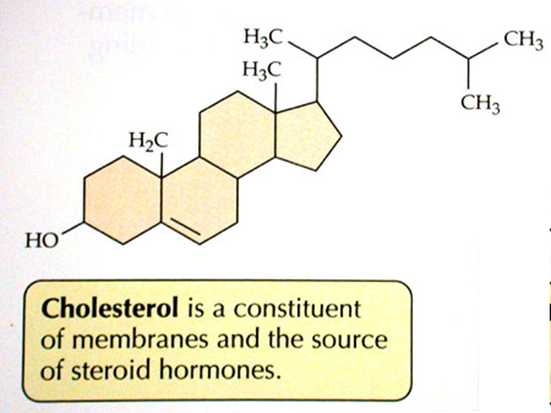
3.10 Phospholipids and steroids are important lipids with a variety of functions
Steroids are lipids in which the carbon skeleton contains four fused rings.
Cholesterol
a common component in animal cell membranes
a starting material for making steroids, including sex hormones
Notes:
15
Student Misconceptions and Concerns
• Students might struggle to extrapolate the properties of lipids to their roles in an organism. Ducks float because their feathers repel water instead of attracting it. Hair on our heads remains flexible because of oils produced in our scalp. Examples such as these help connect the abstract properties of lipids to concrete examples in our world.
Teaching Tips
• Before explaining the properties of a polar molecule such as a phospholipid, have students predict the consequences of adding phospholipids to water. See if the class can generate the two most common configurations: (1) a lipid bilayer encircling water (water surrounding the bilayer and water contained internally) and (2) a micelle (polar heads in contact with water and hydrophobic tails clustered centrally).
Active Lecture Tips
• See the Activity Reviewing Macromolecules on the Instructor Exchange. Visit the Instructor Exchange in the MasteringBiology instructor resource area for a description of this activity.
• See the Activity Drawing Hydrophobic and Hydrophilic Interactions on the Instructor Exchange. Visit the Instructor Exchange in the MasteringBiology instructor resource area for a description of this activity.

Slide 16
Answer in Notebooks:
#14. What are the 2 main types of fats and list a function of each?
Lipids!

