Slide 1
The Chemistry of Life

Slide 2
Answer in Notebooks:
#4. What does the term Organic mean?
What element needs to be present in organic compounds?

Slide 3
Carbon is the backbone of atoms in living tissue.
C, H, O and N are the most frequently occurring chemical elements in living things.
- a variety of other elements are also needed including S, Ca, P, Fe and Na
Element | Biological role
Ca | Component of bones & teeth
Mg | “ of chlorophyll
Fe | “ of hemoglobin
N (in NO₃⁻) | “ amino acids
P (in PO₄³⁻) | “ nucleotides
Na | Nerve impulse transmission *
K | Controlling water balance in plants *
Cl | Removal of water from urine
S | Component of many proteins

Slide 4
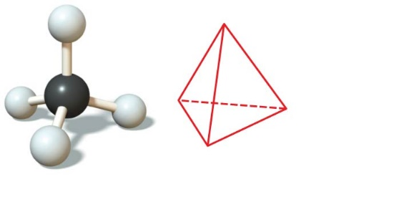
Properties of Carbon
By sharing electrons, carbon can
bond to 4 other atoms and
branch in up to 4 directions.
Methane (CH₄) is one of the simplest organic compounds.
Methane and other compounds composed of only carbon and hydrogen are called hydrocarbons.
Notes:
4
Student Misconceptions and Concerns
• Students might need to be reminded about the levels of biological organization. Without such a review, the relationship between atoms, monomers, and polymers can be confusing as each is discussed. Consider noting these relationships somewhere in the classroom (such as on the board) where students can quickly glance for reassurance.
• General biology students might not have previously taken a chemistry course. The concept of molecular building blocks that cannot be seen can be abstract and difficult to comprehend for such students. Concrete examples from our diets and good images will increase comprehension.
Teaching Tips
• One of the great advantages of carbon is its ability to form up to four bonds, permitting the assembly of diverse components and branching configurations. Challenge your students to find another element that might also permit this sort of adaptability. (Like carbon, silicon has four electrons in its outer shell.)
• Toothpicks and gumdrops (or any other pliable small candy) permit the quick construction of chemical models. Different candy colors can represent certain atoms. The model of the methane molecule in Figure 3.1 can thus easily be demonstrated (and consumed)!

Slide 5
Prefixes for Organic Compounds

Slide 6
Suffixes for Organic Compounds
ane - single bonds
ene - 1 double bond
yne - 1 triple bond
ol -OH
al – 0=C-H
amine – C-NH2
ic – O=C-OH
ether – C-O-C
ate – O=C-O-C
One - C=O

Slide 7
Compounds with the same formula but different structural arrangements are called isomers.
Notes:
7
Student Misconceptions and Concerns
• Students might need to be reminded about the levels of biological organization. Without such a review, the relationship between atoms, monomers, and polymers can be confusing as each is discussed. Consider noting these relationships somewhere in the classroom (such as on the board) where students can quickly glance for reassurance.
• General biology students might not have previously taken a chemistry course. The concept of molecular building blocks that cannot be seen can be abstract and difficult to comprehend for such students. Concrete examples from our diets and good images will increase comprehension.
Teaching Tips
• One of the great advantages of carbon is its ability to form up to four bonds, permitting the assembly of diverse components and branching configurations. Challenge your students to find another element that might also permit this sort of adaptability. (Like carbon, silicon has four electrons in its outer shell.)
• Toothpicks and gumdrops (or any other pliable small candy) permit the quick construction of chemical models. Different candy colors can represent certain atoms. The model of the methane molecule in Figure 3.1 can thus easily be demonstrated (and consumed)!

Slide 8
Animation: Isomers

Slide 9
A few chemical groups are key to the functioning of biological molecules
The first five groups are called functional groups; they affect a molecule’s function in a characteristic way.
These five groups are polar, so compounds containing them are typically hydrophilic (water-loving) and soluble in water.
A sixth group, a methyl group
is nonpolar and not reactive, but still affects molecular shape and thus function.
Notes:
9
Student Misconceptions and Concerns
• General biology students might not have previously taken a chemistry course. The concept of molecular building blocks that cannot be seen can be abstract and difficult to comprehend for such students. Concrete examples from our diets and good images will increase comprehension.
Teaching Tips
• A drill with interchangeable drill bits is a nice analogy to carbon skeletons with different functional groups. The analogy relates the role of different functions to different structures.

Slide 10
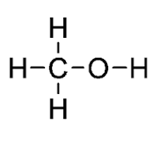
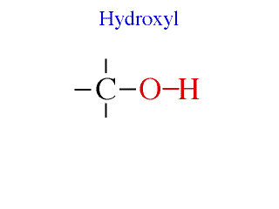
Functional groups
a. hydroxyl (-OH) →
alcohols, polar
Methanol
Notes:
Polar, easily dissolved in H2O, high melting point

Slide 11
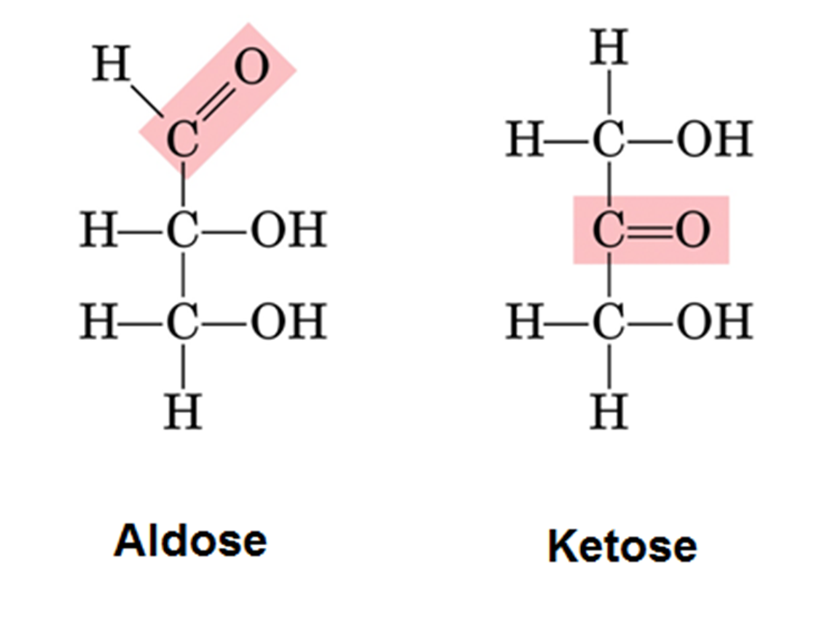
b. carbonyl (C=O) →
a. ketones –
carbonyl is within carbon skeleton
b. aldehyde –
carbonyl is at the end
Notes:
Sugars have carbonyl and several hydroxyl grps
Increase melting or boiling point , affect solubility

Slide 12
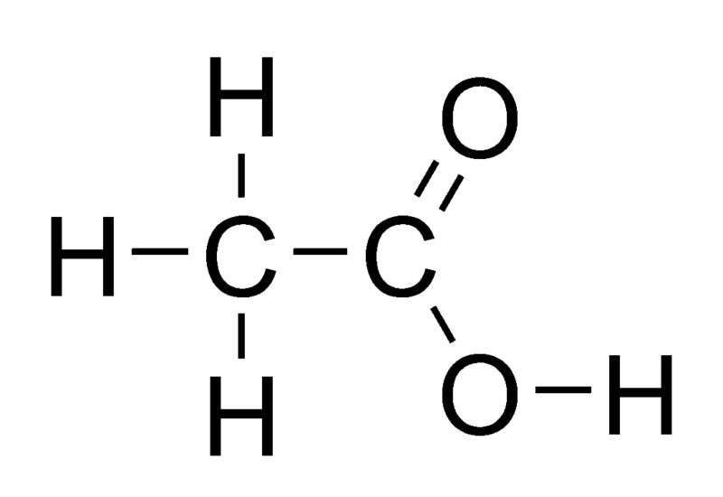
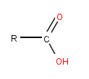
c. carboxyl (COOH) →
organic acids
- found in cells in the form of 1- (carboxylate ion)
Acetic acid
Notes:
Weak acids – dissociate to release H ions

Slide 13
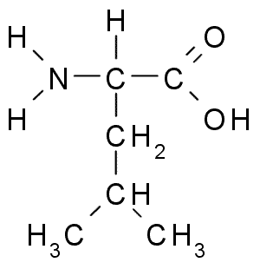
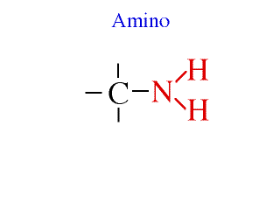
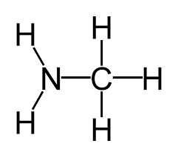
d. amino ( - NH₂) –
acts as a base picking up H+ in cellular conditions
leucine
Methylamine

Slide 14
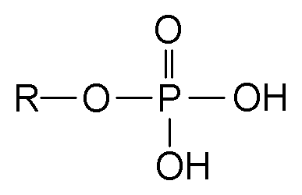
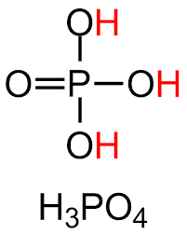
e. phosphate (-OPO₃²⁻) –
usually ionized and attached to C-skeleton by one of its O atoms.
- often involved in energy transfers
Phosphoric Acid

Slide 15
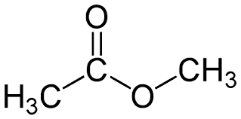
Methyl Group
f. methyl (-CH₃) –
not a functional group; it is an attached group
- nonpolar
Methyl acetate

Slide 16
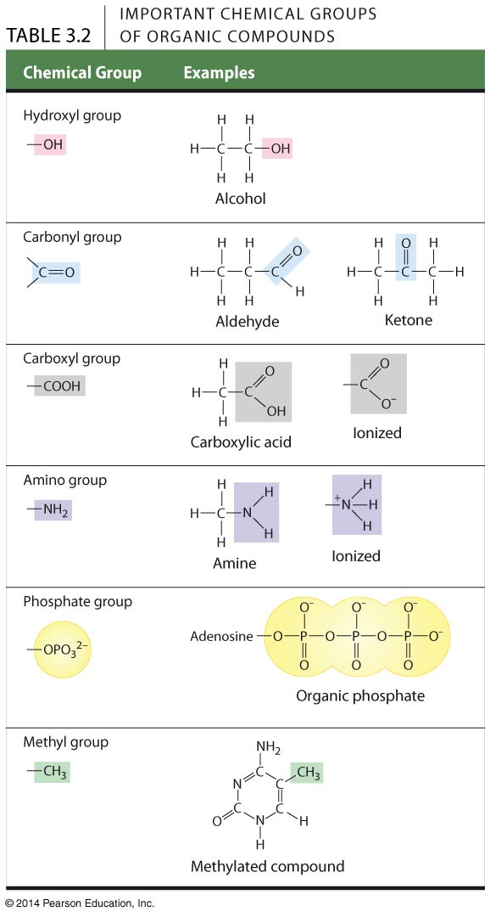
Table 3.2-0
Methyl cytidine
Notes:
Table 3.2-0 Important chemical groups of organic compounds

Slide 17
Complete in Notebooks:
#5. Draw the 6 different chemical groups.

