Slide 1
Biologic Molecules

Slide 2
Answer in Notebooks:
#7. Define the following prefixes:
Micro:
Macro:
Mono:
Di:
Poly:

Slide 3
Biological Molecules
Macromolecules
Polymers built from monomers
Notes:
3
Student Misconceptions and Concerns
• General biology students might not have previously taken a chemistry course. The concept of molecular building blocks that cannot be seen can be abstract and difficult to comprehend for such students. Concrete examples from our diets and good images will increase comprehension.
Teaching Tips
• Train cars linking together to form a train is a nice analogy to linking monomers to form polymers. Consider noting that as the train cars are joined, a puff of steam appears—a reference to water production and a dehydration reaction when linking molecular monomers.
• The authors note that the great diversity of polymers mainly results from variable arrangements of monomers, with different sequences possible from combinations or permutations of the same monomers. Consider illustrating this by simply asking students how many different ways we can arrange the letters A, B, and C, using each letter, and only once, to form three-lettered words. The answer is six permutations: ABC, ACB, BAC, BCA, CBA, CAB (the factorial of 3). And if letters can be repeated, the answer is 27 (= 3³): AAA, BBB, CCC, ABB, ACC, etc.

Slide 4
Monomers are linked together to form polymers through dehydration reactions, which remove water.
Polymers are broken apart by hydrolysis, the addition of water.
These reactions are mediated by enzymes, specialized macromolecules that speed up chemical reactions in cells.
Notes:
4
Student Misconceptions and Concerns
• General biology students might not have previously taken a chemistry course. The concept of molecular building blocks that cannot be seen can be abstract and difficult to comprehend for such students. Concrete examples from our diets and good images will increase comprehension.
Teaching Tips
• Train cars linking together to form a train is a nice analogy to linking monomers to form polymers. Consider noting that as the train cars are joined, a puff of steam appears—a reference to water production and a dehydration reaction when linking molecular monomers.
• The authors note that the great diversity of polymers mainly results from variable arrangements of monomers, with different sequences possible from combinations or permutations of the same monomers. Consider illustrating this by simply asking students how many different ways we can arrange the letters A, B, and C, using each letter, and only once, to form three-lettered words. The answer is six permutations: ABC, ACB, BAC, BCA, CBA, CAB (the factorial of 3). And if letters can be repeated, the answer is 27 (= 3³): AAA, BBB, CCC, ABB, ACC, etc.

Slide 5
Figure 3.3-0
Short polymer
Unlinked monomer
H₂O
H₂O
Dehydration reaction forms a new bond
Hydrolysis breaks a bond
Longer polymer
Notes:
Figure 3.3-0 Dehydration reaction building a polymer (left); Hydrolysis breaking down a polymer (right)

Slide 6
There are four classes of molecules important to organisms:
1. Carbohydrates
2. Lipids
3. Proteins
4. Nucleic acids
Notes:
6
Student Misconceptions and Concerns
• General biology students might not have previously taken a chemistry course. The concept of molecular building blocks that cannot be seen can be abstract and difficult to comprehend for such students. Concrete examples from our diets and good images will increase comprehension.
Teaching Tips
• Train cars linking together to form a train is a nice analogy to linking monomers to form polymers. Consider noting that as the train cars are joined, a puff of steam appears—a reference to water production and a dehydration reaction when linking molecular monomers.
• The authors note that the great diversity of polymers mainly results from variable arrangements of monomers, with different sequences possible from combinations or permutations of the same monomers. Consider illustrating this by simply asking students how many different ways we can arrange the letters A, B, and C, using each letter, and only once, to form three-lettered words. The answer is six permutations: ABC, ACB, BAC, BCA, CBA, CAB (the factorial of 3). And if letters can be repeated, the answer is 27 (= 3³): AAA, BBB, CCC, ABB, ACC, etc.

Slide 7
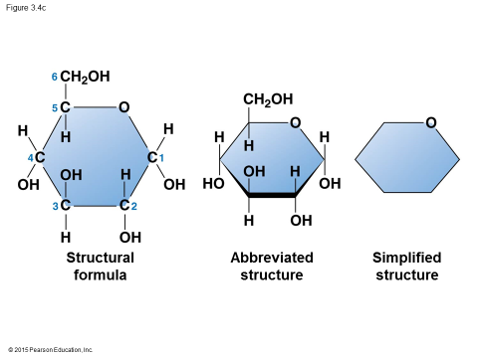
Carbohydrates – fuel and building material
- CH₂O (some form)
ENERGY

Slide 8
Monosaccharides can be hooked together by dehydration reactions to form
more complex sugars
polysaccharides
Building blocks are saccharides
Notes:
8
Student Misconceptions and Concerns
• The abstract nature of chemistry can be discouraging to many students. Consider starting out this section of lecture by examining the chemical groups on a food nutrition label. Candy bars with peanuts are particularly useful, as they contain significant amounts of all three sources of calories (carbohydrates, proteins, and lipids).
• Consider reinforcing the three main sources of calories with food items that clearly represent each group. Bring clear examples to class as visual references. For example, use a can of Coke or a bag of sugar (or cotton candy) for carbohydrates, a tub of margarine for lipids, and some beef jerky for protein (although some fat and carbohydrates might also be included).
Teaching Tips
• If your lectures will eventually include details of glycolysis and aerobic respiration, this is a good point to introduce the basic concepts of glucose as fuel. Just introducing this conceptual formula might help: eating glucose and breathing oxygen produce water and usable energy (used to build ATP) plus heat and carbon dioxide exhaled in our breath.
Active Lecture Tips
• See the Activity Reviewing Macromolecules on the Instructor Exchange. Visit the Instructor Exchange in the MasteringBiology instructor resource area for a description of this activity.

Slide 9
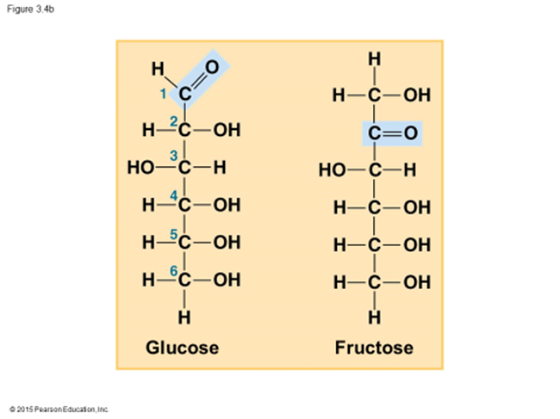
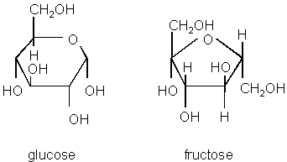
(Single) sugar [monomer] = monosaccharide
1. glucose – C₆H₁₂O₆
fructose – C₆H₁₂O₆
2. have several hydroxyls
3. placement of carbonyl
determines type
- @ end = aldose
- in middle = ketose

Slide 10
2 simple sugars can bond to create a disaccharide [dimer] through condensation (dehydration synthesis)
--Sucrose is a disaccharide
– one fructose and one glucose.

Slide 11
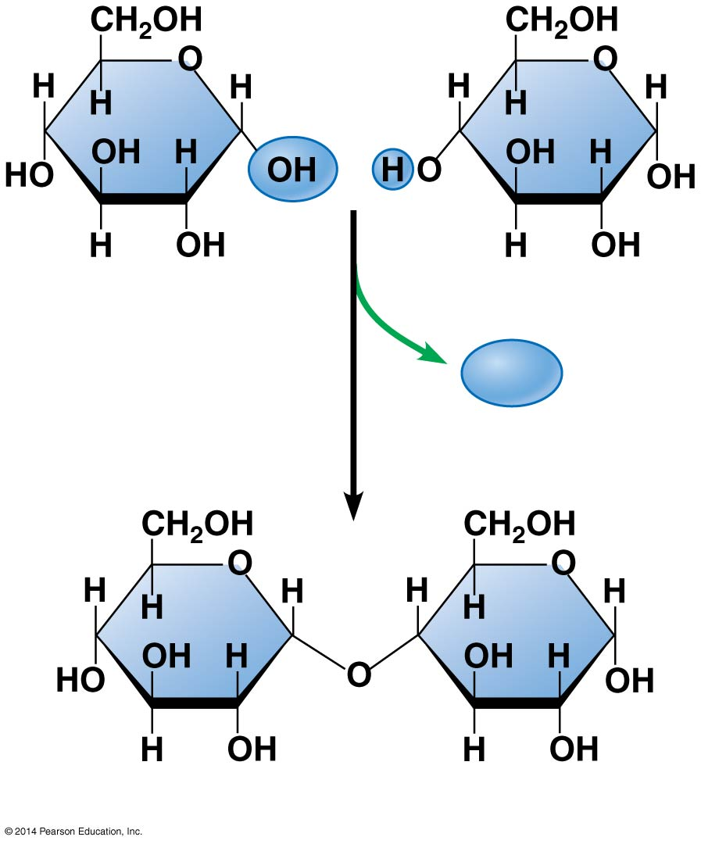
Figure 3.5-2
Glucose
Glucose
H₂O
Maltose
Notes:
Figure 3.5-2 Disaccharide formation by a dehydration reaction (step 2)

Slide 12
Polysaccharides [polymer] – complex carbohydrates (commonly known as starch/cellulose)
i. Starch is the plants way of storing extra simple sugars.
- long chain of glucose monomers
ii. Glycogen is highly branched polysaccharide that is animal storage of glucose, short lived
iii. Cellulose – most abundant organic compound on Earth
- component of cell walls

Slide 13
Animal carbs
Example | Carbohydrate | Function
Glucose | Monosaccharide | Fuel for cellular work
Lactose | Disaccharide | Milk sugar
Glycogen | Polysaccharide | Glucose storage (muscle & liver)
Plant carbs
Example | Carbohydrate | Function
Fructose | Monosaccharide | Fruit sugar
Sucrose | Disaccharide | Soluble, metabolically inactive, transported in plant sap (phloem)
Cellulose | Polysaccharide | Insoluble, structural material in cell walls
Notes:
Glycogen is hydrolyzed into glucose when sugar demand increases, but stores typically only last a day = prob with low carb diets

Slide 14
When humans digest polysaccharides we break the bonds through hydrolysis (adding water) and use the individual glucose molecules.

